Slide 1
Energy Production and Water Use Trends
Jordan Macknick
WSWC-WGA Energy/Water Workshop
April 2, 2013

Slide 2
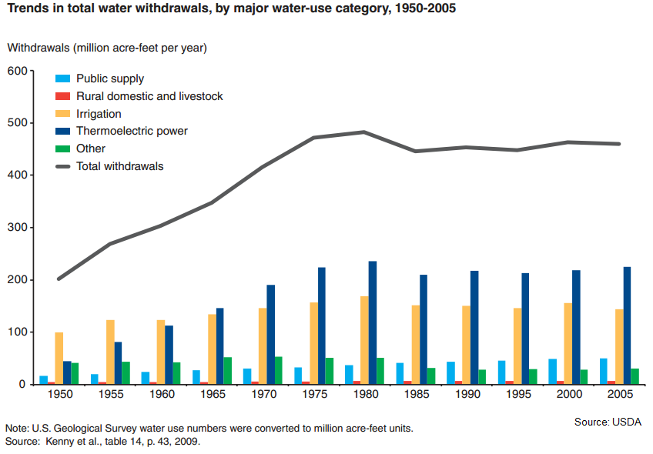
Historical Water Withdrawals, 1950-2005

Slide 3
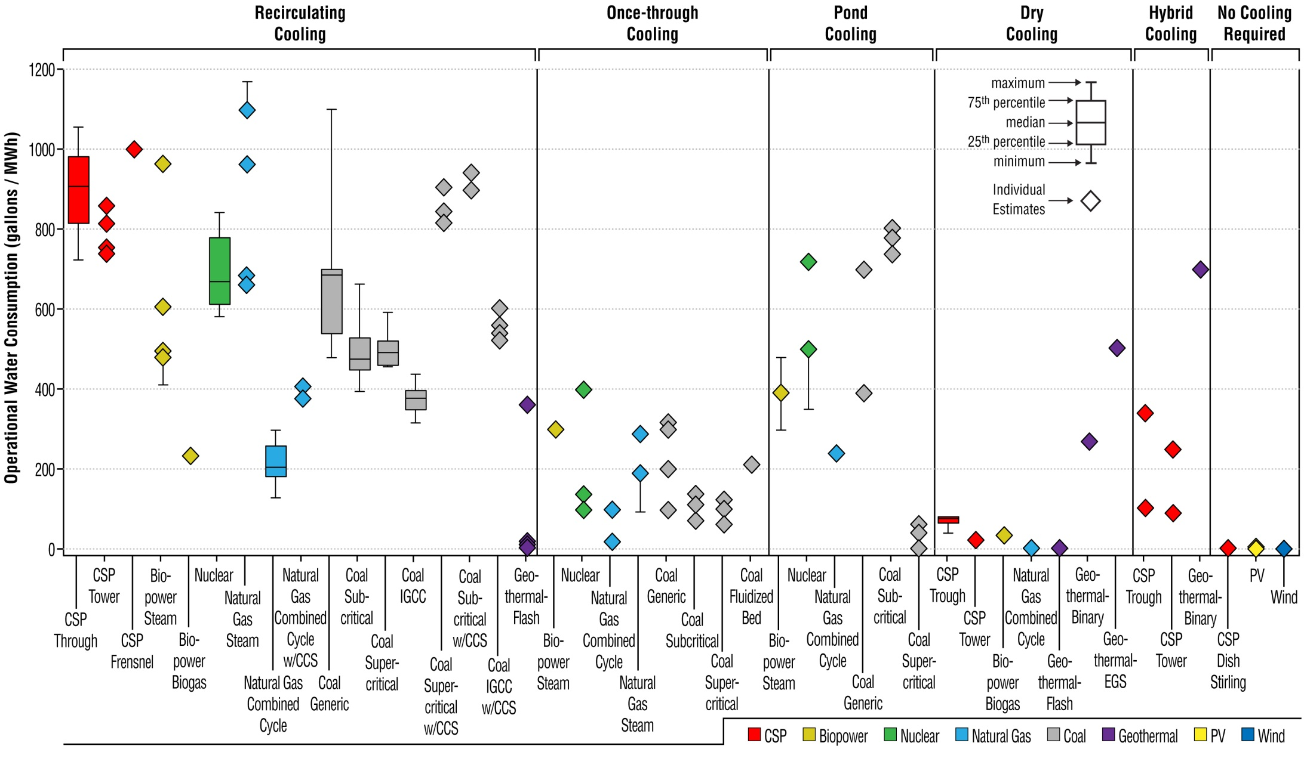
Operational Water Consumption
Source: Macknick, J., Newmark, R., Heath, G., and Hallett, KC. 2012. Operational water consumption and withdrawal factors for electricity generating technologies: a review of existing literature. Environmental Research Letters. 7 (045802).

Slide 4
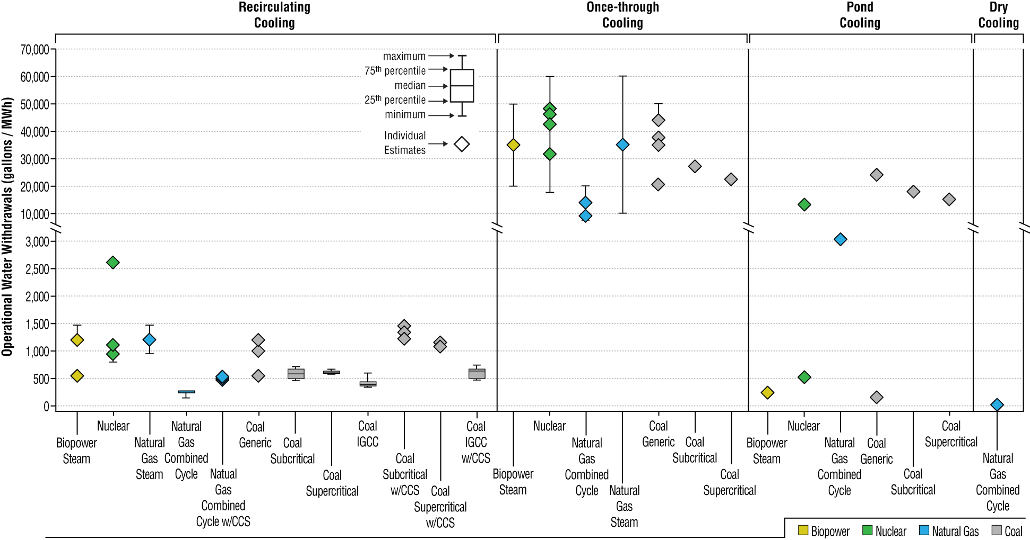
Operational Water Withdrawal
Source: Macknick, J., Newmark, R., Heath, G., and Hallett, KC. 2012. Operational water consumption and withdrawal factors for electricity generating technologies: a review of existing literature. Environmental Research Letters. 7 (045802).

Slide 5
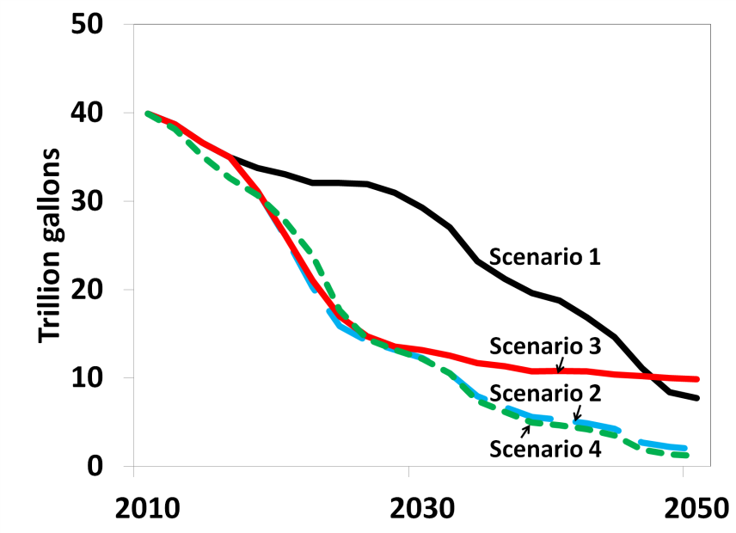
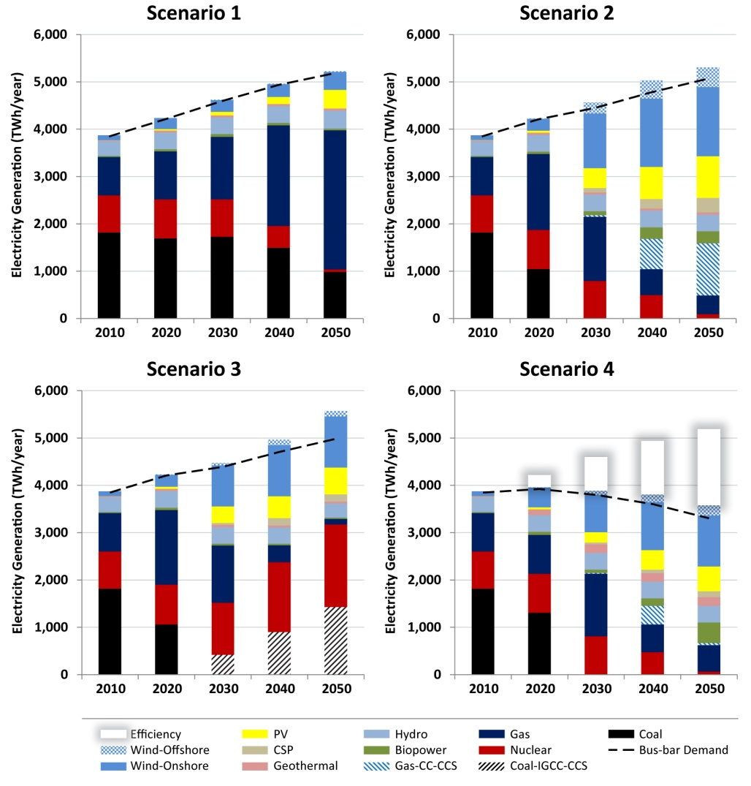
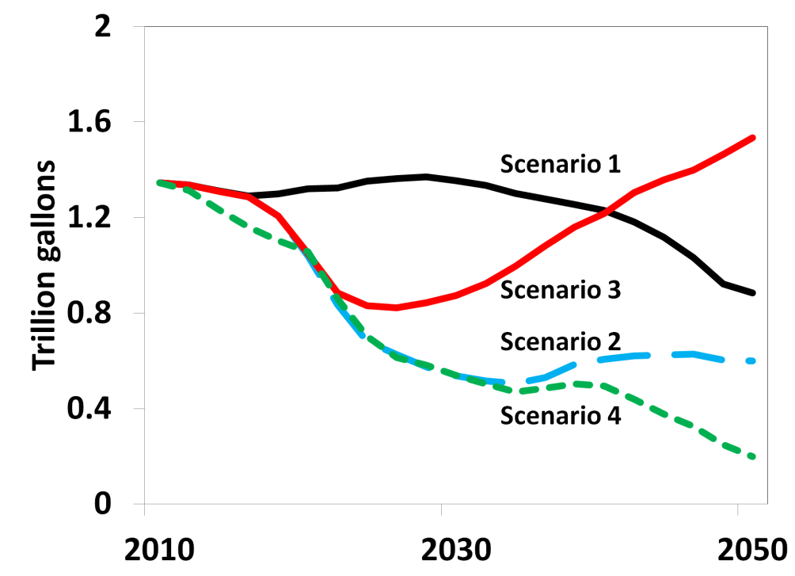
Different clean energy scenarios have different water use profiles
National level withdrawals
National level consumption
Source: Macknick, J., Sattler, S., Averyt, K., Clemmer, S., and Rogers, J. 2012. The water implications of generating electricity: water use across the United States based on different electricity pathways through 2050. Environmental Research Letters. 7 (045803).

Slide 6
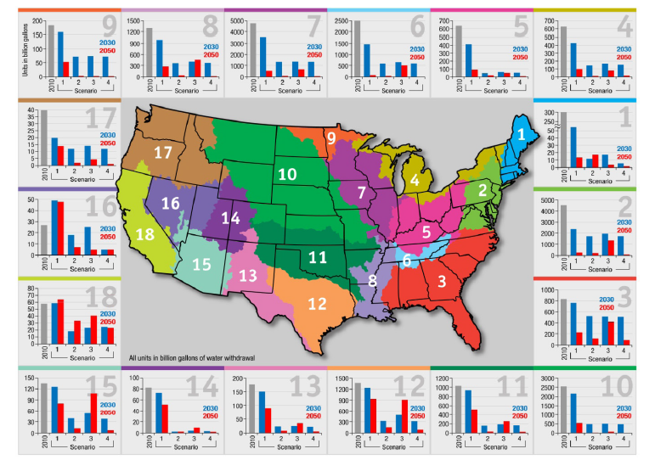
But, regional trends in water use may differ from national trends (withdrawals)
Source: Macknick, J., Sattler, S., Averyt, K., Clemmer, S., and Rogers, J. 2012. The water implications of generating electricity: water use across the United States based on different electricity pathways through 2050. Environmental Research Letters. 7 (045803).

Slide 7
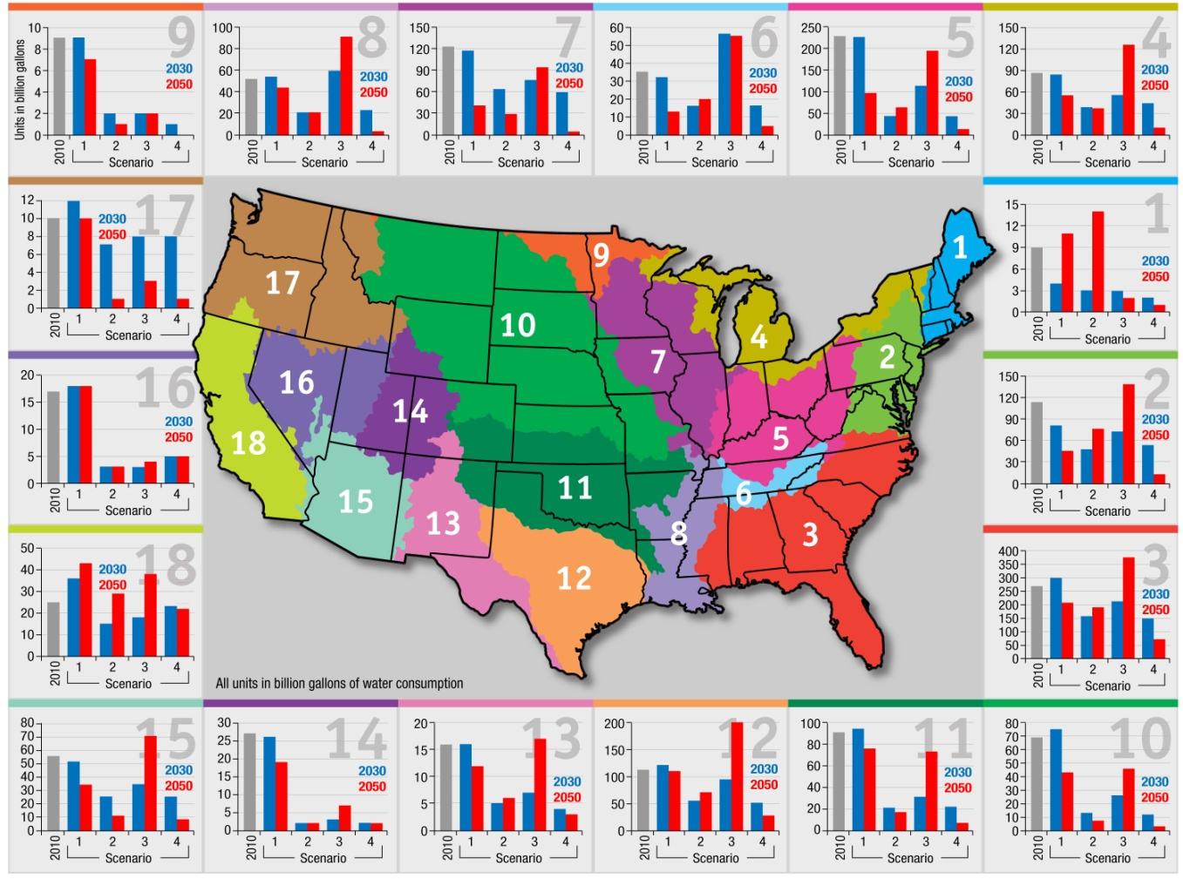
But, regional trends in water use may differ from national trends (consumption)
Source: Macknick, J., Sattler, S., Averyt, K., Clemmer, S., and Rogers, J. 2012. The water implications of generating electricity: water use across the United States based on different electricity pathways through 2050. Environmental Research Letters. 7 (045803).

Slide 8
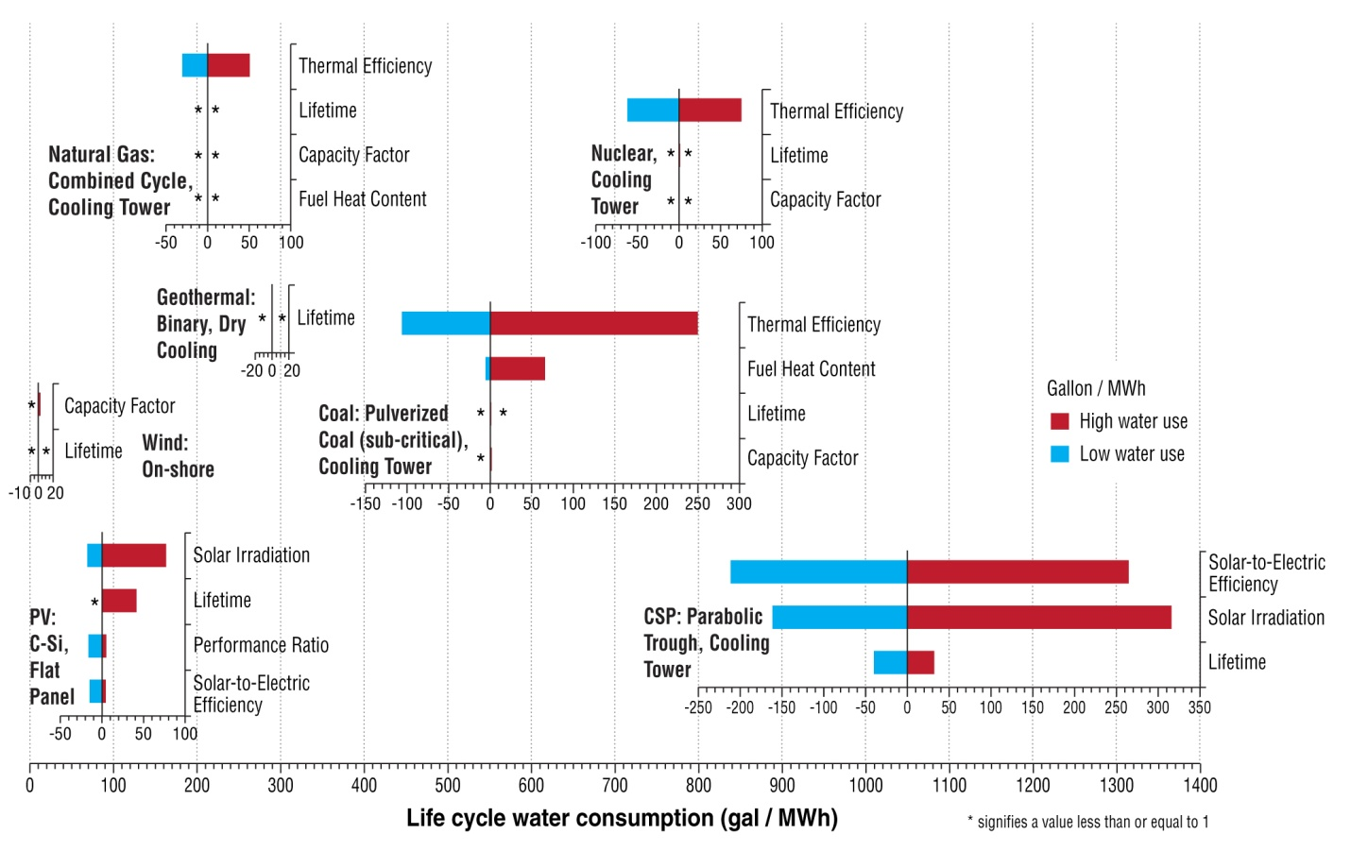
Water use varies greatly depending on site- and technology-specific characteristics
Meldrum , J., Nettles-Anderson, S., Heath, G., and J. Macknick. Life Cycle Water Use for Electricity Generation: A Review and Harmonization of Literature Estimates.” (2013)

Slide 9
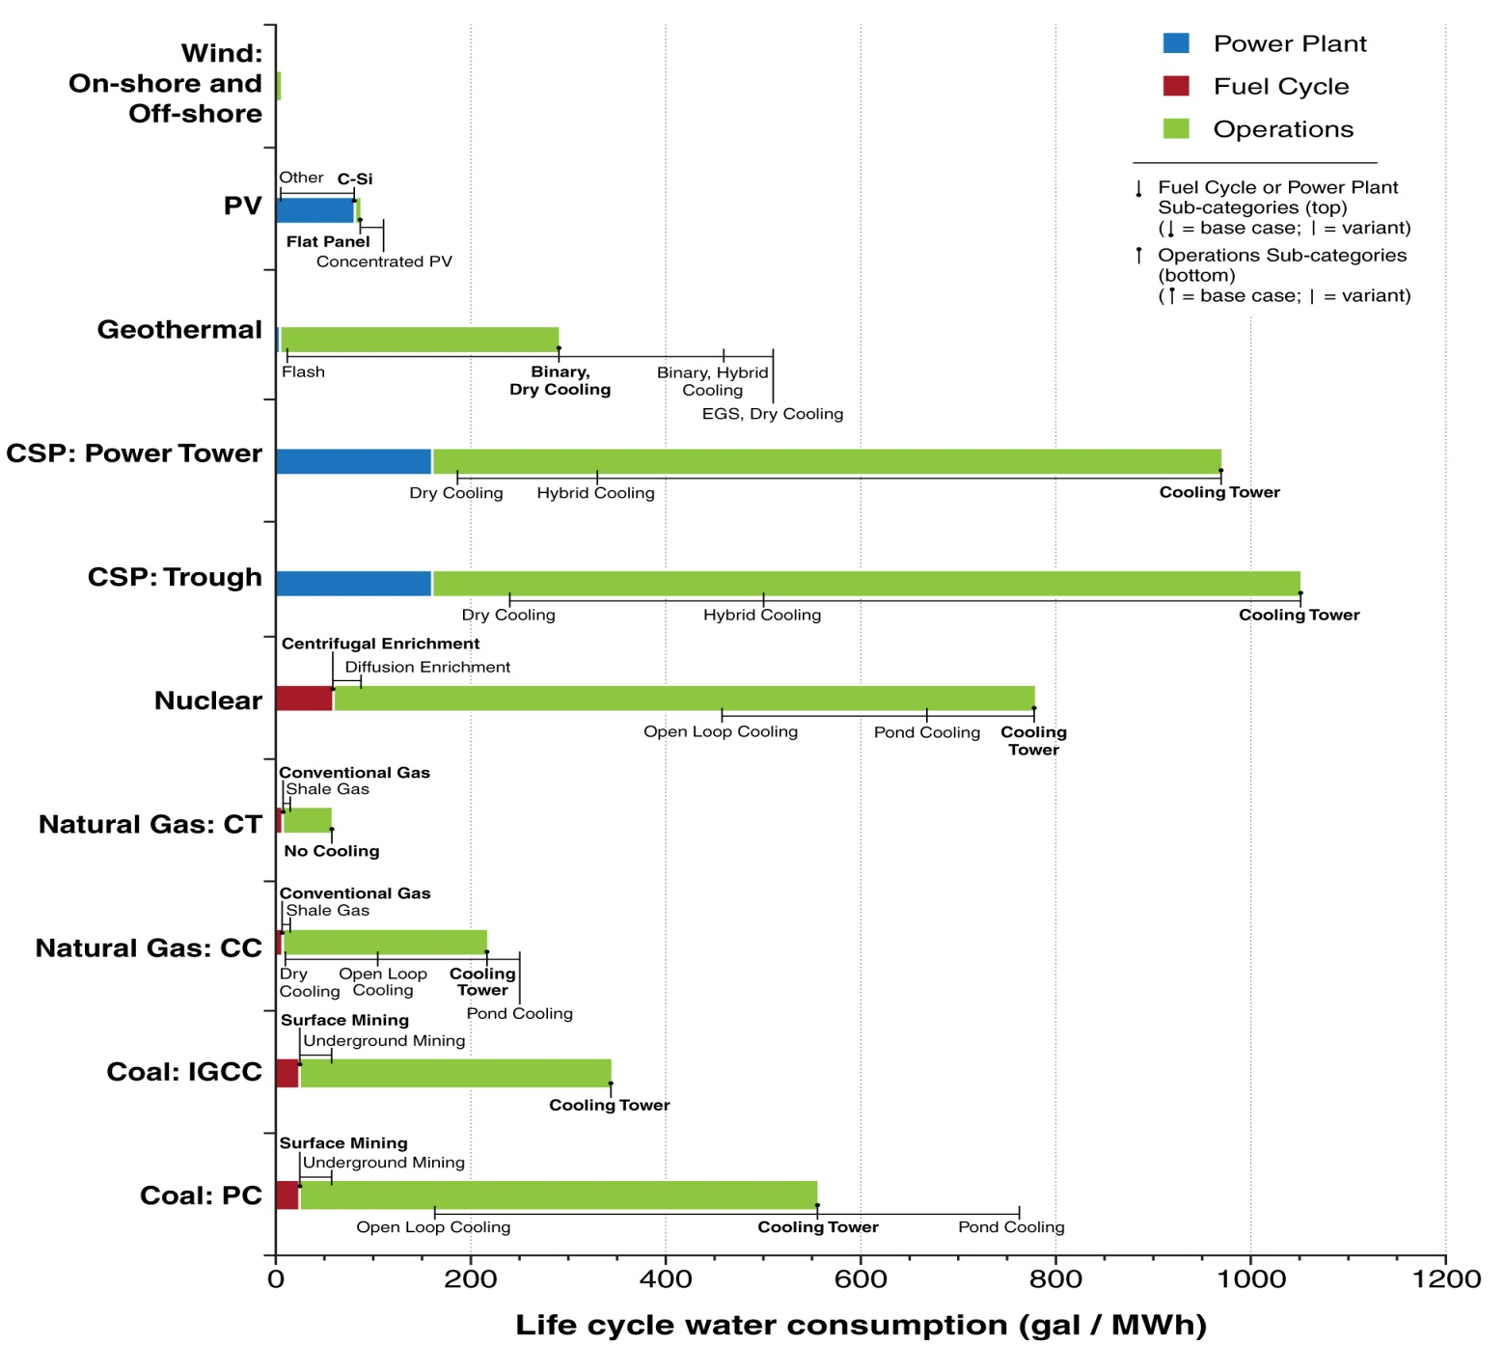
Life Cycle Water Consumption
Meldrum , J., Nettles-Anderson, S., Heath, G., and J. Macknick. Life Cycle Water Use for Electricity Generation: A Review and Harmonization of Literature Estimates.” (2013)

Slide 10
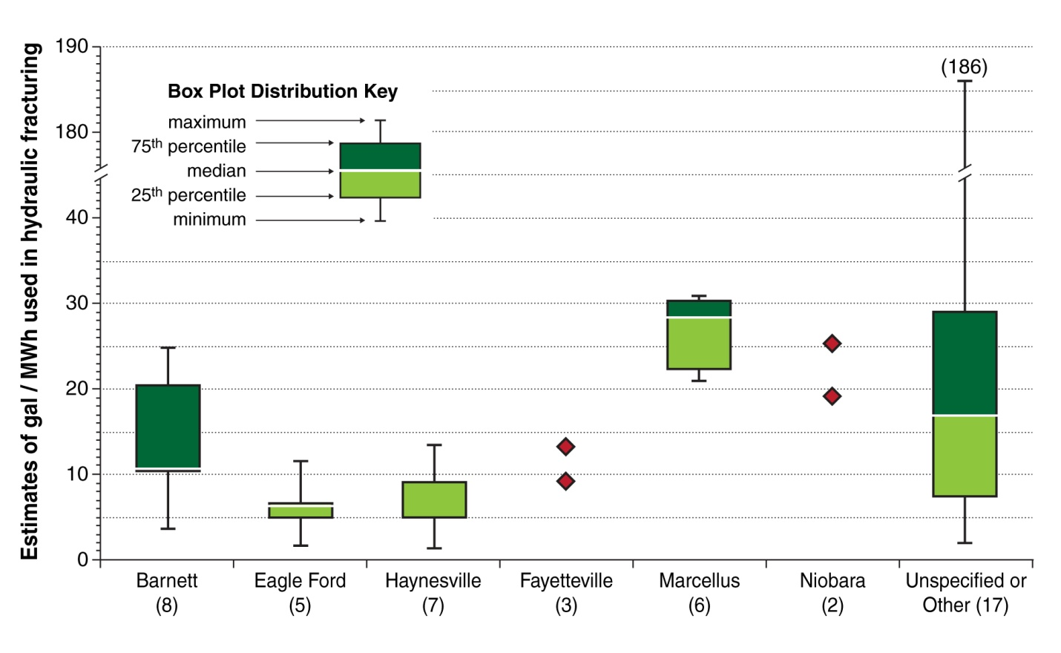
Shale gas development water use is variable, but generally less than what is required for operations
Meldrum , J., Nettles-Anderson, S., Heath, G., and J. Macknick. Life Cycle Water Use for Electricity Generation: A Review and Harmonization of Literature Estimates.” (2013)

Slide 11
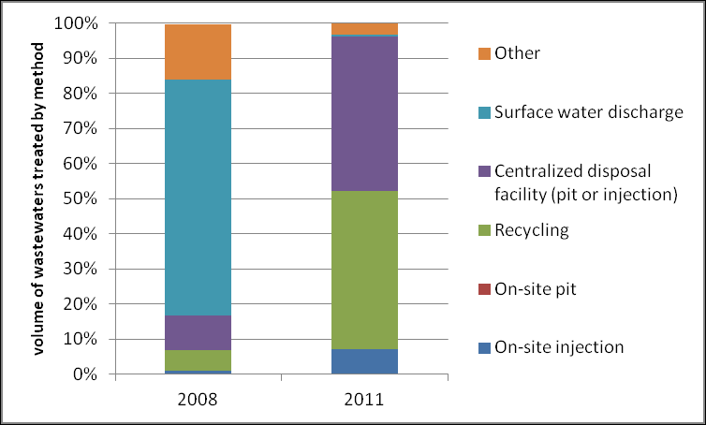
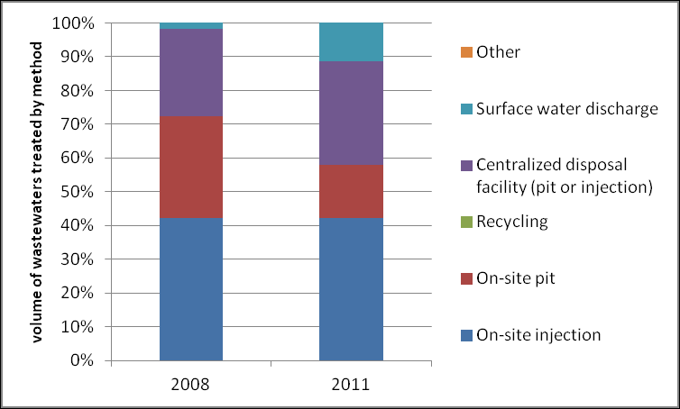
Life Cycle Water Use (Shale Gas wastewater management)
Pennsylvania: Trends in wastewater management at gas development sites (2008-2011)
Colorado: Trends in wastewater management at gas development sites (2008-2011)
From 2008-2011, Pennsylvania eliminated surface water discharge and greatly increased recycling, whereas Colorado increased surface water discharge and hadn’t yet adopted recycling practices
Source Logan, J., Heath, G., deLone Paranhos, E., Boyd, W., Carlson, K. Macknick, J. Natural Gas and the Transformation of the U.S. Energy Sector: Electricity. NREL/TP-6A50-55538. (2012)

Slide 12
Summary
National level withdrawals have remained relatively constant the past 30 years
Projections of future power sector withdrawals and consumptive uses may increase and/or decrease
Regional projections may differ substantially from national projections
Water use trends depend on a number of factors:
  Plant Retirements
  New Power Plants (fuel choice)
  Power Plant Characteristics
  Cooling System Choices
  Regional Dynamics
Life cycle water use trends can also be important for decision-makers
Wastewater treatment method trends from the power sector life cycle can vary regionally

Slide 13
Thank you
Jordan.Macknick@nrel.gov
303-275-3828

