Slide 1
Remote Monitoring of Groundwater with Orbital Radar
Tom G Farr, Zhen Liu
Jet Propulsion Laboratory
California Institute of Technology
tom.farr@jpl.nasa.gov
Copyright 2014 California Institute of Technology. U.S. Government sponsorship acknowledged.
Notes:
Start with some background on how insar can help monitor gw
What can be done now
End with some comments on how this fits into the larger picture

Slide 2
Groundwater from Space
Groundwater is becoming a more important part of water resources
But knowledge of the groundwater level is not uniformly available
Wells provide some monitoring capability, but there are political and practical difficulties
Interferometric Synthetic Aperture Radar (InSAR) can provide information on groundwater levels by measuring surface deformation caused by withdrawal and recharge of aquifers
The deformation also causes problems for infrastructure such as aqueducts and trains
We are developing information products for water managers, the public, and hydrologists including animations, maps of ‘hot spots’, pixel histories, and regional maps of groundwater change
Notes:
One of the big problems is the data is 4D and must be presented in 2D

Slide 3
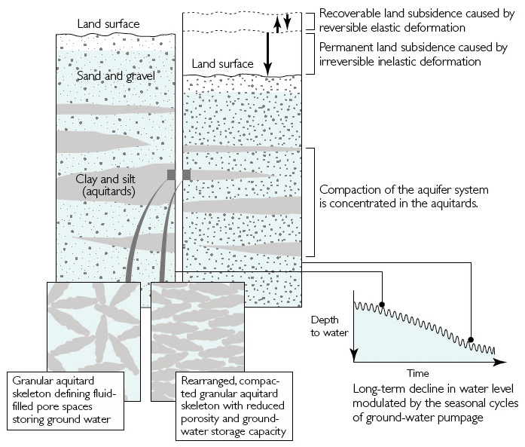
Hydrology 101: Aquifer compaction
Galloway et al., 1999
Notes:
Plot at lower right shows depth to water, but is same for subsidence
Elastic (seasonal) component yields fine sinusoid, inelastic compaction leads to long-term decrease
Note that compaction (and subsidence) happens in the fine-grained aquitards
Time constant of long-term decline could be 10’s-100’s years
Some aquifers not affected by compaction and subsidence, but most are: Alluvial valleys, Deltas, …

Slide 4
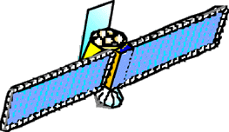

Interferometry 101: Deformation maps
When two observations are made from the same location in space but at different times, the interferometric phase is proportional to any change in the range of a surface feature.
Surface Deformation Phase
Notes:
Point out: line of sight measure
One fringe cycle is ½ wavelength (C-band => 2.8 cm)
Typical periods are ~ 1 month
Don’t always come back to same place => sensitive to topo, but topo can be subtracted!
Landers EQ, 1992- one of the first applications

Slide 5
Orbital Radars for Interferometry
Satellite | dates | resolution (m) | swath (km) | incidence angles | minimum revisit (days) | band*/pol
ERS 1,2 | 1991-2010 | 25 | 100 | 25° | 35 | CVV
Envisat | 2002-2010 | 25 | 100 | 15-45° | 35 | CVV, CHH
PALSAR | 2006-2011 | 10-100 | 40-350 | 10-60° | 46 | L-quad
Radarsat 1 | 1995-2013 | 10-100 | 45-500 | 20-49° | 24 | CHH
Radarsat 2 | 2008- | 3-100 | 25-500 | 10-60° | 24 | C-quad
TerraSAR-X | 2007- | 1-16 | 5-100 | 15-60° | 11 | X-quad
Cosmo-Skymed | 2007- | 1-100 | 10-200 | 20-60° | <1 | X-quad
PALSAR-2 | 2014? | 3-60 | 50-350 | 8-70° | 14 | L-quad
Sentinel | 2014? | 20 | 250 | 30-45° | 14 | C-dual
NI SAR | 2020? | 35 | 350 | 15-60° | 12 | L-quad
* wavelengths: X ~ 3 cm, C ~ 5 cm, L ~ 25 cm
Notes:
We have data for California from 1992 to 2011
Includes ERS, Envisat, PALSAR, Radarsat
But temporal coverage is not complete
Radarsat-1 died in March 2013

Slide 6
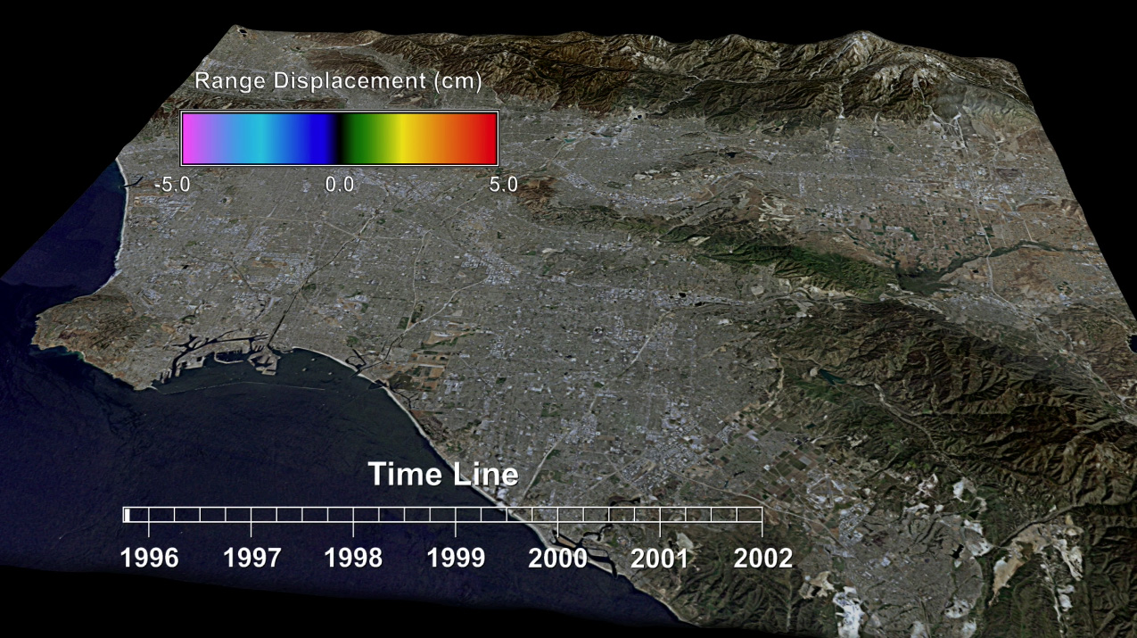
Monitoring LA Basin
Paul Lundgren, Vince Realmuto, JPL
Notes:
Data in archives for all of California because of tectonic studies
This is a still for the video (next slide). Will give time to explain what will be seen
Most effects are elastic/seasonal
Note Newport-Inglewood fault blocks groundwater (early 1998 and at end)
Note deep ‘pit’ develops in Pomona- permanent subsidence

Slide 7

Monitoring LA Basin
Paul Lundgren, Vince Realmuto, JPL
Notes:
Most effects are elastic/seasonal
Note Newport-Inglewood fault blocks groundwater (early 1998 and at end)
Note deep ‘pit’ develops in Pomona- permanent subsidence

Slide 8
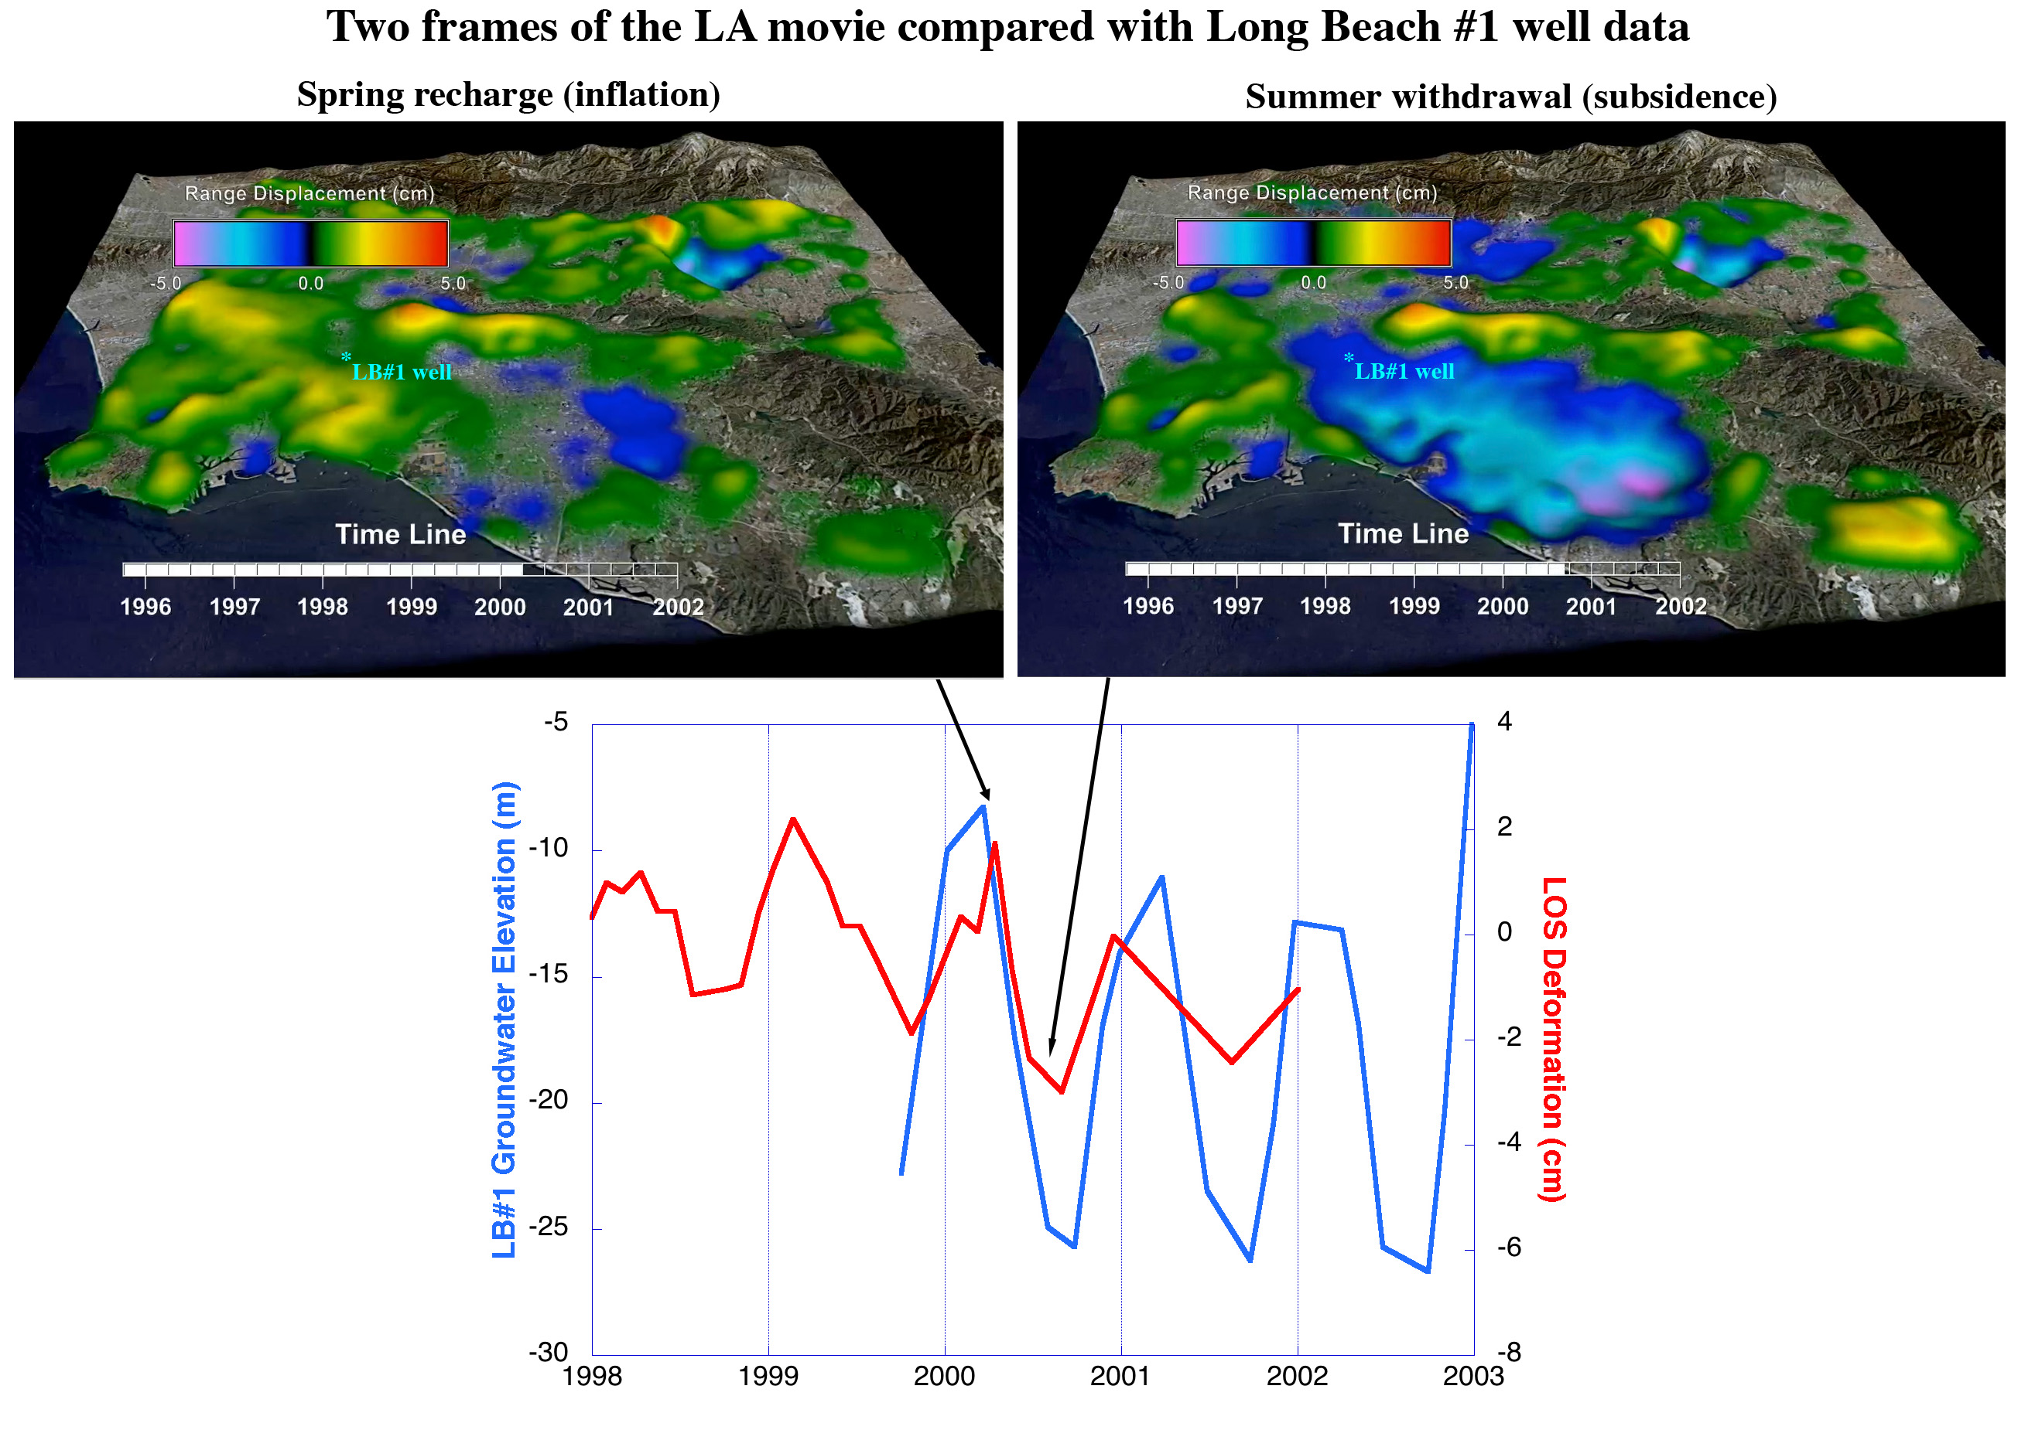
Try it yourself at: http://webgis.irea.cnr.it/

Slide 9
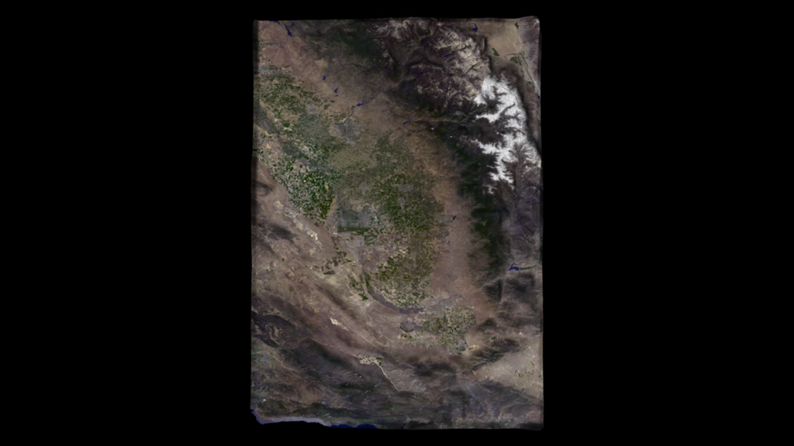
Subsidence in the Central Valley of California: PALSAR, 2007-2011
Zhen Liu, Vince Realmuto, Tom Farr, JPL
Notes:
Deep subsidence bowl in southern CV
Affects groundwater storage and also aqueducts and high-speed rail

Slide 10
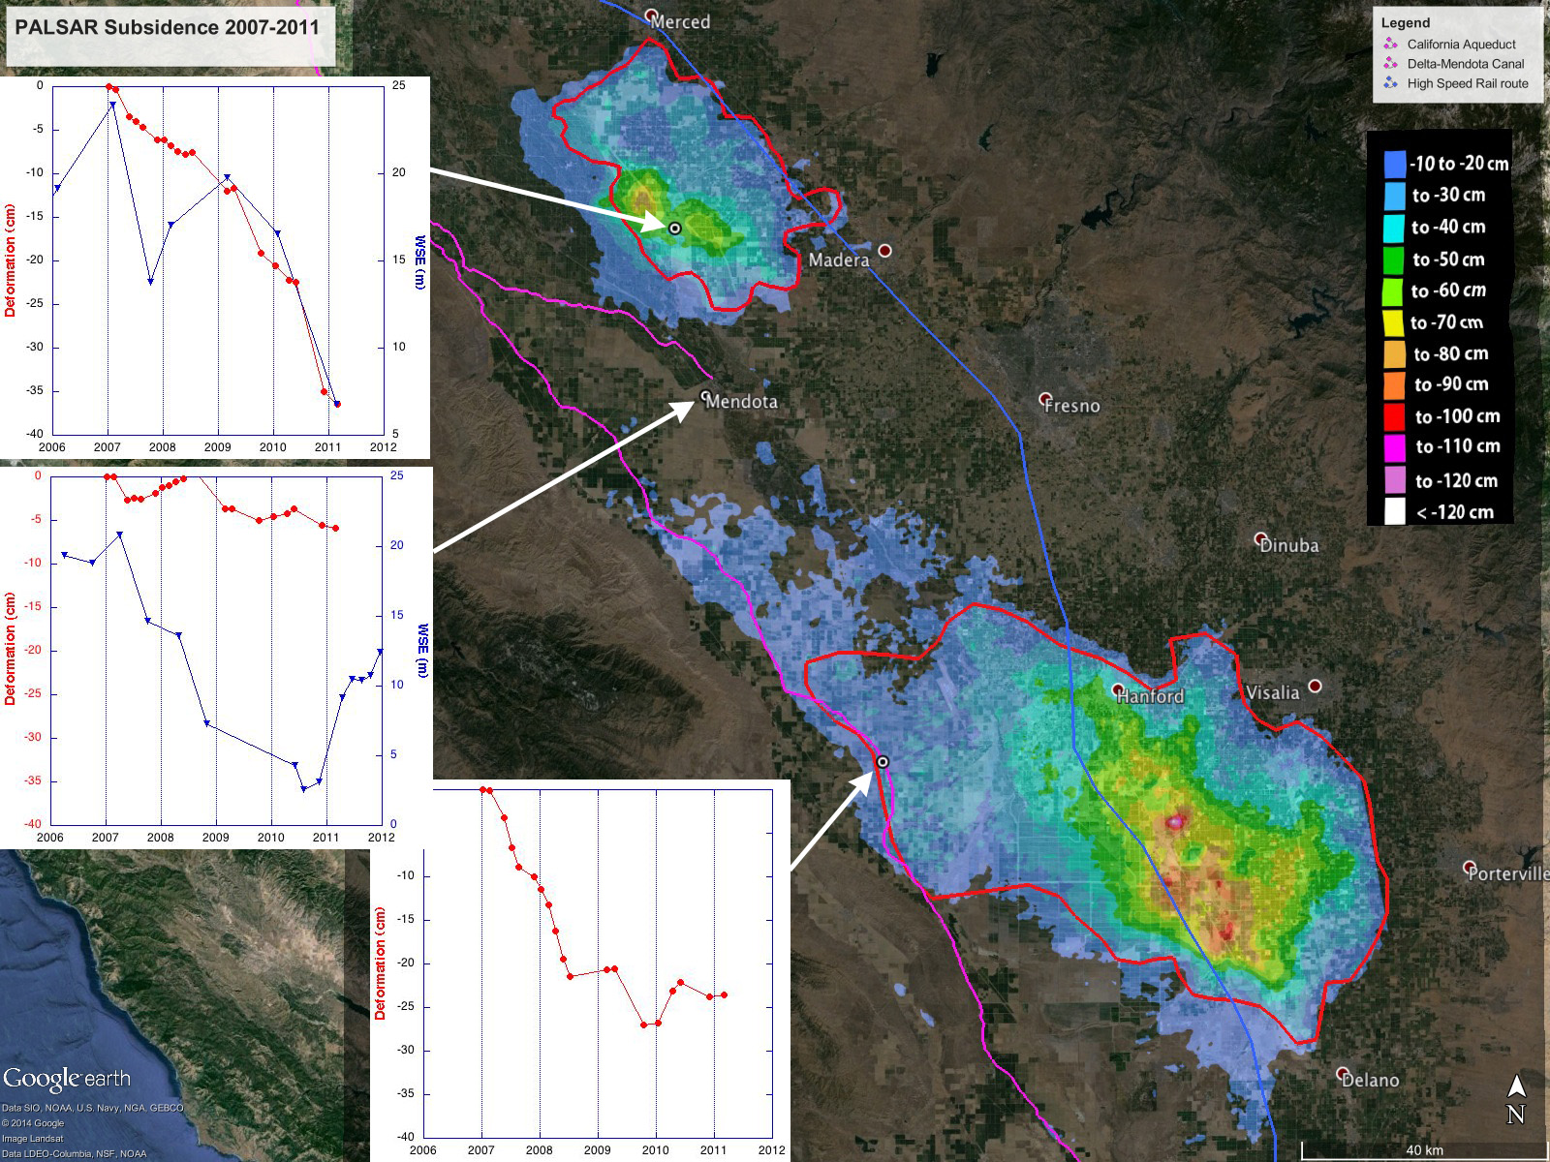
9 cm/yr
1 cm/yr
15 then 1 cm/yr
Notes:
Top: well in subsidence bowl
Middle: Well outside of bowl- not much subsidence, stronger seasonal signal, wet 2011
Bottom: southern bowl (off to E) causes subsidence on Aqueduct.
2 wells drop about same (~20 m) but subsidence different => subsurface geology?

Slide 11
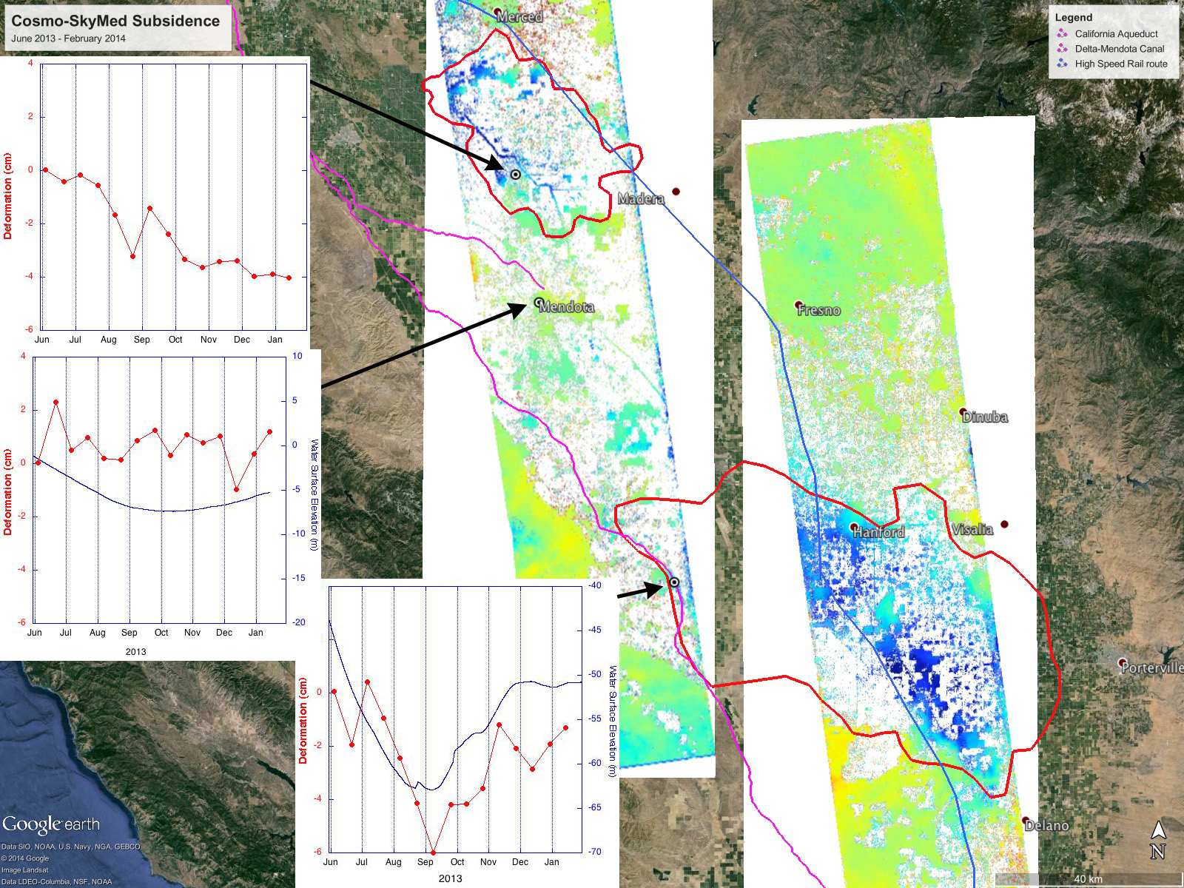
6 cm/yr
0 cm/yr
10 then +8 cm/yr
total 2 cm/yr
Notes:
Experimental project with Italian Space Agency to evaluate use of CSK
Same 3 points as PALSAR.

Slide 12
Summary and Next Steps
InSAR maps and measures subsidence and rebound which correlates with groundwater withdrawal and recharge
A new project funded by the California Department of Water Resources (DWR) will extend the time series to the end of 2014
We are also working with DWR to define a project to build capacity to monitor subsidence into the future as is being done in Arizona
We currently rely on data from other countries (Italy, Japan, Europe, and Canada)
The NASA-ISRO SAR mission will ensure continuity of these critical data sets
Notes:
Working on the quantitative interpretation of subsidence
New project will use Radarsat-2 data, then could use any new data
NI-SAR may be ~ 2020

