Slide 1
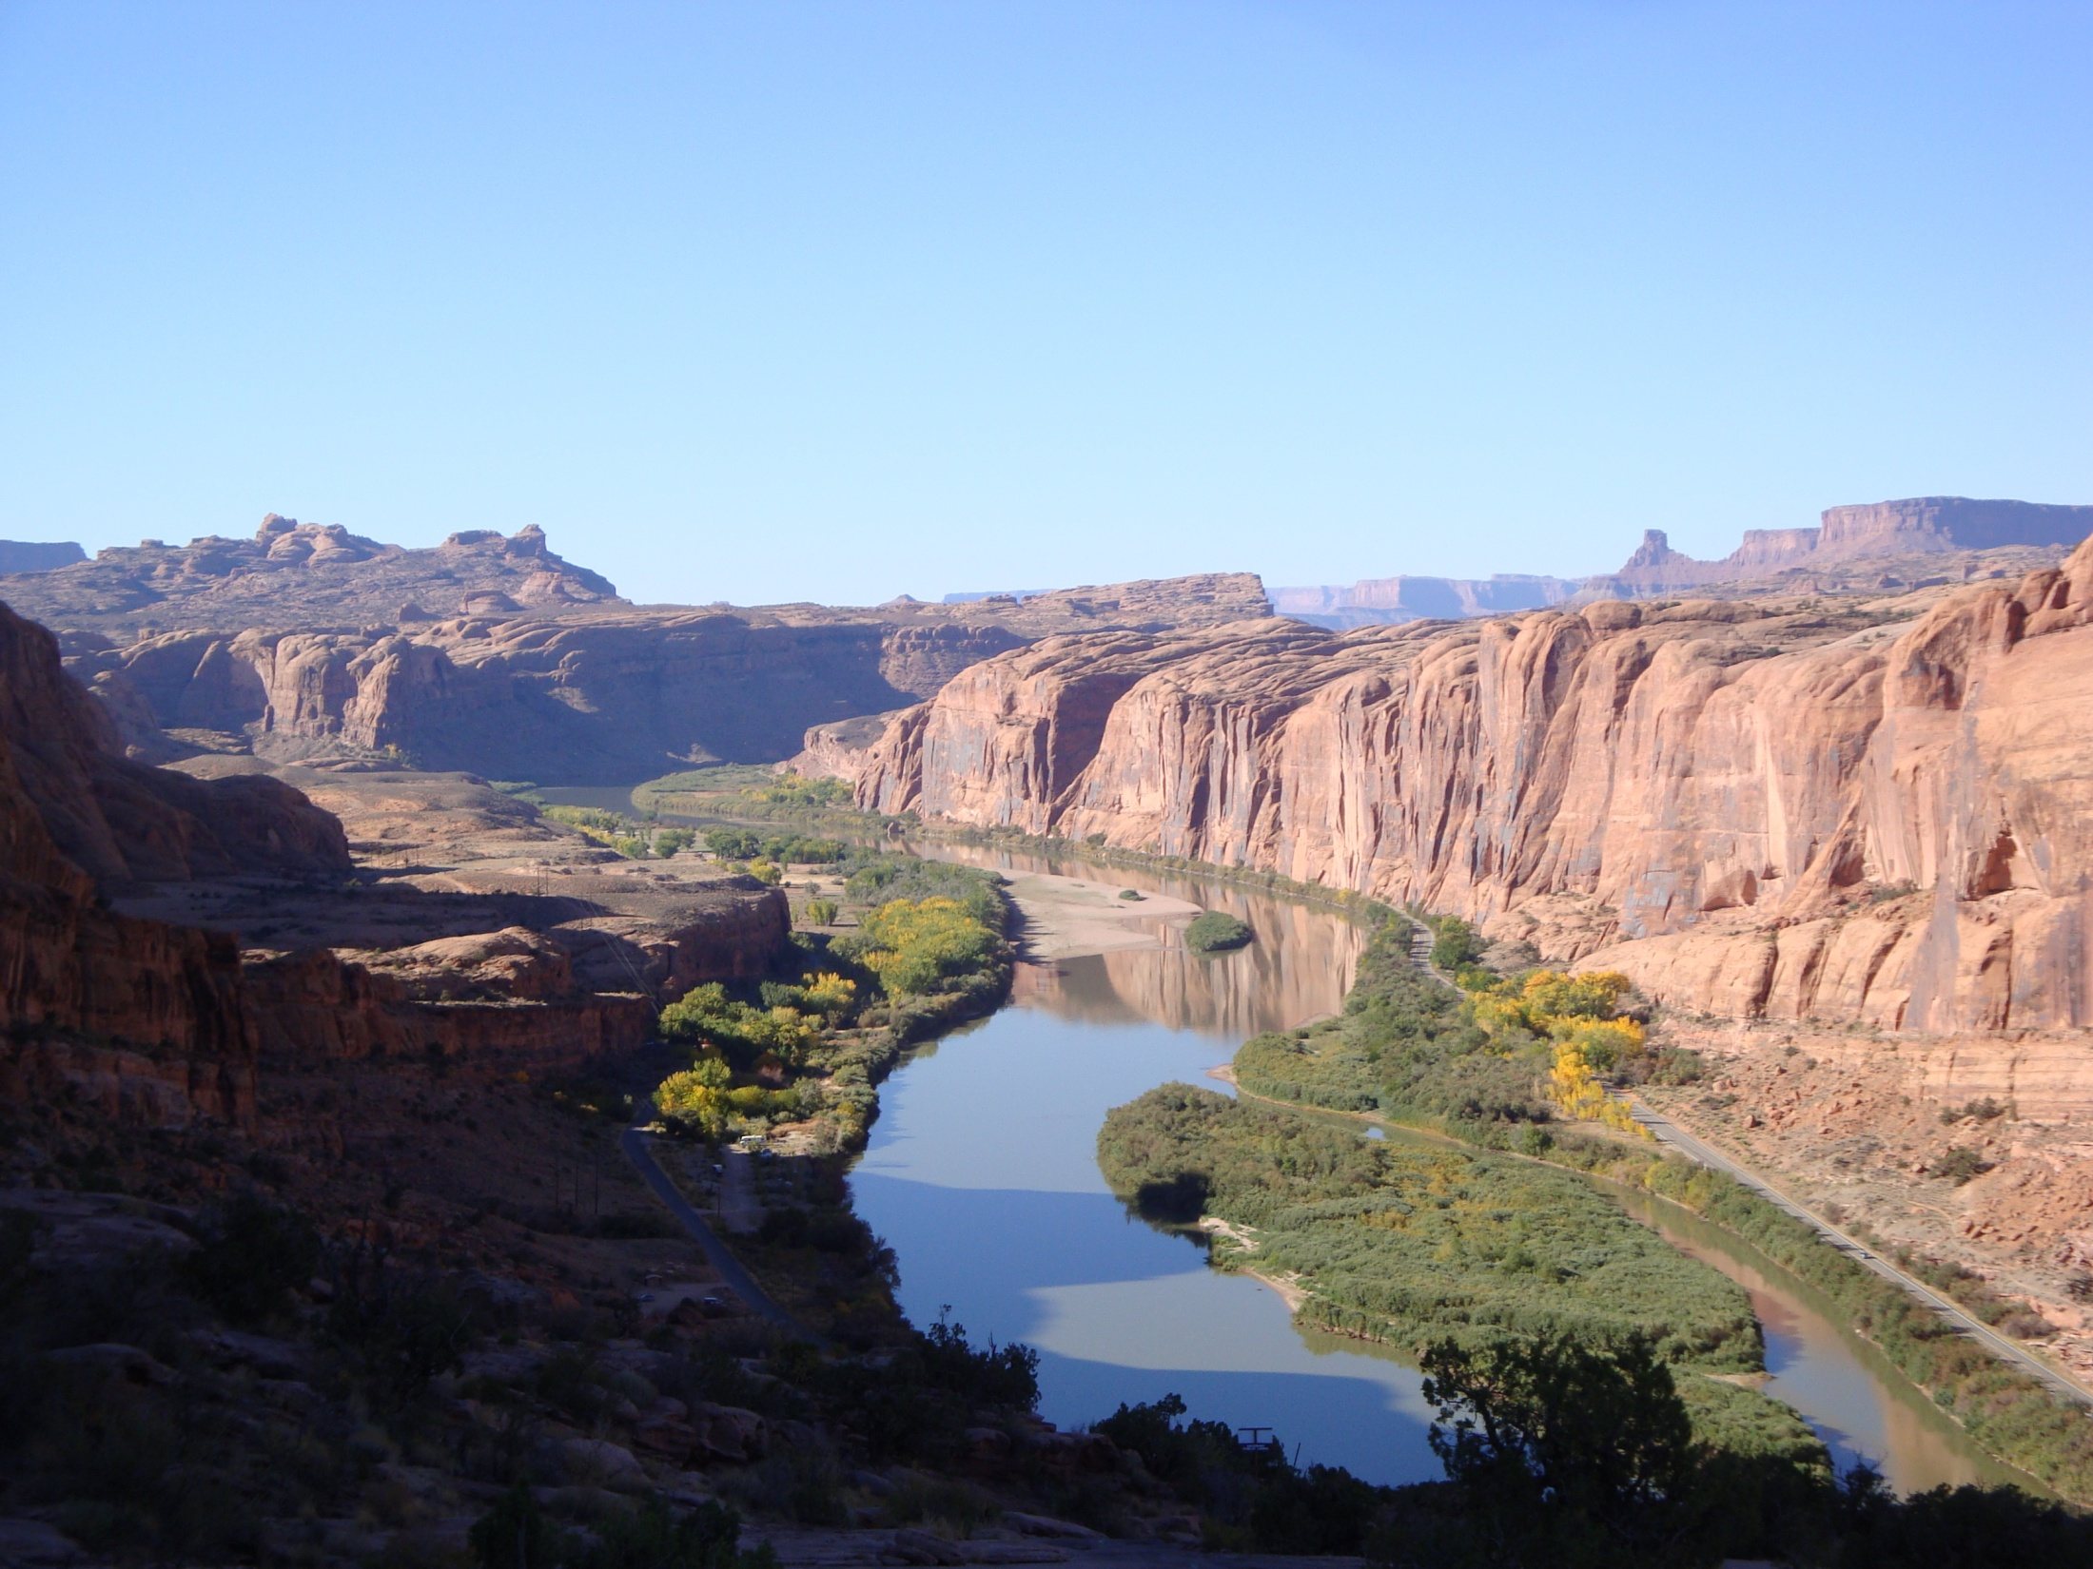


The Importance of Groundwater in Sustaining Streamflow in the Upper Colorado River Basin
Matthew Miller
Susan Buto, David Susong, Christine Rumsey, John Solder
U.S. Geological Survey, Utah and Nevada Water Science Centers
May 5th, 2016

Slide 2
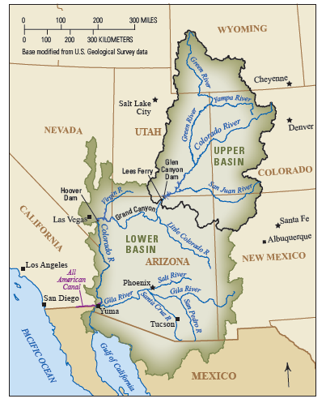
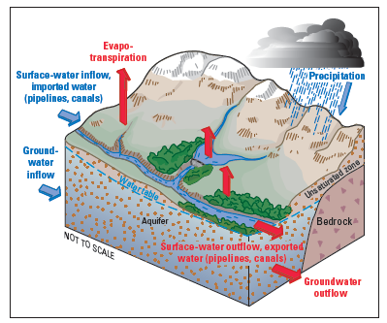

USGS National Water Census:
Colorado River Basin Focus Area Study
Evapotranspiration
Snowpack Hydrodynamics
Water Use Information
Groundwater Discharge to Streams
Summarized in Bruce and others (2015) – USGS Fact Sheet 2015-3080

Slide 3
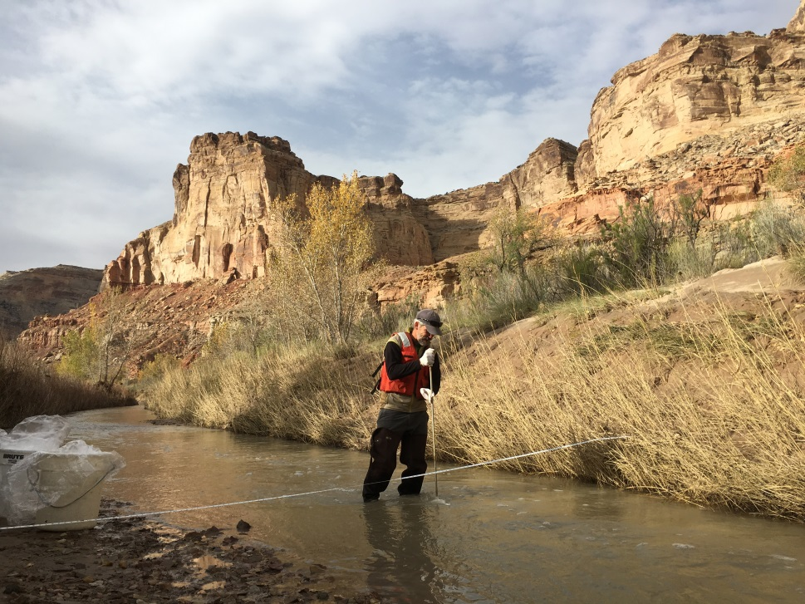
Project Development and Coordination
Objectives developed from a USGS meeting with selected stakeholders including Reclamation
Strategy focused on filling in information gaps
Lack of groundwater information in UCRB
Groundwater and surface water
are an interconnected resource
Wealth of historic USGS data

Slide 4
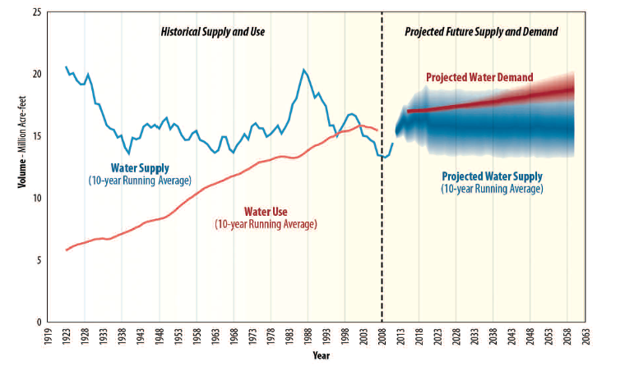
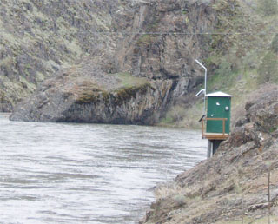
BOR Colorado River Basin Supply and Demand Study
Overarching Objective Provide quantitative information that adds new understanding of the joint groundwater-surface water resource in the UCRB
US Bureau of Reclamation (2012)
Projected demand is greater than projected supply
Median imbalance of ~ 3.2 million acre-feet by 2060

Slide 5
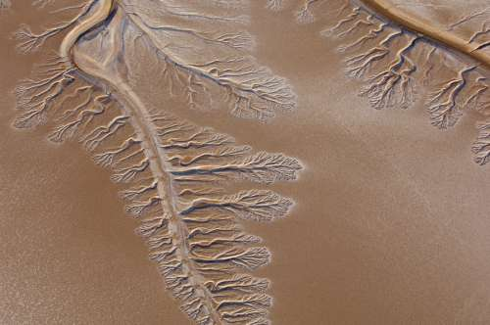
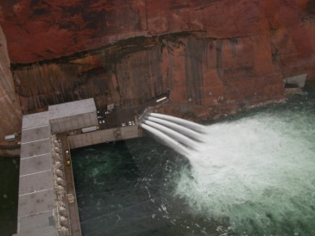
Study Objectives
Determine the spatial distribution of groundwater discharge to streams (where)
Quantify the fraction of total streamflow that is supported by groundwater discharge (how much)
Quantify the age of groundwater in the UCRB (vulnerability)
USGS
USGS

Slide 6
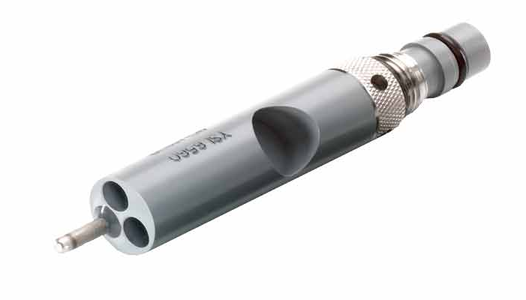
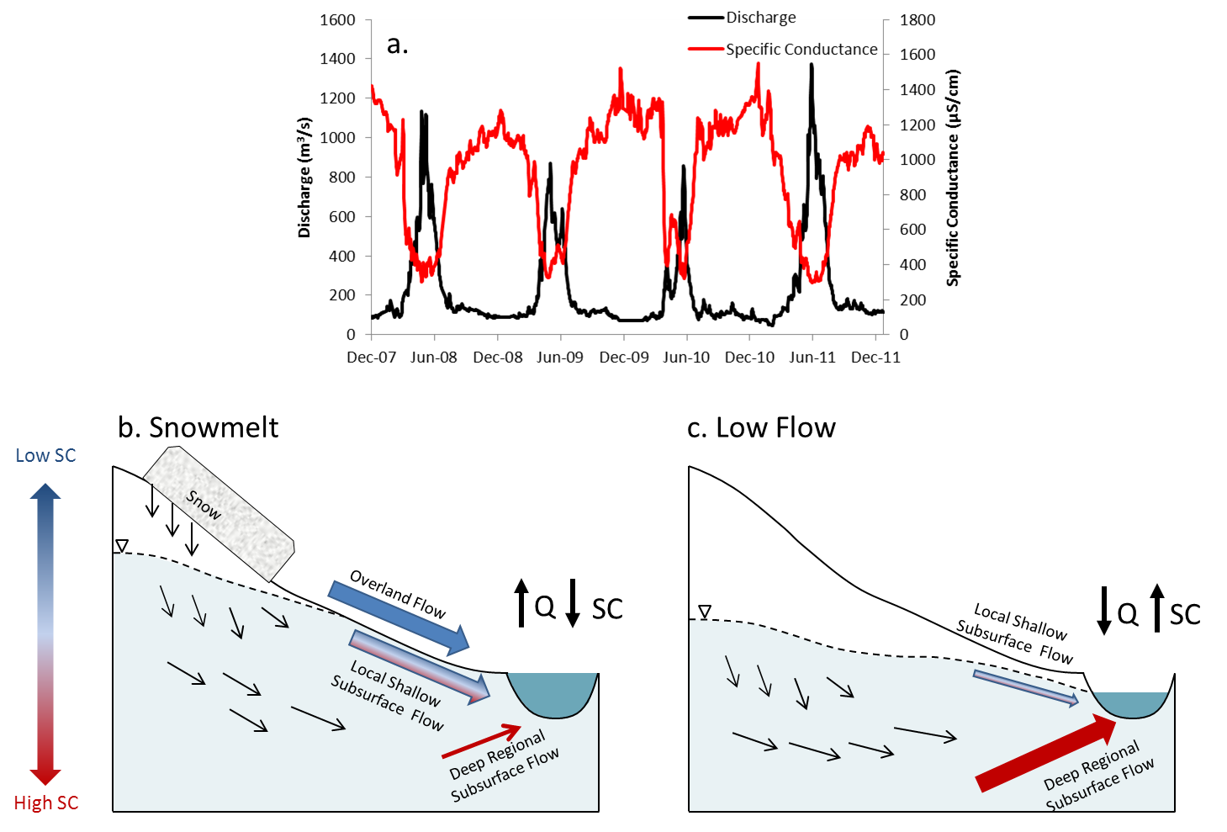
Chemical Hydrograph Separation
Information from streamflow and chemical composition used to separate streamflow into runoff and groundwater components
Miller and others (2014, Water Resources Research)

Slide 7
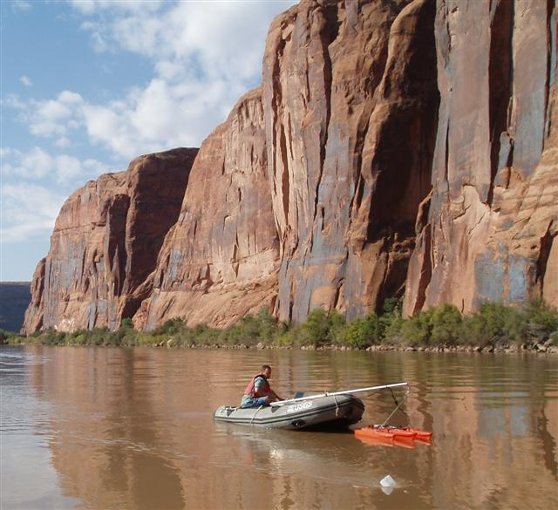
USGS Long Term Records
1947
Long-term discharge and specific conductance data collected by USGS were used for hydrograph separation.
Data from 1984-2012 used for present study
2010

Slide 8
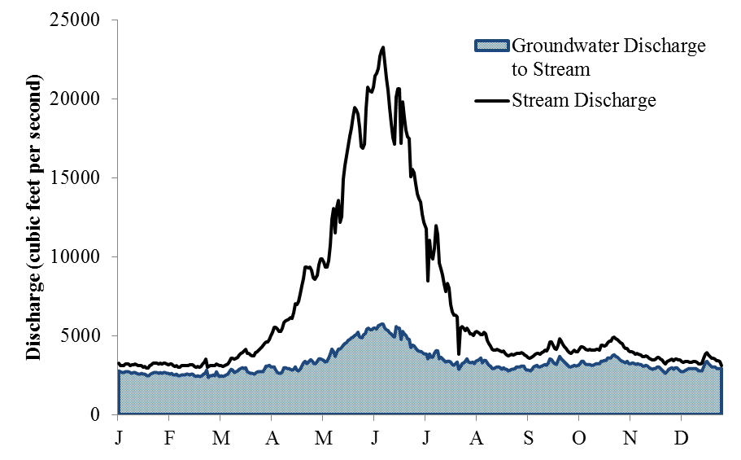
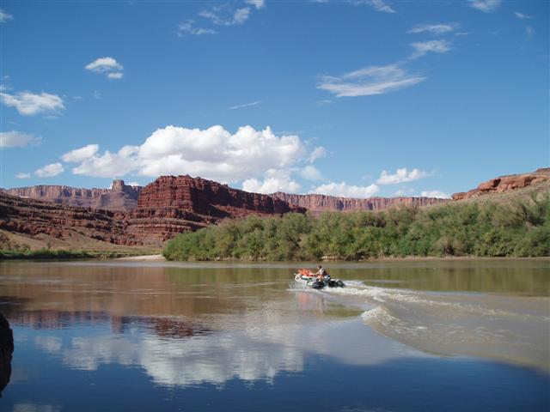
Groundwater Discharge to Streams
Summary of 12 Stations in UCRB
“Pulse” of groundwater during snowmelt
Percent of total flow that is groundwater
  Annual: 21 – 58%
  Snowmelt: 13 – 45%
  Low-flow: 40 – 86%
Hydrograph separation results for Colorado River at Cisco, UT
Miller and others (2014, Water Resources Research)

Slide 9
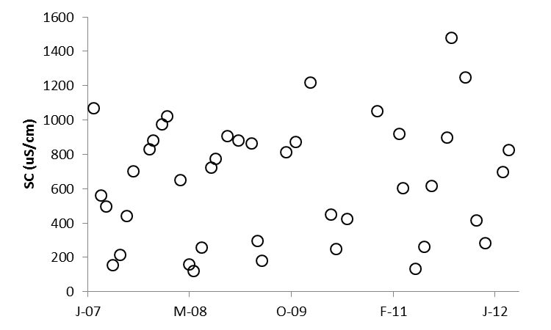
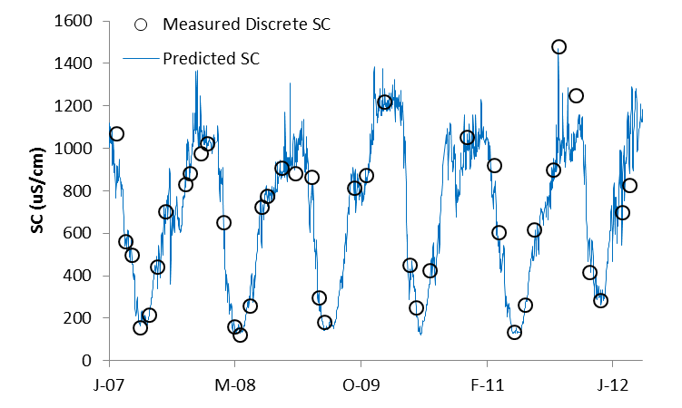
Discrete data Continuous Data
Problem: Given a small number of observed SC concentration values, and a continuous record of discharge how can we “fill in the gaps” in the SC record?
Discharge
Season
$ln⁡(SC)=β_{0}+β_{1}\left[\ln\left(Q\right)\right]+β_{2}$[$\ln\left(Q^{2}\right)]+β_{3}\left(T\right)+β_{4}\left(T^{2}\right)+β_{5}[\sin{(2πT)]+β_{6}[\cos{(2πT)]}}$
Time

Slide 10
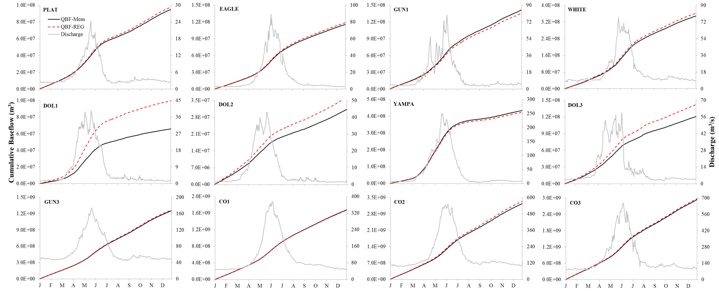
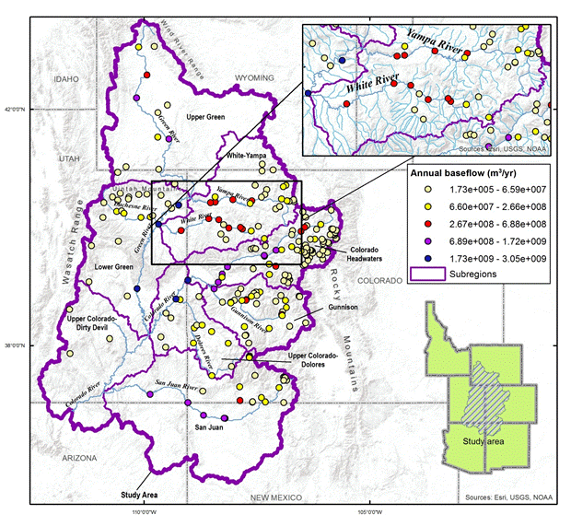
Groundwater Discharge to Streams – Estimation with Discrete Data
Excellent fit between groundwater discharge to streams estimated using measured data and a regression approach at sites not directly impacted by anthropogenic activities
Miller et al. (2015, J. Hydrol.)
Groundwater discharge to streams estimated at 229 sites using regression approach (sites filtered to remove those directly impacted by anthropogenic activities)
Rumsey et al. (2015, J. Hydrol. – Reg. Stud.)

Slide 11
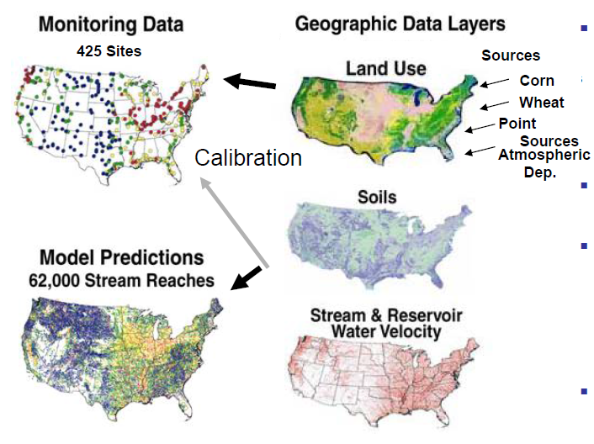
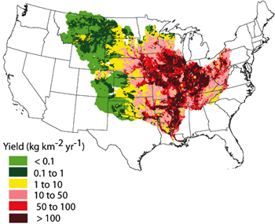
USGS SPARROW Model
Developed to estimate long-term mean steady state water quality conditions

Slide 12
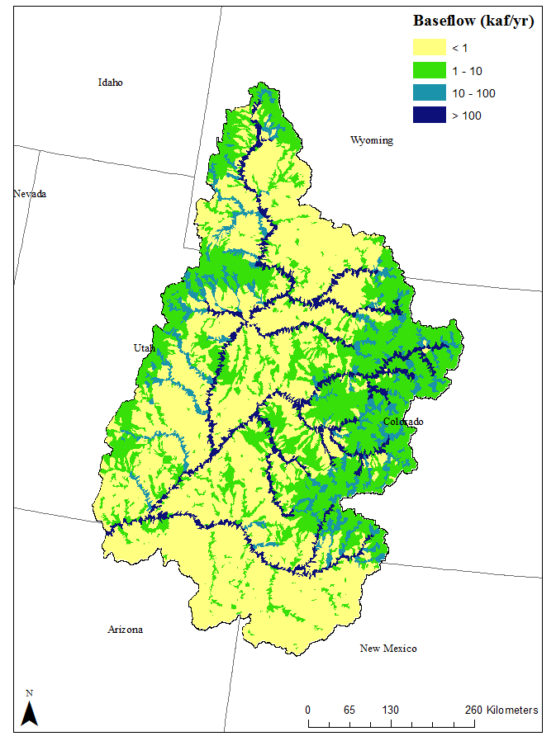
Spatial Distribution of Groundwater Discharge
Most groundwater discharge to streams occurs in upper elevation catchments
Climate change in high elevation systems will affect the groundwater resource, and therefore the amount of surface water in streams
14.5 maf/yr = Groundwater discharge to streams in Upper Basin
2.7maf/yr = Water delivered to the Lower Basin that originated as groundwater
Water lost during in-stream transport due largely to irrigation withdrawals and evapotranspiration
Miller and others (in press, Water Resources Research)

Slide 13
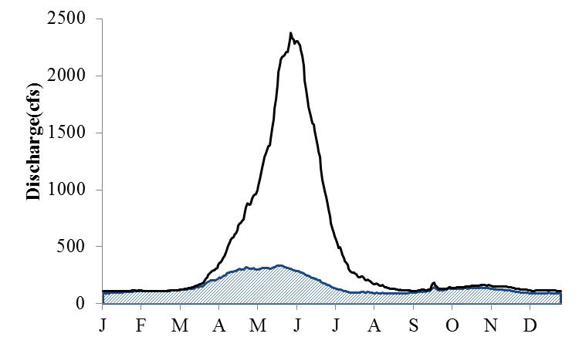
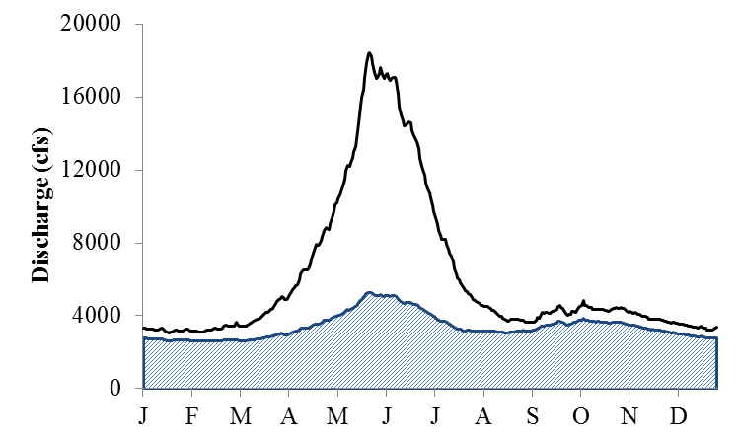
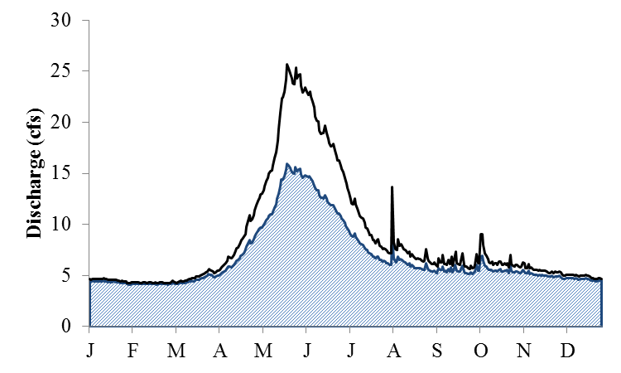
Groundwater and Surface Water – A Single Resource
Yampa River at Steamboat Springs, CO (34% GWD)
Colorado River Near Cisco, UT (55% GWD)
Mill Creek Near Moab, UT (79% GWD)

Slide 14
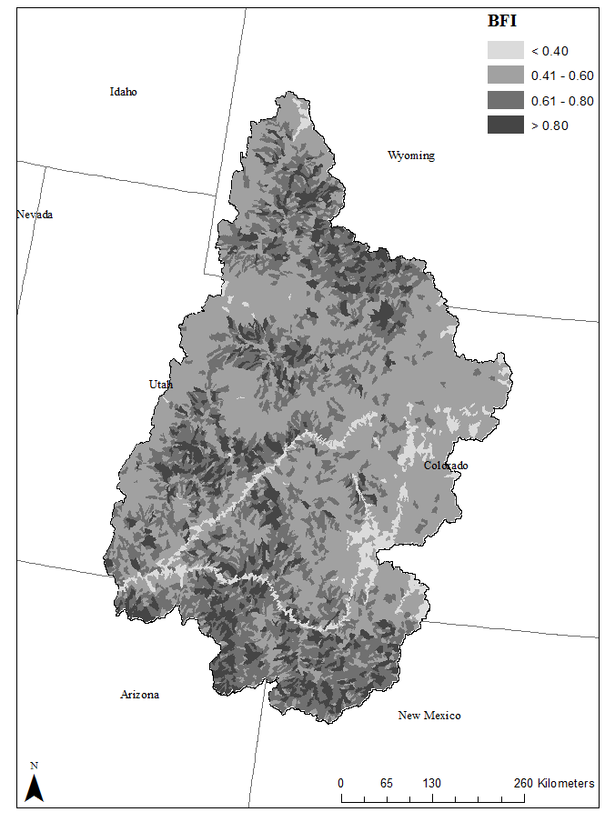
Streamflow Sustained by Groundwater
On average 56% of streamflow in the UCRB is estimated to be from groundwater discharge
Streamflow in lower elevation catchments is more dependent on groundwater discharge than high elevation systems
These streams support ecologically sensitive habitats (e.g. riparian zones)
Miller and others (in press, Water Resources Research)

Slide 15
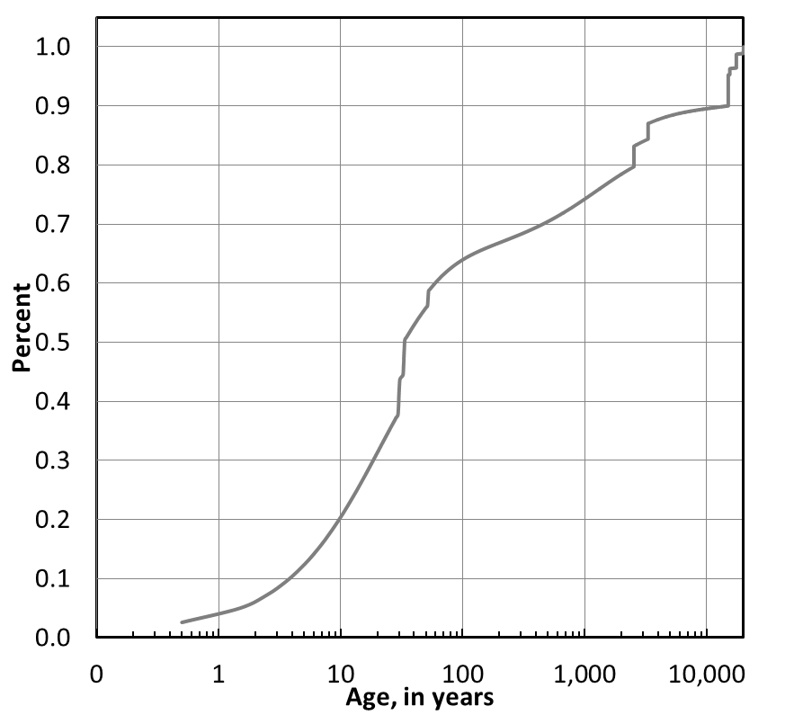
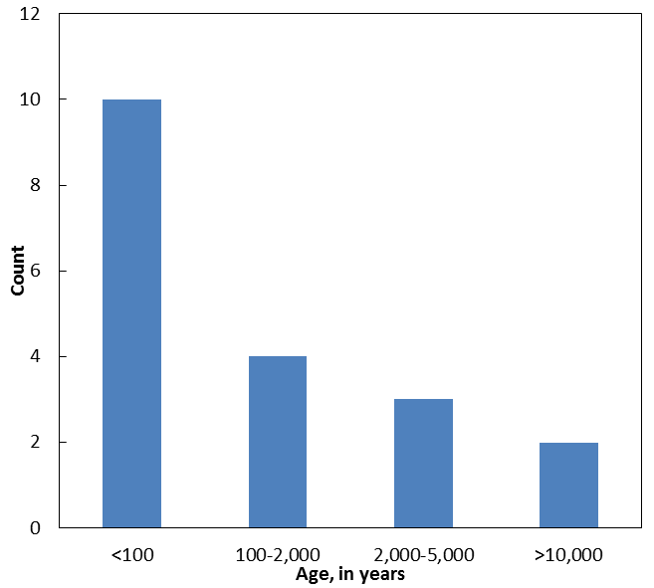
Age of Groundwater in UCRB
20% of groundwater < 10 years old
65% < 100 years old
Relatively young age of groundwater suggests potential rapid response to changes in environmental conditions
Age Tracers – ³H, Noble gases, CFCs, SF₆, ¹⁴C

Slide 16
Summary and Implications
Any processes that affect the groundwater resource will also affect the surface water resource – Now have quantitative estimates of groundwater discharge to streams
Most groundwater discharge to streams occurs in upper elevation watersheds
Streamflow in lower elevation systems is dependent on groundwater discharge to streams
Most groundwater is young, suggesting the potential for rapid response of groundwater discharge to environmental change
Collaborating with Reclamation on study that will use this model as a tool to predict future groundwater discharge to streams under different climate scenarios

Slide 17
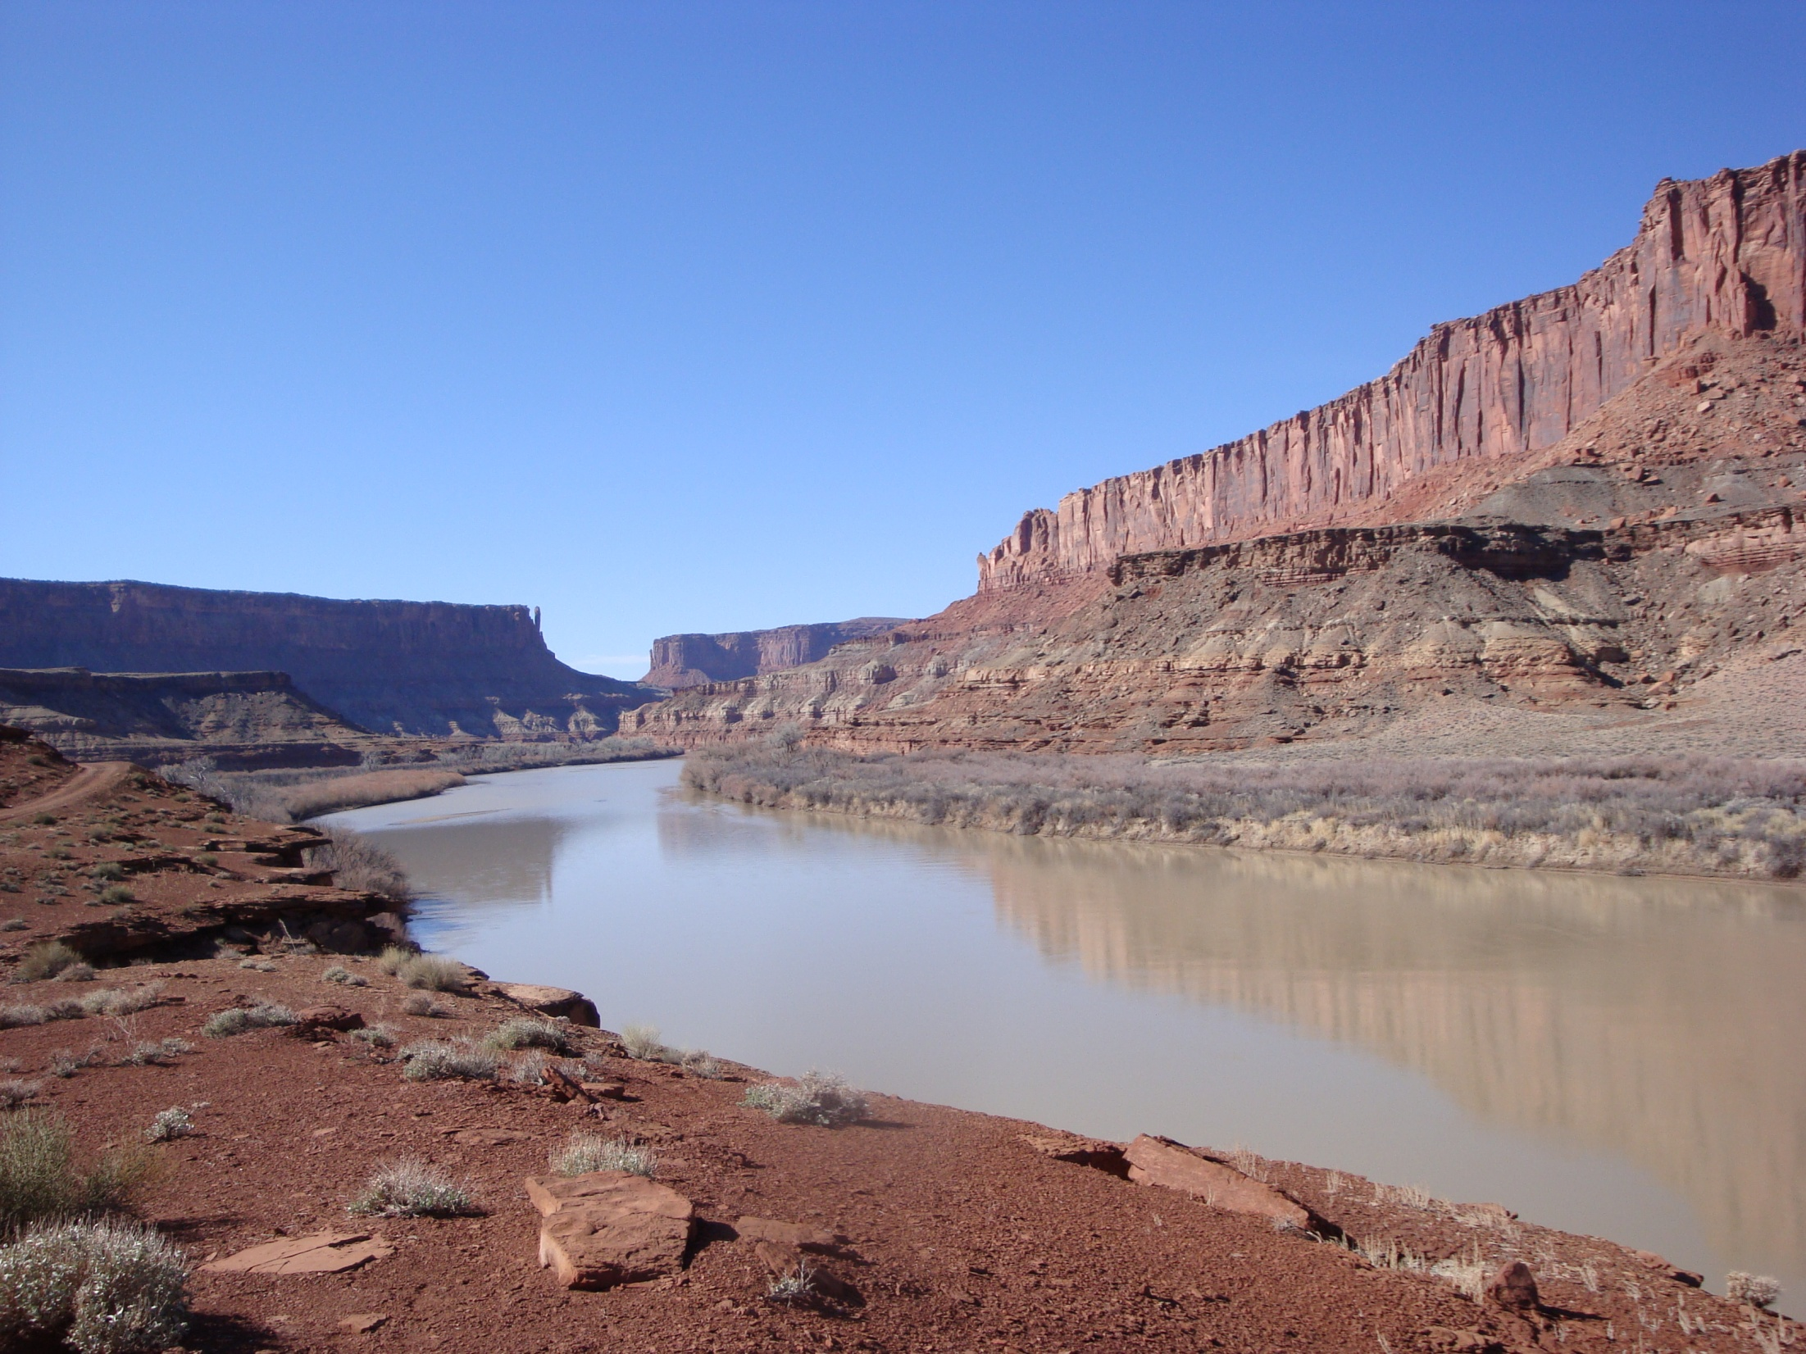
Thank you
Matt Miller
USGS, Utah Water Science Center
mamiller@usgs.gov

