Slide 1
California Irrigation Management Information System (CIMIS)
Bekele Temesgen
Senior Land and Water Use Scientist
California Department of Water Resources
Presented at the
Irrigation Management Information Systems Workshop
San Diego, CA
August 25, 2016

Slide 2
Outline
Part I - CIMIS
  Introduction and History
  Stations and data
  Users and uses
  Data gaps
Part II – Spatial CIMIS
  Data collection and processing
  Spatial ETo estimation
  Daily ETo maps
Part III – Challenges and future plans

Slide 3
What is CIMIS?
CIMIS is a network of over 150 fully automated weather stations that collect weather data throughout California and provide weather data and estimates of reference evapotranspiration (ETo) to users.
Archived data is also available from 96 inactive stations.

Slide 4
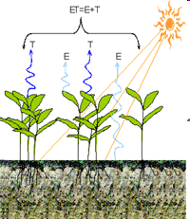
What is ETo?
ETo is evaporation plus transpiration from a standardized grass surface over which the weather stations stand.
Crop coefficients (Kc) are used to estimate actual ET from specific crops.

Slide 5
Brief History of CIMIS
1982 - developed by DWR and UCD
1985 - DWR assumed full control
2002 – data access via web and FTP
2009 – Spatial CIMIS was released
Current data access:
  Web - http://wwwcimis.water.ca.gov
  FTP - ftpcimis.water.ca.gov
  CIMIS WEB API (web service)

Slide 6
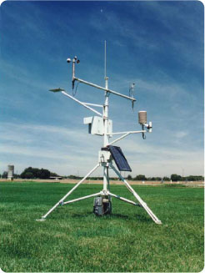
Typical CIMIS station
Lightning Rod
Anemometer
Pyranometer
Wind Vane
Temperature/RH
Datalogger
Solar Panel

Slide 7
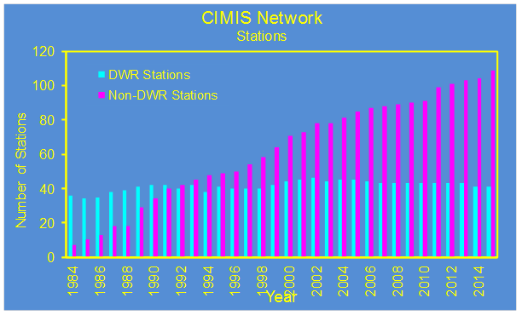
Who owns CIMIS stations?
Some stations are owned by DWR.
Others are owned by cooperators, such as:
  Local water agencies
  Universities
  Cities
  USDA
  USBR
  Conservation Districts (CD)
  Private industries

Slide 8
CIMIS Data
The following weather data are measured at the CIMIS stations:
  Air temperature (Ta)
  Relative humidity (RH)
  Solar radiation (Rs)
  Wind speed (U2)
  Wind direction
  Precipitation (P)
  Soil temperature (Ts)

Slide 9
CIMIS Data (cont.)
Dataloggers poll the sensors every minute.
Sixty minute-by-minute readings are averaged/totaled.
Daily maximum, minimum, average, and total values are calculated by the end of each day.
Hourly and daily values are stored in the dataloggers.
CIMIS servers call stations every hour and retrieve data in CSV format.
Data goes through QC and ETo is calculated.
Hourly ETo is aggregated to produce daily ETo.

Slide 10
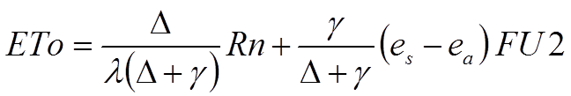
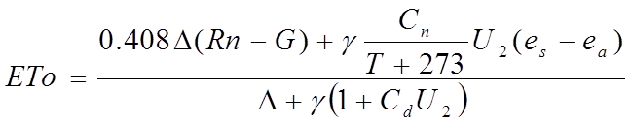
ETo Equations
CIMIS Penman
Penman-Monteith

Slide 11
Who Uses CIMIS Data?
Growers
Consultants
Water agencies
Public agencies
Home owners
Researchers
Firefighters
Schools
Investigators

Slide 12
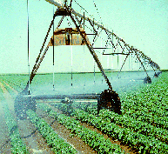

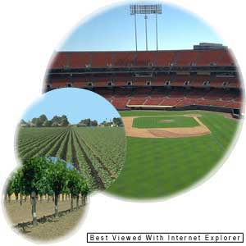
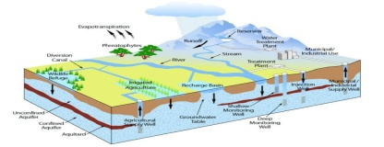


CIMIS Data Uses
Irrigation scheduling
Air quality monitoring
Firefighting
Energy generation
Engineering designs
Weather forecasting
Pest management
Chilling hours and degree days
Research

Slide 13

Benefits of Using CIMIS Data
The following are some of the benefits of using CIMIS data:
  Save water and energy
  Mitigate the impacts of drought and climate change
  Improve the environment
  Produce high quality yield and better looking land scape

Slide 14
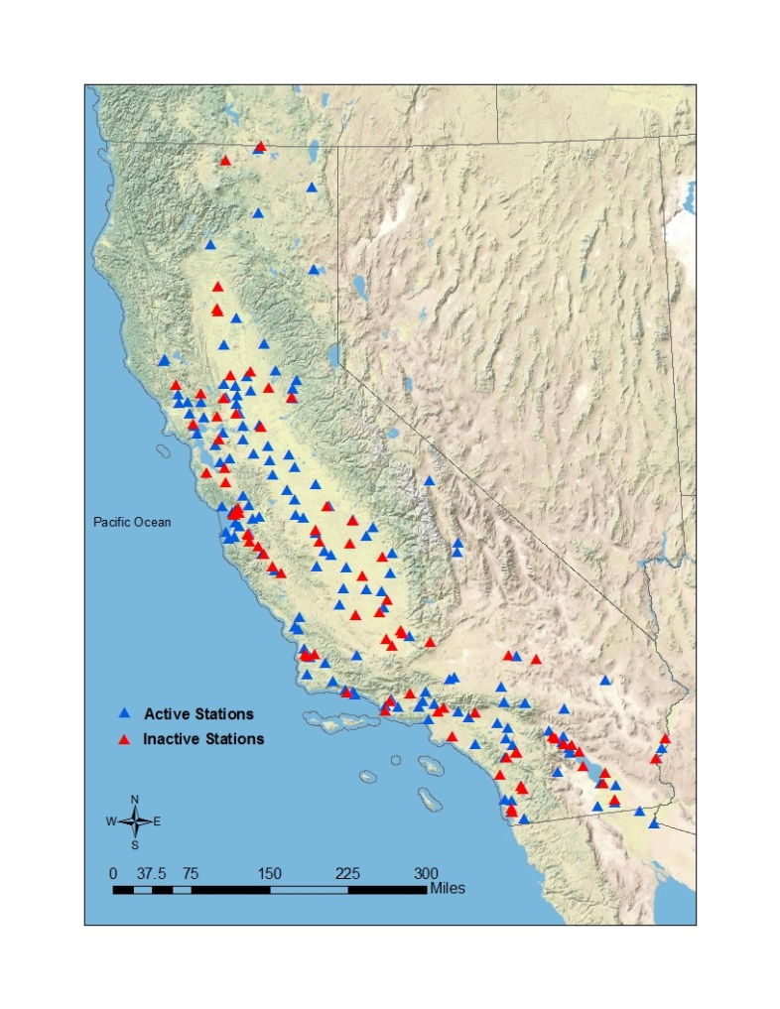
Spatial Data Gaps

Slide 15
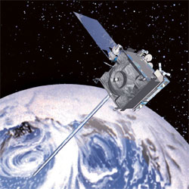
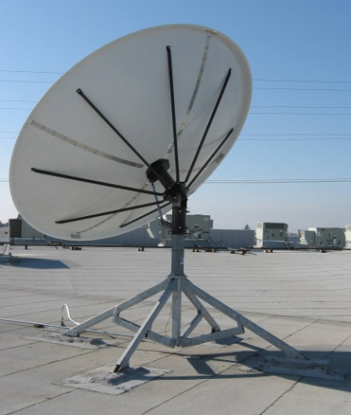
Spatial CIMIS
Couples remotely sensed data from GOES satellite with point measurements from CIMIS stations to estimate ETo.
Provides daily maps of ETo at 2-km grid.
Released to the public in September 2009.

Slide 16
Spatial ETo Estimation
Rs is derived from the GOES data using Heliosat-II model.
Ta, RH, and U2 are interpolated between CIMIS stations using the Spline interpolation method.
The ASCE version of the Penman-Monteith equation is used to calculate ETo.

Slide 17

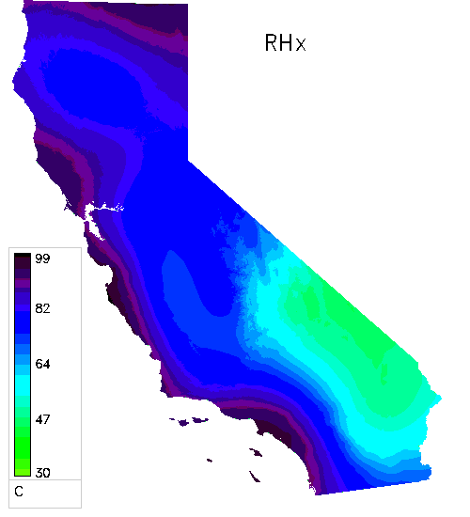
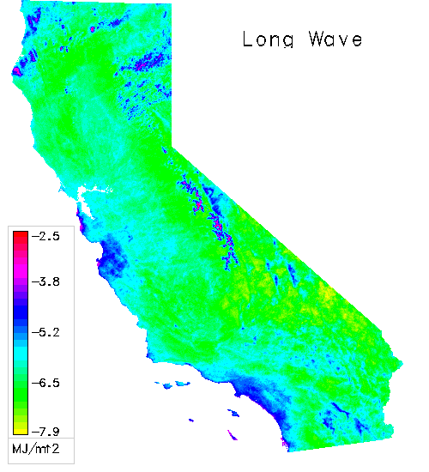
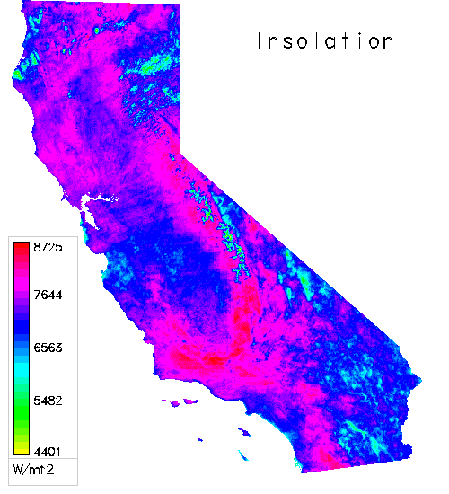
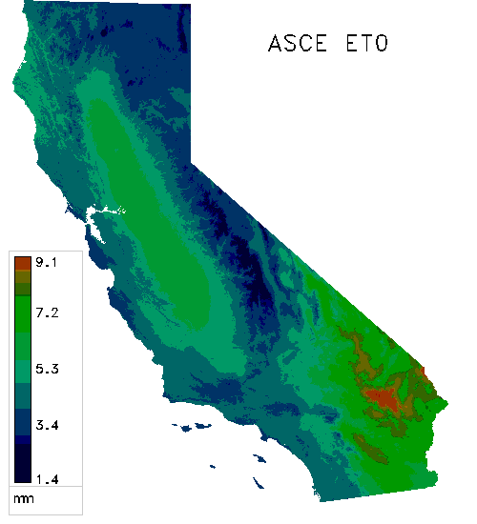
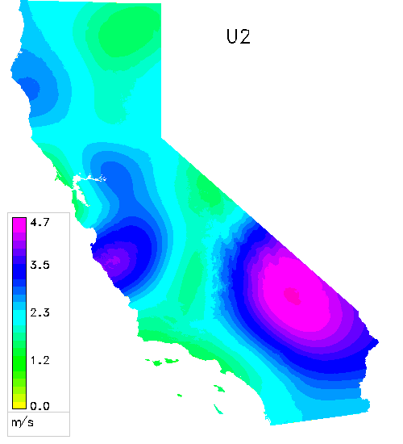
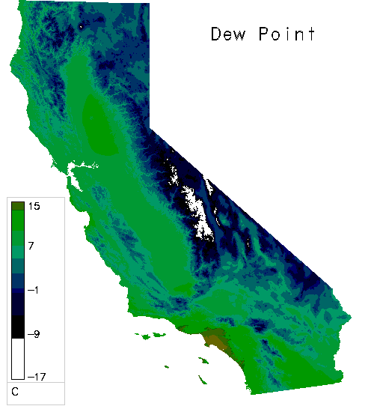
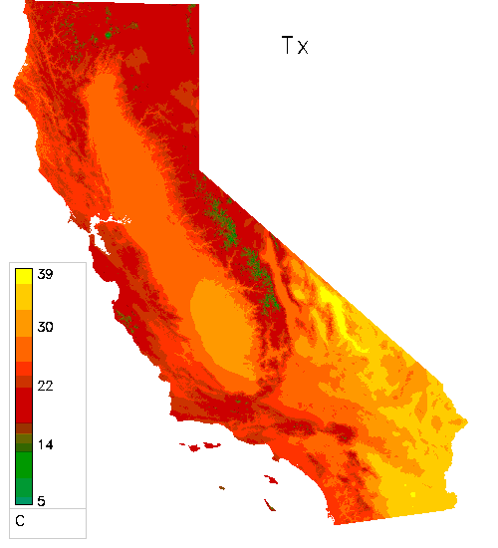
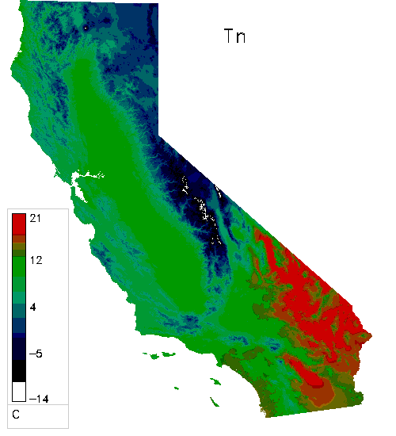
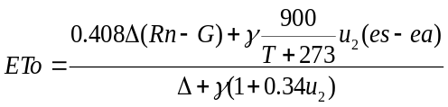
Spatial CIMIS (cont.)
ETo Equation

Slide 18
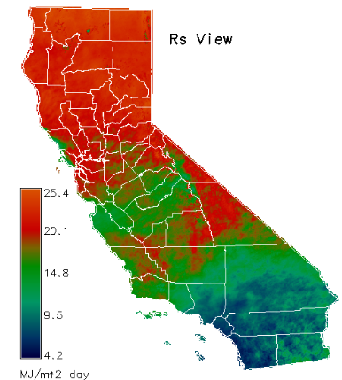
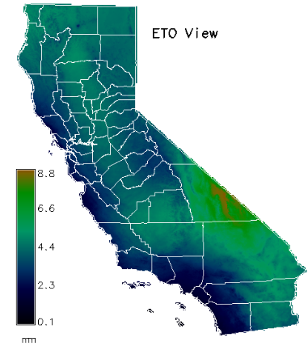
Spatial Maps
Rs (04/07/2016)
ETo (04/07/2016)

Slide 19
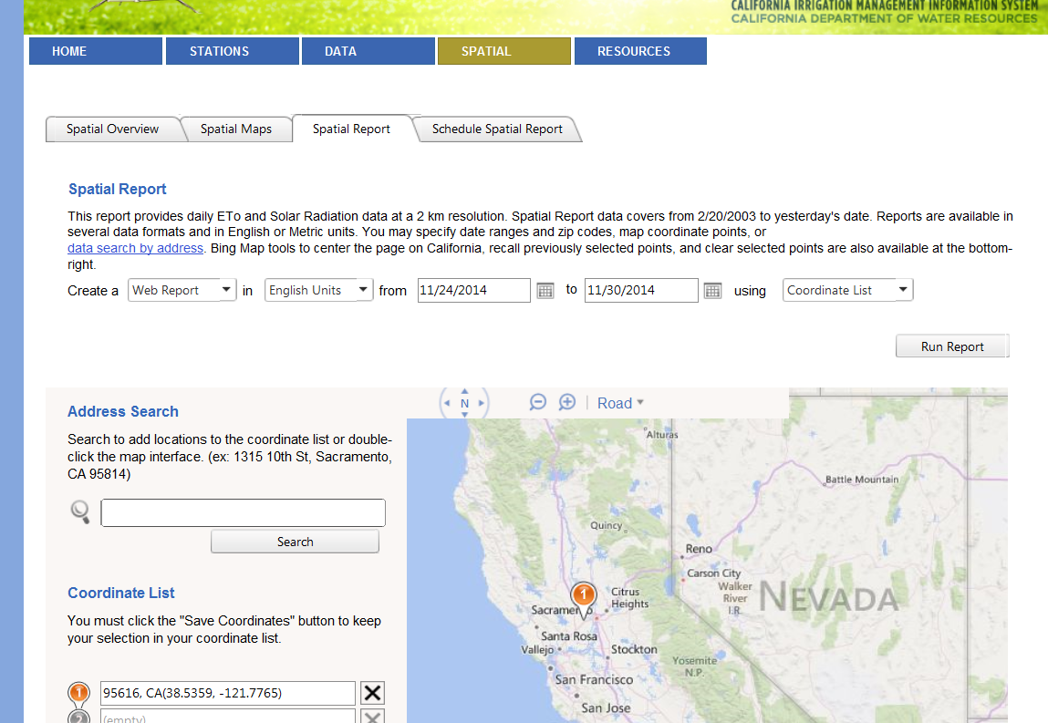
Spatial Reports

Slide 20


Challenges
Resource limitations
Station maintenance
Sensor failures
Station siting
Public outreach

Slide 21
Future Plans
Improve station density and data quality
Update ETo Zones map
Develop CIMIS smartphone app
Refine the Spatial CIMIS model
Develop crop-coefficient (Kc) maps – TOPS SIMS
Provide estimates of evaporation from water surfaces
Provide ETo forecast
Interactive data delivery with improved features

Slide 22

Questions?

