Slide 1
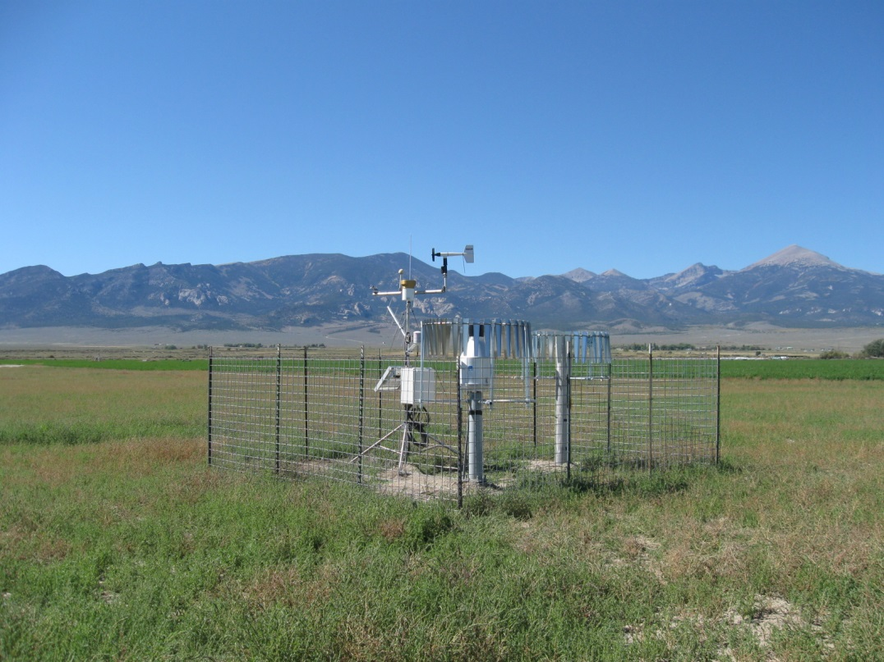
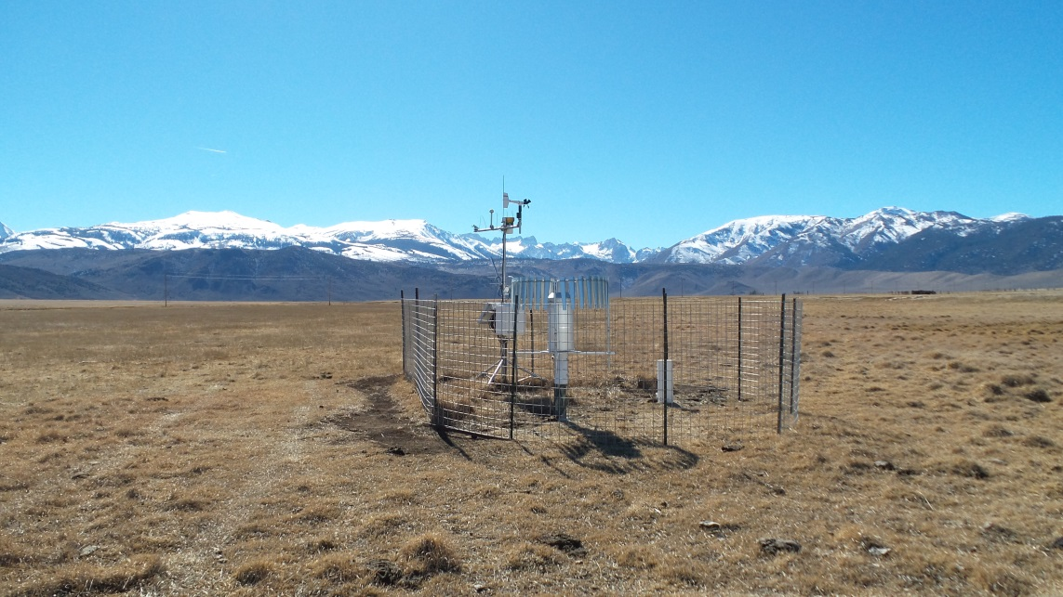




NICE Net and Reference Evapotranspiration in Nevada
Snake Valley, NV
October, 2014
Justin Huntington, Dan McEvoy, Greg McCurdy, and Brad Lyles:
Desert Research Institute and Western Regional Climate Center
Bridgeport, CA
February, 2015
Irrigation Management Information Systems’ Workshop
August 25-26, San Diego CA

Slide 2
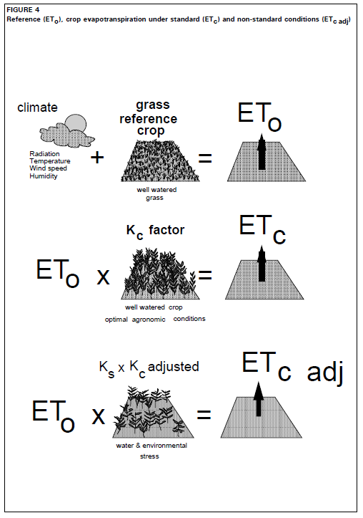
General need for Reference ET (ET_{o}) in NV and elsewhere
Important for estimating ag. consumptive use
Successful application of traditional ET_{o} * K_{c} approach relies on well watered ET_{o} estimates
METRIC and other remote sensing approaches rely on well watered reference ET_{o} estimates too
NV specific:
  Huge spatial variability in weather
  Each valley has unique weather and deserves own monitoring
  Most groundwater basins are fully or over appropriated due to water rights for irrigation
  Need reliable ET_{o} estimates to calculate crop consumptive use using traditional and remote sensing methods!!
[Allen et al. 1998]

Slide 3
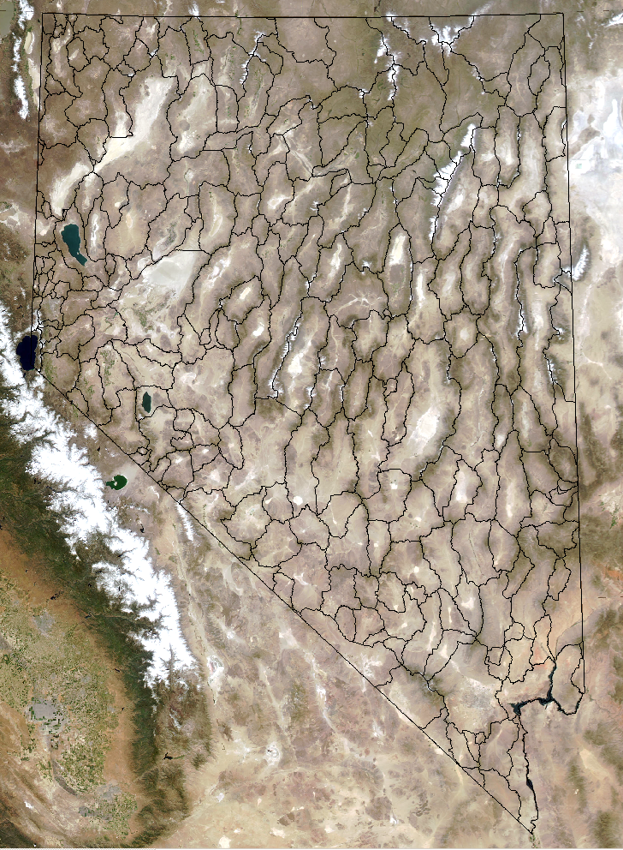
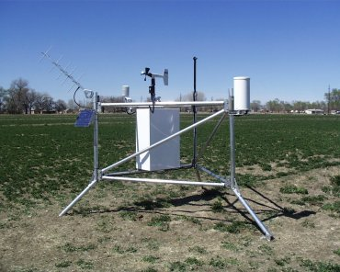
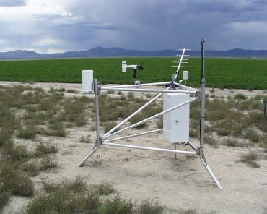
NICE Net Motivation
Prior to the Nevada Integrated Climate and Evapotranspiration Network (NICE Net) only two NV ag stations
Most NV stations located in dry, non-irrigated environments
Funded by a federal initiative and state of NV to improve estimates of consumptive use in NV
Project started 2010, most stations installed 2010-2012
Fallon AgriMet
Eureka AgriMet

Slide 4
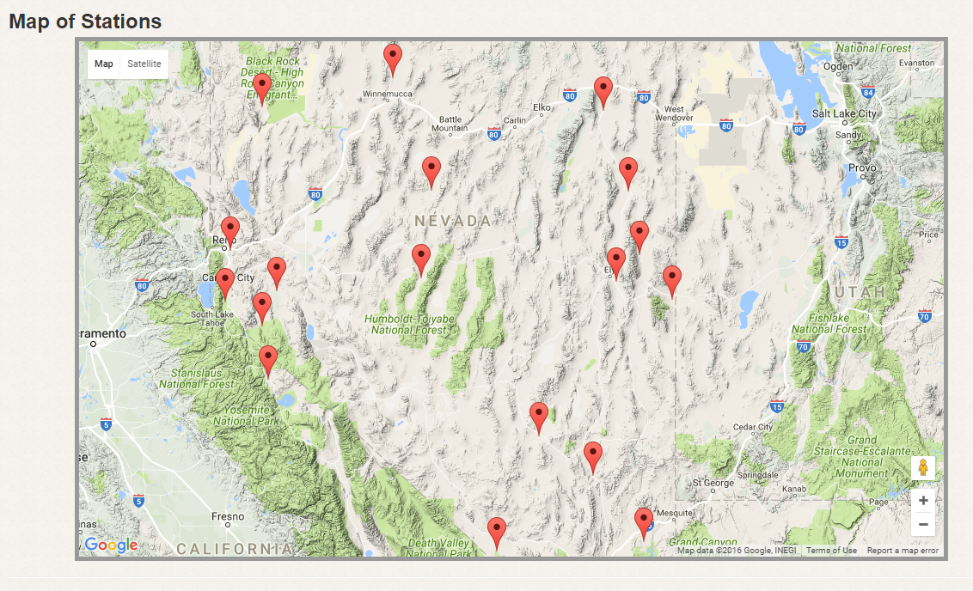
NICE Net stations
http://nicenet.dri.edu/
Currently 18 NICE Net stations

Slide 5
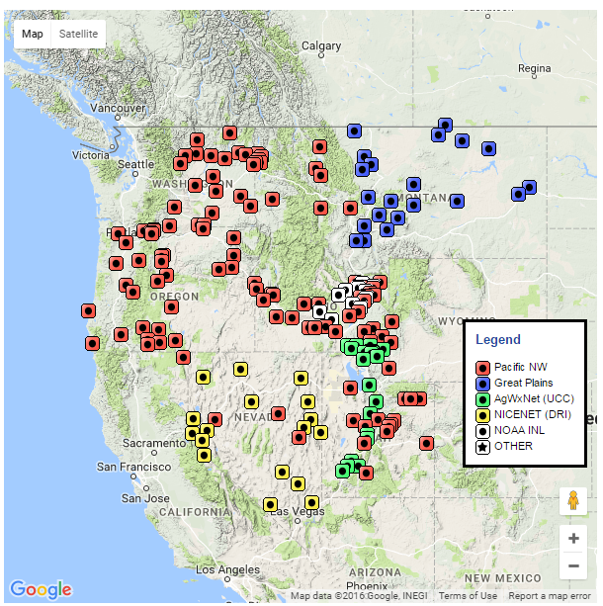
NICE Net stations
http://nicenet.dri.edu/
Also hosted on USBR AgriMet page: http://www.usbr.gov/pn/agrimet/agrimetmap/agrimap.html
Big thanks to Jama Hamel!

Slide 6
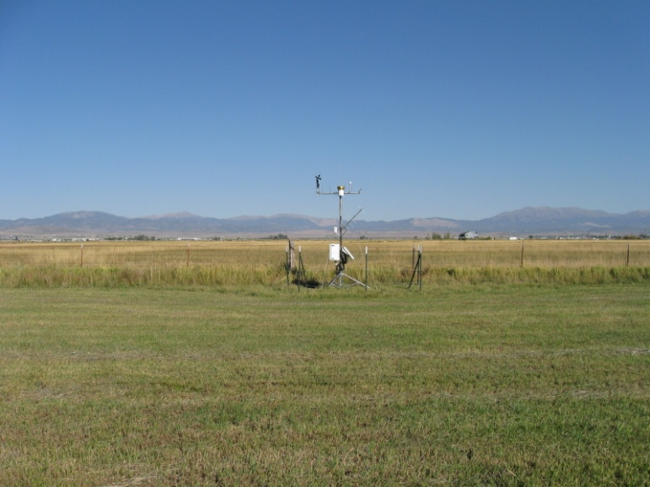
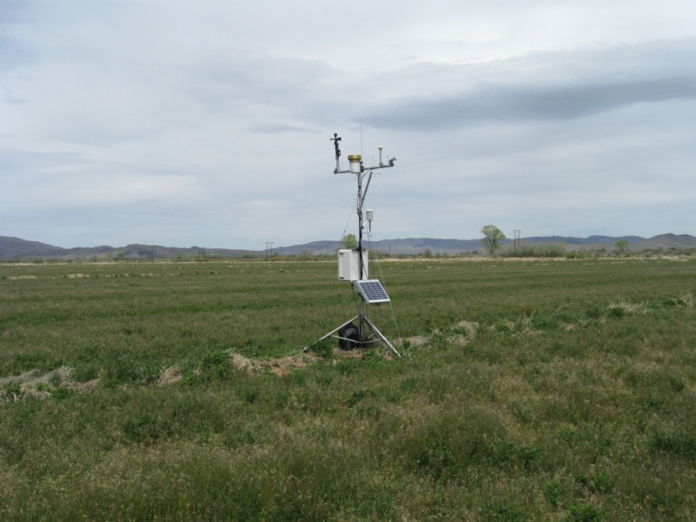
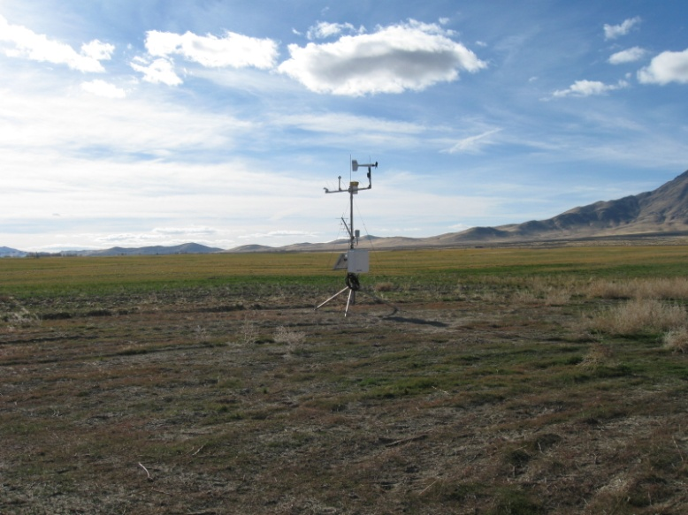
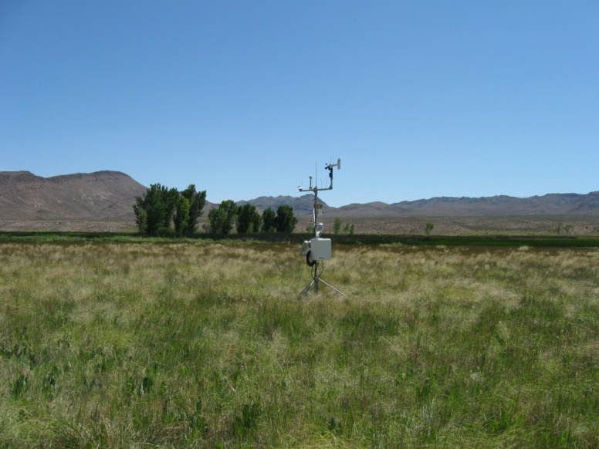
NICE Net stations
Carson Valley
Mason Valley
Paradise Valley
Pahranagat Valley

Slide 7
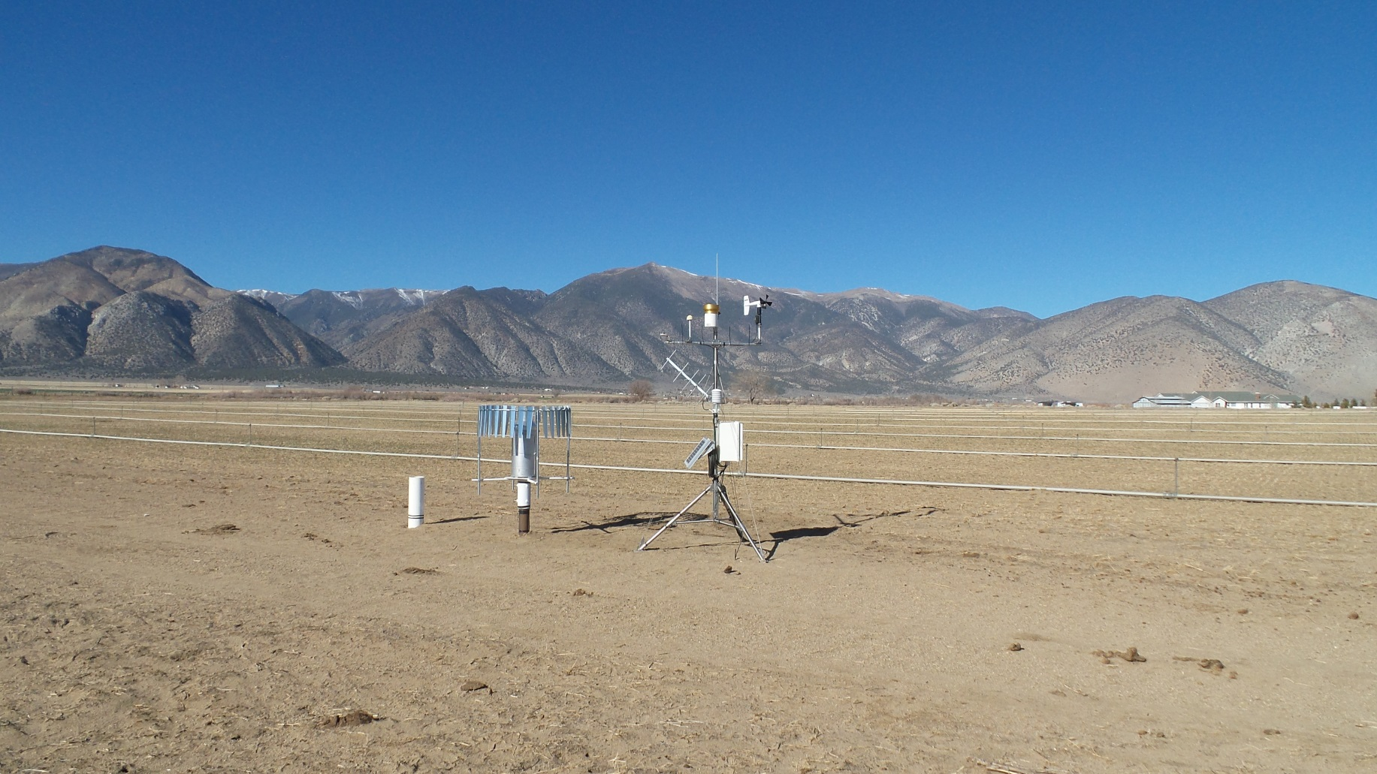
NICE Net stations
Precipitation measurements are just as important as ET_{o}!
Needed for net irrigation water requirements
All NICE Net stations now have tipping bucket and weighing type rain gauges
Weighing type gauges are essential for accurate measurement of frozen precipitation
Smith Valley, NV
February, 2015
Geonor weighing gauge
with Alter shield
Tipping bucket
Storage gauge to collect
precip isotopes

Slide 8
NICE Net stations
Sensor list:
CR 1000 data loggers
Campbell HMP45C temperature and humidity sensors
Campbell CS106 barometric pressure sensors
Apogee CS300 pyranometer
R.M. Young 05103 wind speed and direction sensors
Modified Universal precipitation gauge
Texas Electronics TE525 tipping bucket precipitation gauge
Thermocouple soil temperature sensors
Campbell CS650 soil moisture probes

Slide 9
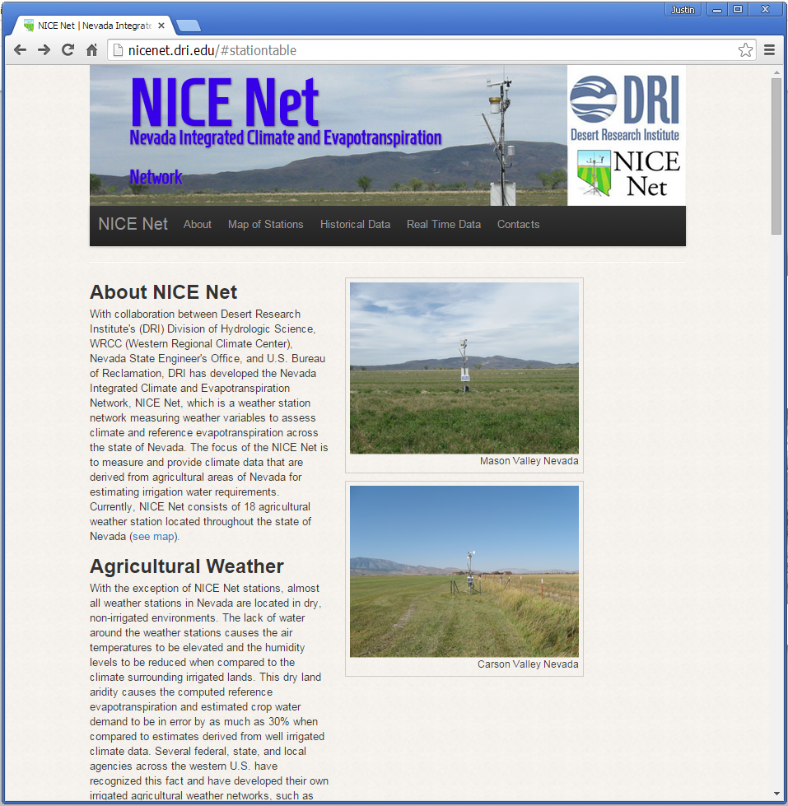
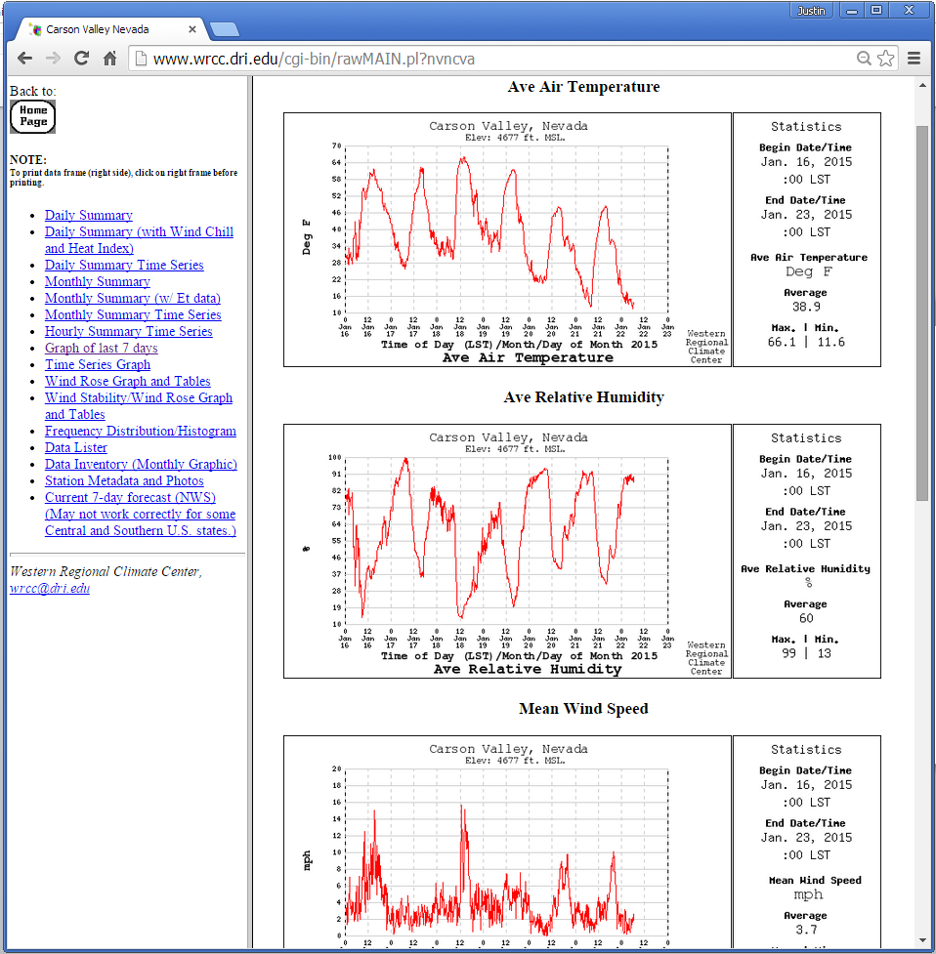
NICE Net webpage
Data available in the standard WRCC format
10-minute, hourly, daily, and monthly available
All Ref ET variables: temperature, wind, humidity, solar radiation, and pre-computed ASCE grass Ref ET
http://nicenet.dri.edu/

Slide 10
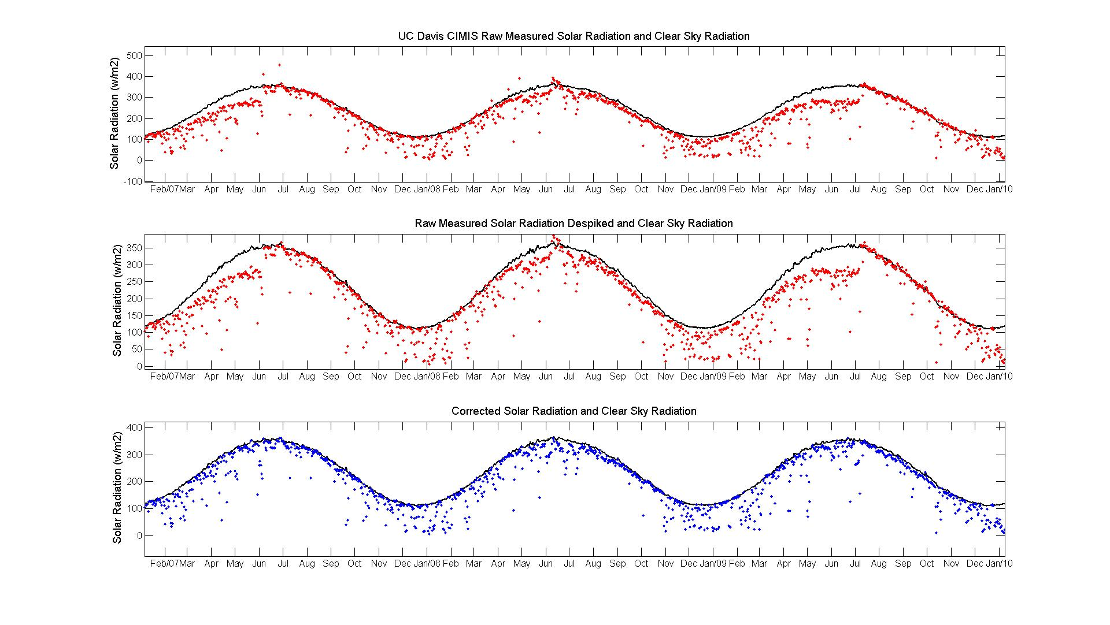
Weather Data QA/QC
QAQC of solar radiation, temperature, humidity, and windspeed is REQUIRED prior to comparing estimated ET_{o} to measured ET_{o}
Example of QAQC process of solar radiation
Based adjustments on ratios between theoretical clear sky solar radiation and top percentiles of measured data

Slide 11
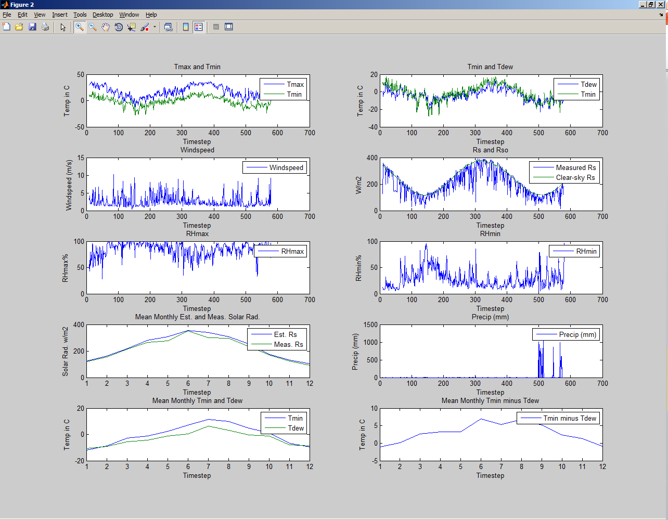
Weather Data QA/QC
Snake Valley NICE Net
Matlab QA/QC interface
Currently, only raw NICE
Net data available on web
Need to develop
automated process to put
QA/QC data back on web
Use ASCE RSO_{b} to
compute clear sky curve
Solar bias exists in most censors, and needs some adjustment before computing ET_{o}

Slide 12
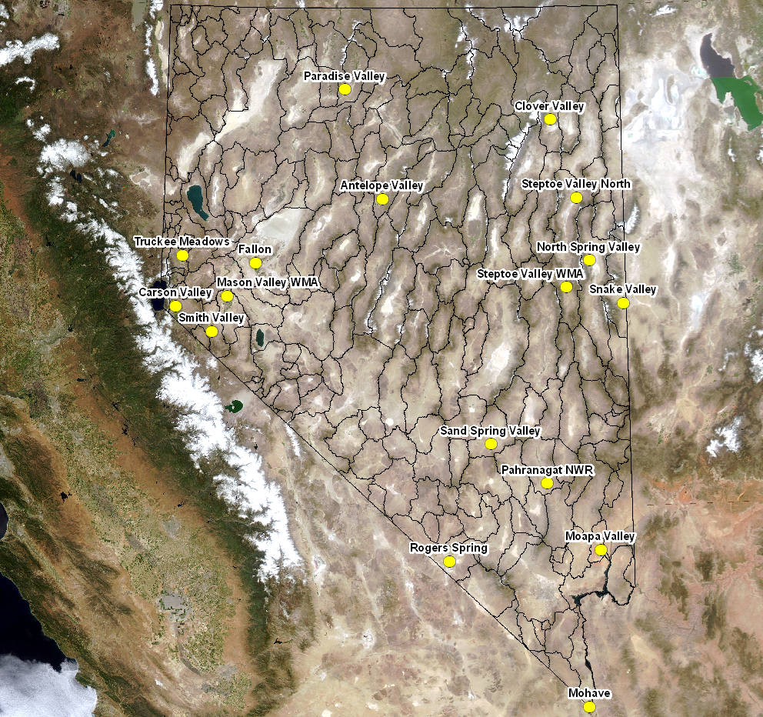
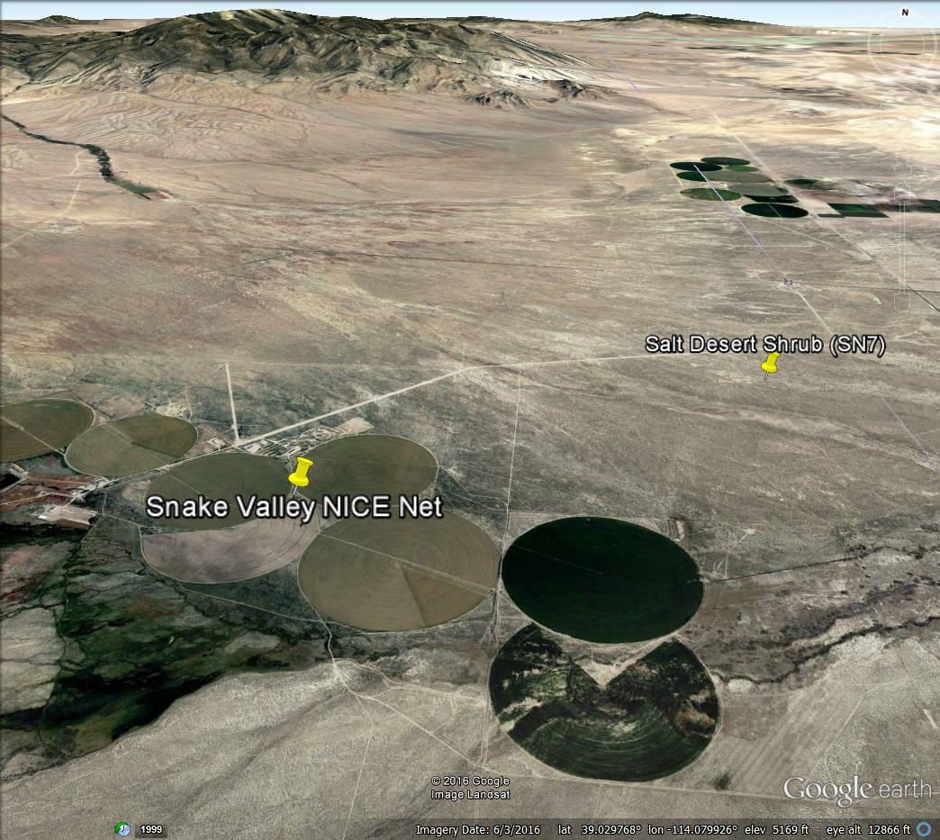
Arid bias is ET_{o} estimates, NICE Net case study
Snake Valley NICE Net
Salt Desert Shrub Nevada Climate-ecohydrological Assessment Network (NevCAN)
3.5 km apart
5 m elevation difference

Slide 13
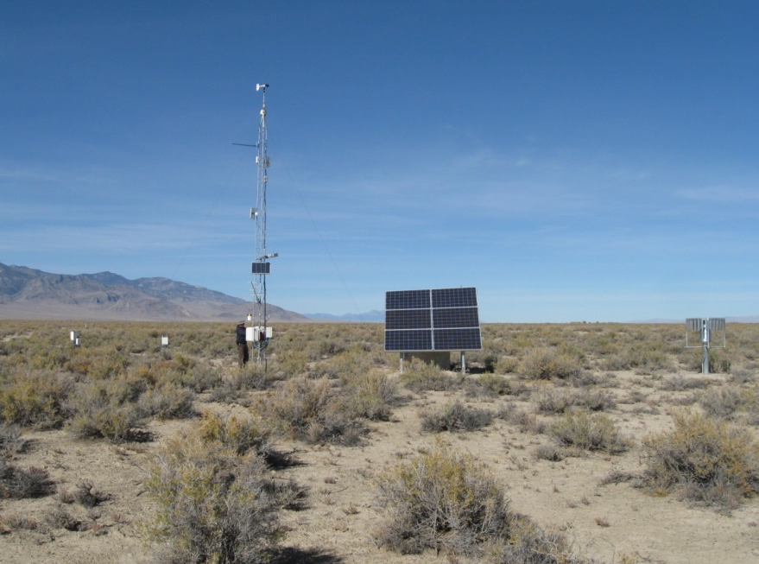

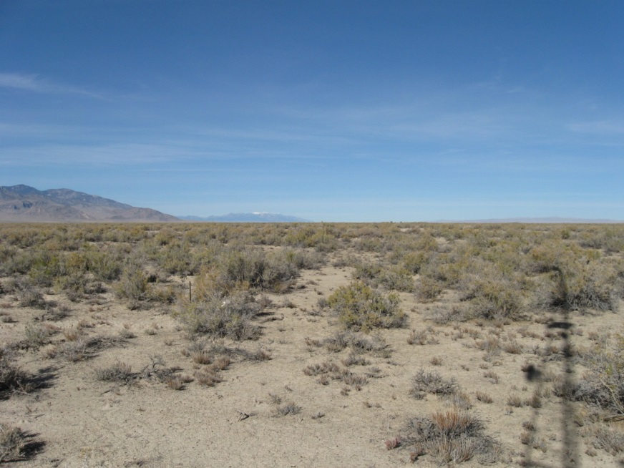
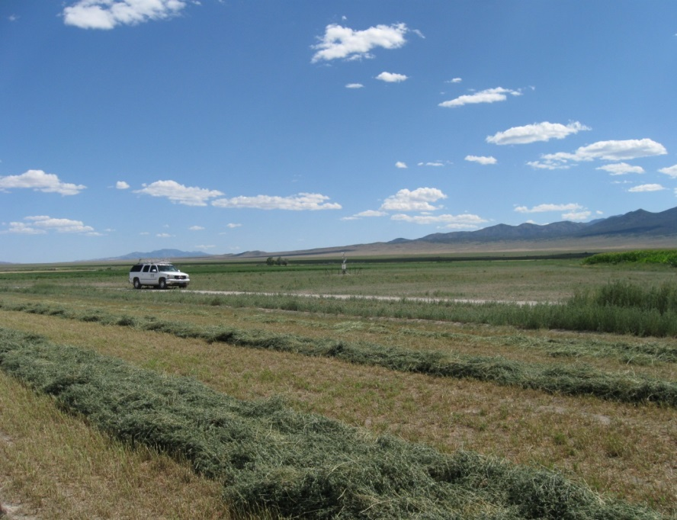
Arid bias is ET_{o} estimates, NICE Net case study
NevCAN
NICE Net
Area surrounding NevCAN
Area surrounding NICE Net

Slide 14
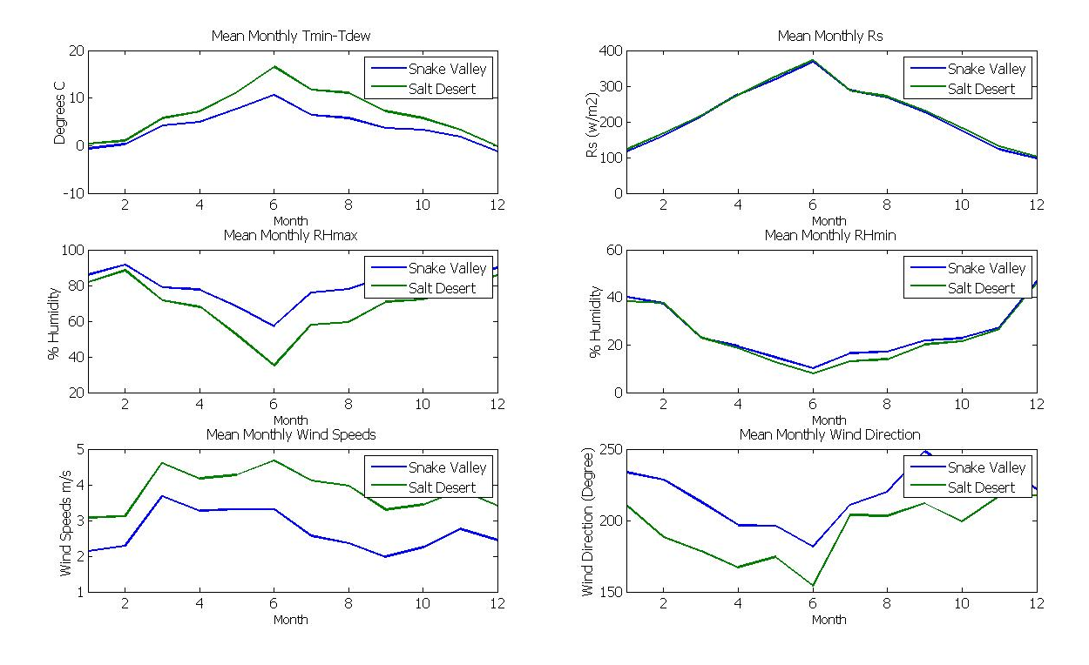
Arid bias is ET_{o} estimates, NICE Net case study
Arid site: larger dew point depression, lower humidity, higher temperatures, higher wind speed
[Dunkerly et al. 2014]

Slide 15
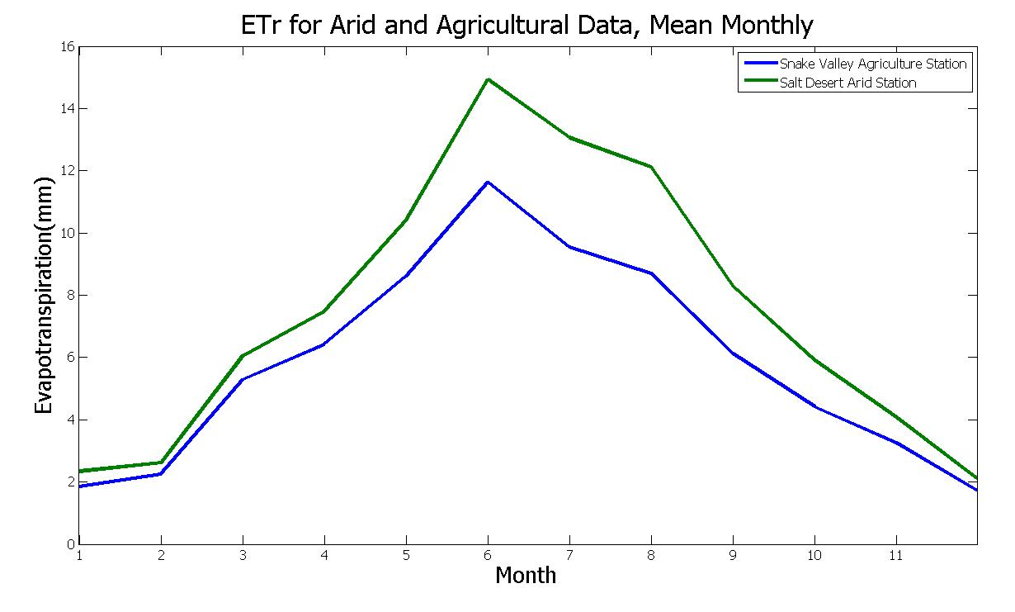
Arid bias is ET_{o} estimates, NICE Net case study
Annual average ET_{r} 31% higher at arid station!
These biases must be considered in spatial ET_{o}/ET_{r} estimates from gridded weather data and remote sensing
[Dunkerly et al. 2014]

Slide 16
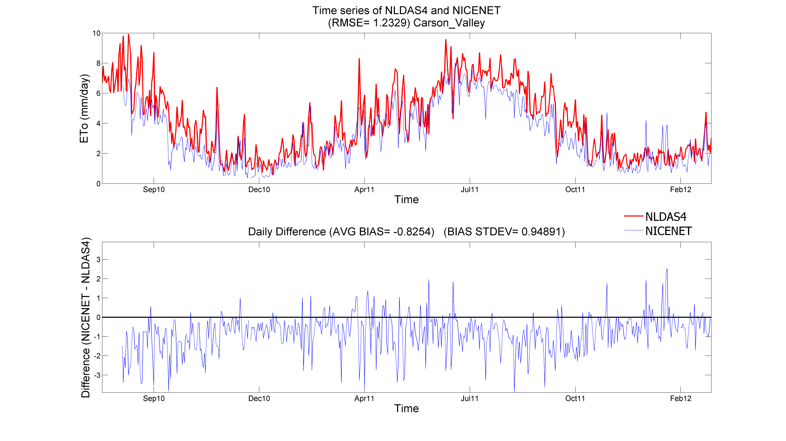
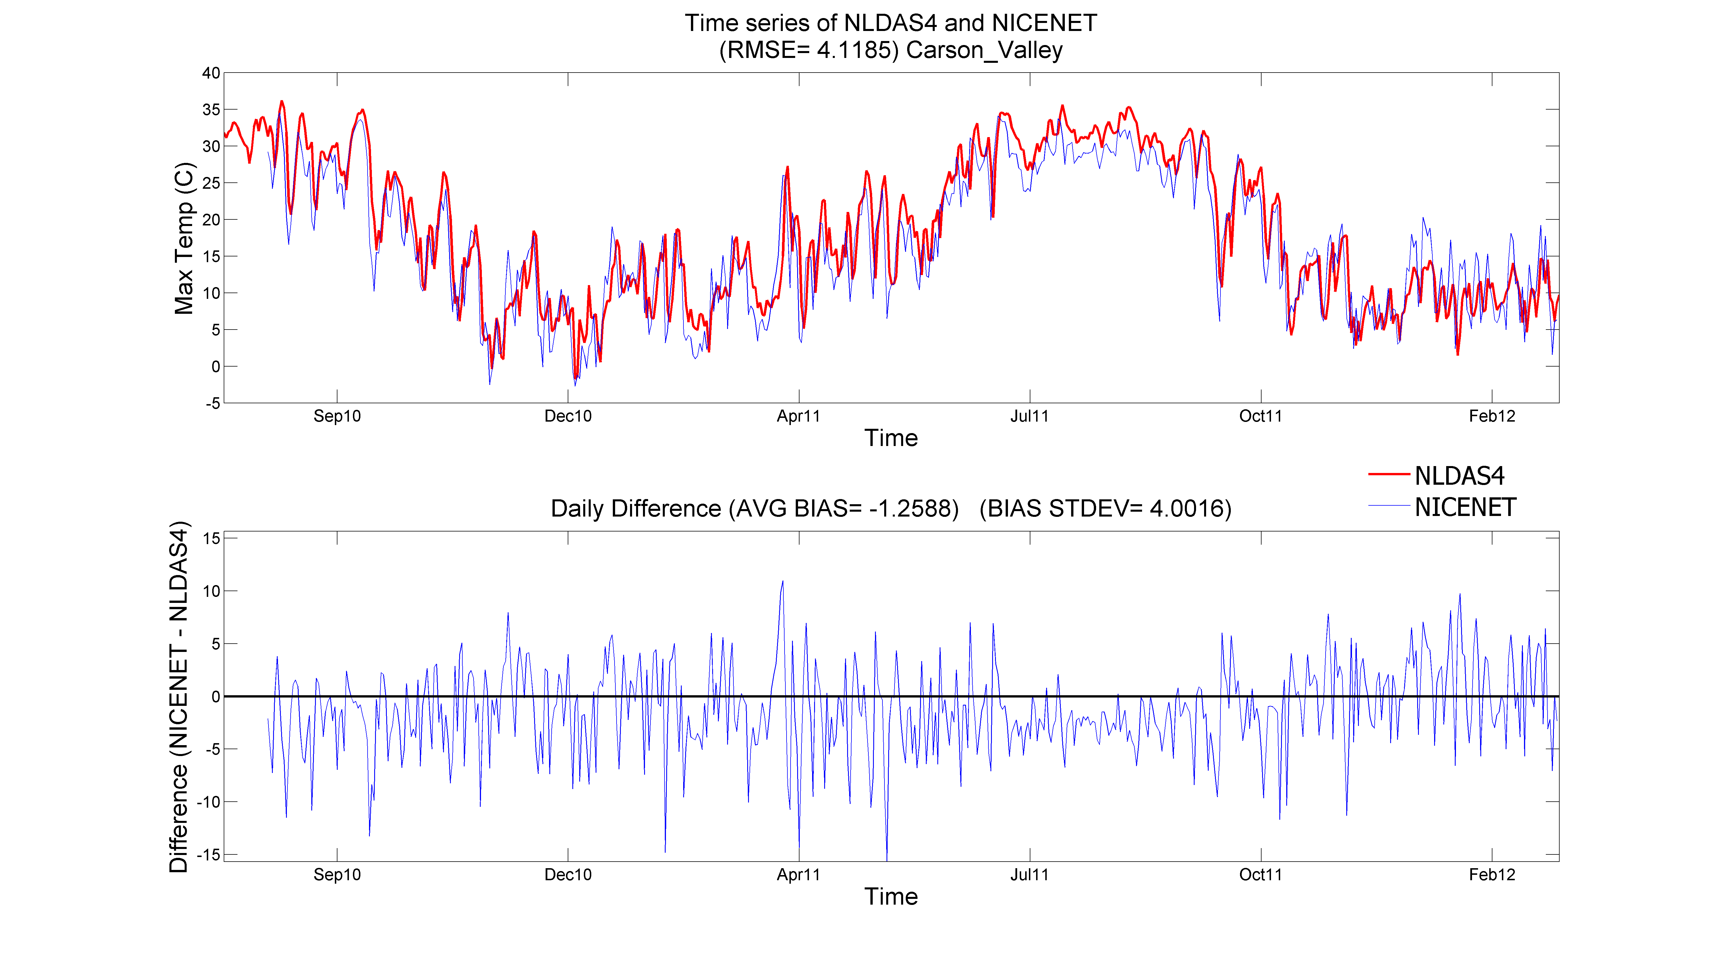
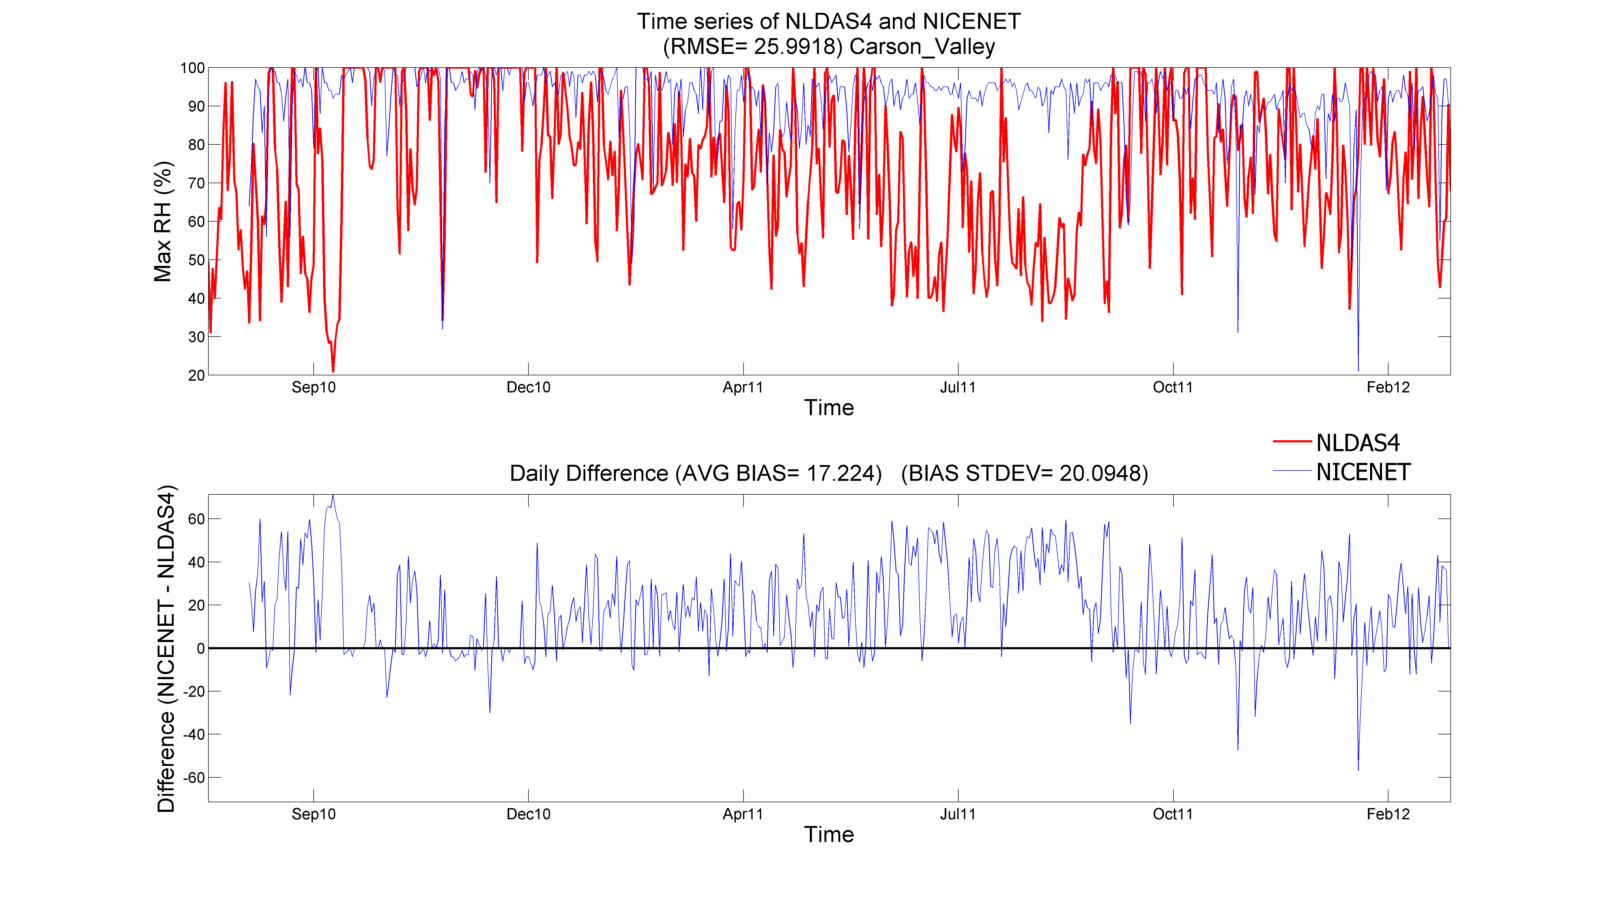
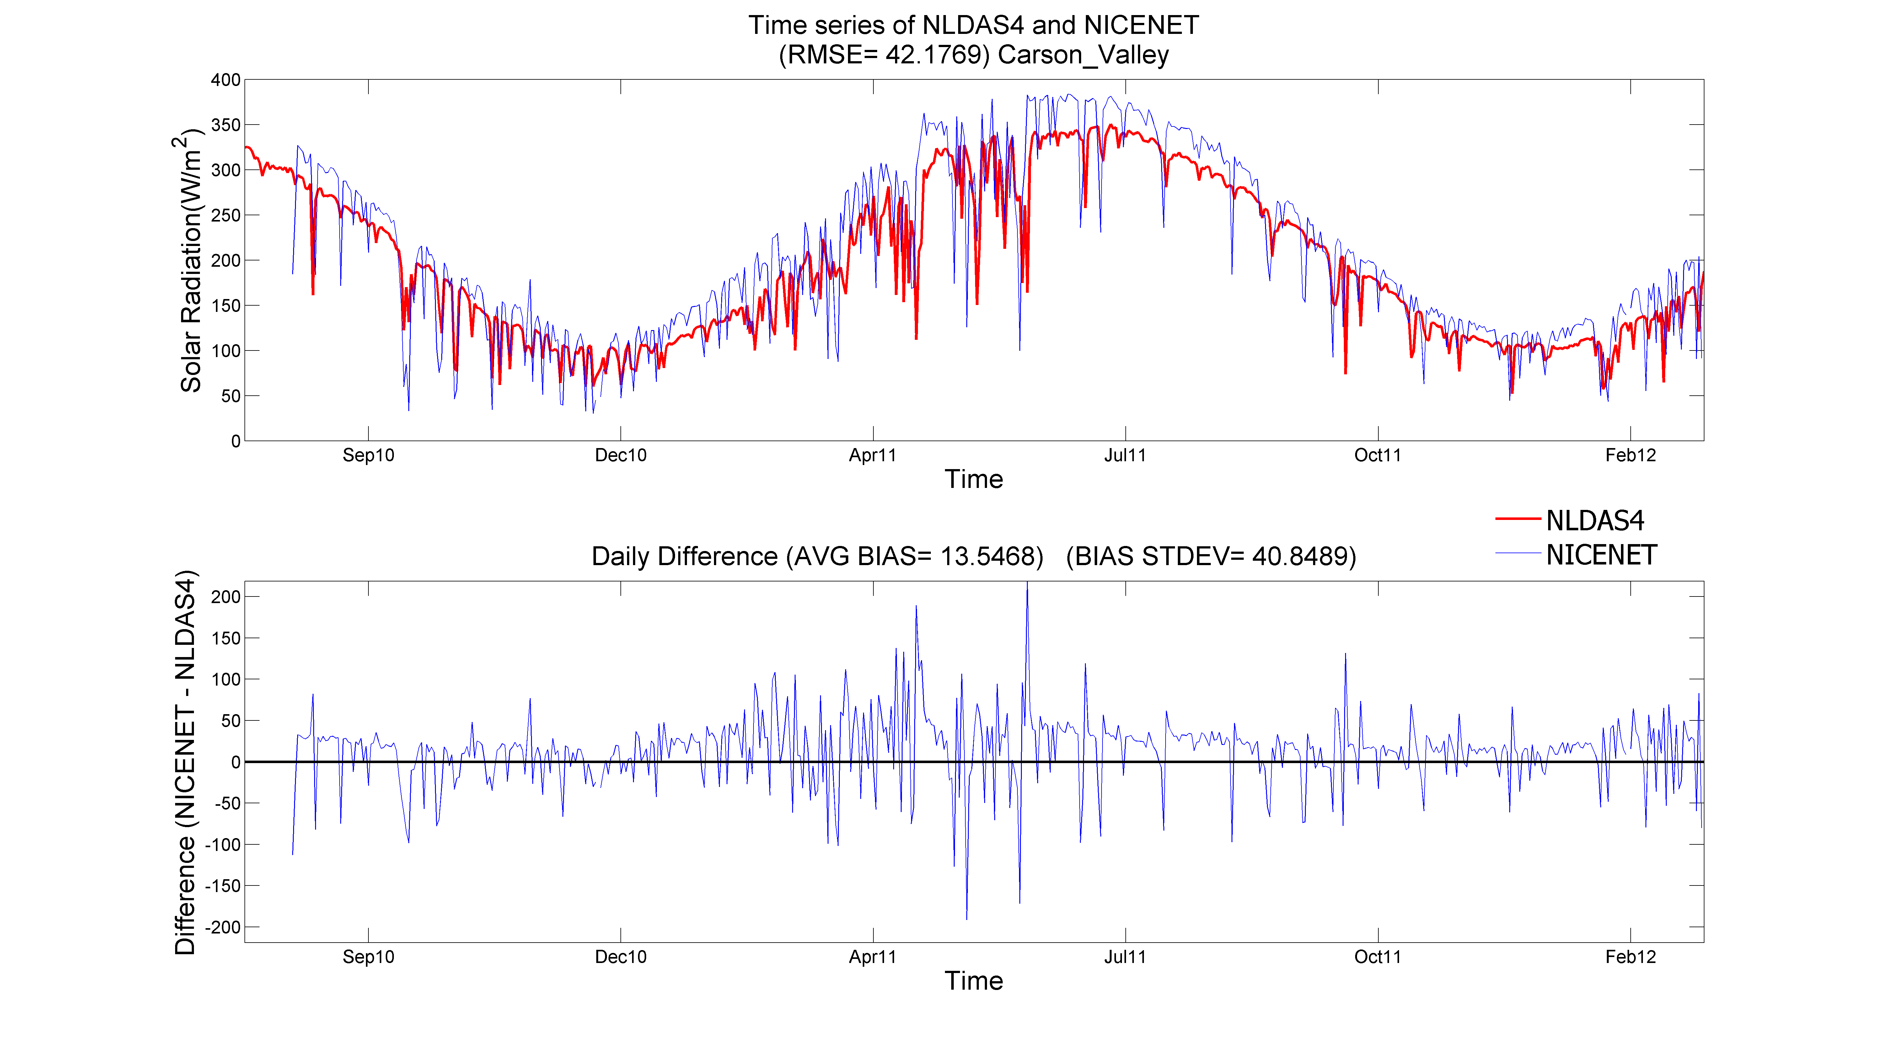
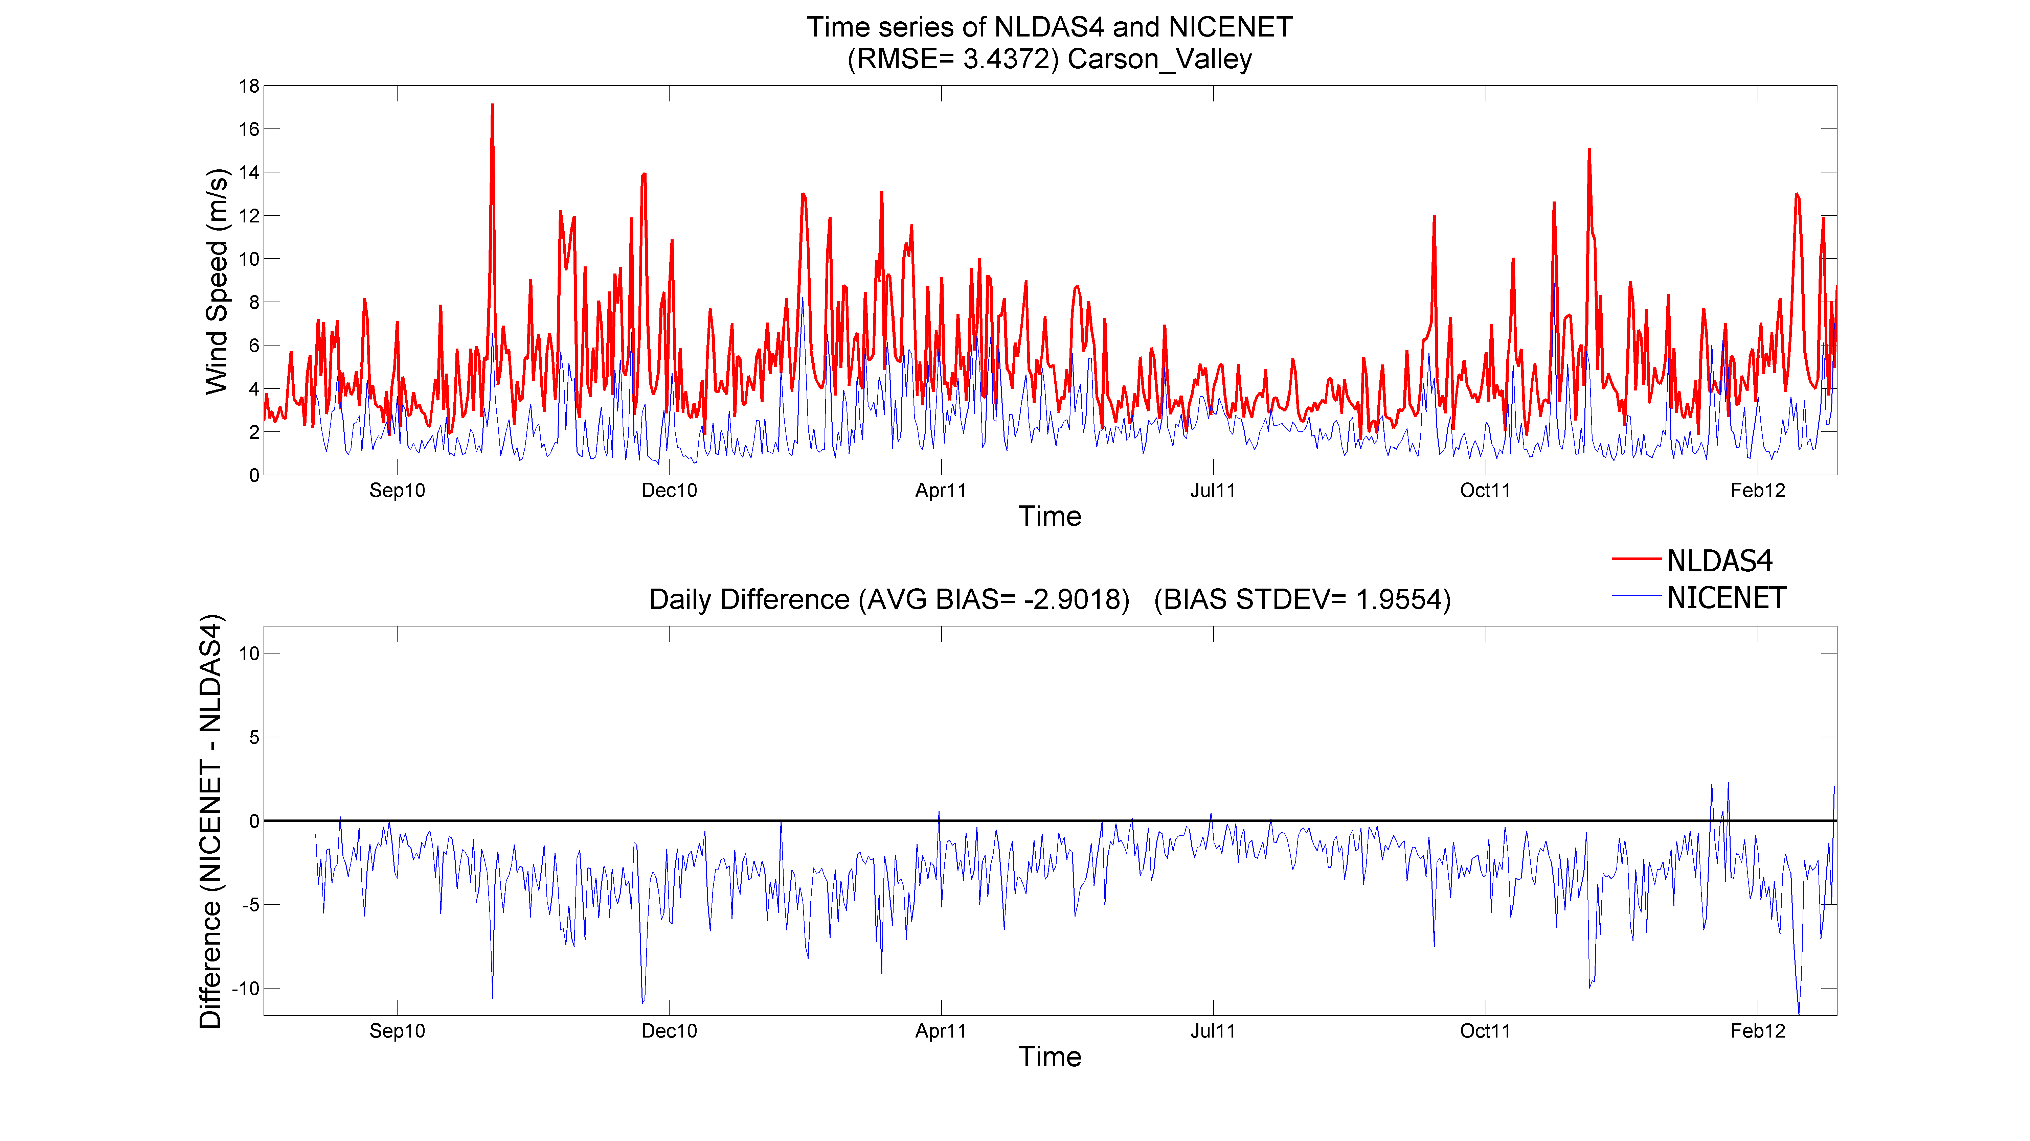
ET_{o} gridded weather data bias
Carson Valley NICE Net (blue line) and gridMET 4-km cell (red line)
Consistent high bias in gridMET
gridMET knows nothing about irrigation, similar to arid NevCAN station

Slide 17
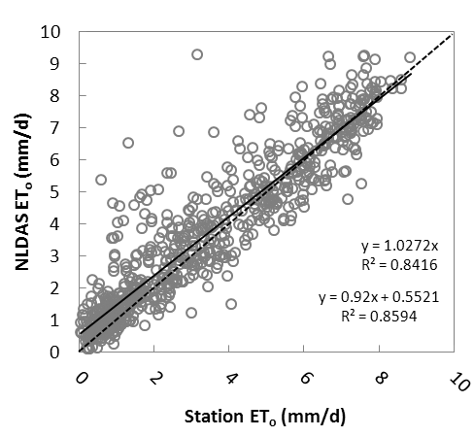
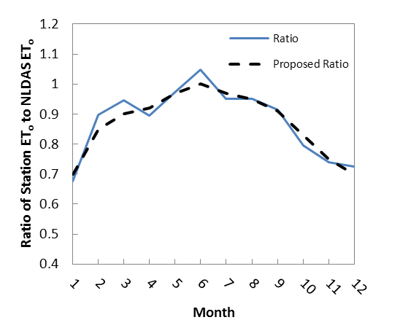
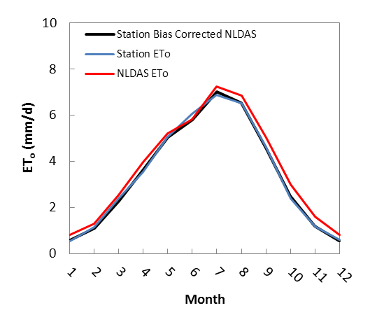
ET_{o} gridded weather data bias correction
[Huntington et al. 2014]
Boulder Valley weather station, northern NV
Make mean monthly ratios: observed/estimated
Adjust gridded data by month using ratios
Rick Allen and others working on boundary layer conditioning

Slide 18
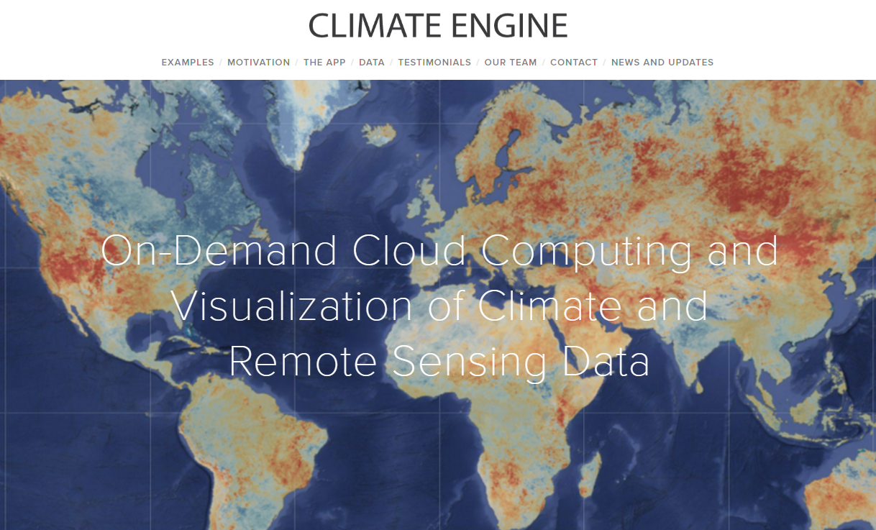


ET_{o} tools: Climate Engine

Slide 19
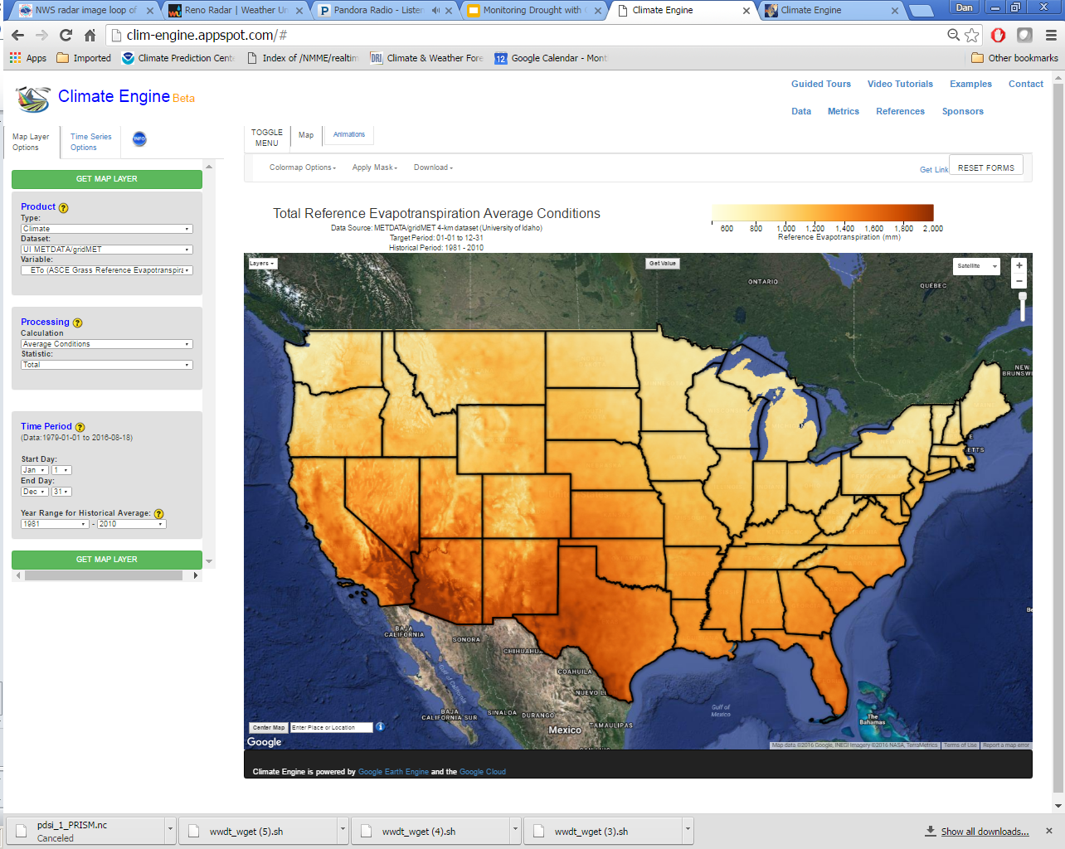
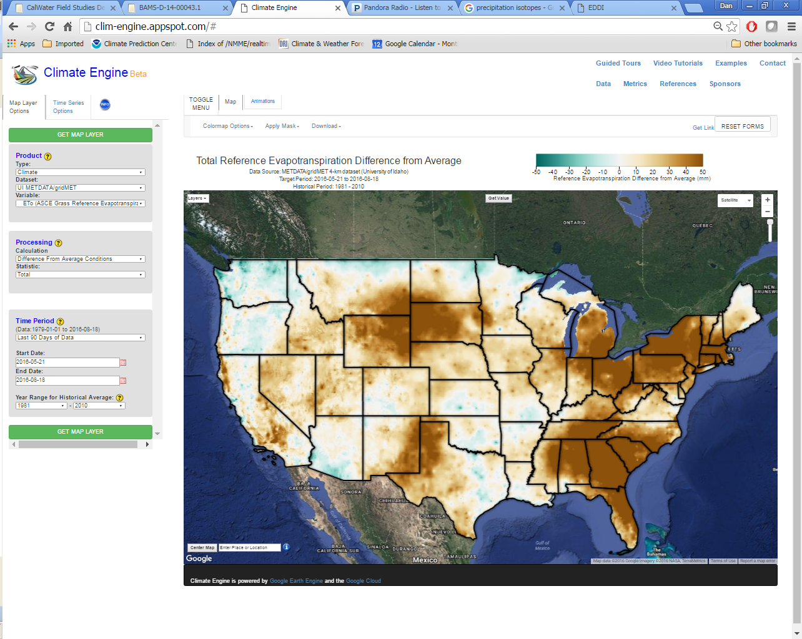
ET_{o} tools: Climate Engine
Climate Engine: easily accessible real-time gridded ET_{o} and ET products
Application: http://clim-engine.appspot.com/
Landing page: http://climateengine.org/
Average annual ET_{o}
gridMET
1981-2010 climatology
90-day ET_{o} anomaly
gridMET
5-21-2016 to 8-18-2016

Slide 20
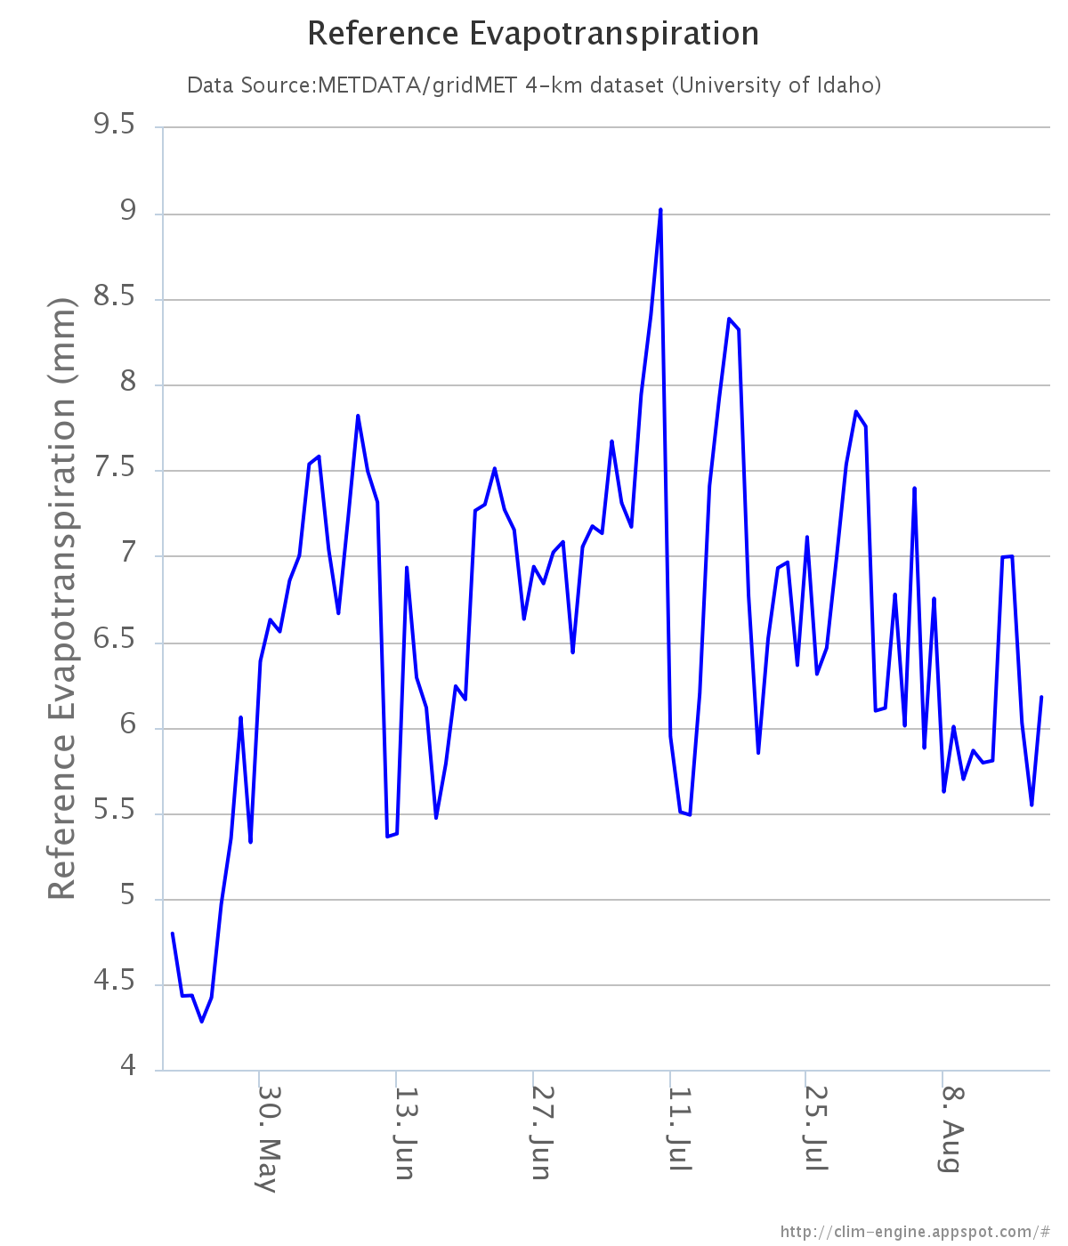
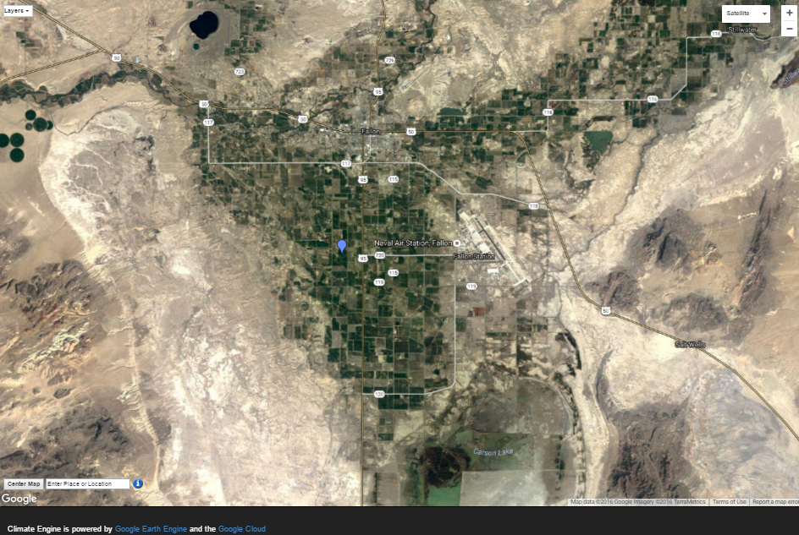
ET_{o} tools: Climate Engine
Near real-time ET_{o} timeseries near Fallon, NV
May 21 though August 18, 2016
Recall high ET_{o} biases, not representative of actual ag conditions!

Slide 21
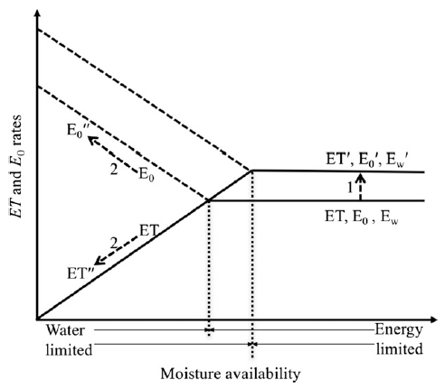
ET_{o} as a drought metric
Flash drought, moisture changes lag behind changes in meteorological drivers. Both ET_{o} and ET will increase
Sustained drought, ET declines and ET_{o} increases in response to an increasingly limited moisture supply
Figure 1 from Hobbins et al. 2016: Idealized parallel and complementary responses of ET and ET_{o} to varying moisture and energy conditions shown within the Budyko framework.
ET_{o} will increase under both drought types!

Slide 22
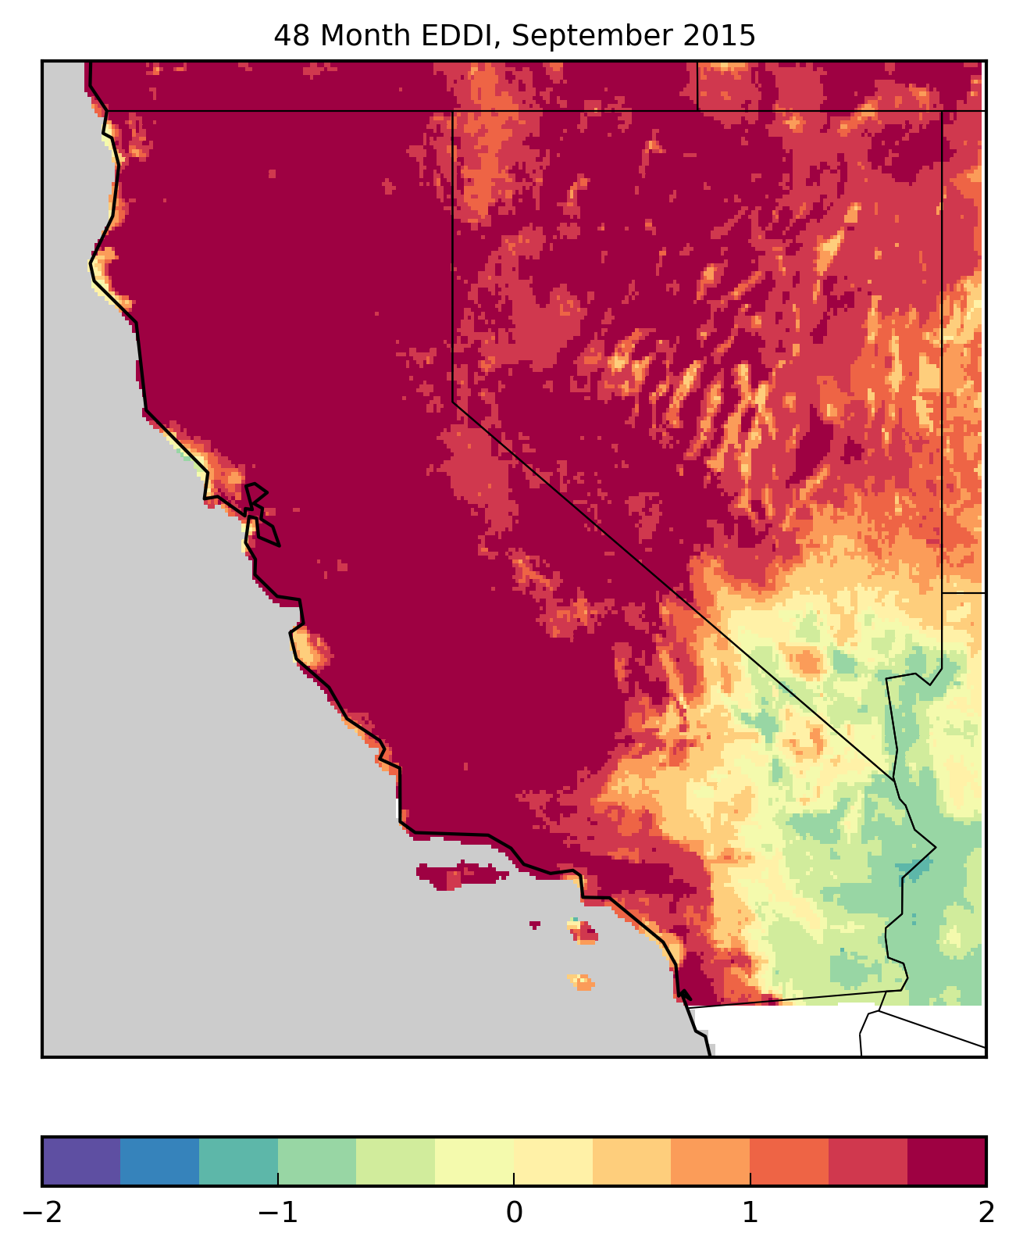
The Evaporative Demand Drought Index (EDDI)
Pair of papers in Journal of Hydrometeorology
Hobbins et al. 2016: EDDI theory and formulation
McEvoy et al. 2016: EDDI assessment against other drought indices
EDDI represents standardized anomalies in ET_{o}
Based on gridMET 4-km daily data, 1979-present
+ EDDI = drought or drought development likely
- EDDI = cool and moist conditions
48-month EDDI shows excessive accumulated ET_{o}
over the first 4 water years of CA drought

Slide 23
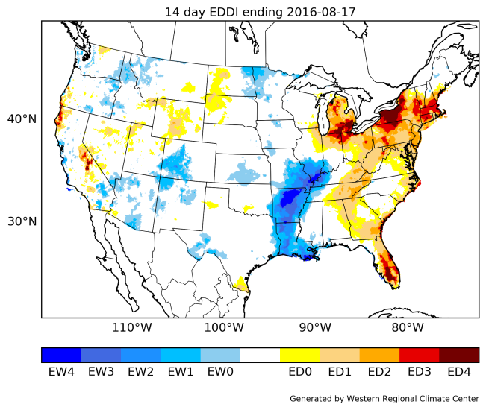
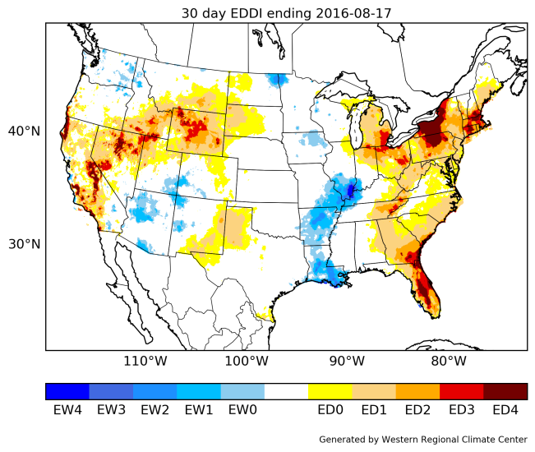
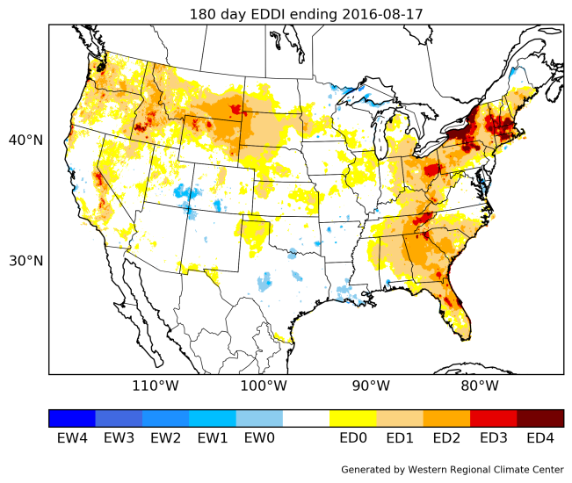
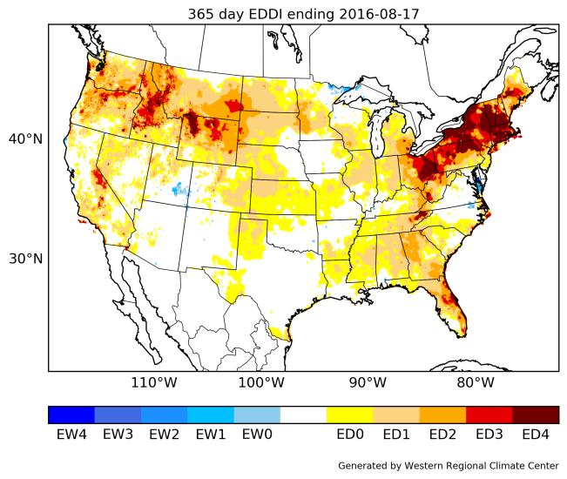
The Evaporative Demand Drought Index (EDDI)
Experimental EDDI maps:
https://mydrive.dri.edu/index.php/s/XgGuJ2CKJ3sa3L6 (4-km gridMET)
ftp://ftp.cdc.noaa.gov/pub/Public/mhobbins/EDDI/USDM/ (12-km NLDAS)
ftp://ftp.cdc.noaa.gov/pub/Public/mhobbins/EDDI/CN_DEWS/ (CA/NV region)
14-day EDDI
8-17-2016
30-day EDDI
8-17-2016
180-day EDDI
(6-month)
8-17-2016
365-day EDDI
(12-month)
8-17-2016

Slide 24
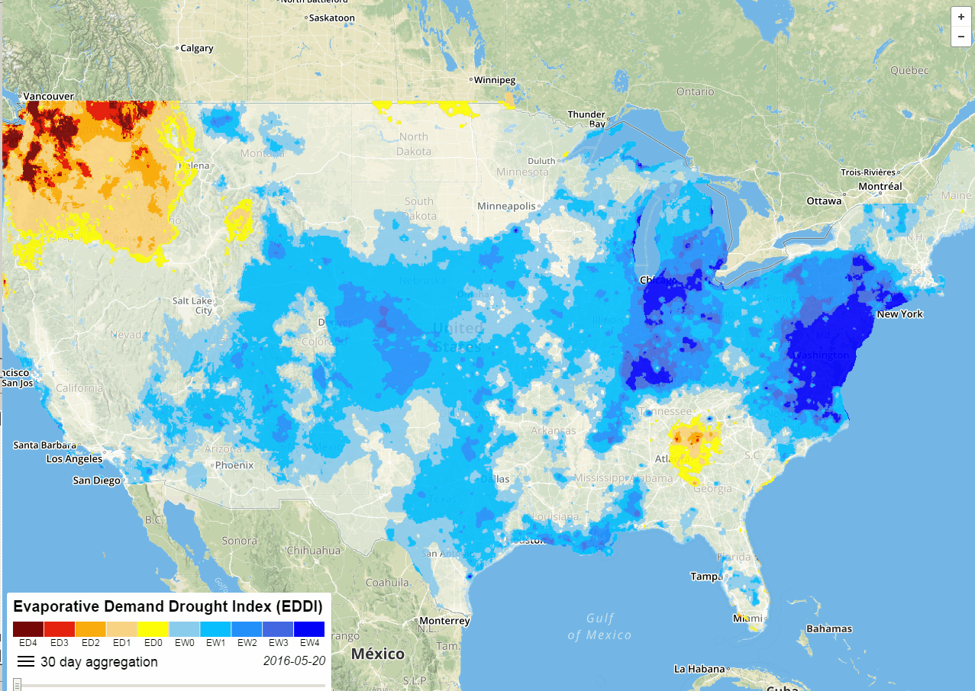
The Evaporative Demand Drought Index (EDDI)
EDDI animation slider tool: https://eddi-dri.appspot.com/

Slide 25
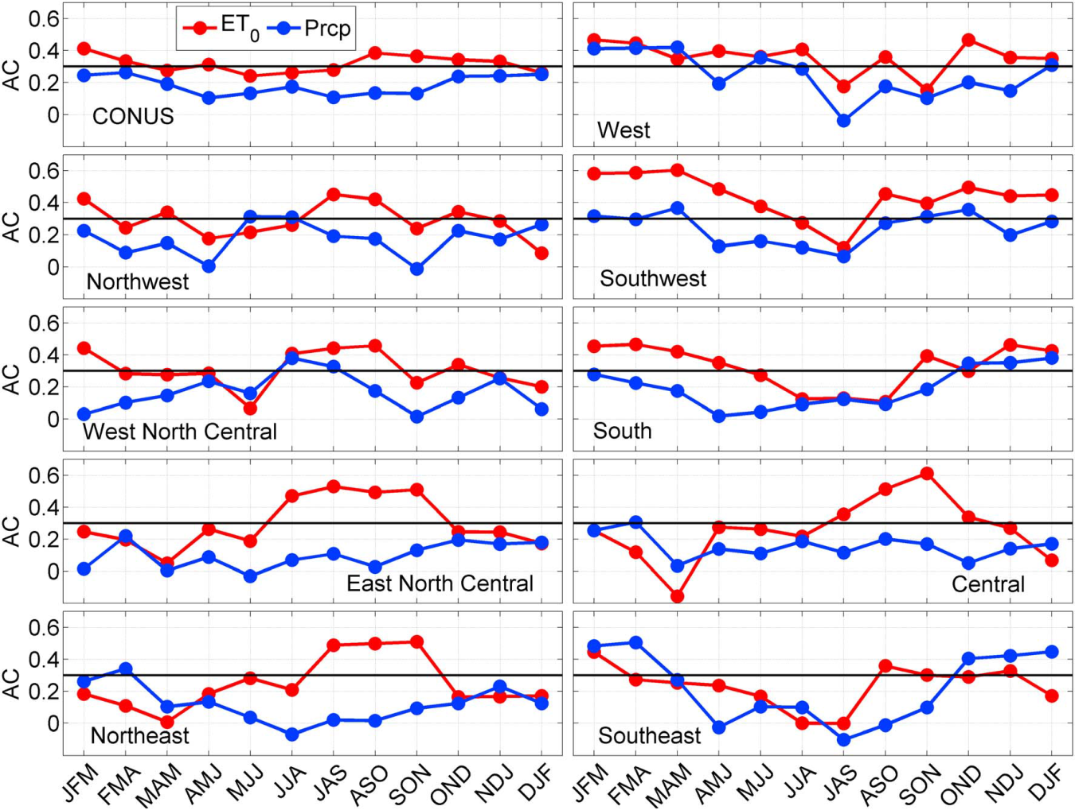
Seasonal drought forecasts using ET_{o}
McEvoy et al. 2016, GRL: Improved seasonal drought forecasts using reference evapotranspiration anomalies: http://www.dri.edu/images/stories/divisions/das/dasfaculty/McEvoy_et_al-2016-Geophysical_Research_Letters.pdf
Retrospective skill analysis using Climate Forecast System Version 2 (CFSv2) seasonal forecast model
ET_{o} forecast skill superior to precipitation during droughts
Major improvement in central and northeast US during growing season
Minor improvement in west (CA/NV)

Slide 26
Future directions
Continue to seek out funding opportunities to maintain NICE Net (funding ran out December 2015)! DRI and NV Division of Water Resources are seeking state funding/legislative approval for NICE Net
$2000-$3000 per station/per year (~$54K per year total)
Look forward to collaborating with Reclamation on ingesting NICE Net data for calculating well irrigated crop ET (ET_{o} * K_{c})
Integration of NICE Net into an irrigation scheduler (i.e., WA State University, Troy Peters)
Host raw and QA/QCed data on NICE Net
Develop a CONUS-wide benchmark dataset of ag stations with good, long-term records that measure ET_{o} variables to validate gridded ET_{o}
Further develop bias correction methodology for ET_{o} from gridded weather data
Operationalize EDDI, 3-year NOAA funded project that just began
Produce operational bias corrected and downscaled seasonal ET_{o} forecasts

Slide 27
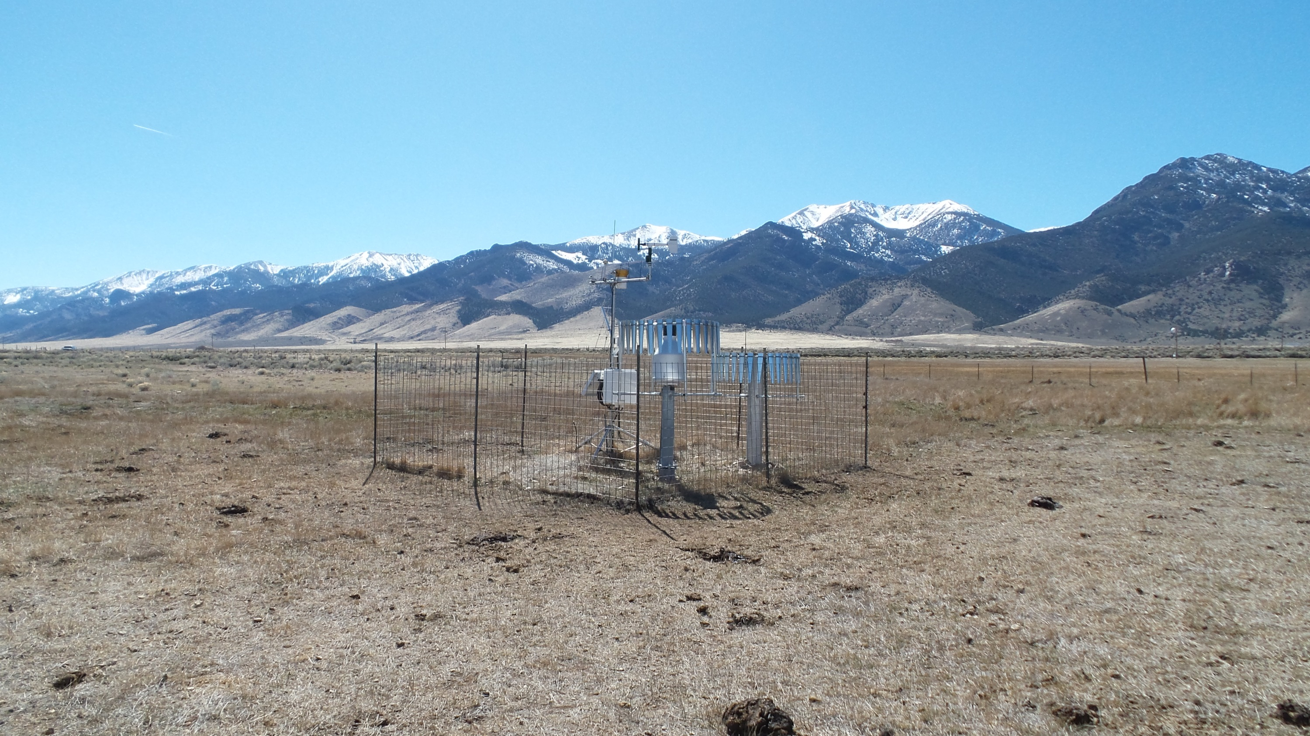
North Spring Valley NICE Net
March, 2015
Thank you!
Dan.McEvoy@dri.edu
Justin.Huntington@dri.edu

