Slide 1

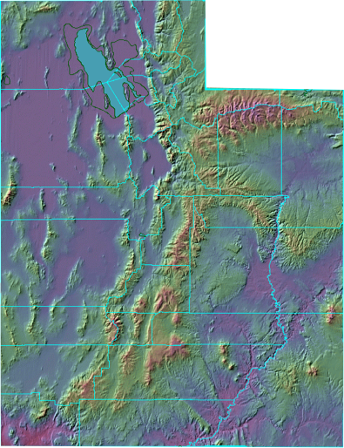

Pawel Szafruga
Research Technician
WSWC IMIS workshop
August 25-26, 2016

Slide 2

Personnel
Budget
director/state climatologist
State allocation ~ $400,000
Supplements:
research grants
returned overhead
contracted services
USU Extension
BOR
academic researchers
staff meteorologist
physicist/education specialist
statistician
Expenditures:
technicians
60% salaries
30% contracted IT services
10% maintenance
contracted IT services

Slide 3
Service
Research
climate data
climate extremes, variability, trends
drought
instrumentation networks
dynamics & ENSO
forecasts & projections
severe weather
outreach & education
tropical cyclones

Slide 4
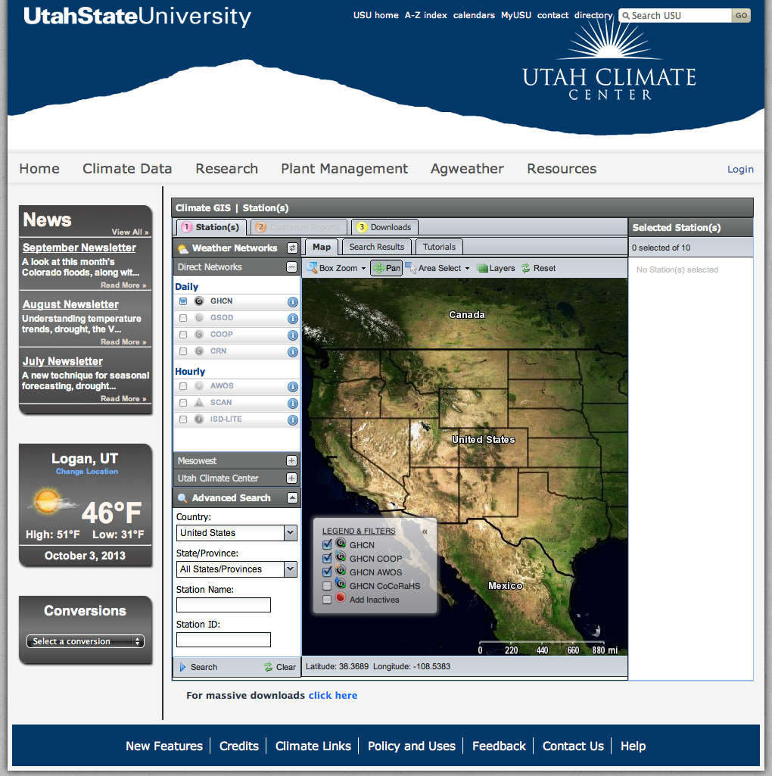
climate.usu.edu
Service
Access:
Data from our stations
Over 160,000 other
stations!
Inversion forecasts
Pest management
Other resources
data networks
instrumentation networks
forecasts & projections
outreach & education

Slide 5
Automated data collection and processing scheme
climate.usu.edu
Remote communication
RF/Cell
telemetry
Data logging
CR1000 loggers
and peripherals
Service
Data harvest – at 5 - 15 minute intervals
Current condition, hourly and daily
tables collected via CSI Loggernet
data networks
Loggernet’s Split program & Perl script
Recode bad data and append
current condition master file
instrumentation networks
Data editing
forecasts & projections
Assign treatment variables
Apply computational functions
Transposing
Plotting
Web posting
Error checking
SAS integrated system software
outreach & education
Ingest into SQL database
Numeric
flag missing values
identify outliers
flag suspect data
Email notification of suspect data
Graphical check plots
plot each sensor
- for the year
- for the past week
Web data presentation & products

Slide 6
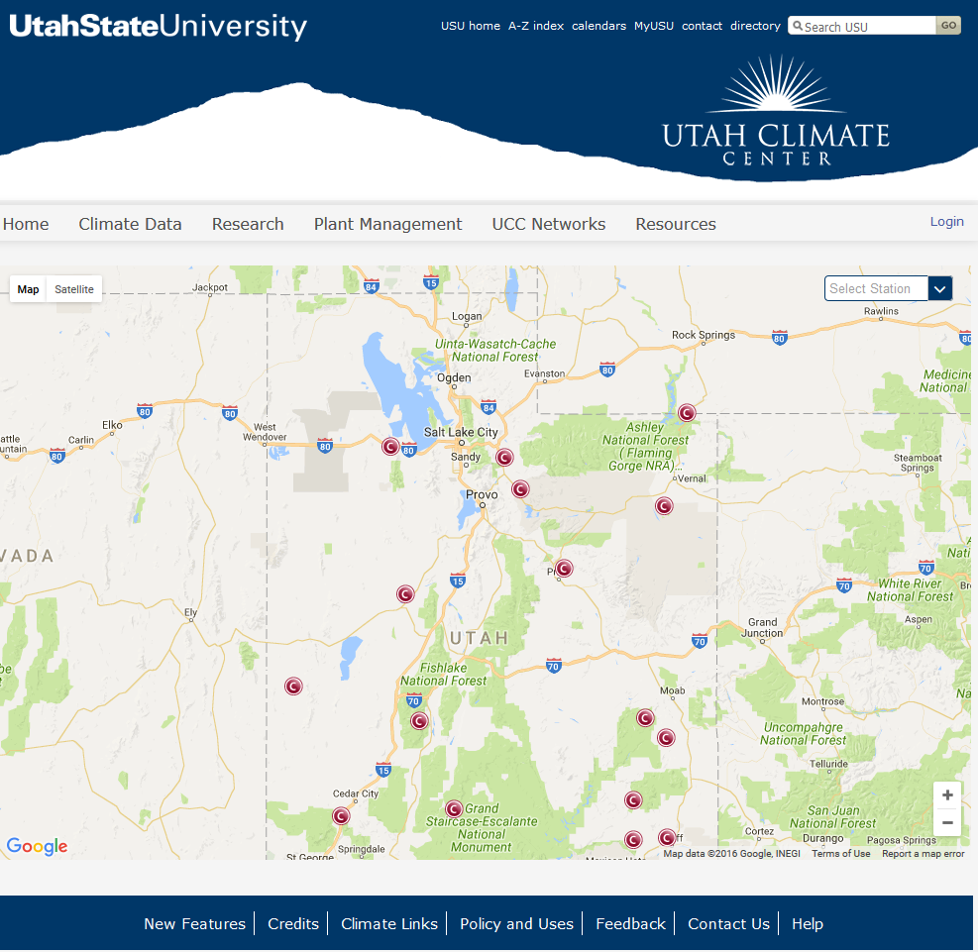
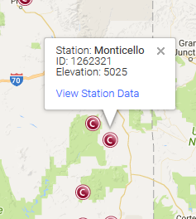
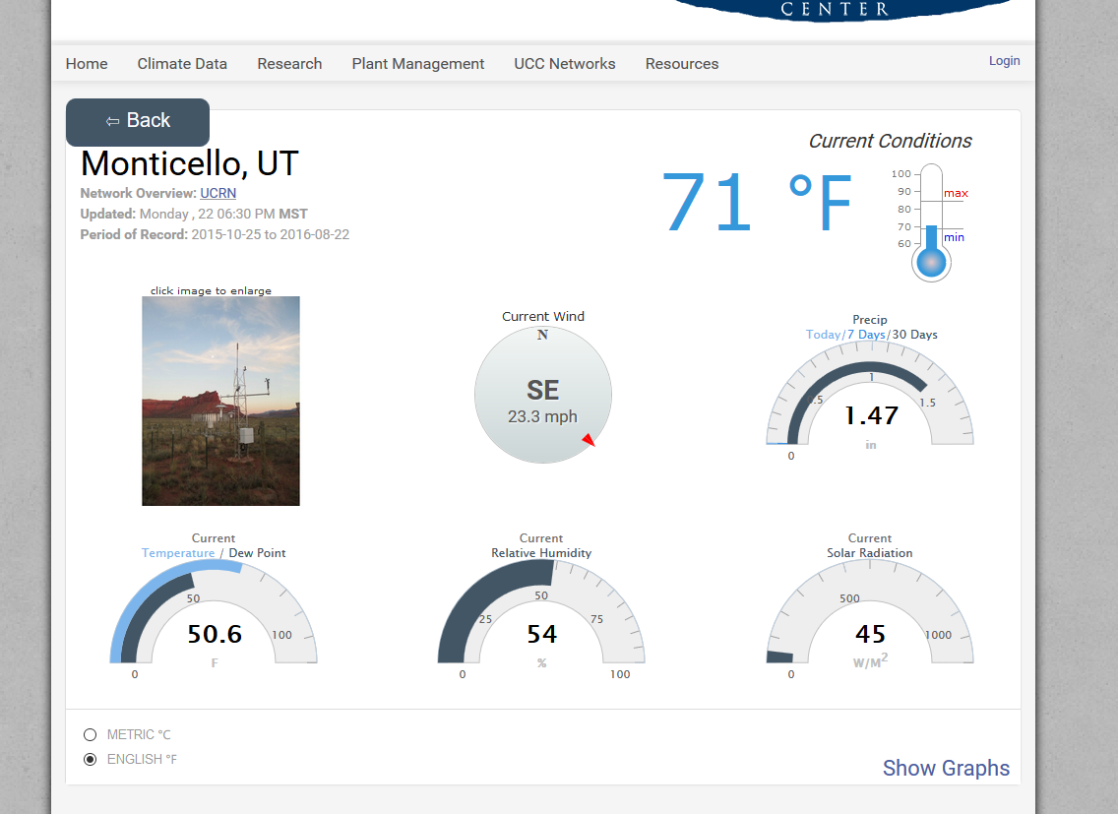
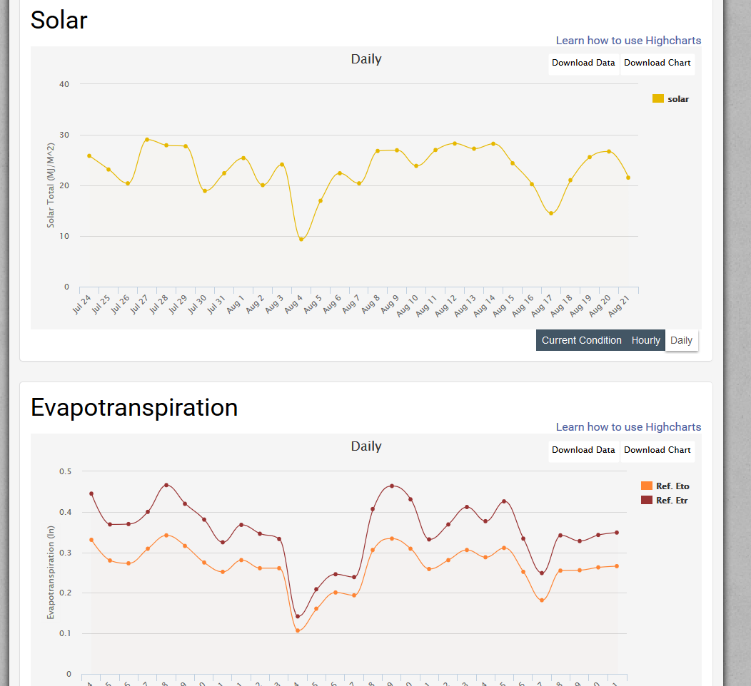
Web interface (UCC networks)
climate.usu.edu
Service
data networks
instrumentation networks
forecasts & projections
outreach & education

Slide 7
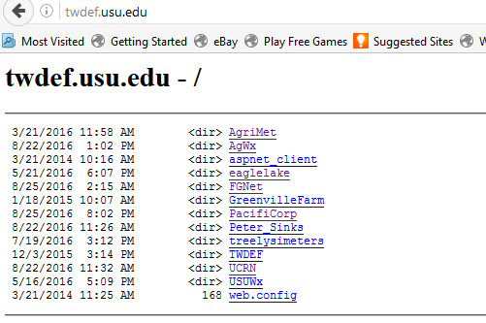
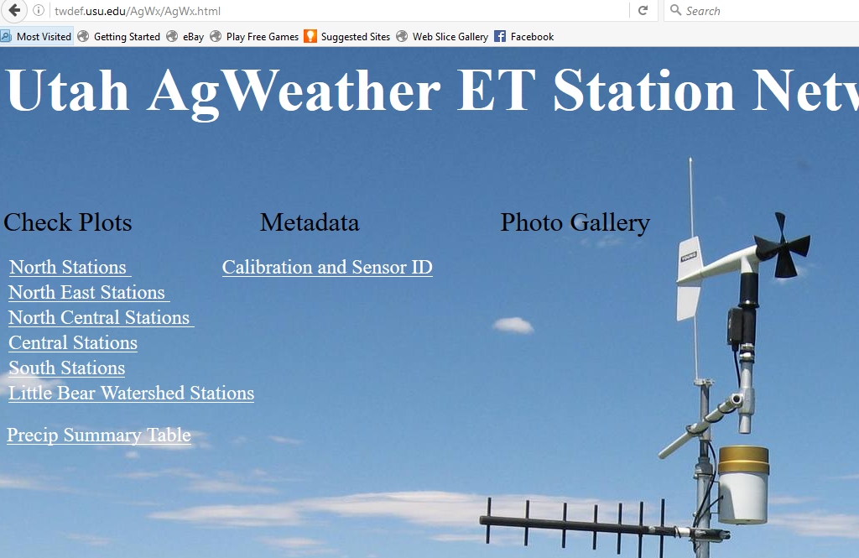
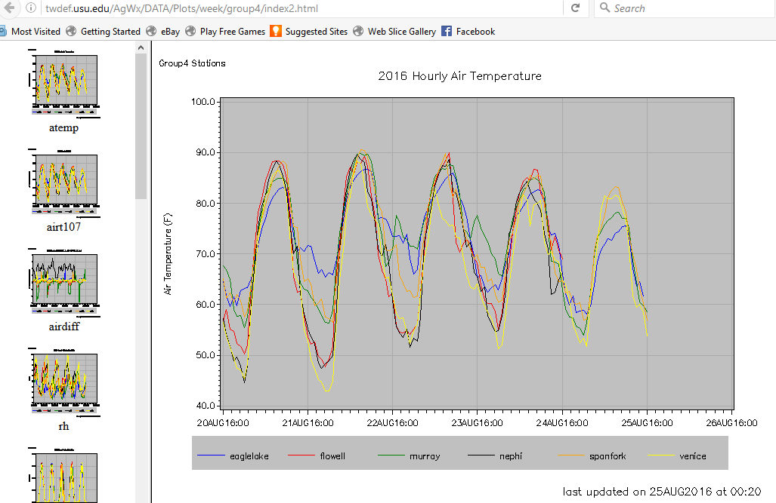
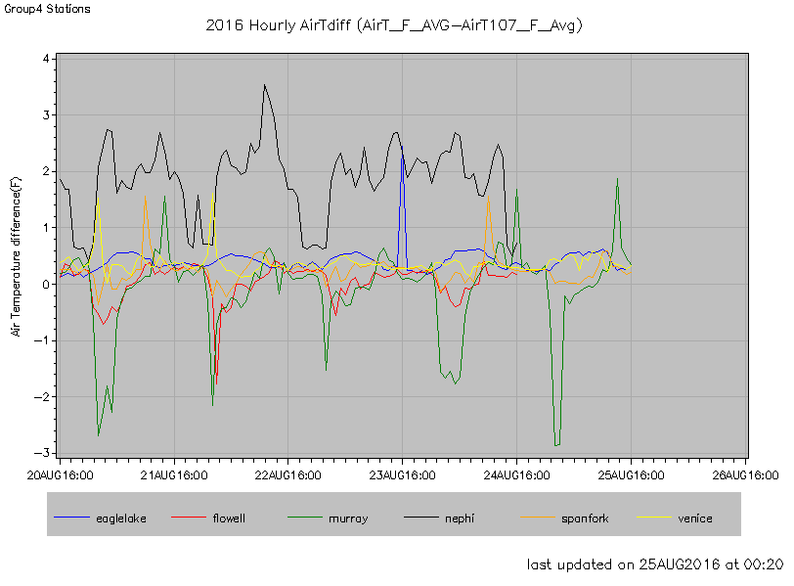
Web interface (QA/QC)
climate.usu.edu
Service
data networks
instrumentation networks
forecasts & projections
outreach & education

Slide 8
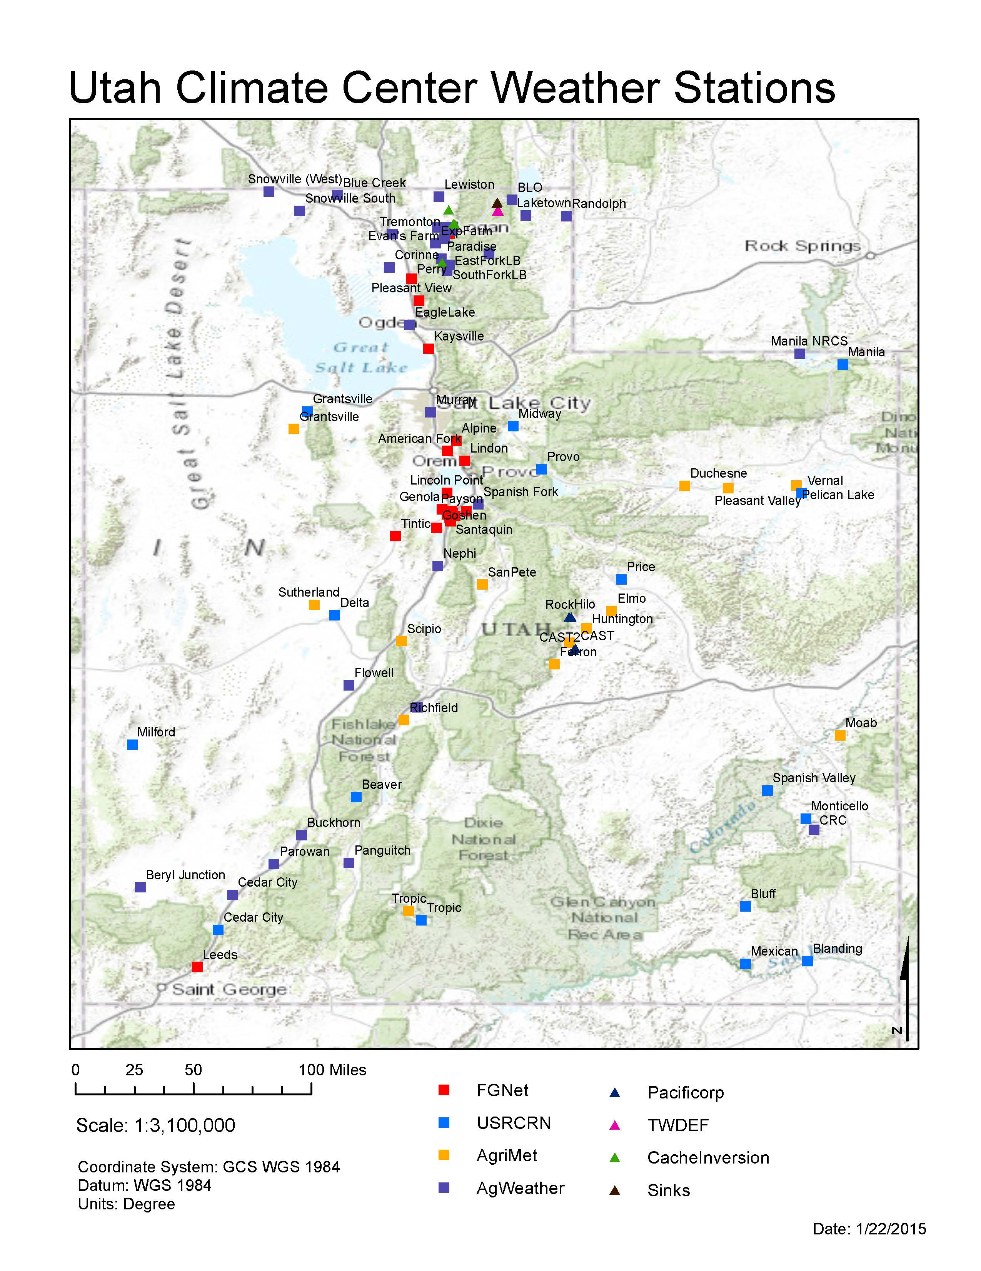
128 stations
5 networks
Service
FGNet 24
data networks
AgWx 35
instrumentation networks
AgriMet 20
forecasts & projections
UCRN 16
outreach & education
Research 33

Slide 9
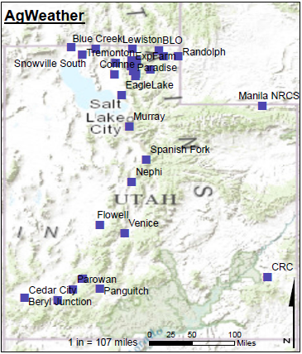
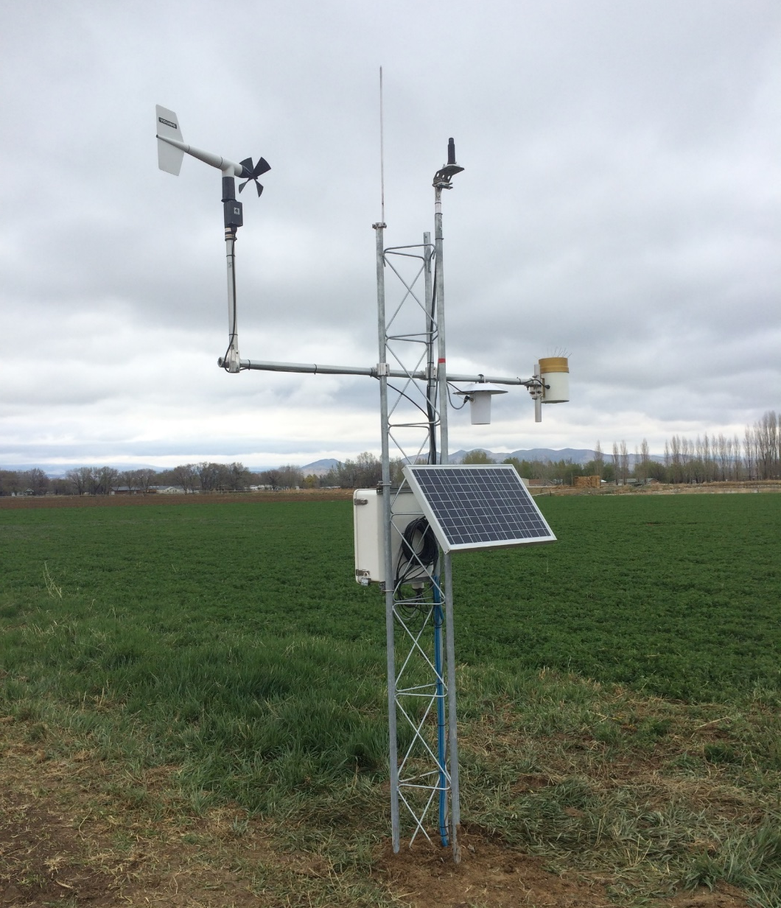
AgWeather Network
Service
data networks
instrumentation networks
forecasts & projections
outreach & education
35 stations
ETo from Campbell Scientific ETsz utility
Stations in agricultural areas

Slide 10
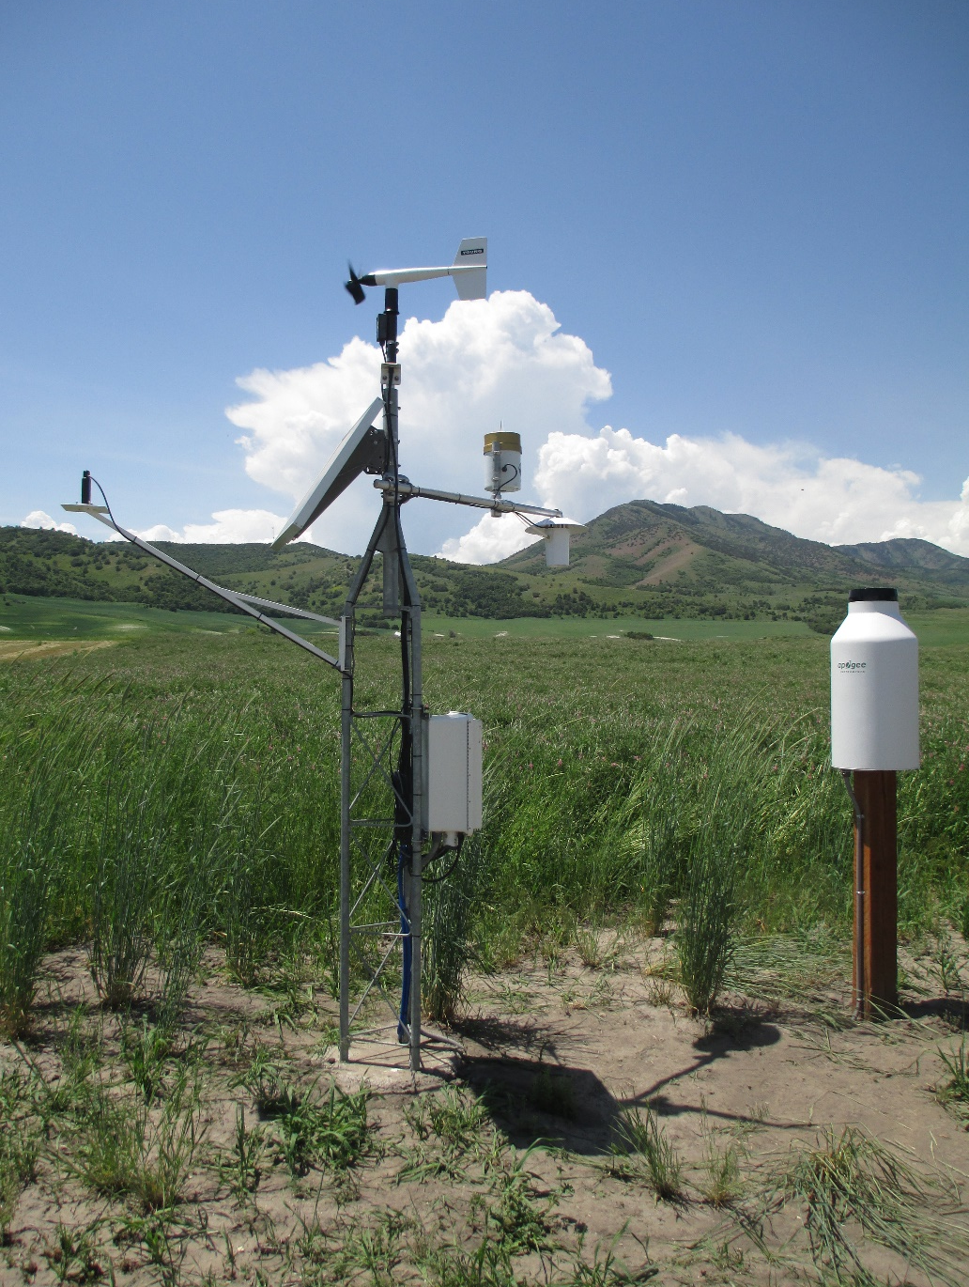
AgWeather Network
Measurements:
Air temperature (2)
Relative humidity
Wind speed, direction
Solar radiation
Soil temperature (4”, 8”)
Soil moisture (8”)
Precipitation detector
Precipitation
  -Tipping bucket (all)
  -Weighing (25)
Service
data networks
instrumentation networks
forecasts & projections
outreach & education

Slide 11
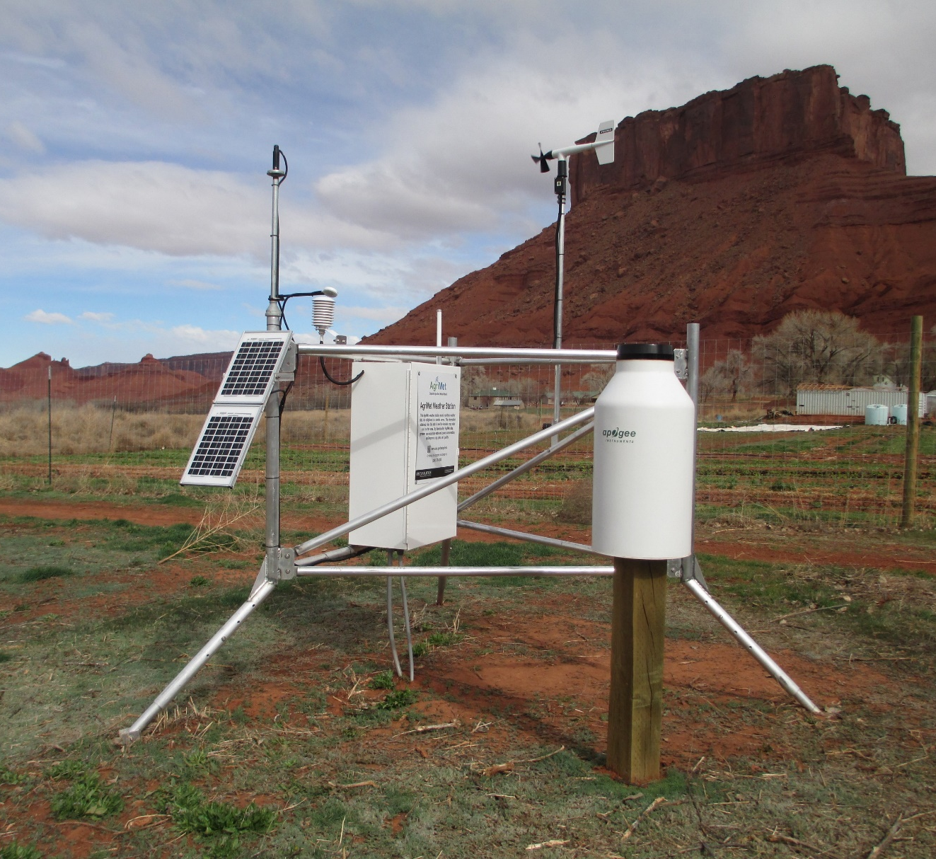
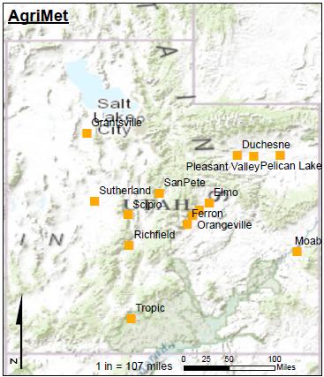
AgriMet Network
Service
data networks
instrumentation networks
forecasts & projections
outreach & education
20 stations (BOR jointly maintained)
ETo from Campbell Scientific ETsz utility
Assumptions of PM well met

Slide 12
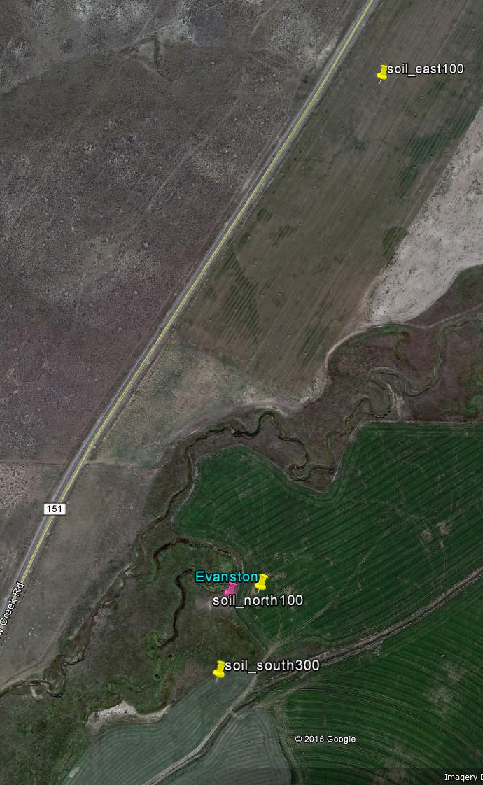
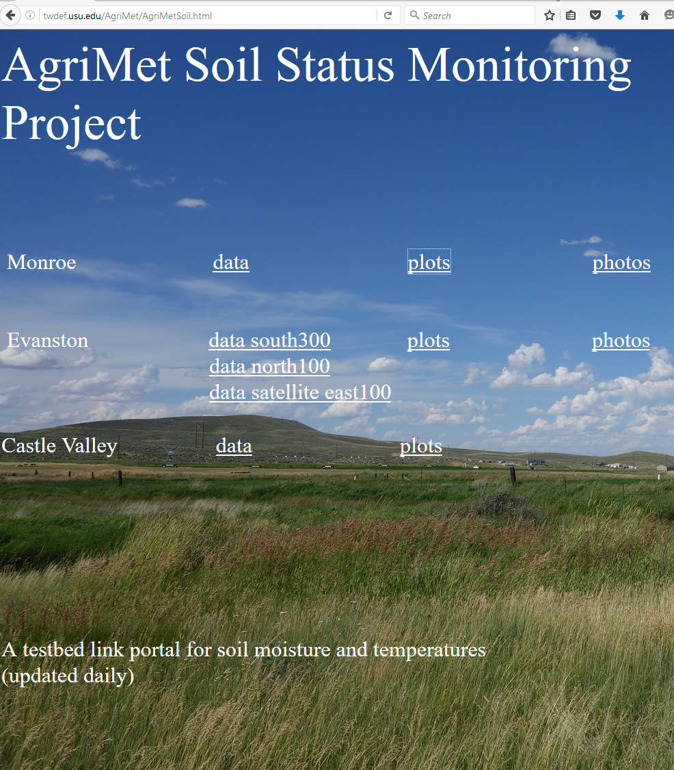
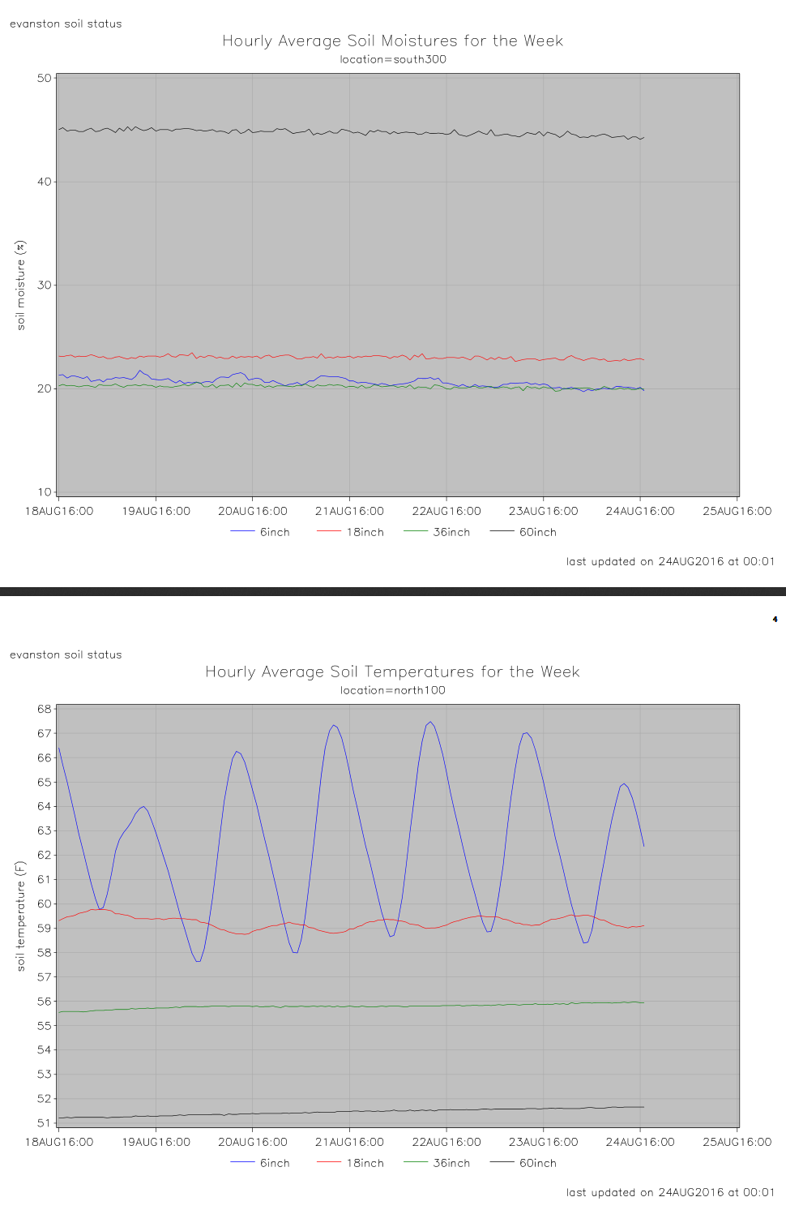
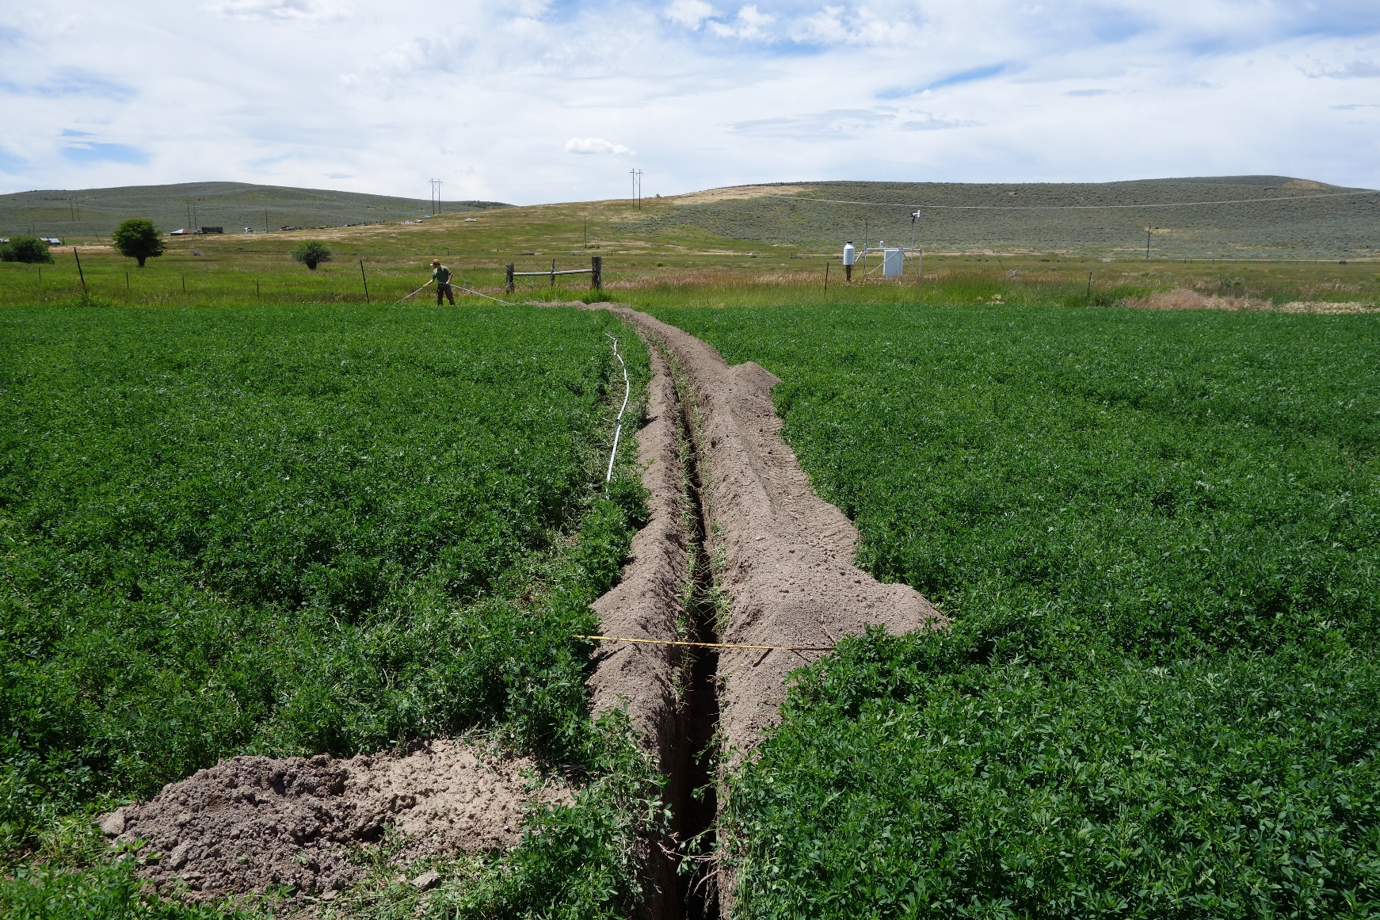
AgriMet Network
Soil Instrumentation
Service
data networks
instrumentation networks
forecasts & projections
outreach & education
Evanston station equipped with 3 soil arrays
6”, 18”, 36” and 60” depths
Measurement critical due to water regulations

Slide 13
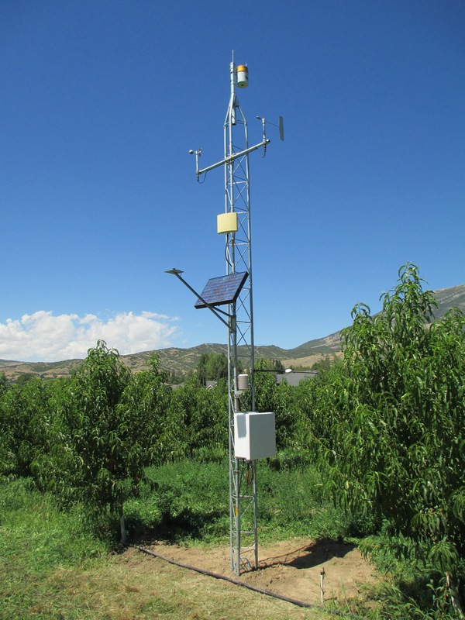
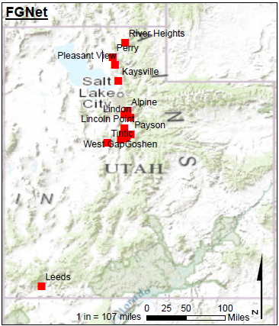
Fruit Growers Network (FGNet)
Service
data networks
instrumentation networks
forecasts & projections
outreach & education
24 stations
ETo using Campbell Scientific ETsz utility
Stations in fruit orchards

Slide 14
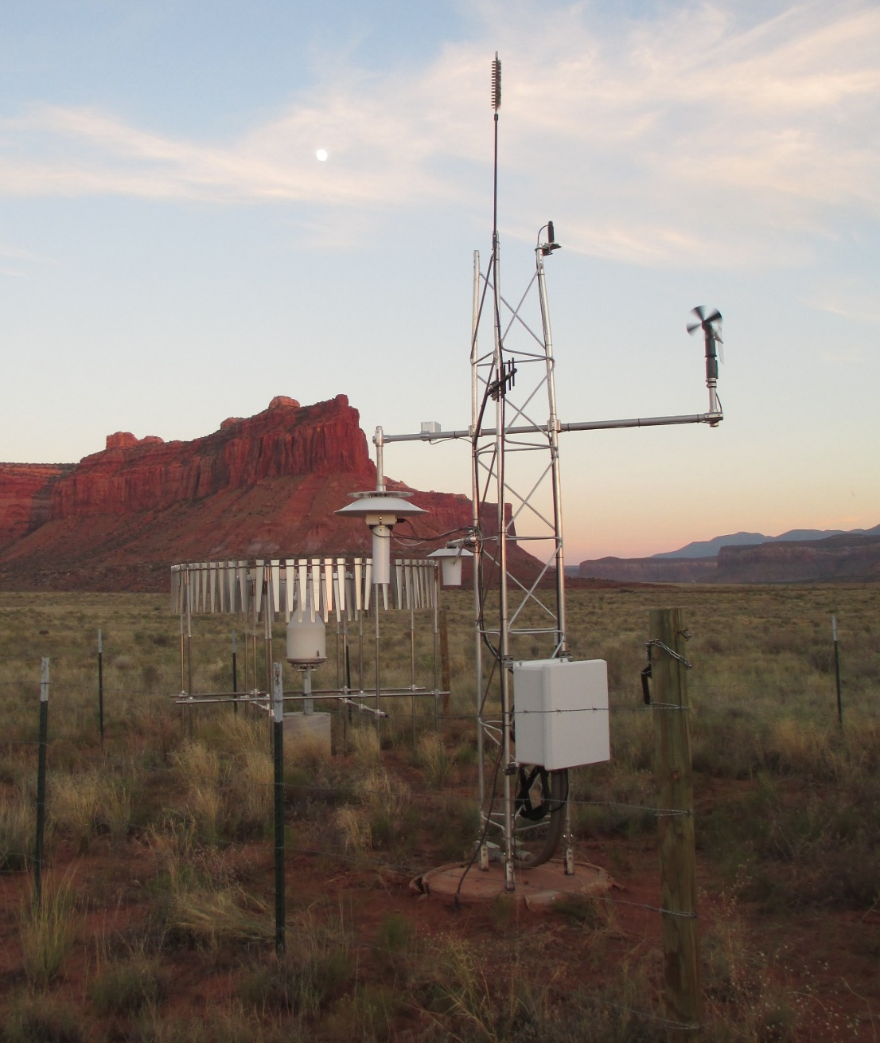
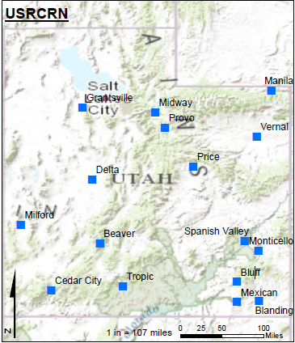
UCRN Network
Service
data networks
instrumentation networks
forecasts & projections
outreach & education
16 stations
Formerly USRCRN; sensor suite expanded
ET estimates would need to be corrected
      Arid; PM assumptions not met

Slide 15
Instrumentation Inspections
Annually field check:
Air Temp and Relative Humidity
Solar Radiation
Wind Speed and Direction
Leaf wetness, leaf/bud temperature
Load cells
Most problems can be predicted from data
Replace/Recalibrate:
Air Temp and Relative Humidity (2 years)
Tipping buckets (annually)
Wind speed (2 years)
Service
data networks
instrumentation networks
forecasts & projections
outreach & education

Slide 16
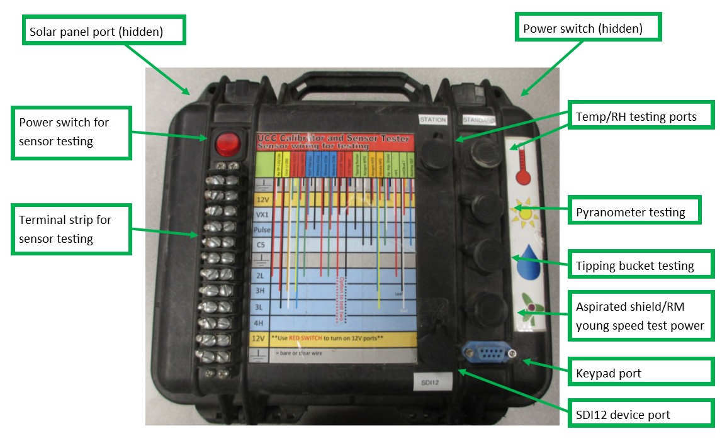
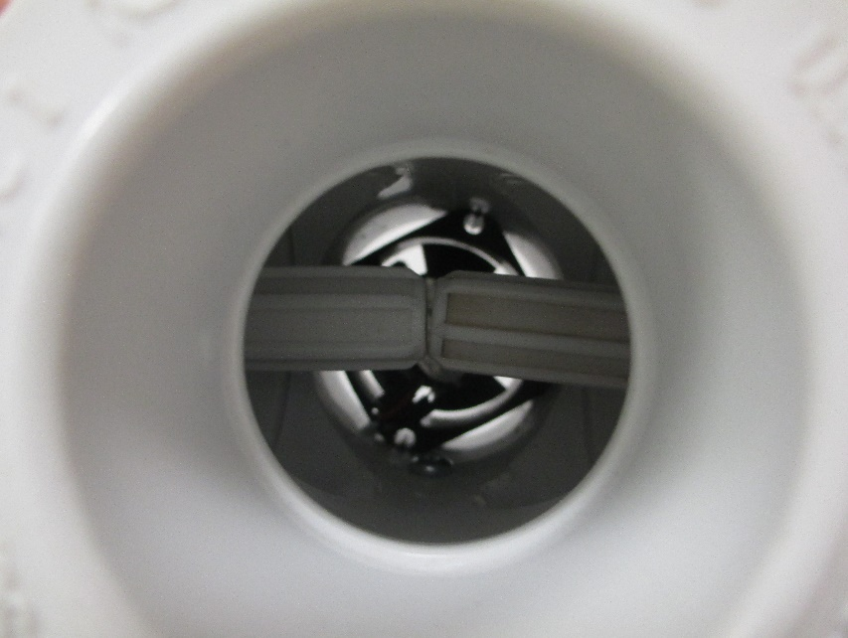
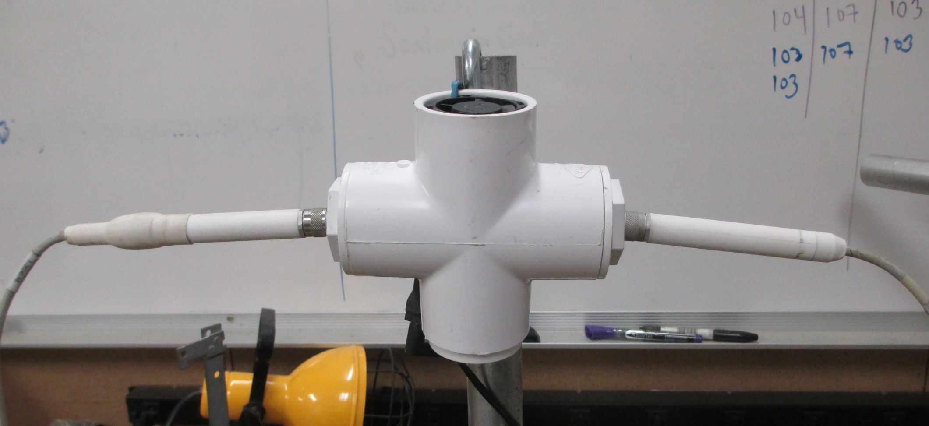
Instrumentation Inspections
Service
data networks
instrumentation networks
forecasts & projections
outreach & education

Slide 17
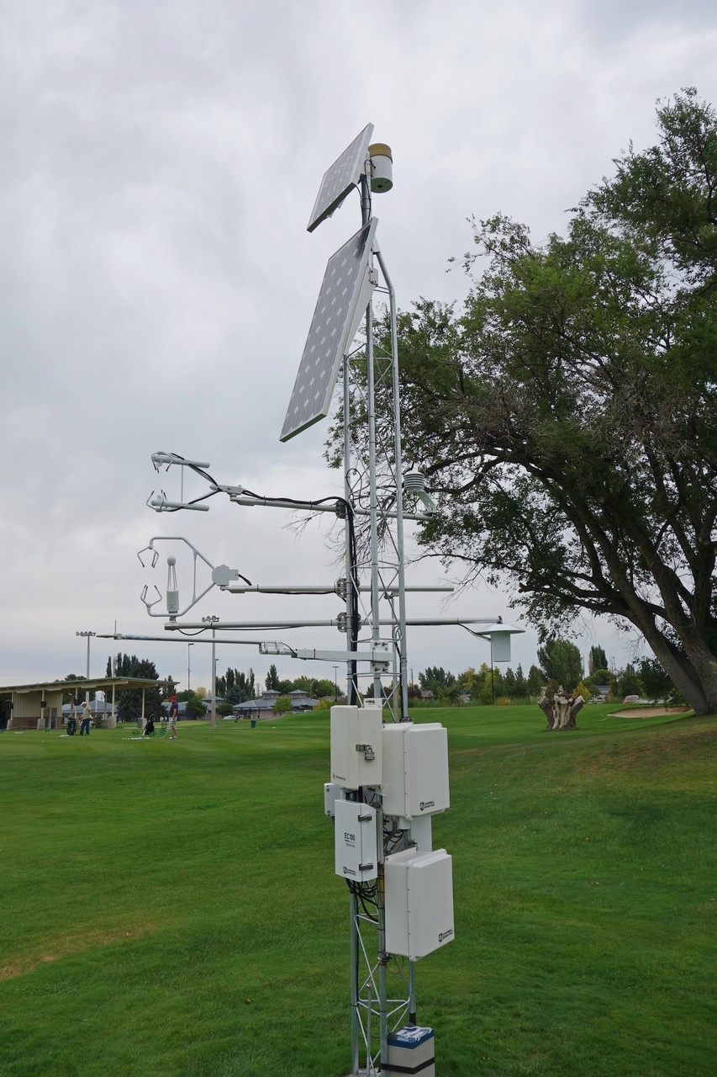
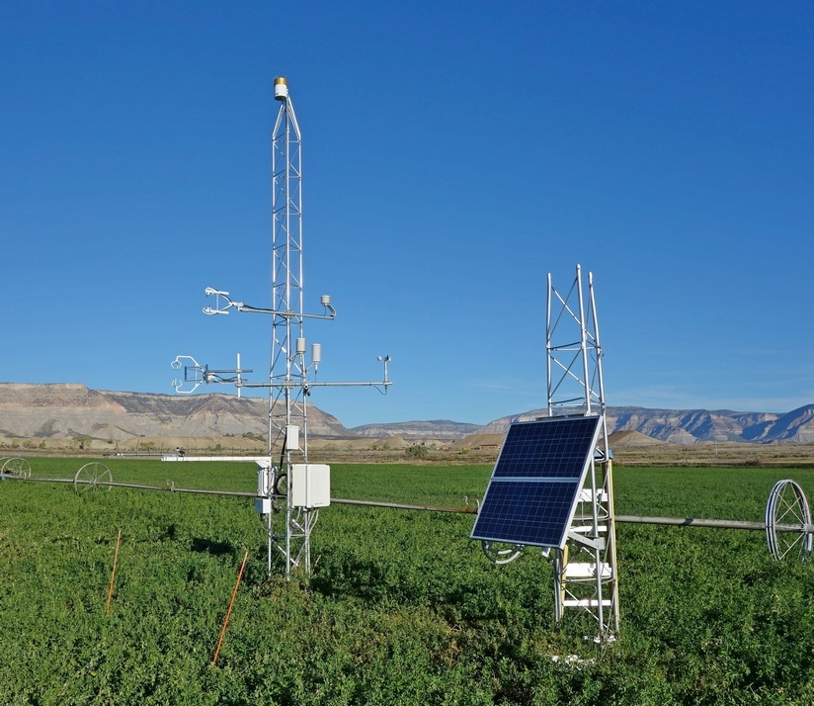
Research network
Service
data networks
instrumentation networks
forecasts & projections
outreach & education
33 stations
(5 eddy covariance systems)

Slide 18
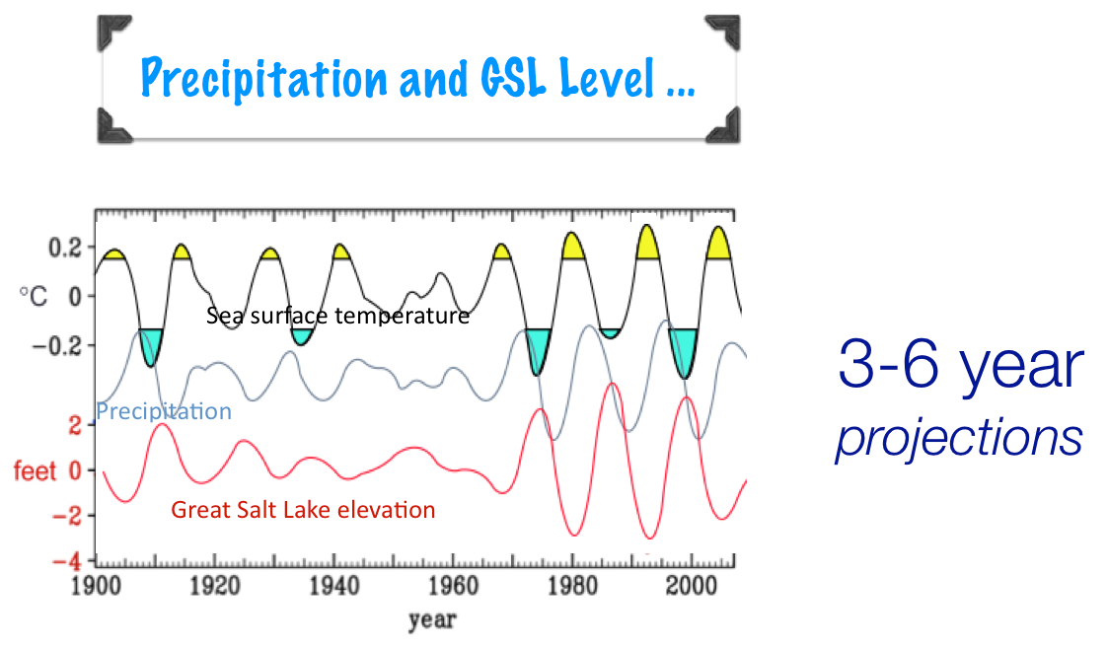
Service
data networks
instrumentation networks
forecasts & projections
outreach & education

Slide 19
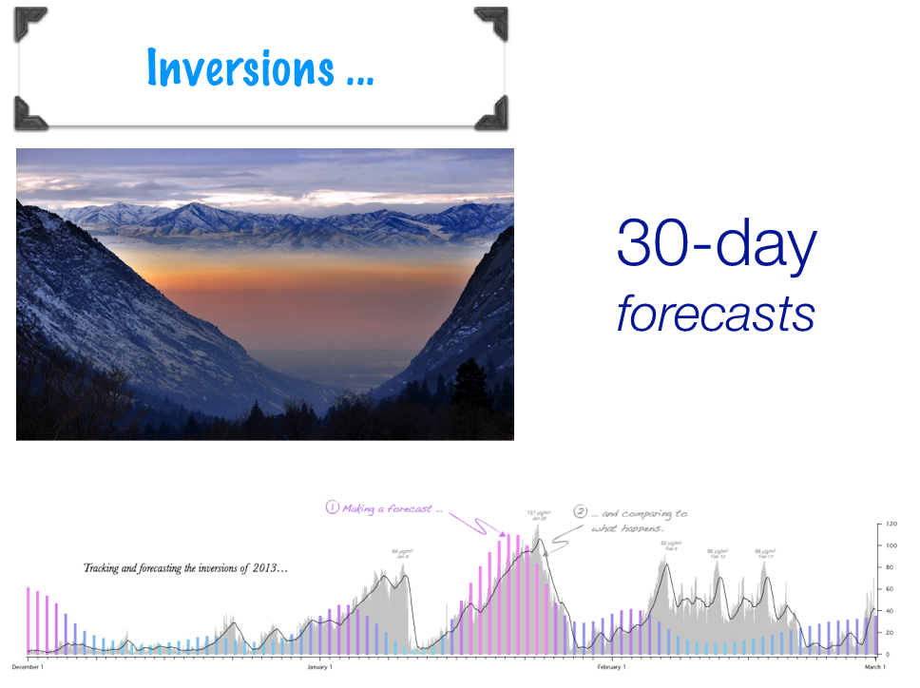
Service
data networks
instrumentation networks
forecasts & projections
outreach & education

Slide 20
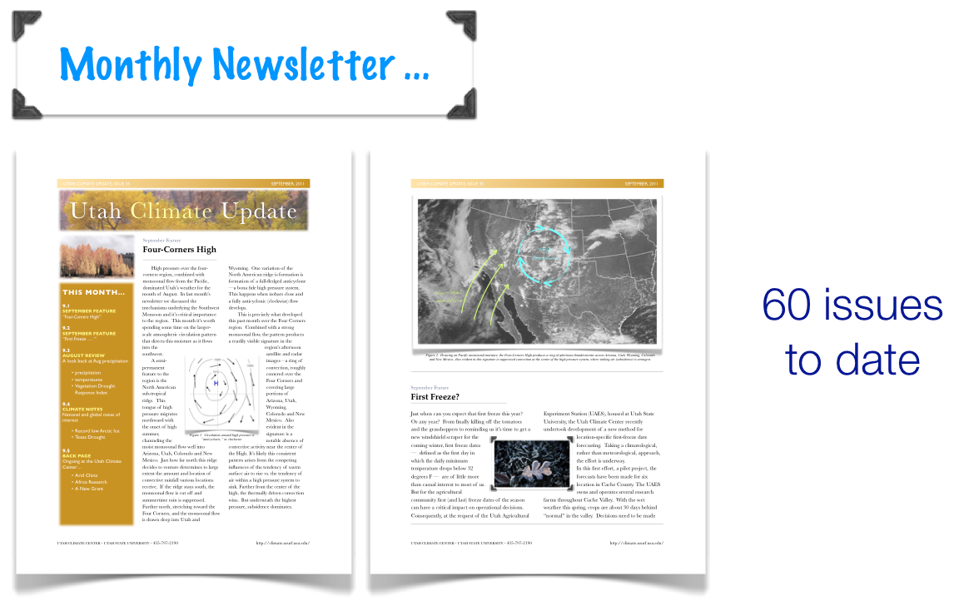
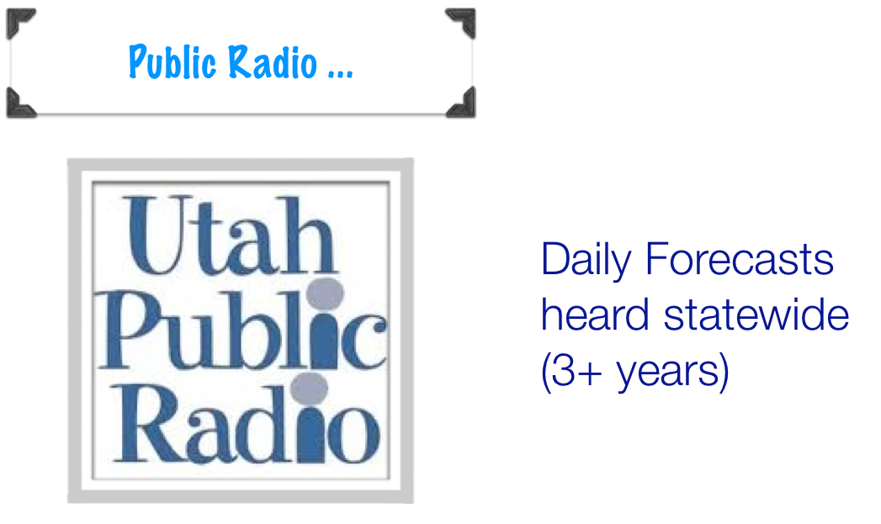
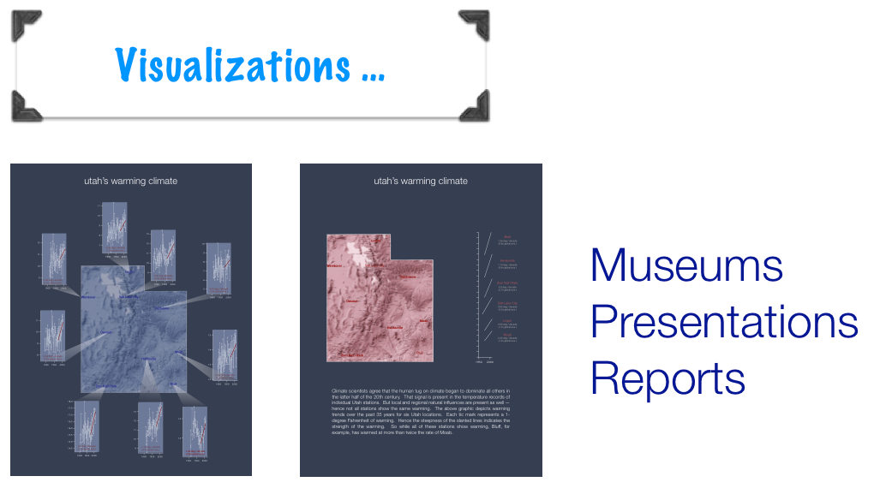
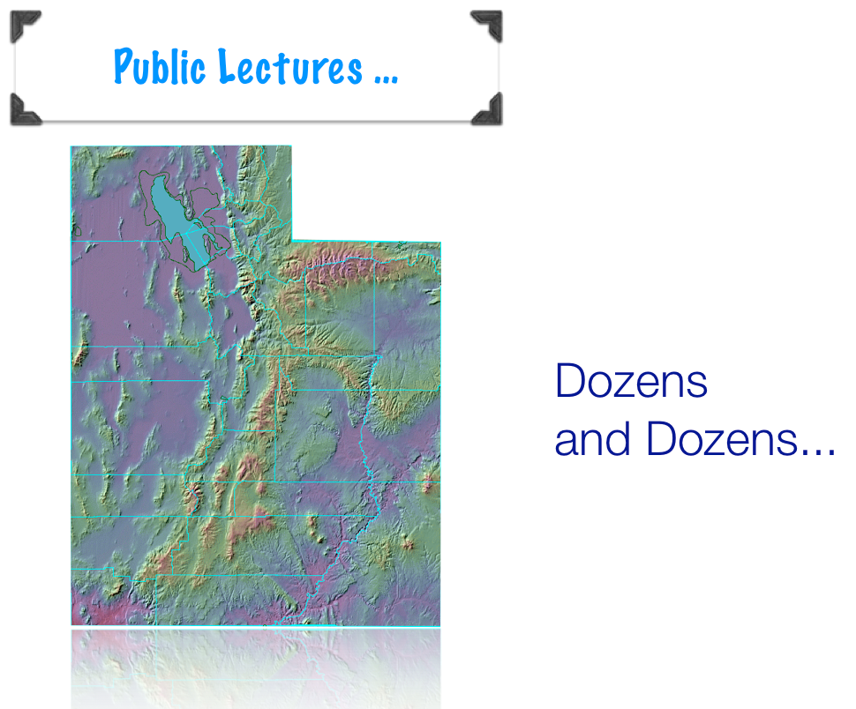
Service
data networks
instrumentation networks
forecasts & projections
outreach & education

Slide 21
paleoclimate
utah
drought
taiwan
climate extremes
RESEARCH
mongolia
climate prediction
china
severe weather
nepal
tropical cyclones
african sahel
climate trends
pakistan

Slide 22
UCC Publications
20
12
11
9
7
6
2
2009
Wang, S.-Y., Gillies, R. R., Takle, E. S., Gutowski, W. J. (2009). Evaluation of precipitation in the Intermountain Region simulated by the NARCCAP regional climate models. Geophysical Research Letters, 36, L11704.
Wang, S.-Y., Gillies, R. R., Jin, J., Hipps, L. E. (2009). Recent rainfall cycle in the Intermountain Region as a quadrature amplitude modulation from the Pacific Decadal Oscillation. Geophysical Research Letters, 36, L02705.
2010
Huang, W. R., Chan, J. C.-L., Wang, S.-Y. (2010). A planetary-scale land–sea breeze circulation in East Asia and the western North Pacific. Quarterly Journal of the Royal Meteorological Society, 136, 1543-1553.
Gillies, R. R., Wang, S.-Y., Booth, M. R. (2010). Atmospheric scale interaction on wintertime Intermountain West low-level inversions. Weather And Forecasting, 25, 1196-1210.
Gillies, R. R., Wang, S.-Y., Yoon, J. -H., Weaver, S. (2010). CFS prediction of winter persistent inversions in the Intermountain Region. Weather And Forecasting, 25, 1211-1218.
Wang, S.-Y., Hipps, L. E., Gillies, R. R., Jiang, X., Moller, A. L. (2010). Circumglobal teleconnection and early summer rainfall in the U.S. Intermountain West. Theoretical and Applied Climatology, 102, 245-252.
Wang, S.-Y., Gillies, R. R., Jin, J., Hipps, L. E. (2010). Coherence between the Great Salt Lake level and the Pacific quasi-decadal oscillation. Journal of Climate, 23, 2161-2177.
Wang, S.-Y., Clark, A. J. (2010). NAM model forecasts of warm season quasi-stationary frontal environments in the central U.S. Weather And Forecasting, 25, 1281-1292.
2011
Wang, S.-Y., and R. R. Gillies, 2011: Observed change in Sahel rainfall, circulations, African easterly waves, and Atlantic hurricanes since 1979. Int. J. Geophysics (Special Issue), #259529, doi:10.1155/2011/259529.
Wang, S.-Y., R. E. Davies, W.-R. Huang, and R. R. Gillies, 2011: Pakistan’s two-stage monsoon and links with the recent climate change. Journal of Geophysical Research, D16114, doi:10.1029/2011JD015760.
Wang, S.-Y., and A. J. Clark, 2011: Quasi-decadal spectral peaks of tropical Western Pacific SSTs as a precursor for tropical cyclone threat. Geophys. Res. Lett., 37, L21810. doi:10.1029/2010GL044709.
Gillies, R. R., O.-Y. Chung, S.-Y. Wang, and P. Kokoszka, 2011: Incorporation of Pacific SSTs in a time series model towards a longer-term forecast for the Great Salt Lake elevation. J. Hydrometeorology, 12, 474-480, doi:10.1175/2010JHM1352.1
Wang, S.-Y., R. R. Gillies, L. E. Hipps, and J. Jin, 2011: A transition-phase teleconnection of the Pacific quasi-decadal oscillation, Clim Dynamics, 36, 681-693.
Wang, S.-Y., T.-C. Chen, and J. Correia, 2011: Climatology of summer midtropospheric perturbations in the U.S. Northern Plains. Part I: Influence on northwest flow severe weather outbreaks. Clim Dynamics, 36, 793-810.
Wang, S.-Y., T.-C. Chen, and E. S. Takle, 2011: Climatology of summer midtropospheric perturbations in the U.S. Northern Plains. Part II: Large-scale effects of the Rocky Mountains on genesis. Clim Dynamics, 36, 1221-1237.
2012
Wang, S.-Y., and R. R. Gillies, 2012: Influence of the Pacific quasi-decadal oscillation on the monsoon precipitation in Nepal. Climate Dynamics (in press).
Zhao, L., J. Jin, and S.-Y. Wang, 2012: Integration of remote-sensing data with WRF to improve lake effect precipitation simulations over the Great Lakes region. Journal of Geophysical Research (in press).
Wang, S.-Y., M. L’Heureux, and H-H Chia, 2012: ENSO prediction one year in advance using Western North Pacific sea surface temperatures. Geophysical Research Letters, 39, L05702 (pdf).
Wang, S.-Y., R. R. Gillies, and T. Reichler, 2012: Multi-decadal drought cycles in the Great Basin recorded by the Great Salt Lake: Modulation from a transition-phase teleconnection. Journal of Climate, 25, 1711-1721.
Gillies, R. R., S.-Y. Wang, and M. R. Booth, 2012: Observational and synoptic analyses of the winter precipitation regime change over Utah. Journal of Climate (in press).
Wang, S.-Y., R. R. Gillies, R. Martin, R. E. Davies, and M. R. Booth, 2012: Connecting subseasonal movements of the winter ridge in western North America to inversion climatology in Cache Valley, Utah. Journal of Applied Meteorology and Climatology, 51, 617-627. (pdf)
Gillies, R. R., S.-Y. Wang, and W.-R. Huang, 2012: Observational and supportive modeling analyses of winter precipitation change in China over the last half century. International Journal of Climatology, 32, 747-758.
Huang, W.-R., T.-C. Chen, and S.-Y. Wang, 2012: Co-variability of poleward propagating atmospheric energy with tropical and higher-latitude climate oscillations. Climate Dynamics (in press), DOI: 10.1007/s00382-011-1238-3
Huang, W.-R., S.-Y. Wang, and J. C.-L. Chan, 2012: Discrepancies between global reanalyses and observations in the interdecadal variations of Southeast Asian cold surge. International Journal of Climatology (in press) doi: 10.1002/joc.2234.
2013
Barandiaran, D., S.-Y. Wang, and K. Hilburn, 2013: Observed trends in the Great Plains low-level jet and associated precipitation changes in relation to recent droughts. Geophysical Research Letters, 40, 6247–6251.
Wang, S.-Y., R. E. Davies, and R. R. Gillies, 2013: Identification of extreme precipitation threat across midlatitude regions based on short-wave circulations. Journal of Geophysical Research, 118, 11059-11074 (pdf).
Barandiaran, D. and S.-Y. Wang, 2013: The Missing Teleconnection Between the North Atlantic and Sahel Precipitation in CFSv2. Atmospheric Science Letters (RMS), DOI: 10.1002/asl2.457.
Wang, S.-Y., J.-H. Yoon, R. R. Gillies, and C. Cho, 2013: What caused the winter drought in western Nepal during recent years? Journal of Climate. 26, 8241-8256 (pdf).
Wang, S.-Y., B. Buckley, J.-H. Yoon and B. Fosu, 2013: Intensification of pre-monsoon tropical cyclones in the Bay of Bengal and its impacts on Myanmar. Journal of Geophysical Research, 118, 1-12, doi: 10.1002/jgrd.50396.
Wang, S.-Y., H.-H. Chia, R. R. Gillies, and X. Jiang, 2013: Quasi-biweekly mode and its modulation on the diurnal rainfall in Taiwan forecasted by the CFS. Weather and Forecasting. 28, 981-993 (pdf).
Wang, S.-Y., M. L’Heureux, and J.-H. Yoon, 2013: Are greenhouse gases changing ENSO precursors in the Western North Pacific? Journal of Climate, 26, 6409-6322. (PDF).
DeRose, R. J., S.-Y. Wang, J. D. Shaw, 2013: Feasibility of high-density climate reconstruction based on the Forest Inventory and Analysis (FIA) tree-ring data. Journal of Hydrometeorology, 14, 375–381. (pdf)
Wang, S.-Y., and R. R. Gillies, 2013: Influence of the Pacific quasi-decadal oscillation on the monsoon precipitation in Nepal. Climate Dynamics, 40, 95-107. [ Erratum ]
Gillies, R. R., S.-Y. Wang, Y. Sun, and O.-Y. Chung, 2013: Supportive empirical modeling for the forecast of monsoon precipitation in Nepal. International Journal of Climatology, 33, 3047-3054. DOI: 10.1002/joc.3649.
Wen, L., N. Nagabhatla, S. Lv, and S.-Y. Wang, 2013: Impact of rain snow threshold (RST) temperature on snow depth simulation in land surface model and regional climate model. Advances in Atmospheric Sciences, 30, 1449-1460 doi: 10.1007/s00376-012-2192-7
2014
·DeRose, J. R., M. Bekker, S.-Y. Wang, R. Kjelgren, E. B. Allen, T. Bardsley, and B. M. Buckley, 2014: A millennium-length reconstruction of Bear River stream flow, Utah. Journal of Hydrology, (in press)
·Wang, S.-Y., X. Jiang, and B. Fosu, 2014: Global eastward propagation signals associated with the 4-5-year ENSO cycle. Climate Dynamics DOI 10.1007/s00382-014-2422-z (in press) - PDF.
·Wang, S.-Y., D. Barandiaran, K. Hilburn, P. Houser, et al., 2014: Could the 2012 drought in central U.S. have been anticipated? - A review of NASA working group research. J. Earth Sci. Engineering, 4, 428-437 (PDF).
·Li, R., J. Jin, S.-Y. Wang, and R. R. Gillies, 2014: Significant impacts of radiation physics in the WRF model on the precipitation and dynamics of the West African Monsoon. Climate Dynamics, DOI: 10.1007/s00382-014-2294-2 - PDF.
·Fosu, B. O., and S.-Y. Wang, 2014: Bay of Bengal: Coupling of pre-monsoon tropical cyclones with the monsoon onset in Myanmar. Climate Dynamics, DOI: 10.1007/s00382-014-2289-z, PDF.
·Wang, S.-Y., L. Hipps, R. R. Gillies, and J.-H. Yoon, 2014: Probable causes of the abnormal ridge accompanying the 2013-14 California drought: ENSO precursor and anthropogenic warming footprint. Geophysical Research Letters. DOI: 10.1002/2014GL059748 [open access]
·Buckley, B. M., R. Fletcher, S.-Y. Wang, B. Zottoli, and C. Pottier, 2014: Monsoon extremes and society over the past millennium on mainland Southeast Asia. Quaternary Science Reviews. 95, Pages 1–19
·DeRose, J. R., S.-Y. Wang, B. M. Buckley, and M. Bekker, 2014: Tree-ring reconstruction of the Great Salt Lake level. The Holocene. DOI: 10.1177/0959683614530441
·Zhao, L., Wang, S.-Y., J. Jin and A. J. Clark, 2014: Weather Research and Forecasting model simulations of a rare springtime bow echo near the Great Salt. Meteorological Applications (Royal Met. Soc.),(PDF) DOI: 10.1002/met.1455.
·Wang, S.-Y., K. Hakala, R. R. Gillies, and W. J. Capehart, 2014: The Pacific Quasi-Decadal Oscillation (QDO) - An important precursor towards anticipating major flood events in the Missouri River Basin? Geophysical Research Letters,41, 991-997 (link).
·Huang, W.-R., S.-Y. Wang, 2014: Impact of Land-Sea Breezes at Different Scales on the Diurnal Rainfall in Taiwan. Climate Dynamics (in press) 10.1007/s00382-013-2018-z
·Wang, S.-Y., R. R. Gillies, and H. van den Dool, 2014: On the yearly phase delay of winter intraseasonal mode in the western United States. Climate Dynamics, (in press) DOI: 10.1007/s00382-013-1784-y
Notes:
Active researchers + meteorological staff + the odd physicist + statistician

Slide 23
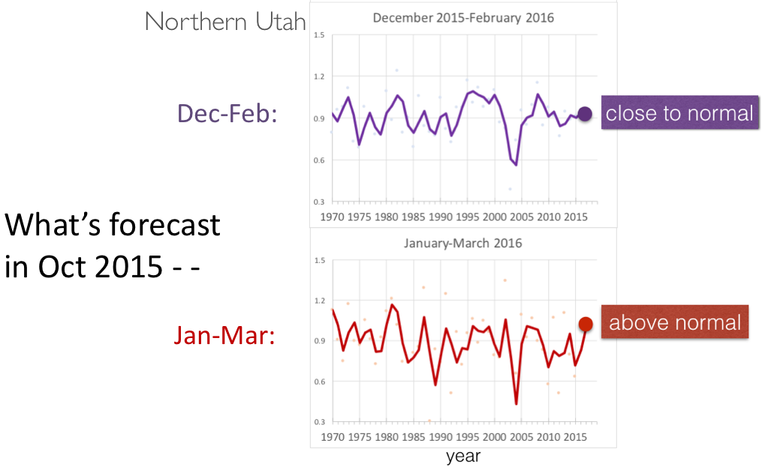
Research linked to water supply
What was forecasted in 2015 for Dec 2015 – March 2016…
Verified!

Slide 24
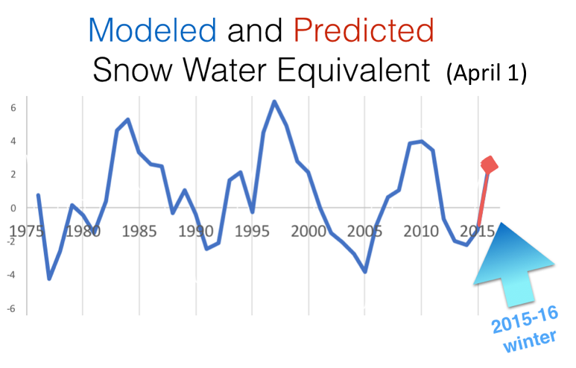
Research linked to water supply
Verified!

Slide 25
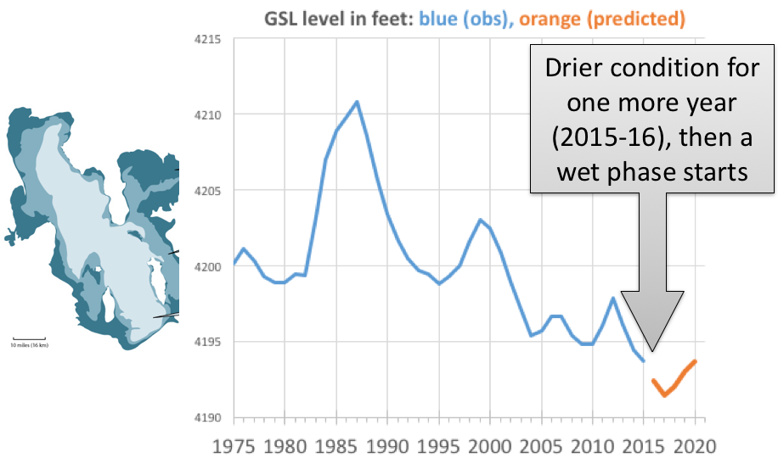
Research linked to water supply

Slide 26
Future work:
Improve web tools:
  -Revamp data presentation for remaining networks
  -Phone app/irrigation scheduling
  QA/QC
    -Back filling bad data
    -Automated systems
  Station rebuilds
    -“Bullet proof” stations = less site visits/maintenance
    Telemetry
    -Aging equipment causes intermittent reliability

Slide 27
Thank you!

