Slide 1
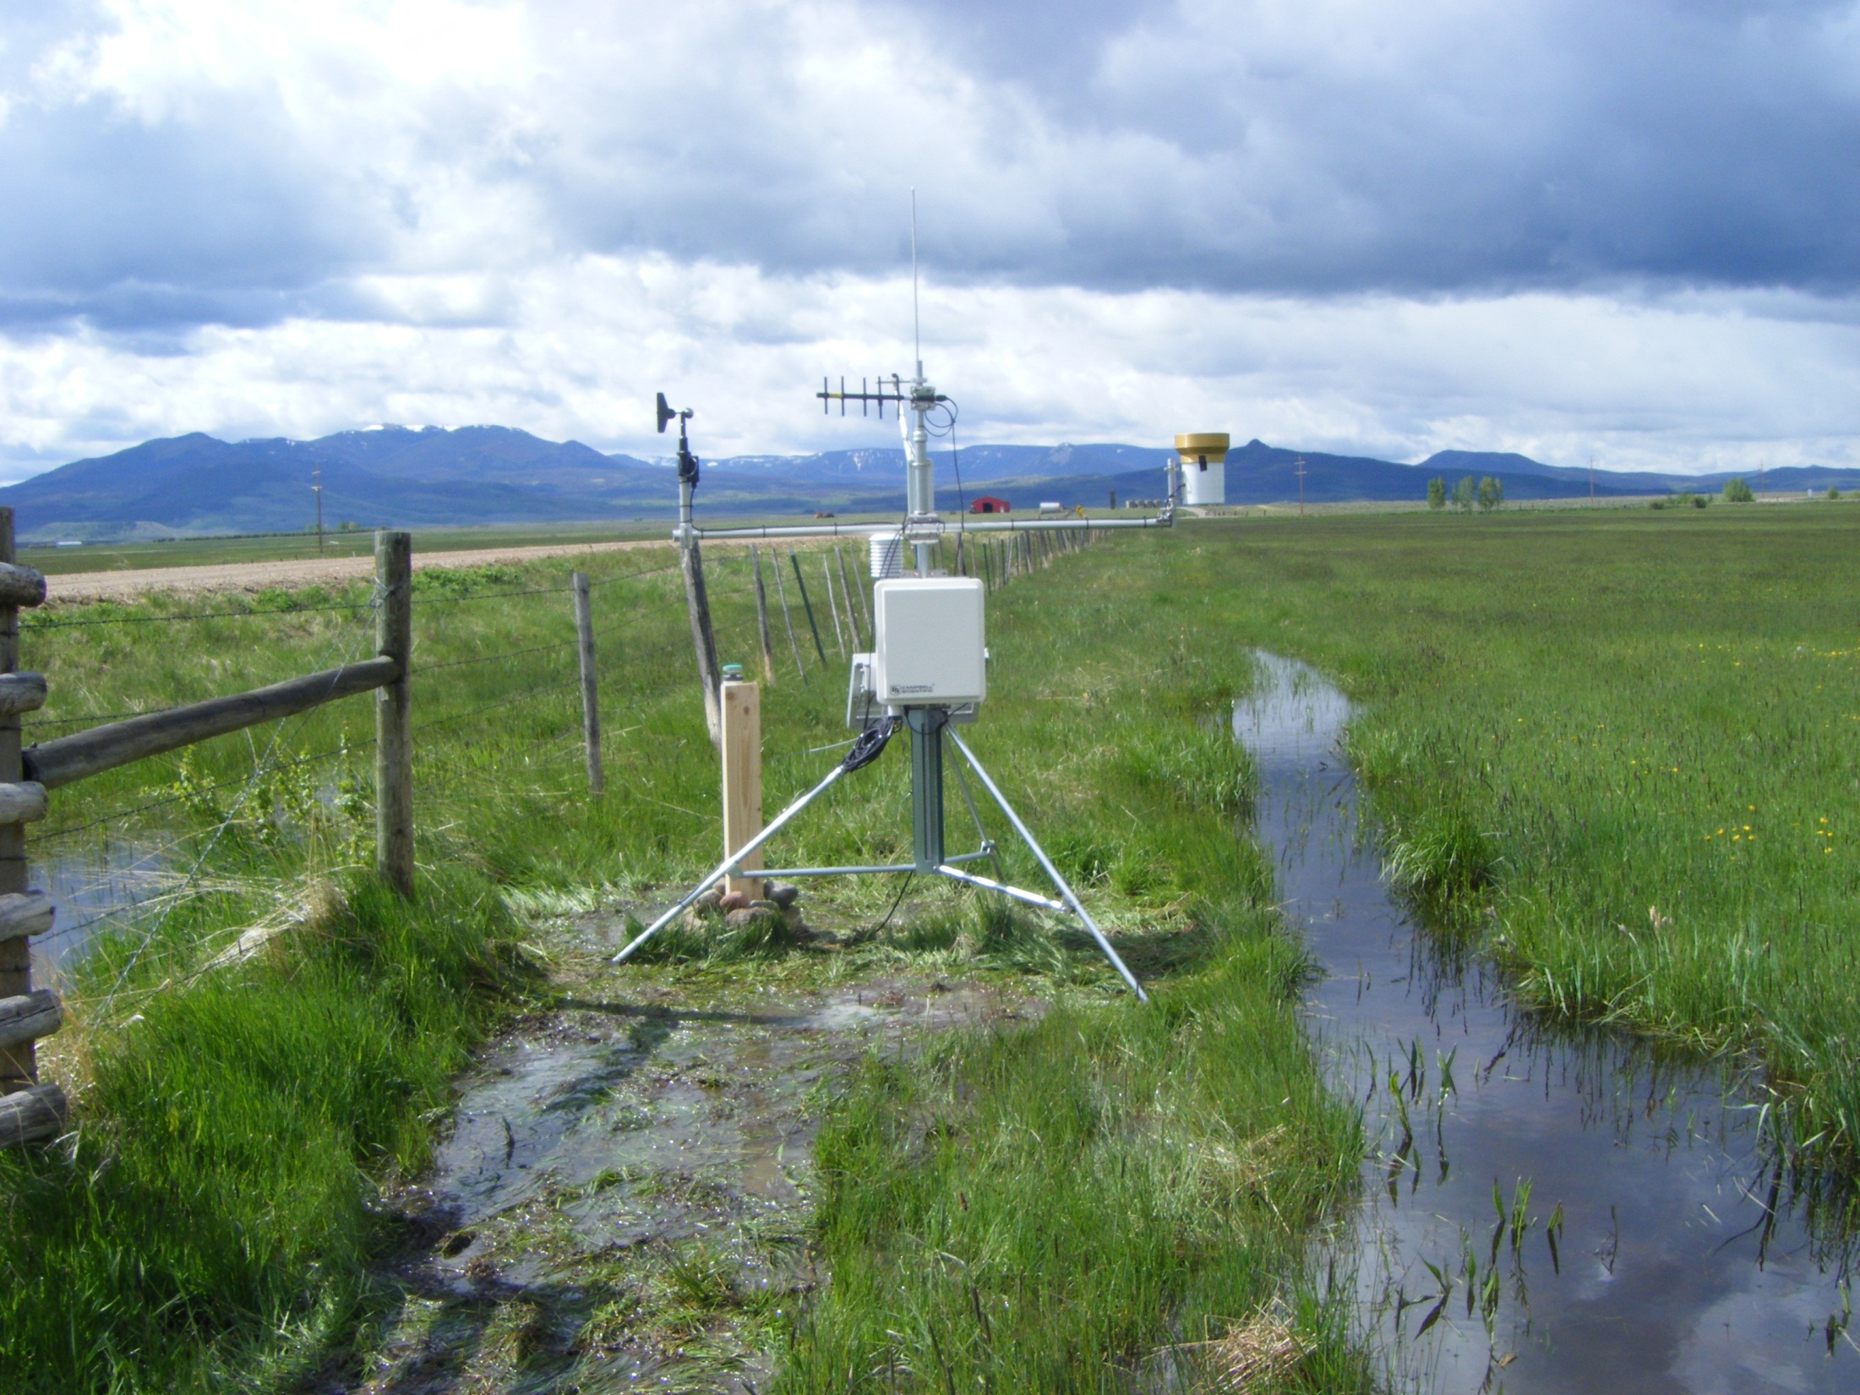


The CoAgMet Network
Zach Schwalbe
Colorado Climate Center
Colorado State University
Irrigation Management Information Systems Workshop
August 25th, 2016
San Diego, CA

Slide 2
CoAgMet =
Colorado Agricultural Meteorological Network

Slide 3
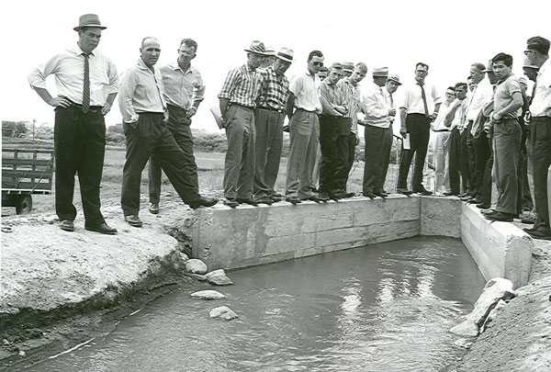
History
In the early 1990’s, CSU extension plant pathologists and ARS scientists decided to collaborate efforts to collect detailed agricultural weather data.
Standard instruments and data collection platform were selected and a small network of stations were deployed in fully irrigated agriculture.
As the network grew, the Colorado Climate Center became increasingly interested in using the data, began daily data collection, quality control and built a web interface to distribute data and products to users across the state.

Slide 4
Colorado Climate Center’s role
Coodination, data management, web support
We hosted annual meetings of key partners and data users – set priorities, secure commitments, prepare proposals (rarely funded but we persisted)
We now run the network including station maintenance, product development, funding, etc.

Slide 5
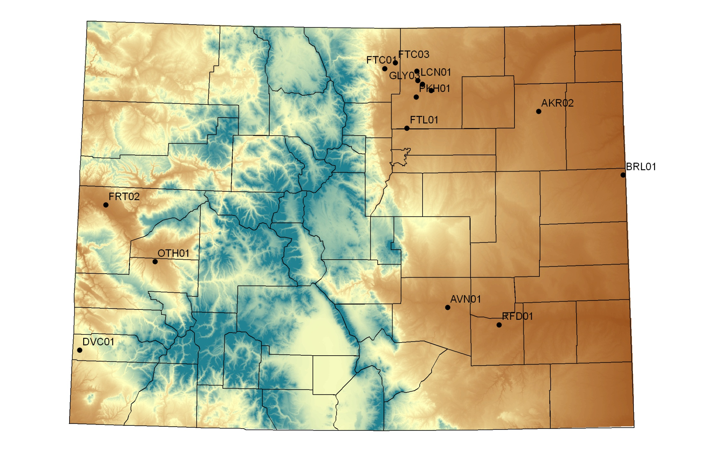
CoAgMet 1992

Slide 6
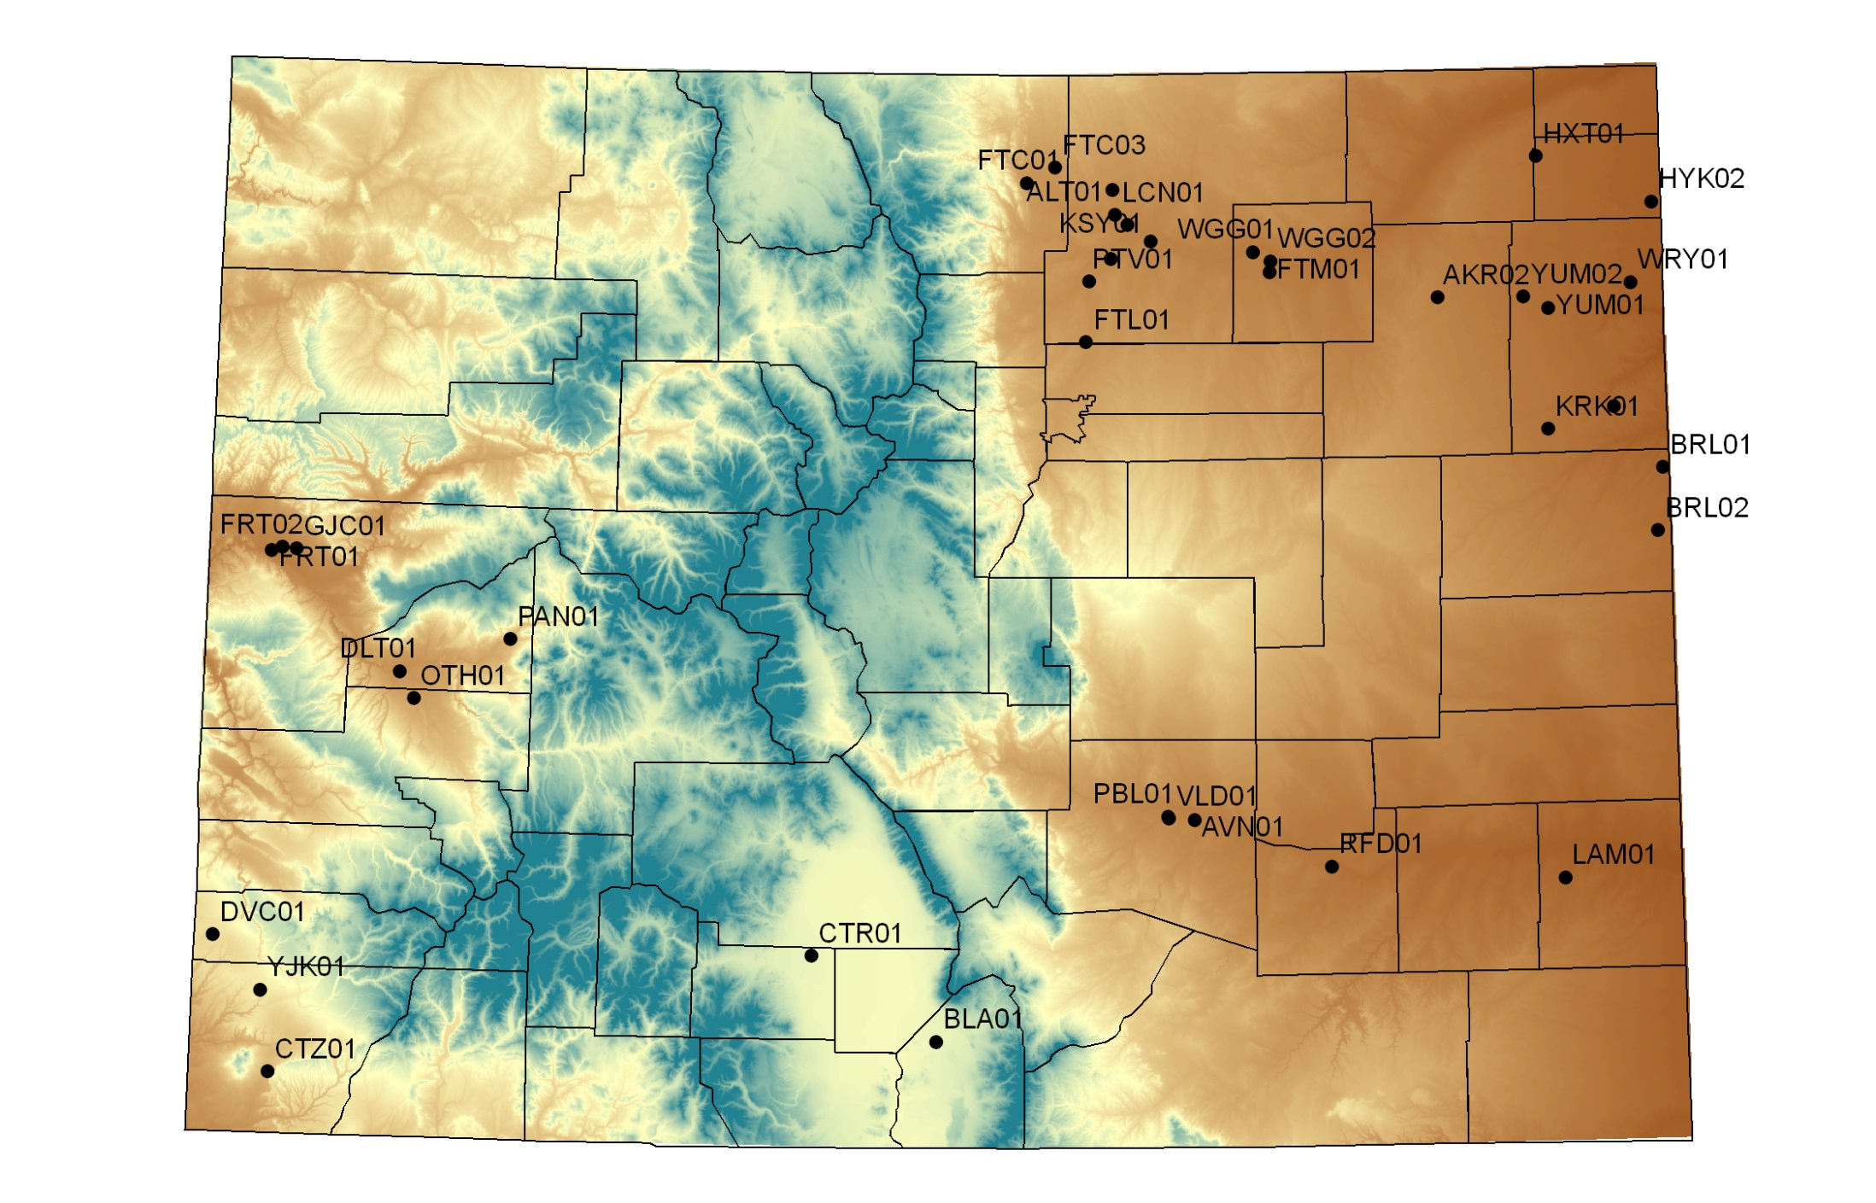
CoAgMet 1997

Slide 7
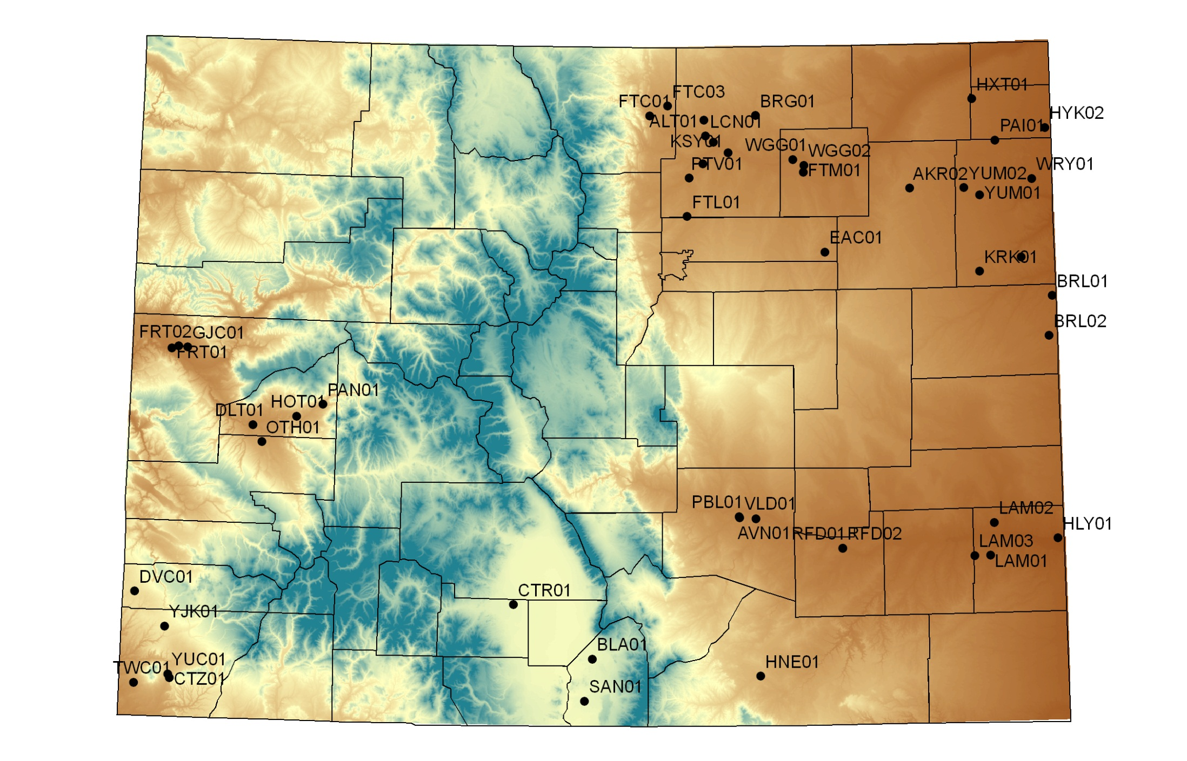
CoAgMet 2002

Slide 8
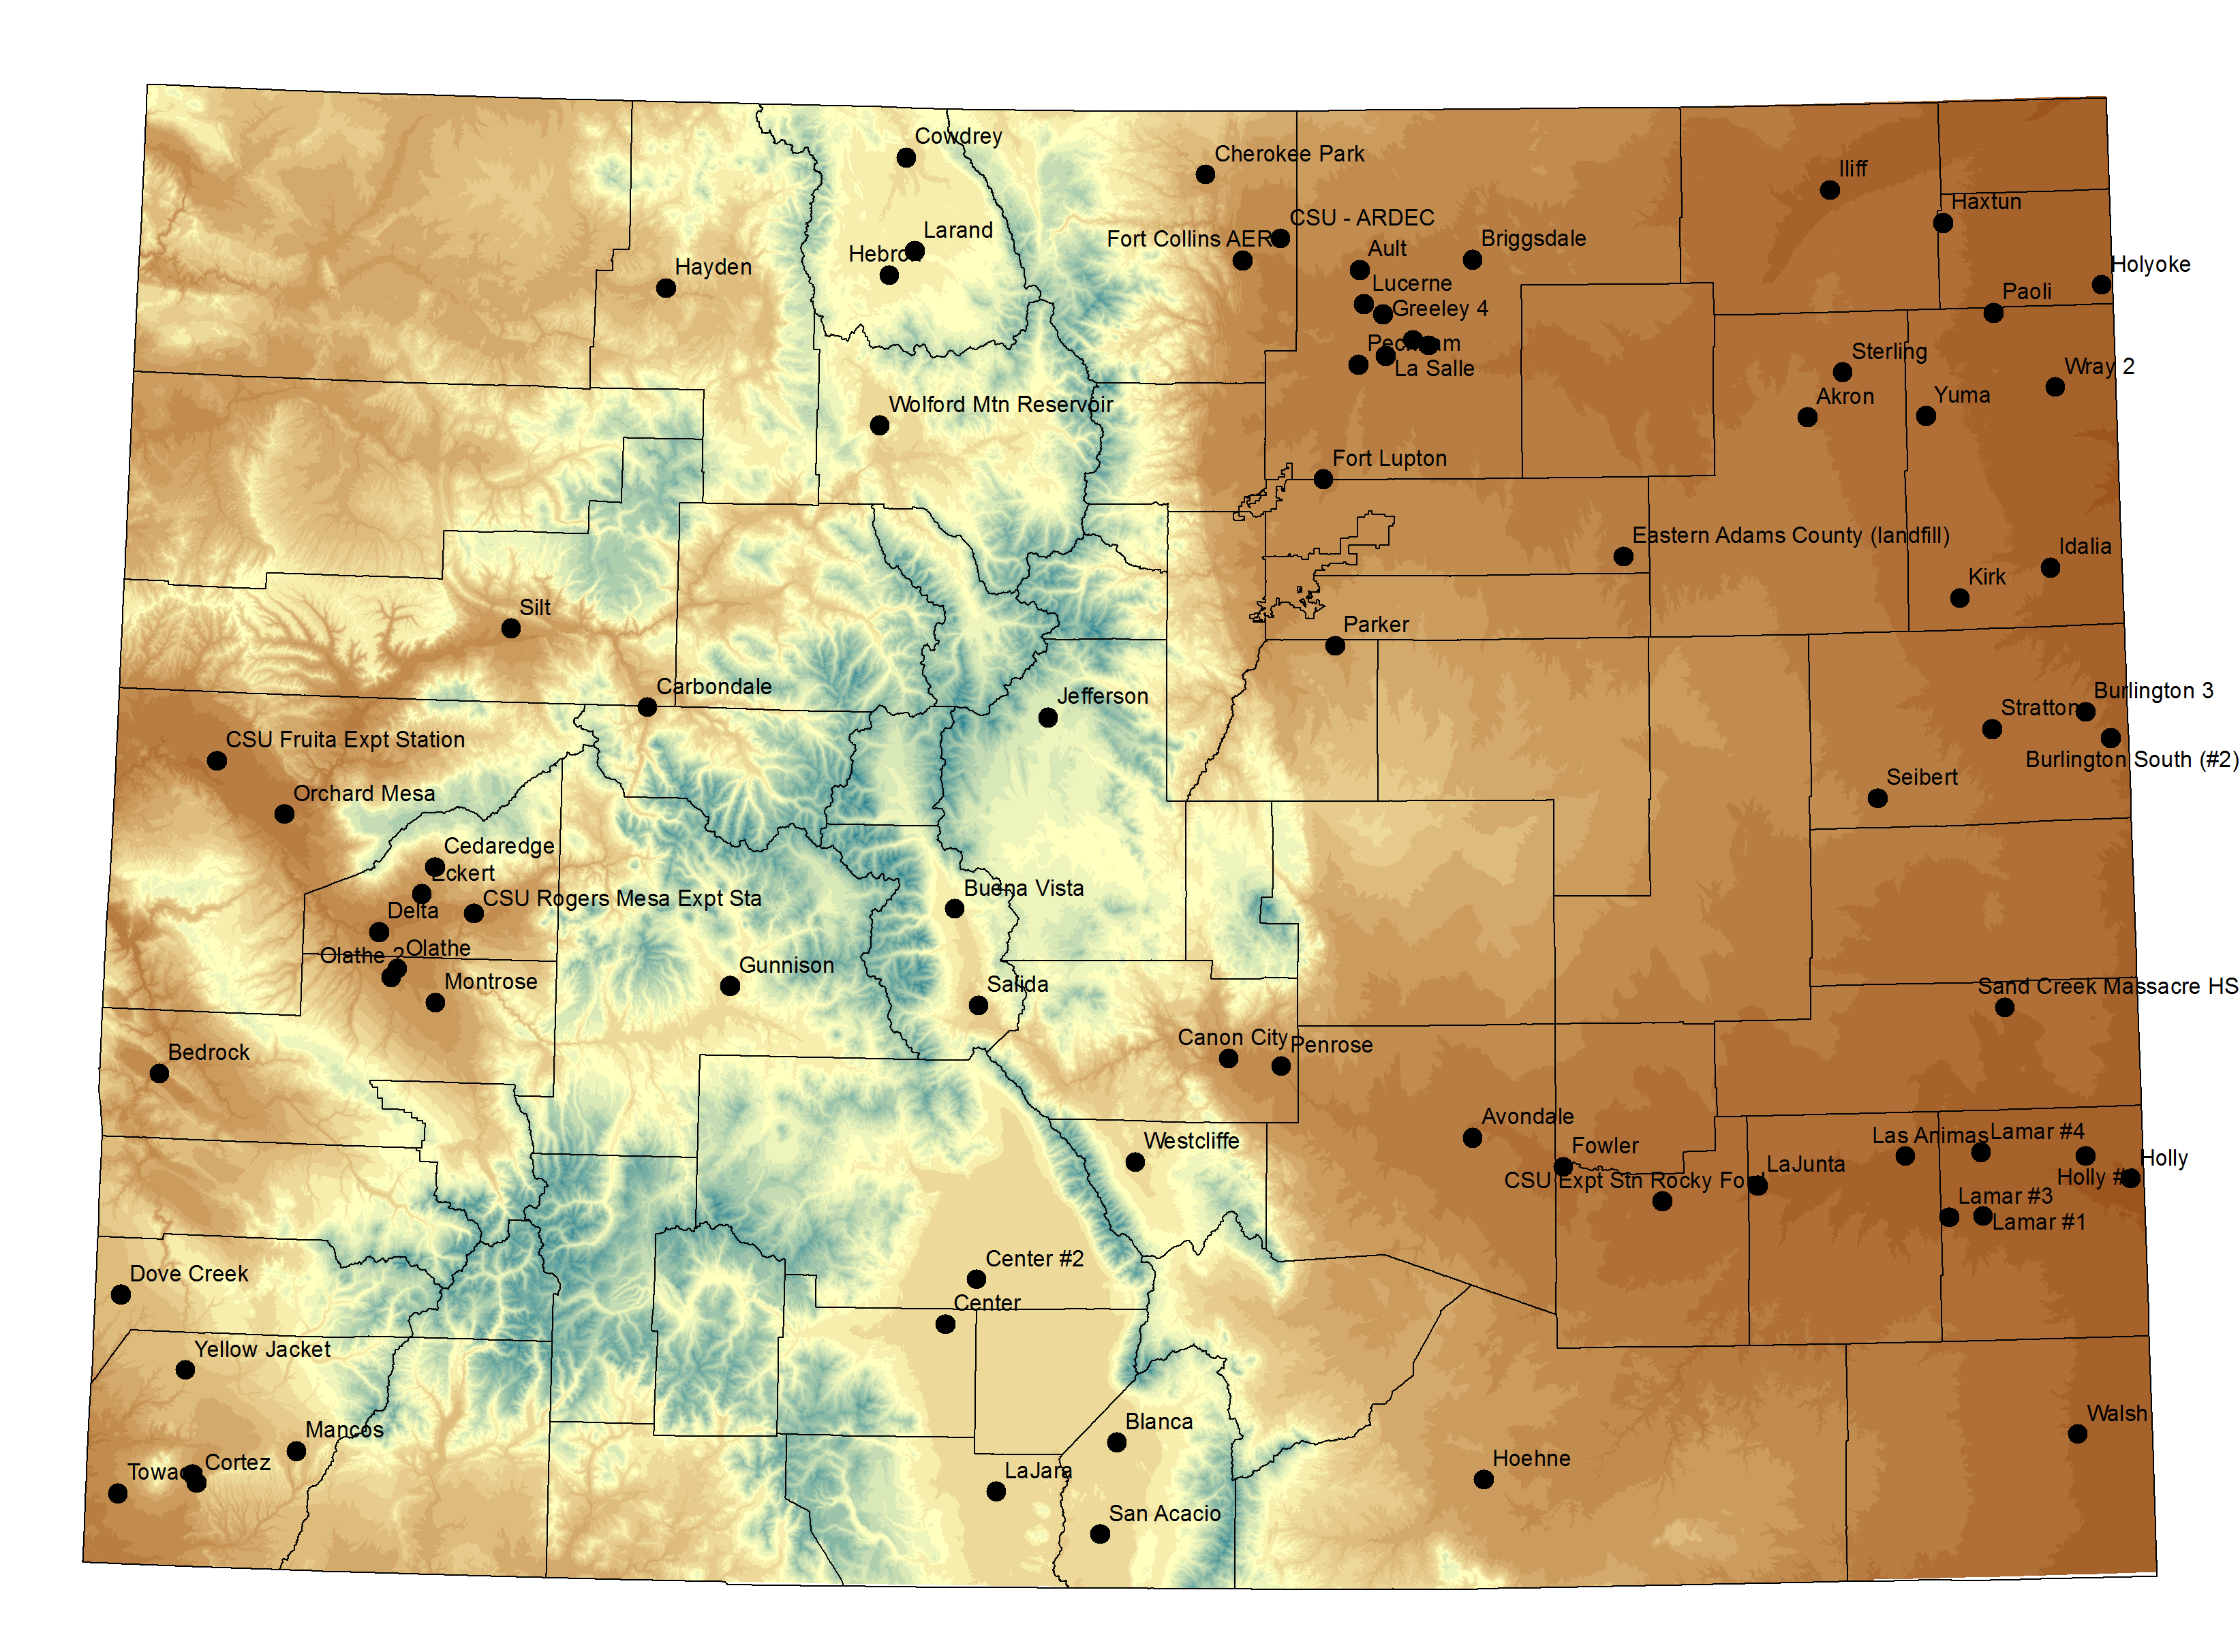
Current stations
Notes:
8
Map from web

Slide 9
How did we expand?
More applications, more partners, more opportunities -- Extension, Research, NRCS, Commodities groups, Conservation Districts and gradually water professionals
For nearly 20 years we used a model of “shared benefits / shared responsibilities”
Shared field techs, year-end funds, donations

Slide 10
2016 Expansion
Primarily in the Colorado River Basin (western Colorado) as a part of Upper Colorado River Compact Commission efforts to standardize upper basin states Consumptive Use estimates.
Stations being purchased and supported by USBR

Slide 11
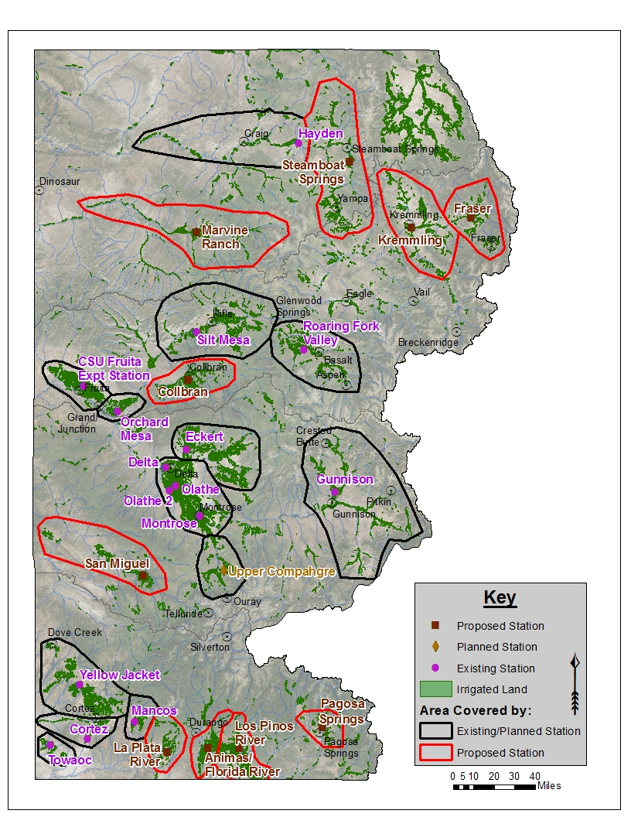

Slide 12
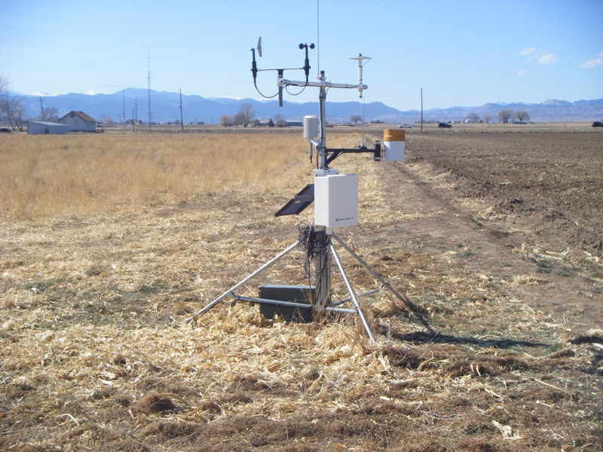
Cup anemometer and wind vane: Wind speed, direction and gusts
Above all else facing South
Pyranometer: Solar radiation
2 m
2 m
Tipping bucket rain gage
Temperature/Humidity sensor in radiation shield
1-3 m
Solar panel powers the station
Data collection platform (DCP)
CR10, CR10x, CR1000
-5/-15 cm
Soil temperatures

Slide 13
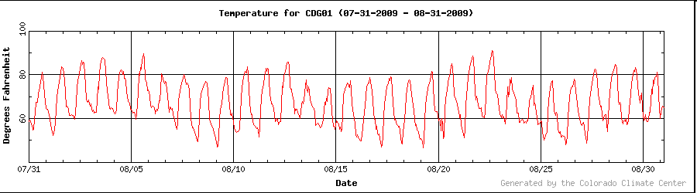
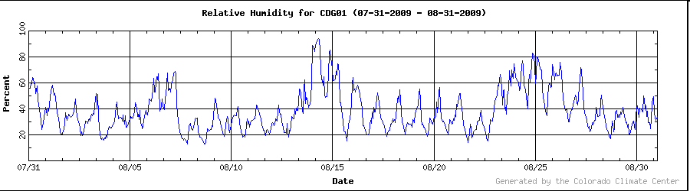

Slide 14
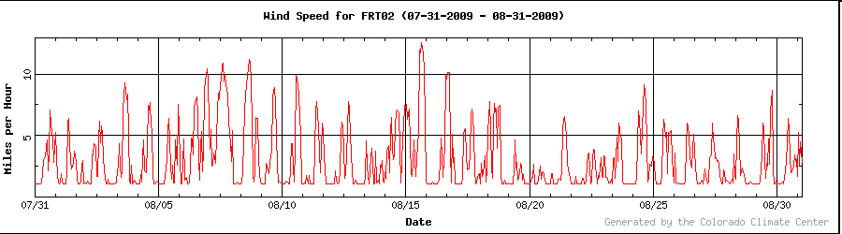
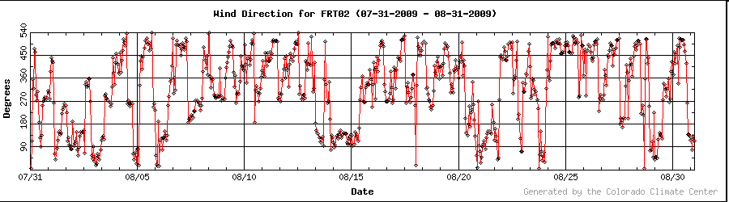

Slide 15
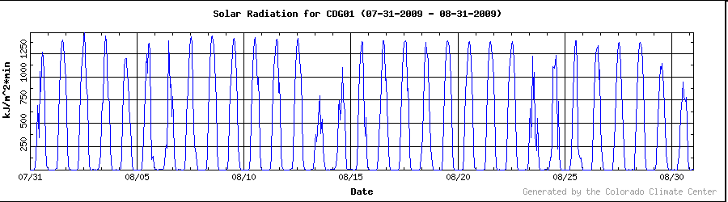
Solar Radiation

Slide 16
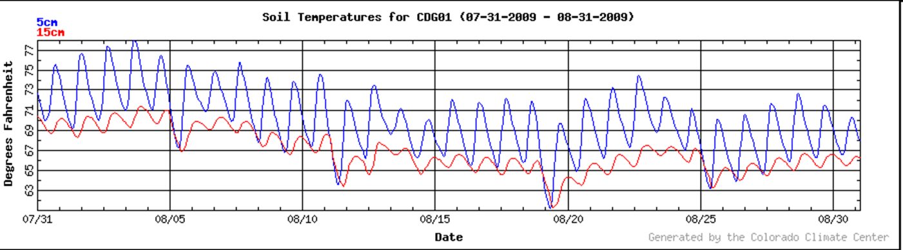
Soil Temperatures
.

Slide 17
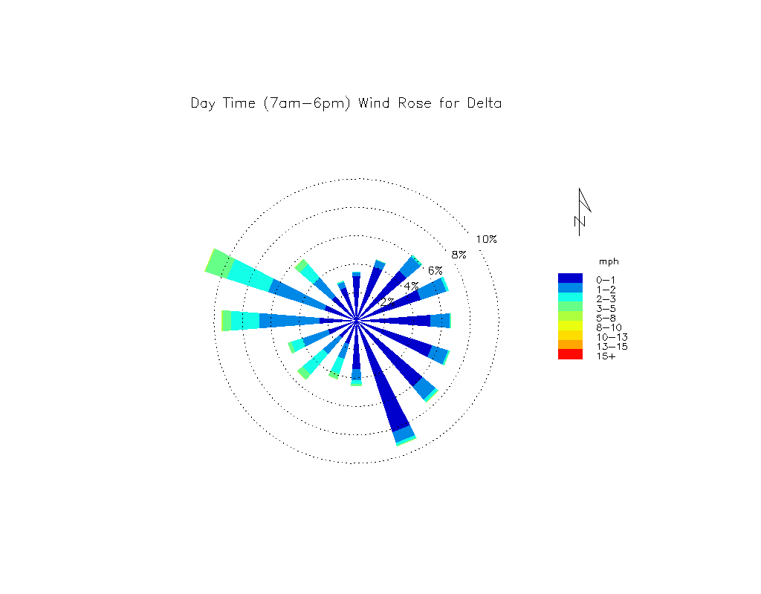
Wind Rose

Slide 18
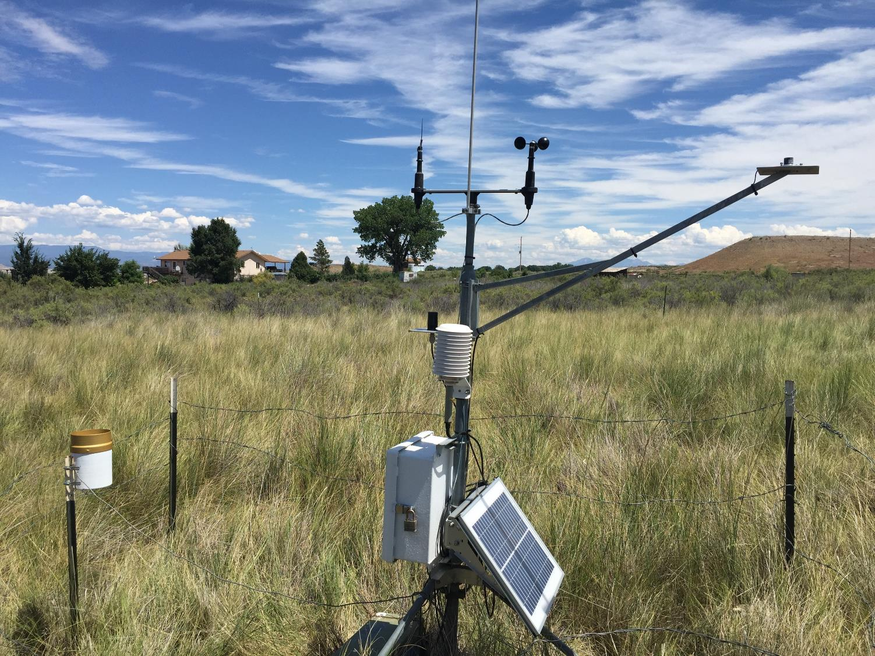
CoAgMet example ET Data

Slide 19
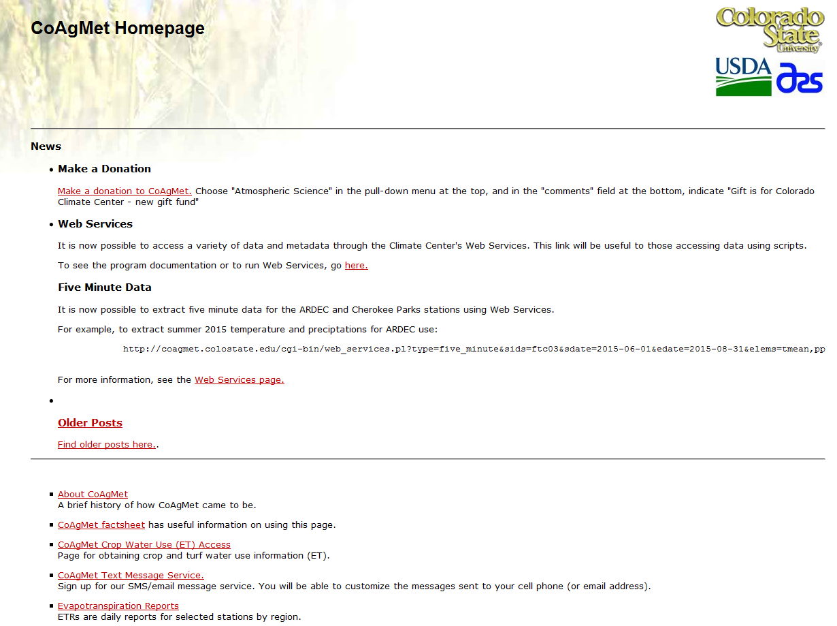

Slide 20
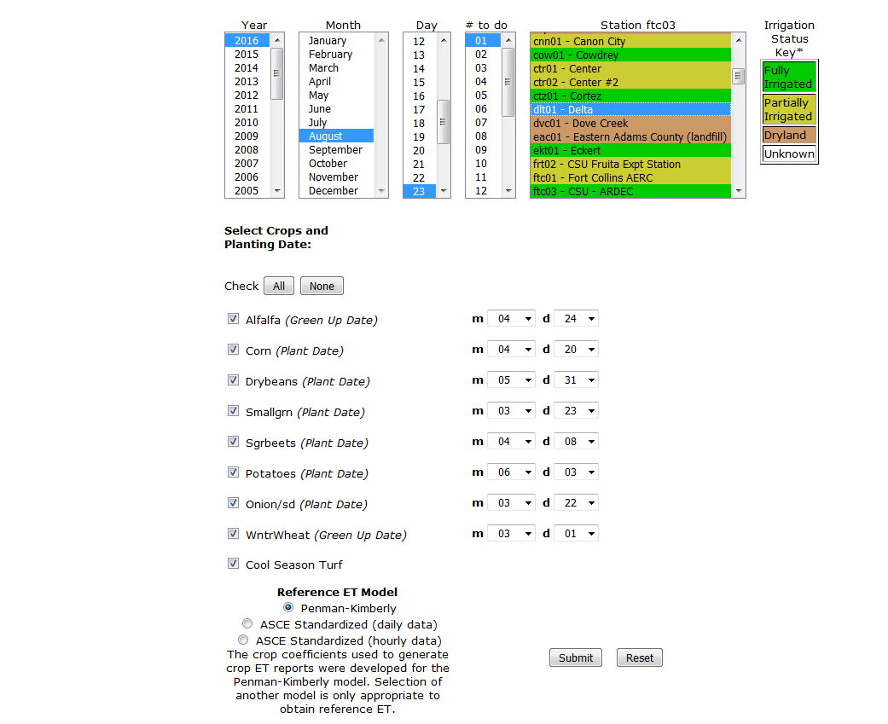
Select from a number of crop types.

Slide 21
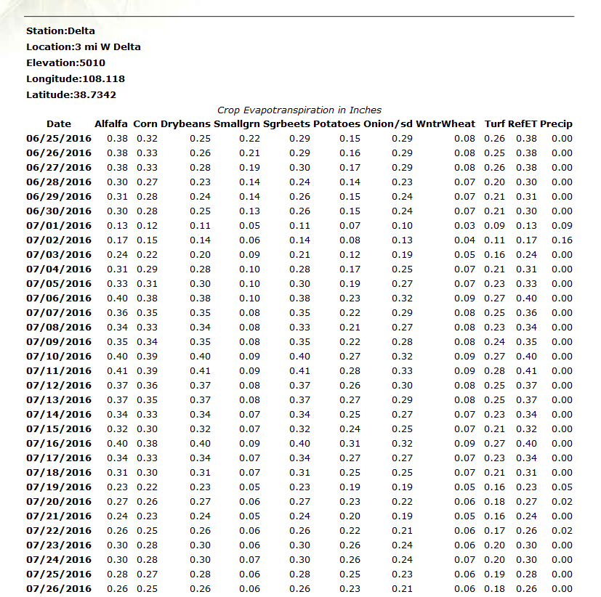

Slide 22
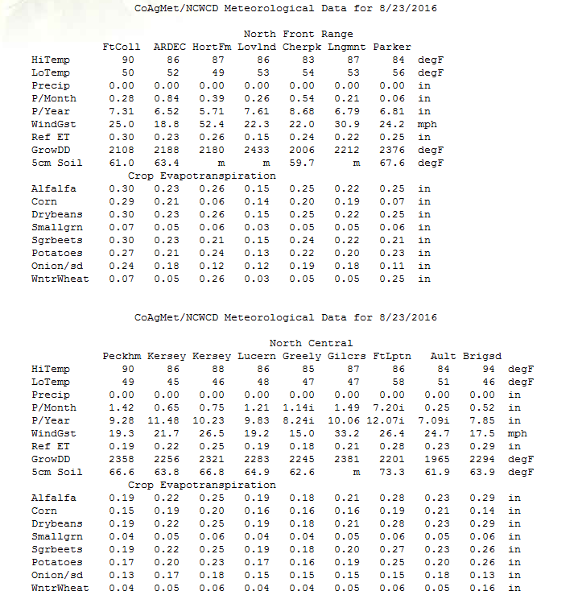
ET reports by region

Slide 23
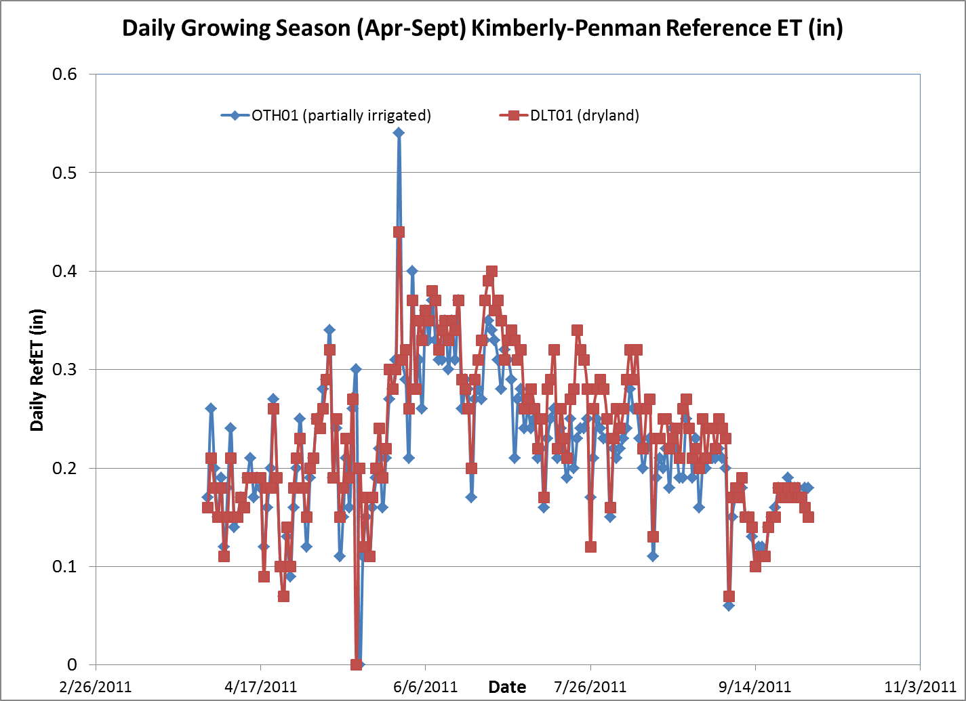
How daily alfalfa ref ET for a dryland site in Delta compares to irrigated lands near Olathe

Slide 24
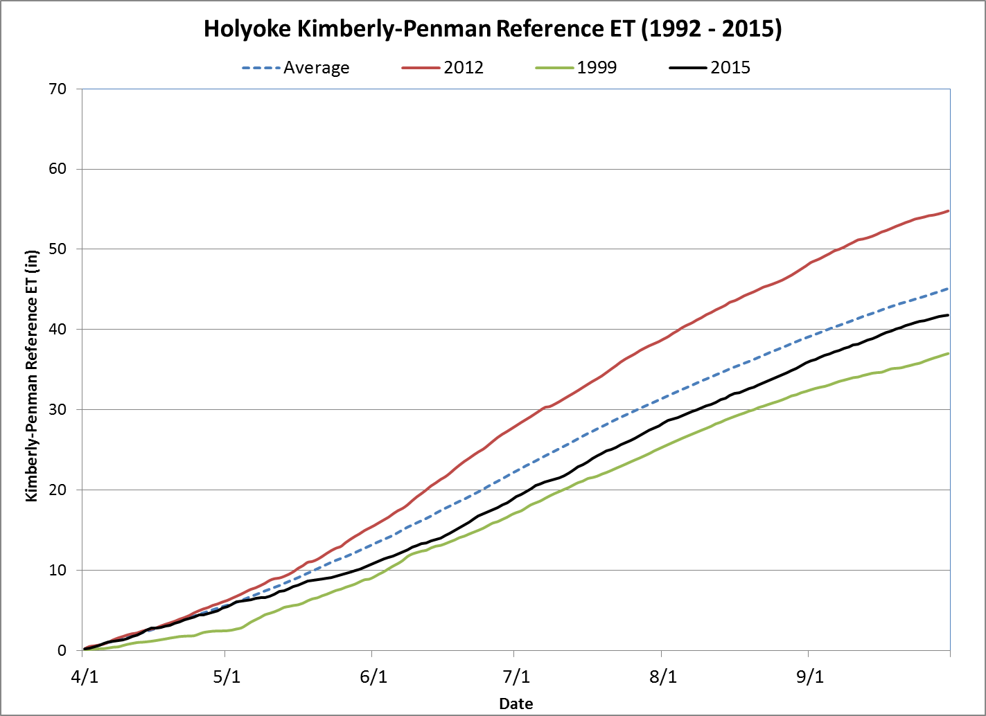
Growing Season Accumulated Ref ET
Helps with Drought Monitoring

Slide 25
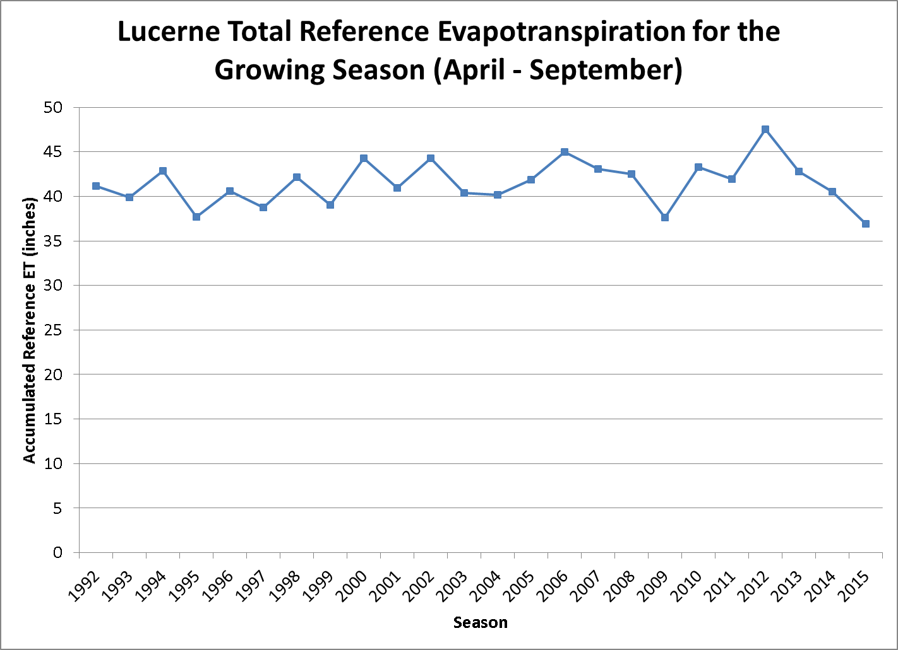
25 years of Ref ET Data now available

Slide 26
Maintenance of Network
Due to the fact that CoAgMet is run by collaborations and operates on a limited budget, routine maintenance is difficult with such a large network.
  There is no full time CoAgMet technician.
  We do rely on partners for easy fixes.
Our goal is to visit each station at least once a year to make sure the station is operating properly.
  Sensor are swapped out once every 2 years.

Slide 27
Funding
Agriculture Experiment Station
  Within the Colorado Climate Center Budget
Station Sponsors
  Water Conservation Districts
  CSU Extension Offices
  Municipalities
  USBR!
Arkansas River Compact Administration

Slide 28
State of Colorado Funding
Basin Roundtables
  Support to learn more about consumptive of irrigated crops and hay meadows
Major funding from the State of Colorado
  First time we have received major funding from the state
  For continued calculations of consumptive use
  To begin running the network as a reliable mesonet with near real-time data.
  Support to continue running RCRN stations and bring them into the network.

Slide 29
What have we done with these funds
Kept the network running with quality data!
Developed a QC app and have started aggressively QC’ing data.
Developed a CoAgMet mapping and metadata system!

Slide 30
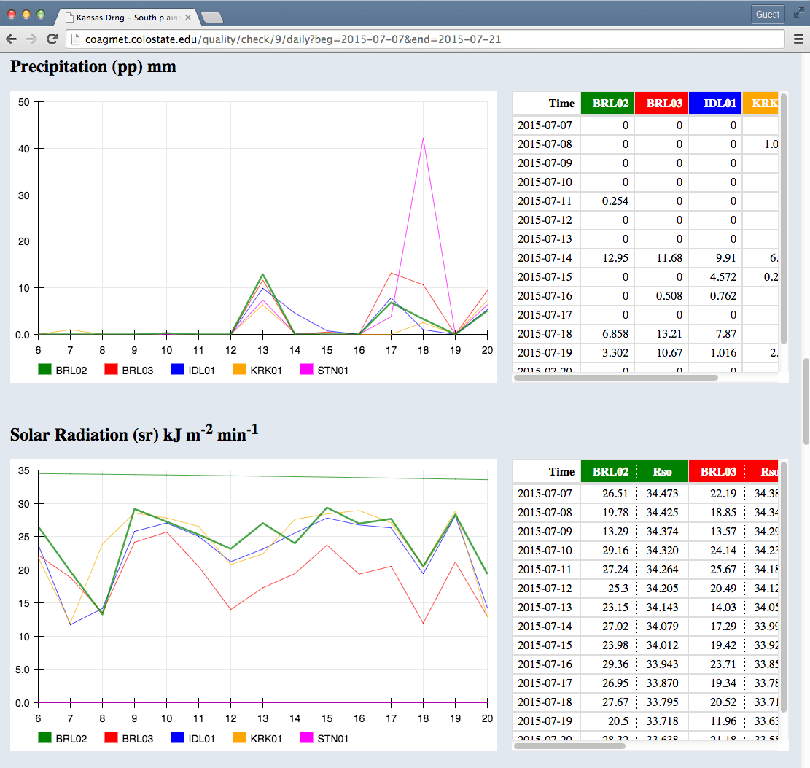
QC App

Slide 31
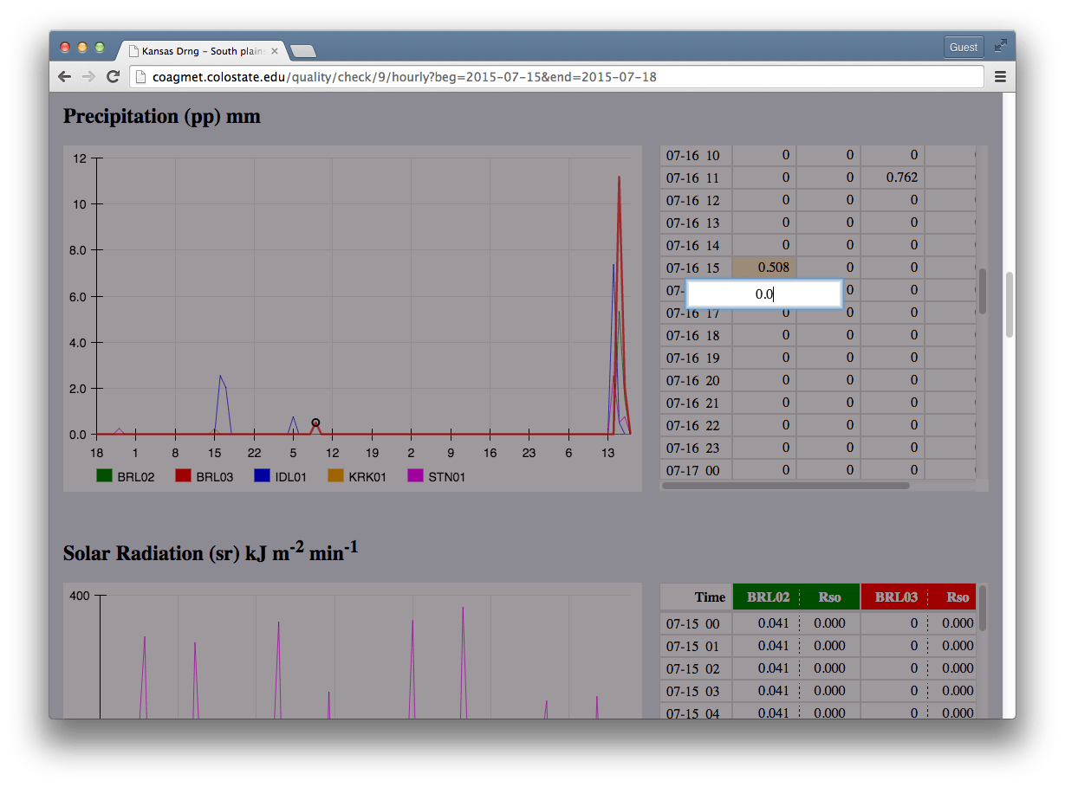
Correcting bad data in data table

Slide 32
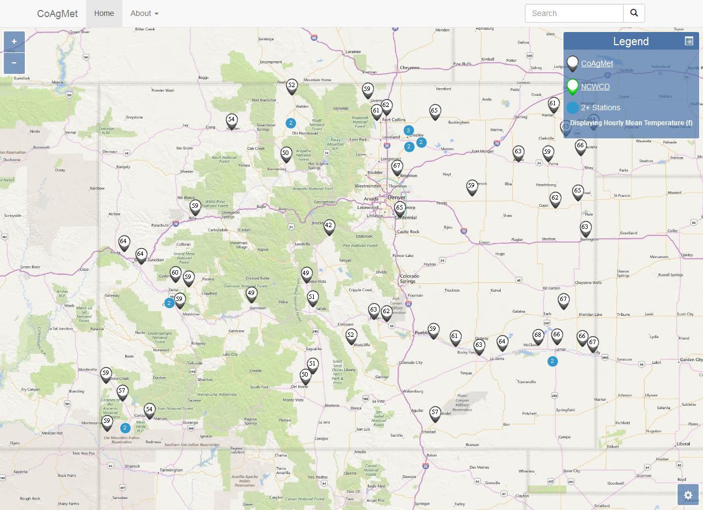
An interactive map

Slide 33
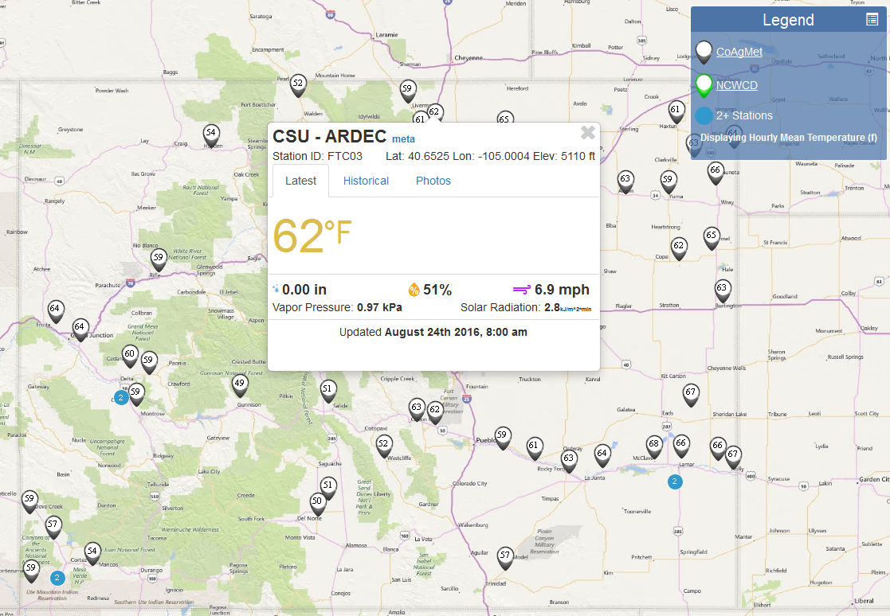
Most recent data for specific station

Slide 34
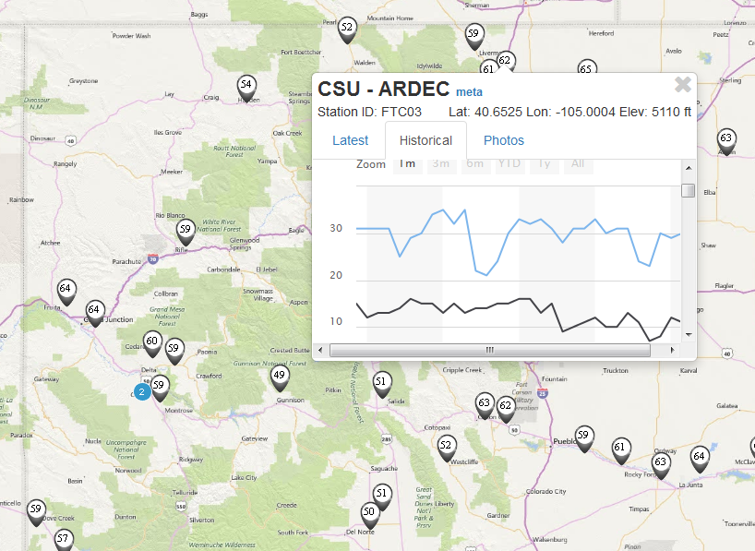
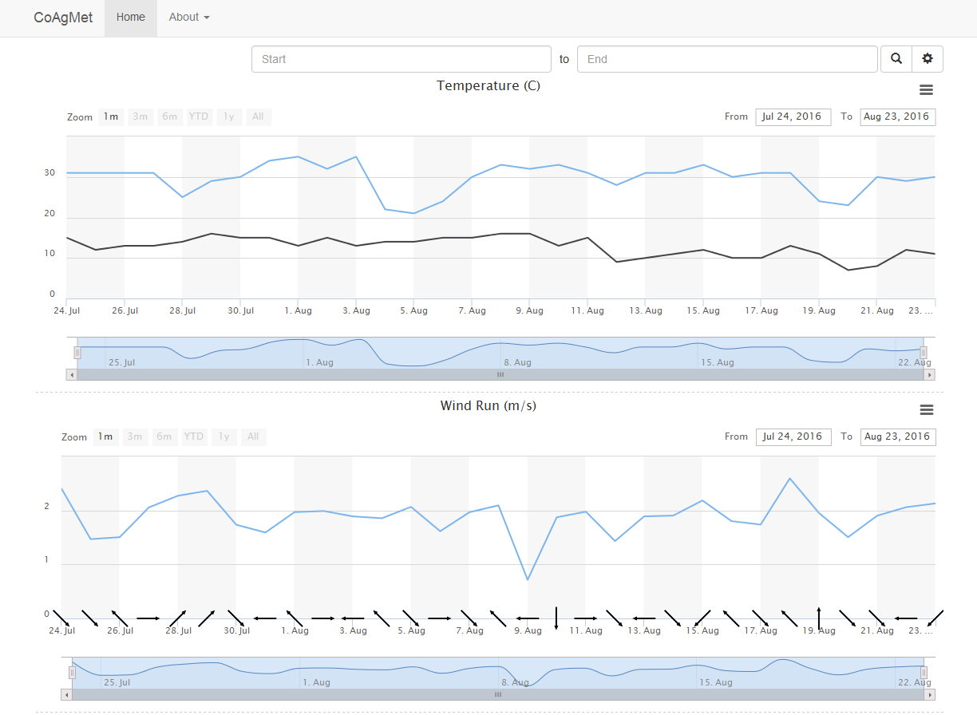
Can view historical data

Slide 35
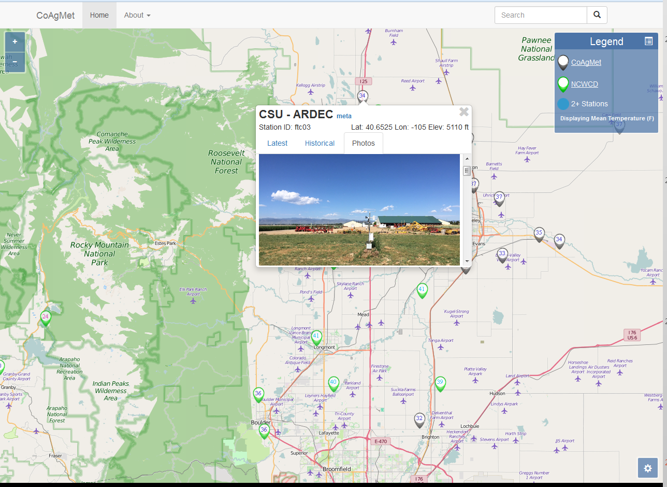
Station Photos

Slide 36
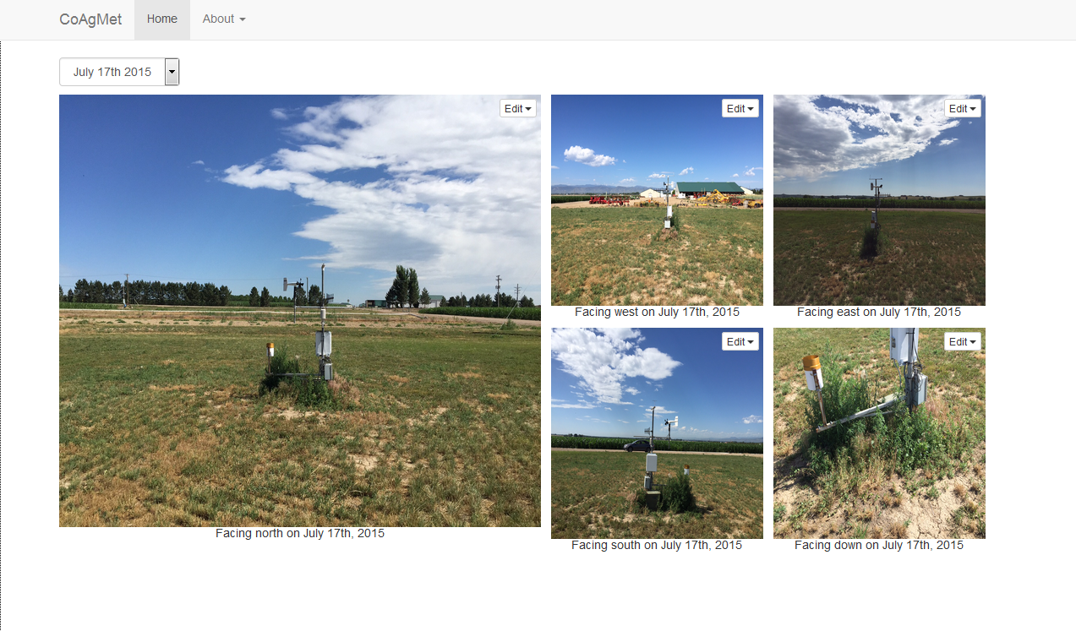
All 4 directions plus the ground, and past photos

Slide 37
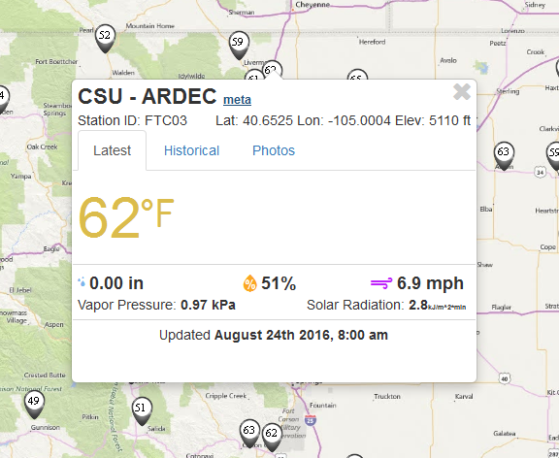
Station metadata

Slide 38
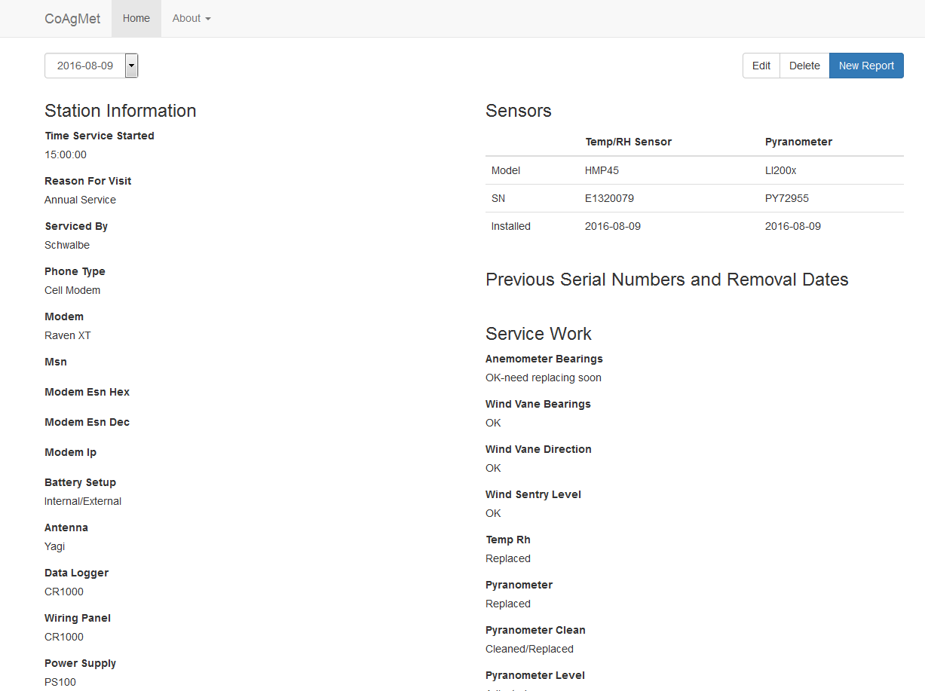
Including sensor information, last visit, what was performed.

Slide 39
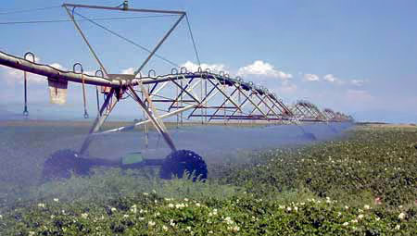
CoAgMet web access:
http://ccc.atmos.colostate.edu/~coagmet/

