Slide 1

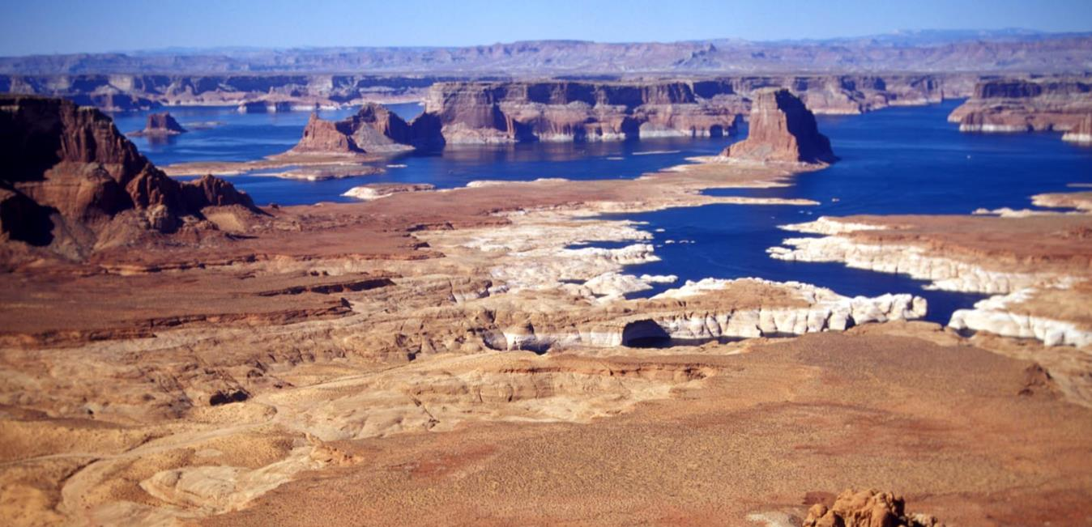
Building an Agency-Wide Water Data Information System for Reclamation
Initial Pilot: Reservoir Water Data
FY2016-FY2017
August 2016
Angela Adams, Jim Nagode, Allison Danner, Bryan Iversen
Notes:
Intro

Slide 2
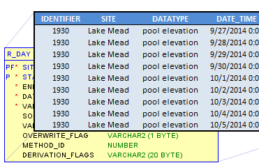
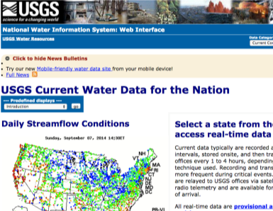
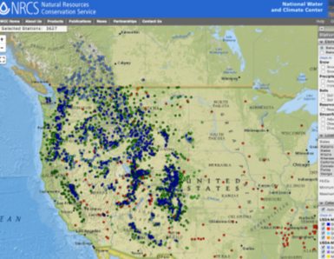
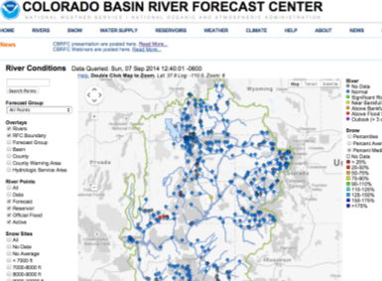
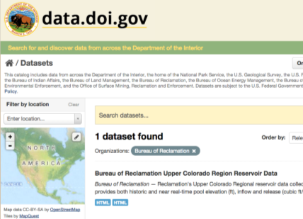
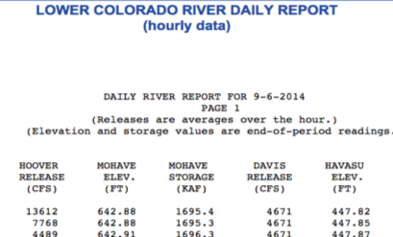
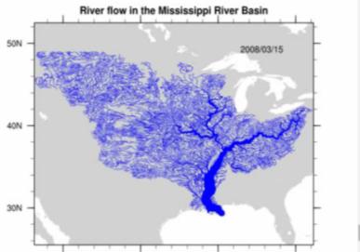
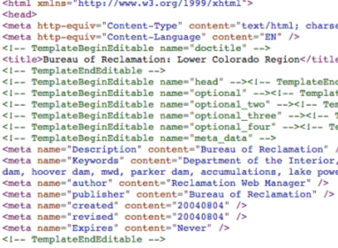
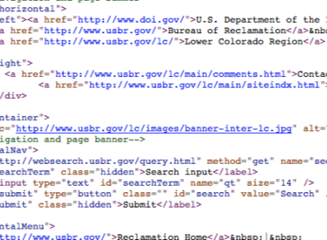
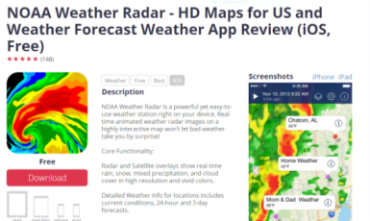
The value of data is in the sharing
Data in Spreadsheets, Databases
Tools Prepared by Others
Integrated Maps
Public Data Portals
Human Readable Data Formats
Advanced Models
invalid bareword "detected"
in expression "detected-0";
should be "$detected" or "{detected}" or "detected(...)" or ...
(parsing expression "detected-0")
invoked from within
"expr $yx-$yn"
(procedure "plotline" line 394)
invoked from within
"plotline "" 300 600 10 10 $nticks "" 1 $ydec $esec $ymax 1 $ylabel $fy2 $fy2param $flabel $plotname.$opid.$field.png "GMT
Machine Readable
Data Formats
Applications
Notes:
The Value of Data is in the Sharing
We derive value from data through sharing it
Reclamation has old data sets, and data gets denser as we get closer in time (historical data – maybe at the daily scale; modern data (80s), hourly and 15 minute)
We are moving from the days of data in spreadsheets and human readable formats (where we are now)
to machine readable, public portals, and ultimately to value-added products
Red box is where we are now

Slide 3
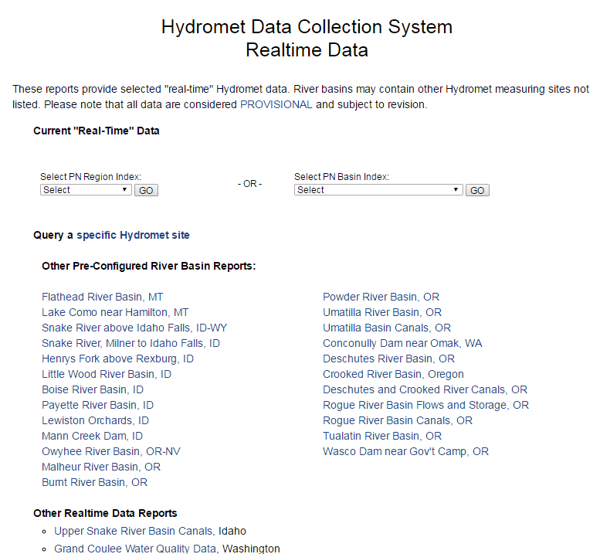
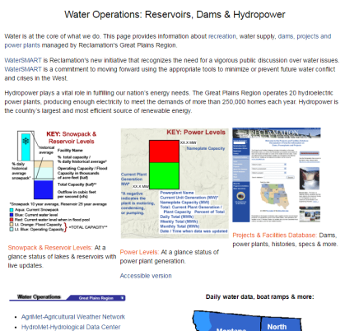
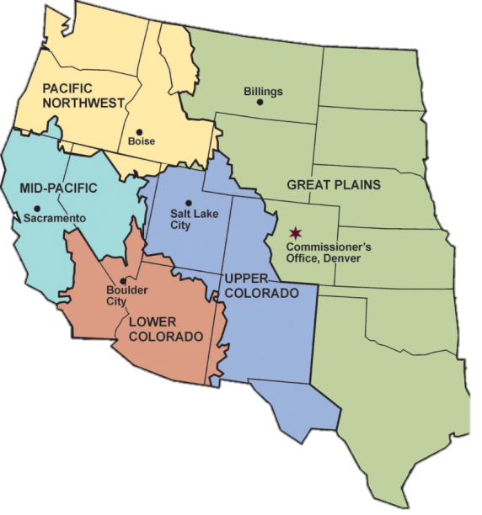
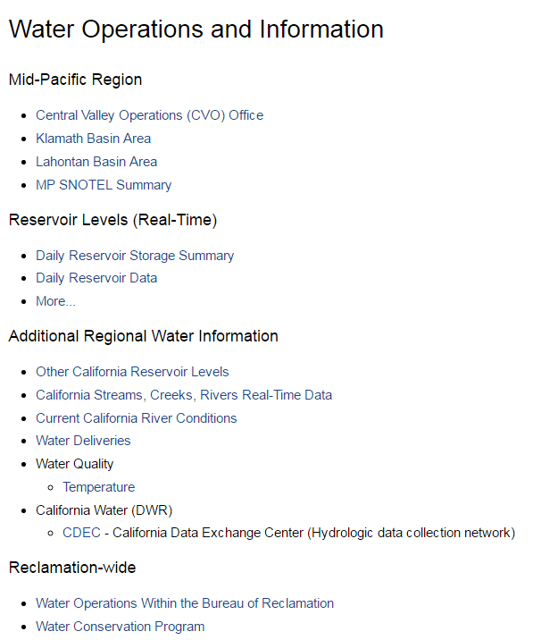
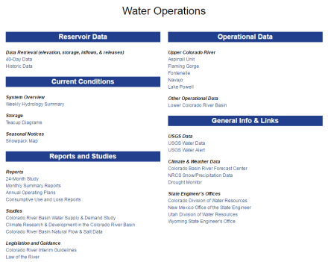
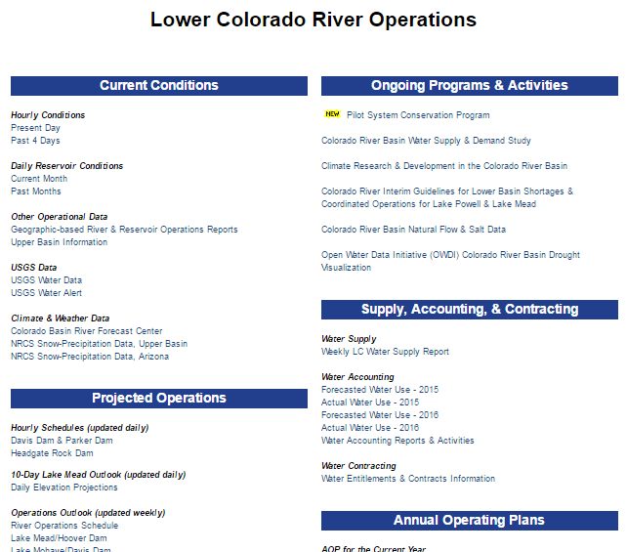
Where are we now?
Region-Specific Data Pages
Notes:
Where are we now – accessing Reclamation data
Things are in different places
No standard formats for data
Different databases
No single interface to access all of reclamation data
Different types of data requests from each of the regions

Slide 4
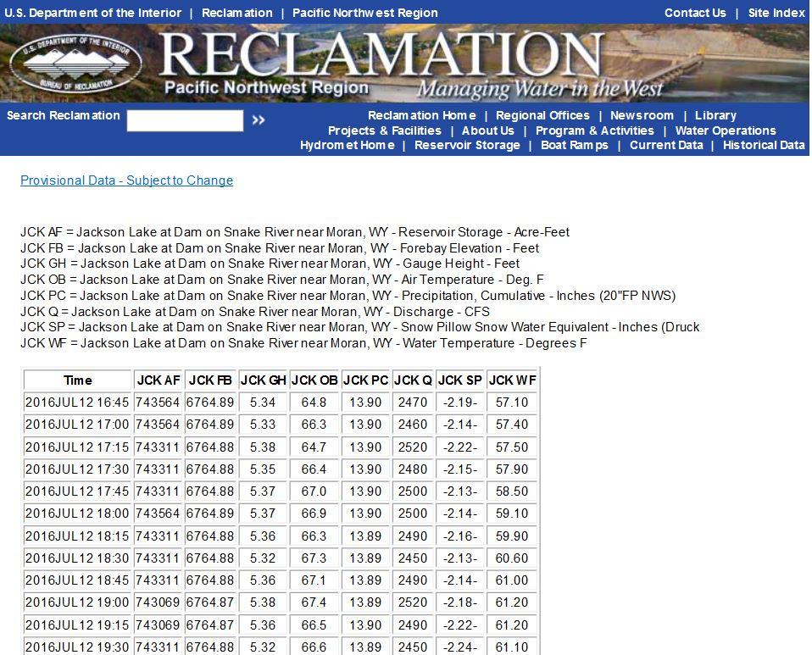
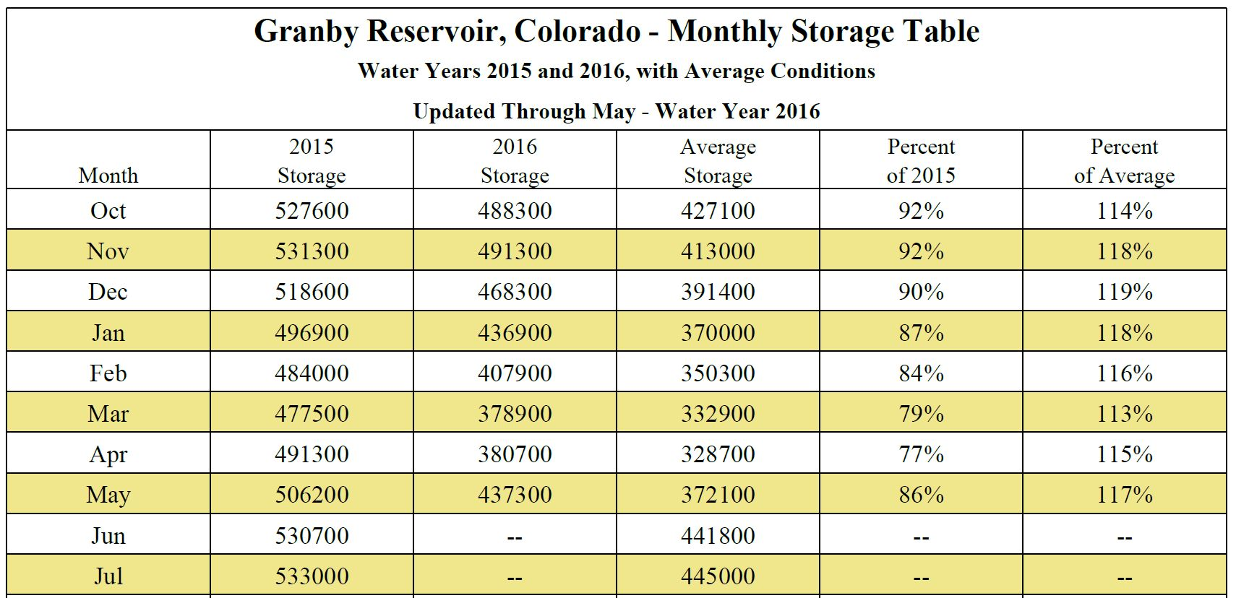
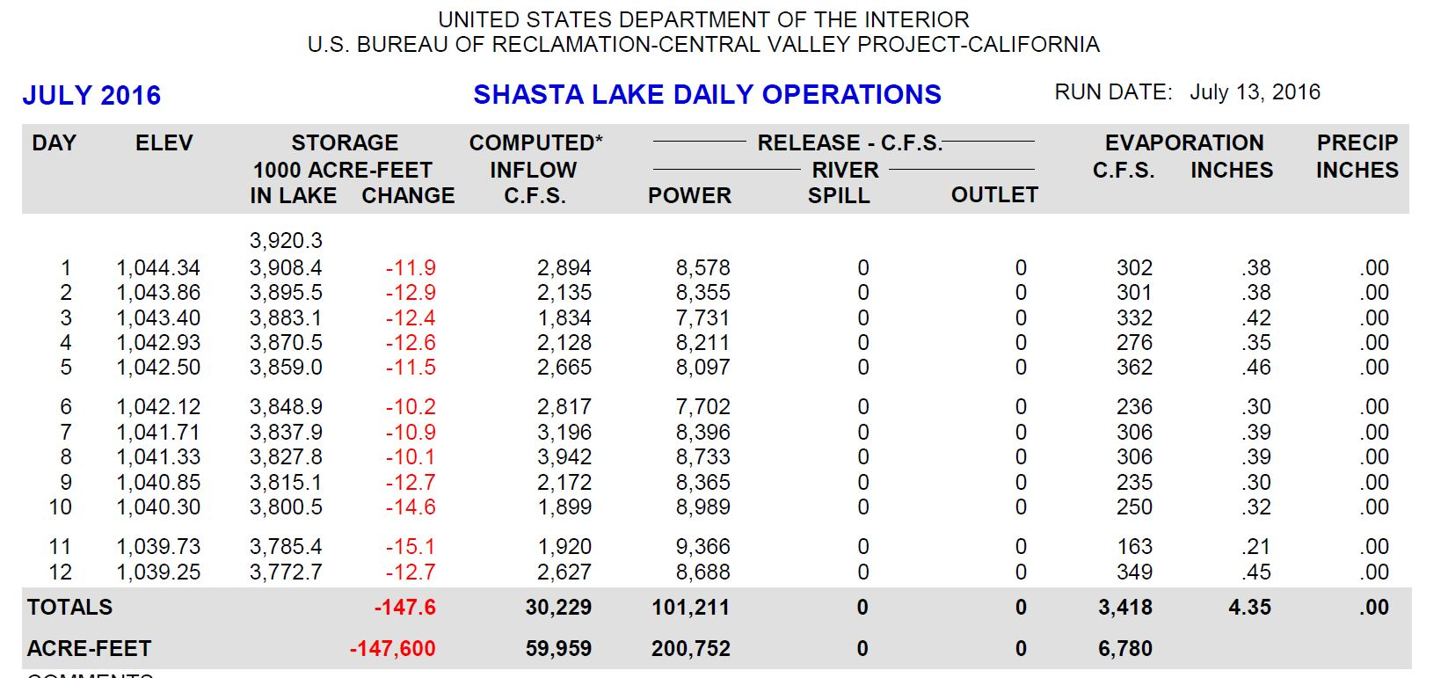
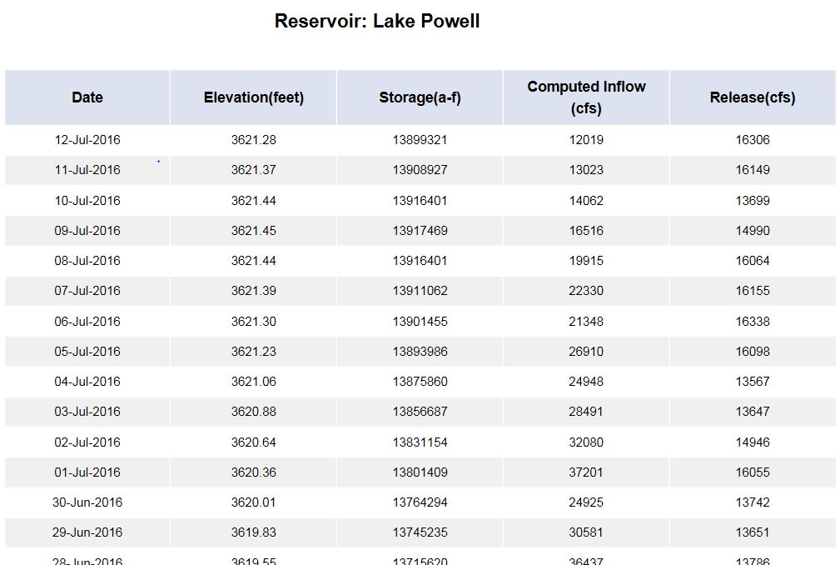
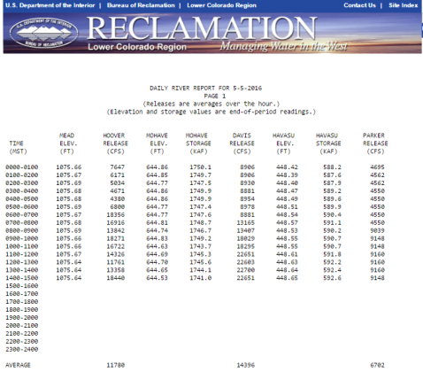
Where are we now?
Region-Specific Time-Series Water Data
Notes:
Where are we now – accessing Reclamation data
Disparate data sources
Different presentation style/format
PDFs, so not even machine readable
Parameters labeled differently -- e.g., Hydromet - reservoir storage called AF (acre-feet); in HAR called LS (lake storage)

Slide 5
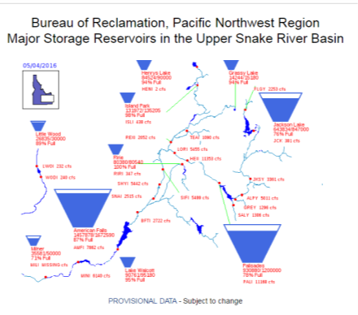
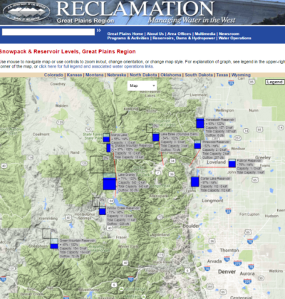
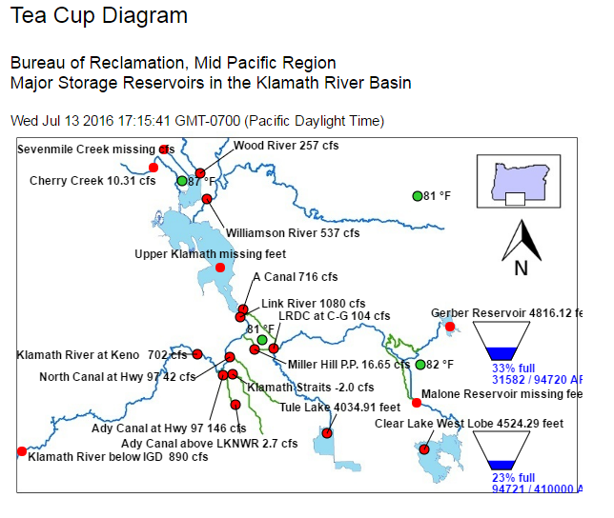
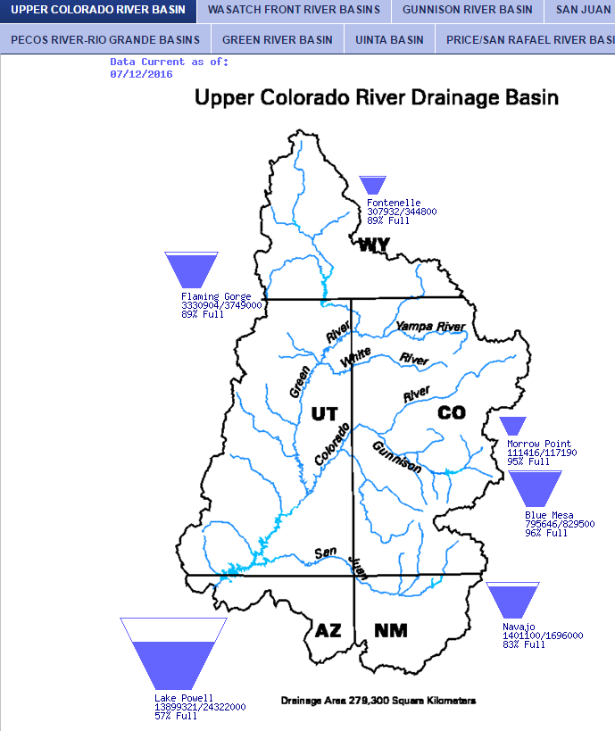
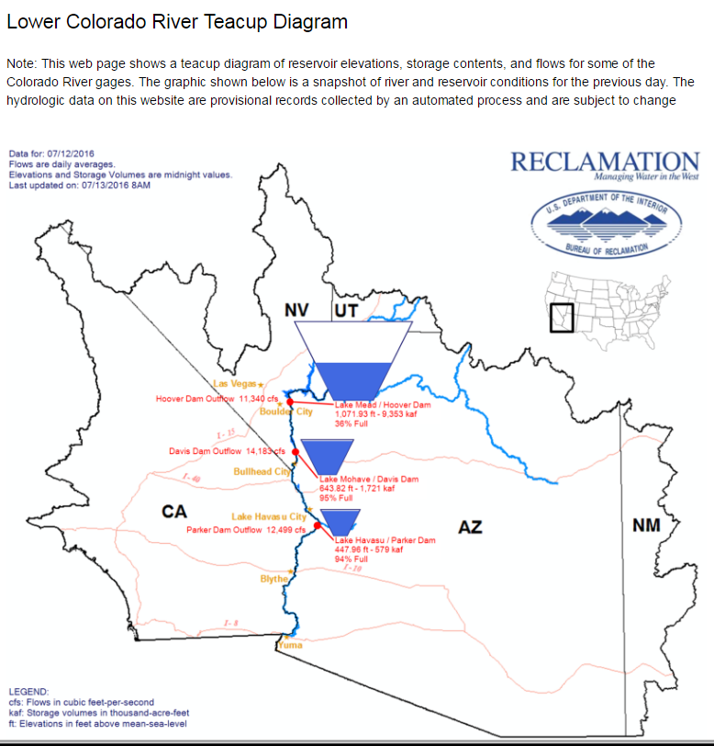
Where are we now?
Region-Specific Data Presentations
Notes:
Where are we now – data outputs
Different databases
Different data outputs – some machine readable (few), most not
Some graphic, some query data
No web services
Several different map viewers
Some graphic interfaces
* PDF & HTML output
* Some query data
* Several [different] map viewers
* Little downloadable data
**No web services**

Slide 6
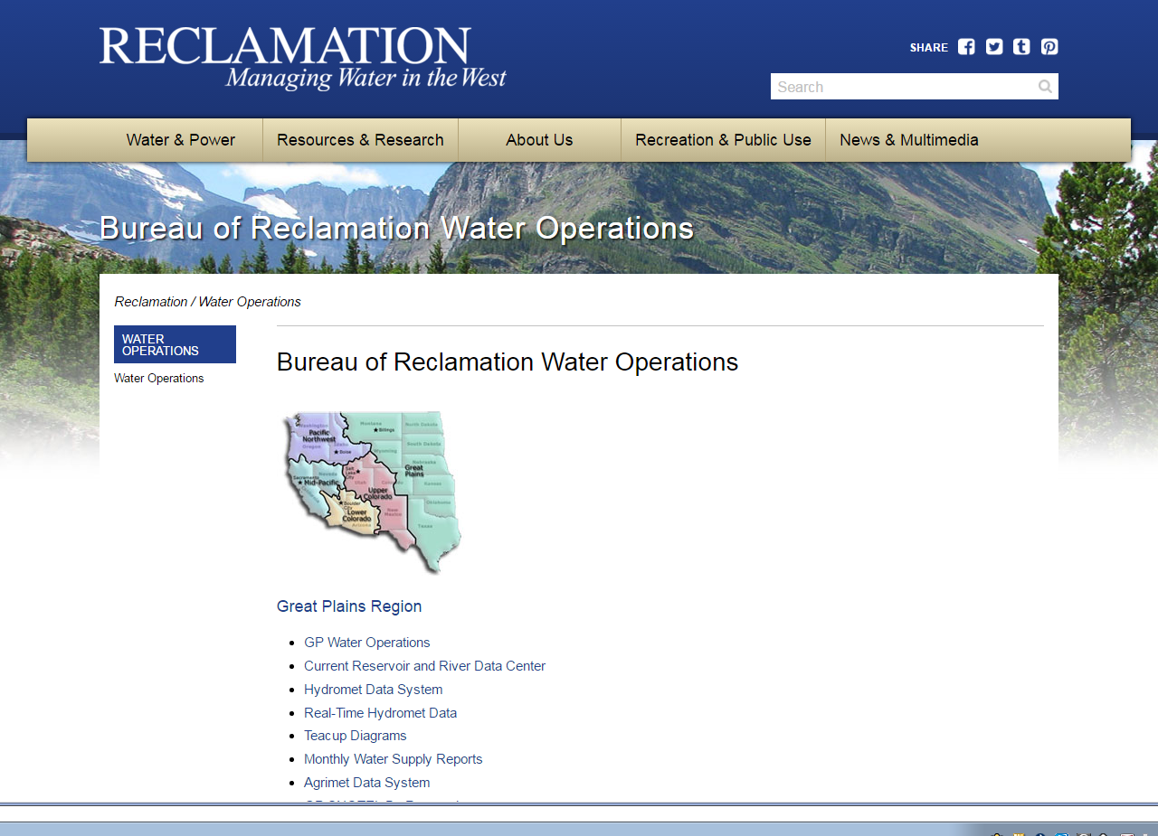
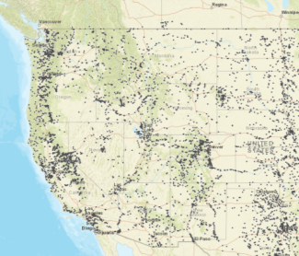
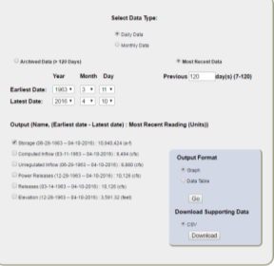
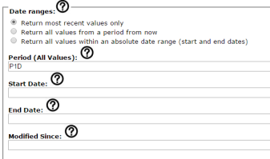
Where are we going?
Reclamation’s water data in one place
Access Reclamation time-series water data through the portal options below:
Web Services
Map
Query Tool
Notes:
Reclamation’s water data in one place
Project Goal is to create a single location from which to access Reclamations water data
Similar to NWIS
Three components: map, query tool and most exciting – web services, to eventually allow automated access to data
This project will be rolling out this year – end of CY16, early CY17
Value Proposition of the project - more accessible, comparable, described
Recognize data has been available for years, but data not machine readable/available, but always we’ve had as asset
“Splashy” - Reclamation-wide tea-cup diagram -- after this project, someone could get the data from a single and build
Current state: we don’t have teacup diagrams for every region, or even for all of Reclamation; we would have to go to different locations
After this project - someone can pull the data from a single location and build a Reclamation-wide teacup diagram.

Slide 7
Pilot Architecture & Tasks
Regional Database
Regional Database
Regional Database
Kickoff the project
Assemble system infrastructure (hardware, software)
Develop a common data standard for Reclamation water datasets
Develop a metadata application to allow data stewards to manage data
Build the data portal
Connect the regional databases to the central database and portal
Begin security documentation
Complete a security review and get Authority to Operate
Launch the site
Get feedback on pilot
Metadata Application and Syncing Tool
Spring / Early Summer
Central
Database
Firewall
Summer
Replicated
Database
RWIS Web Portal
Fall / Winter
Web
Service
Map
Interface
Query
Tool
Notes:
Architecture and Tasks
Essentially aggregating selected datasets from Regional databases
-- Syncing on a regular basis,
-- filtering them through a metadata filtering app for data to be public or not,
-- replicating the public datasets to an external database,
-- making available on a public website through the access tools.
Timeframe is aggressive:
Spring for foundational work on data standards, infrastructure
Early Summer for metadata app, interfaces and website
Late Summer for testing
Fall for security review and launch prep
Early 2017 for launch
-- Iteration in 2017 and 2018

Slide 8
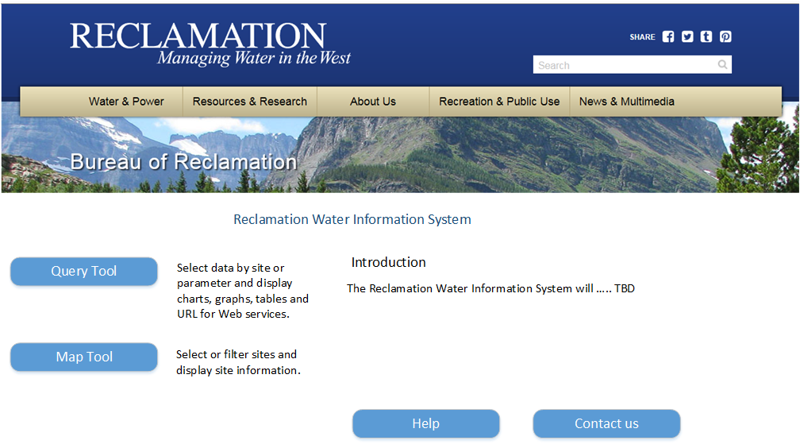
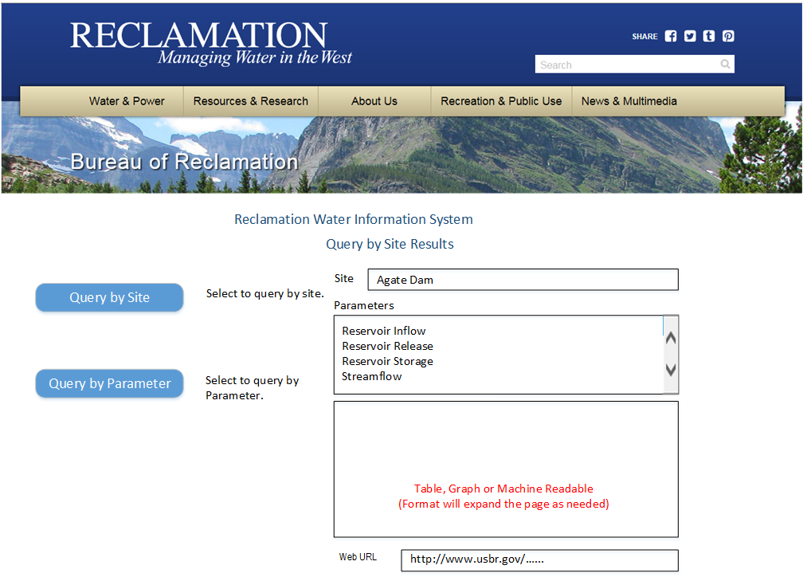
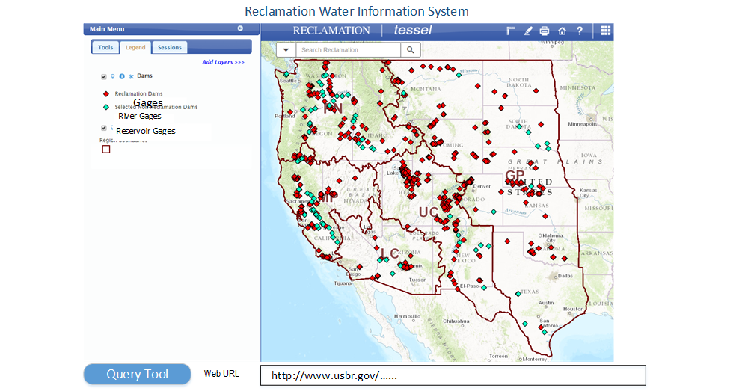
Expected Product:
Basic Web Data Portal
Query Tool
Map Tool
Notes:
Web Portal Mockups
Web service behind the scenes available for machine-to-machine communication

Slide 9

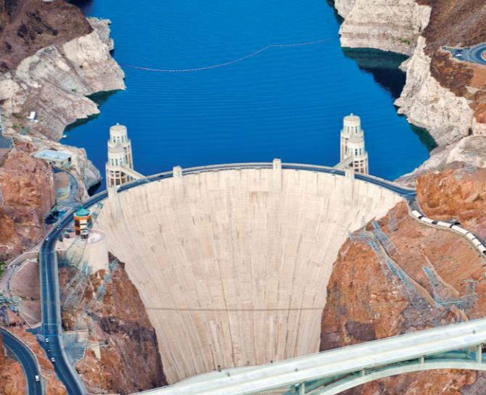
Building an Agency-Wide Water Data
Information System for Reclamation
Angela Adams - aadams@usbr.gov
Jim Nagode – jbnagode@usbr.gov
Allison Danner – adanner@usbr.gov
Bryan Iversen – biversen@usbr.gov
7
Notes:
Sources:
Hoover Dam photo: http://www.hdrinc.com/sites/all/files/content/projects/images/246-hoover-dam-bypass-4270.jpg

