Slide 1
NEGOTIATION OF INDIAN WATER RIGHTS CLAIMS: THE BASICS
Gathering Background Information and the Role of Technicians In Negotiations
Special Edition: How to Deal with Data Gaps during Negotiations (or not)
Christopher Banet, Water Resources Manager, BIA, Southwest Region

Slide 2
Common Data Gaps popping up during Indian
Water Rights Settlement talks (in the
Southwest US):
Water Supply (old and new)
Hydrographic Survey
Tribal Water Demand

Slide 3
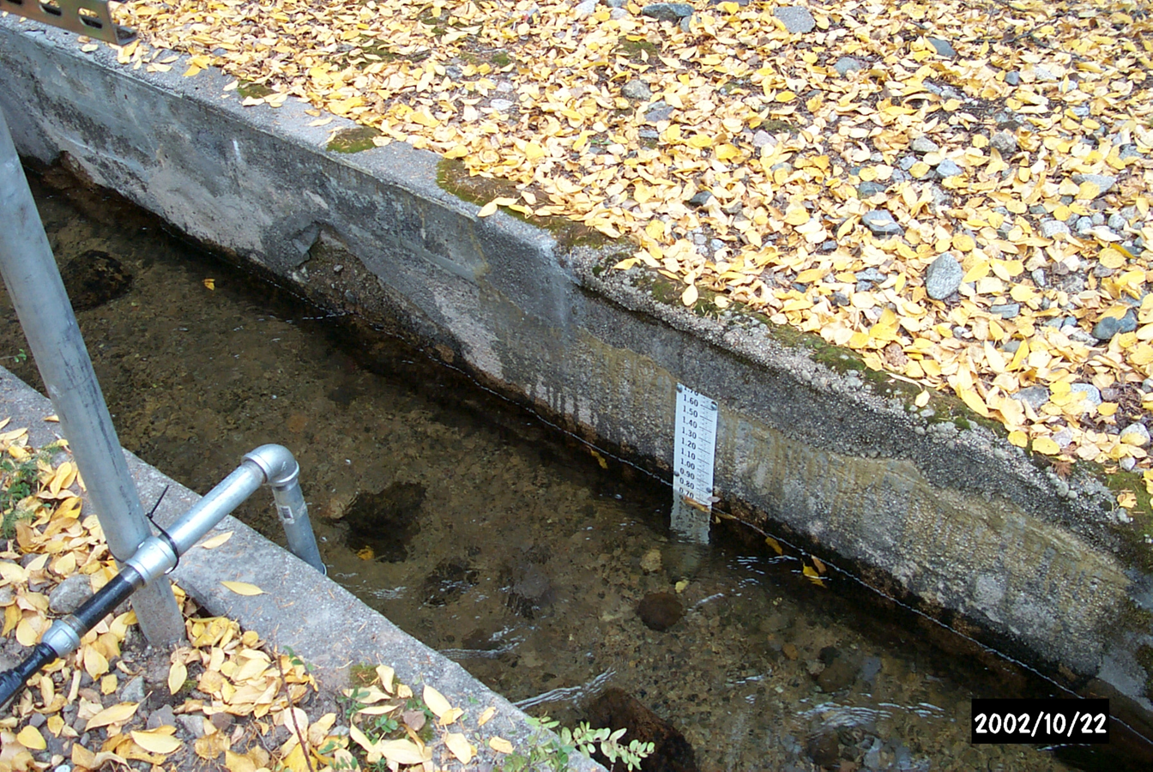
Taos – water supply, old

Slide 4
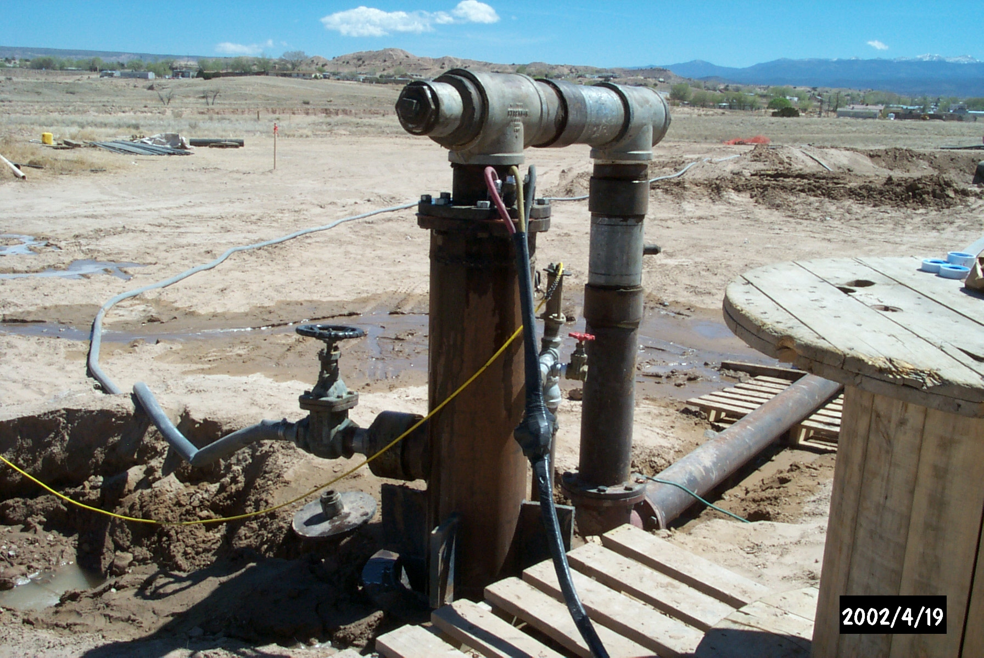
Taos – water supply new

Slide 5
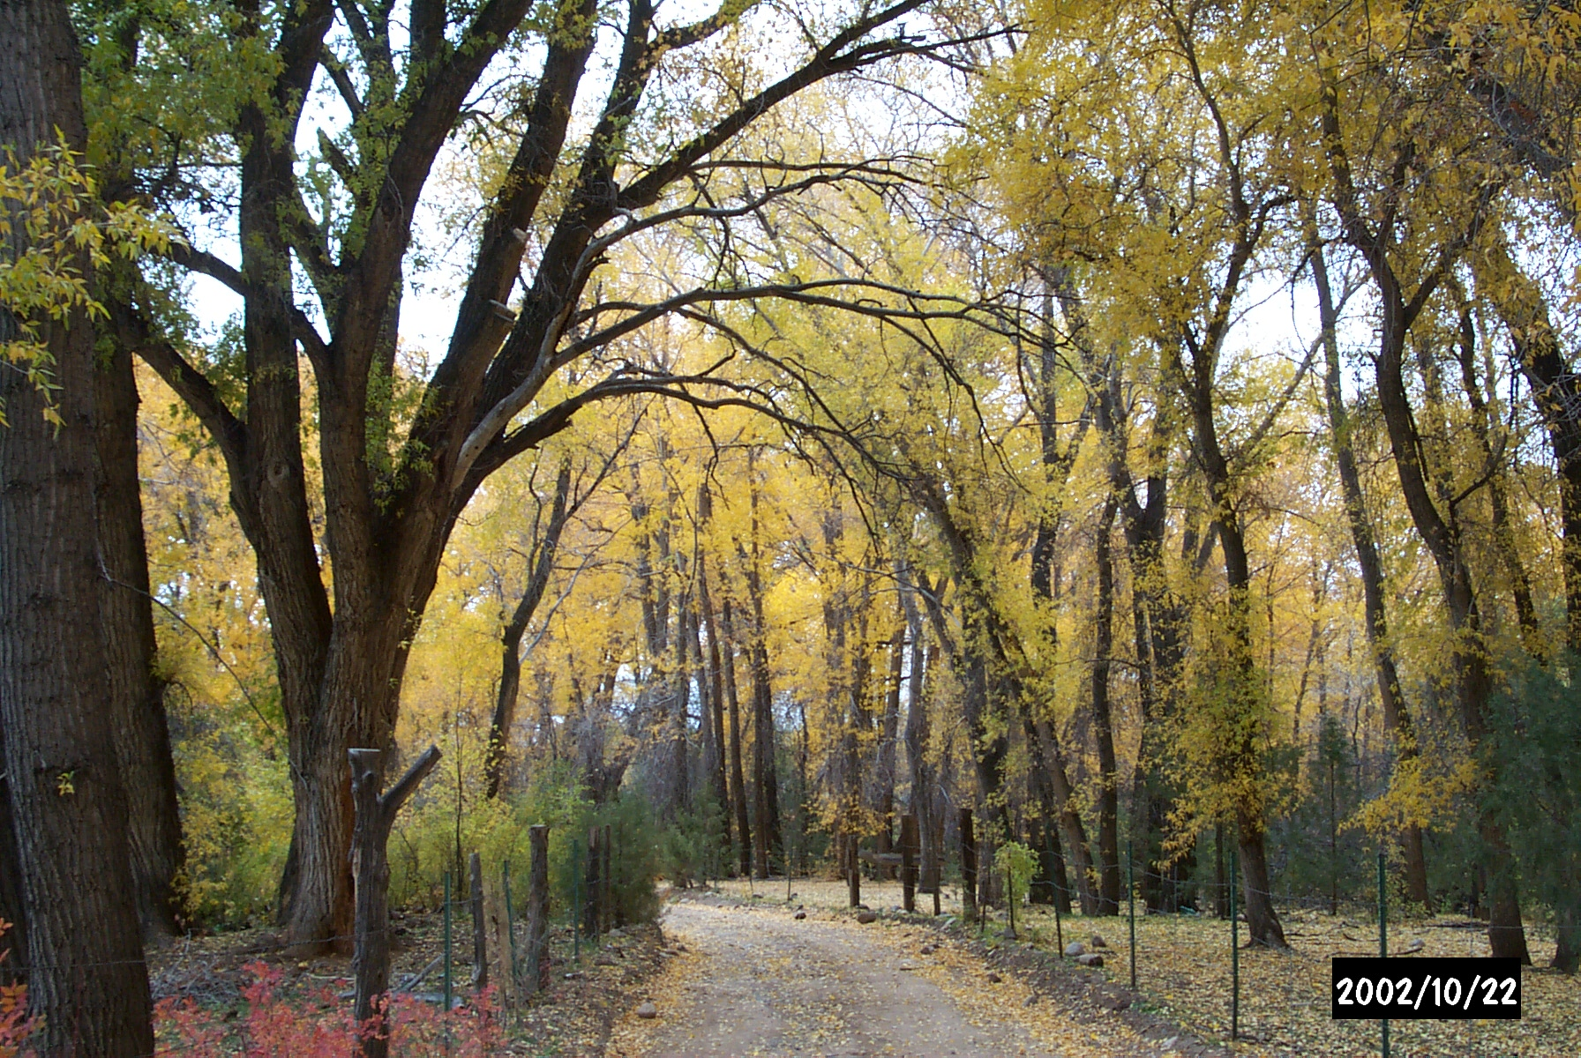
Taos – water supply new

Slide 6
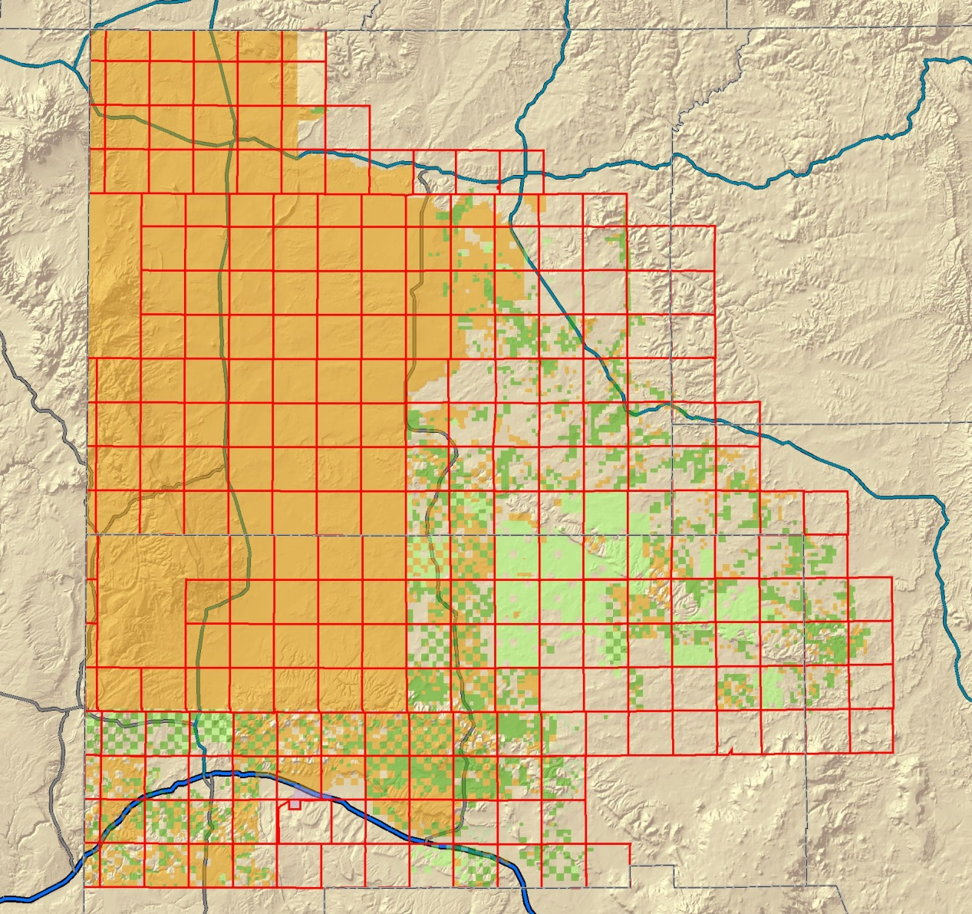
Navajo – Hydrographic Survey

Slide 7
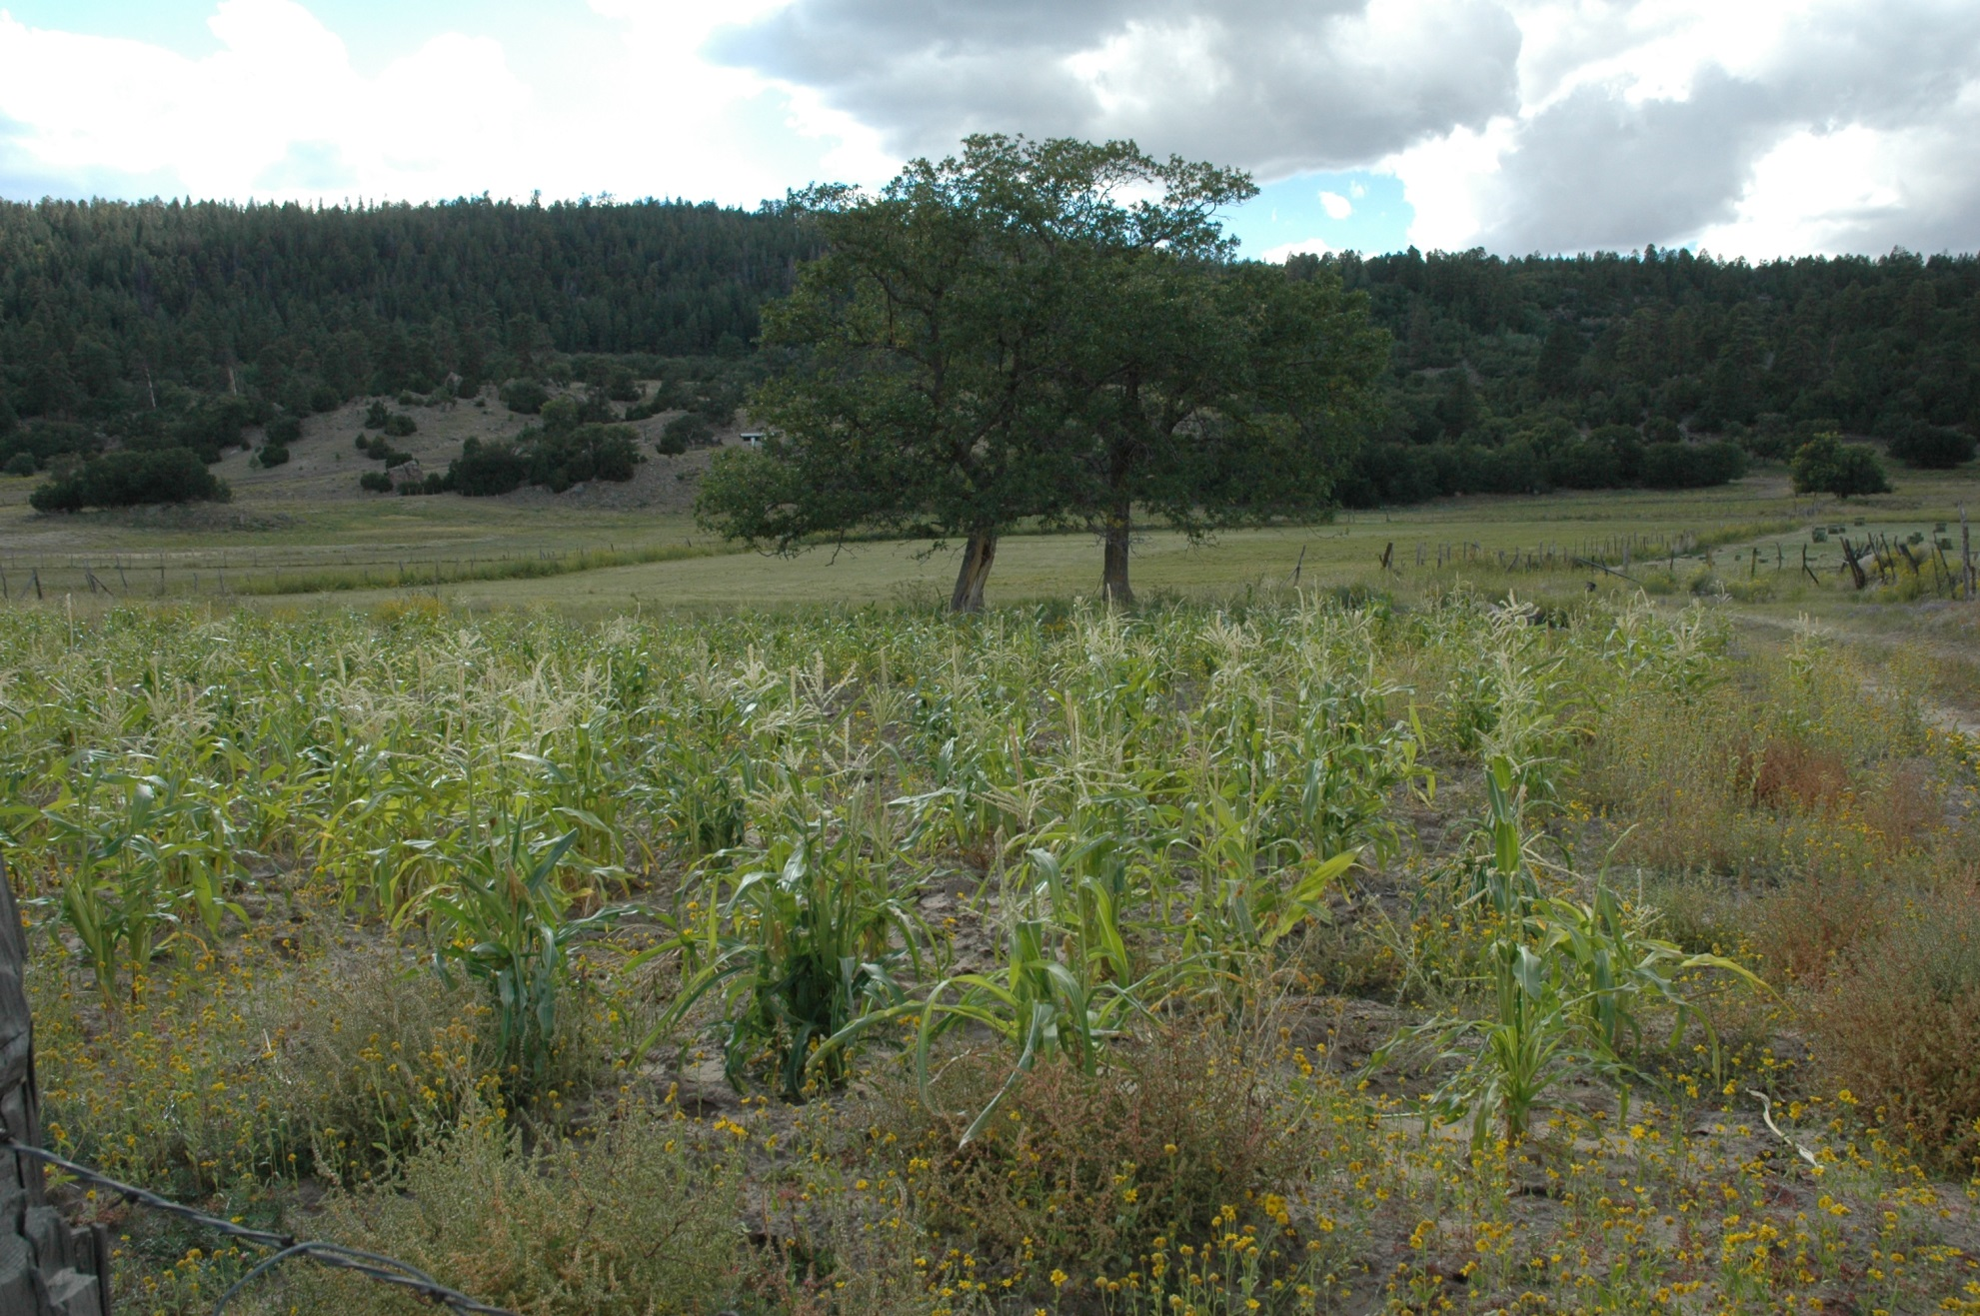
Navajo – Hydrographic Survey

Slide 8
Jicarilla – Hydrographic Survey

Slide 9
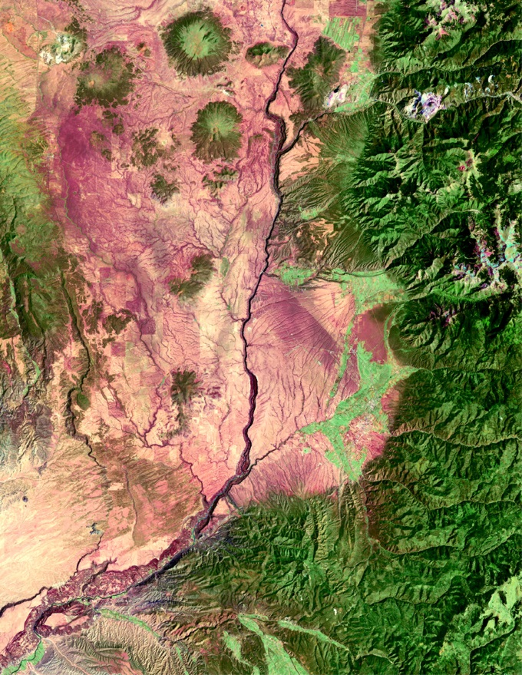

Taos – Tribal Water Demand

Slide 10
Proceed

