Slide 1

How Oregon Uses the National Hydrologic Dataset (NHD) to Route Water Rights
Ken Smith, IT Manager
Oregon Water Resources Department
January 16, 2018

Slide 2
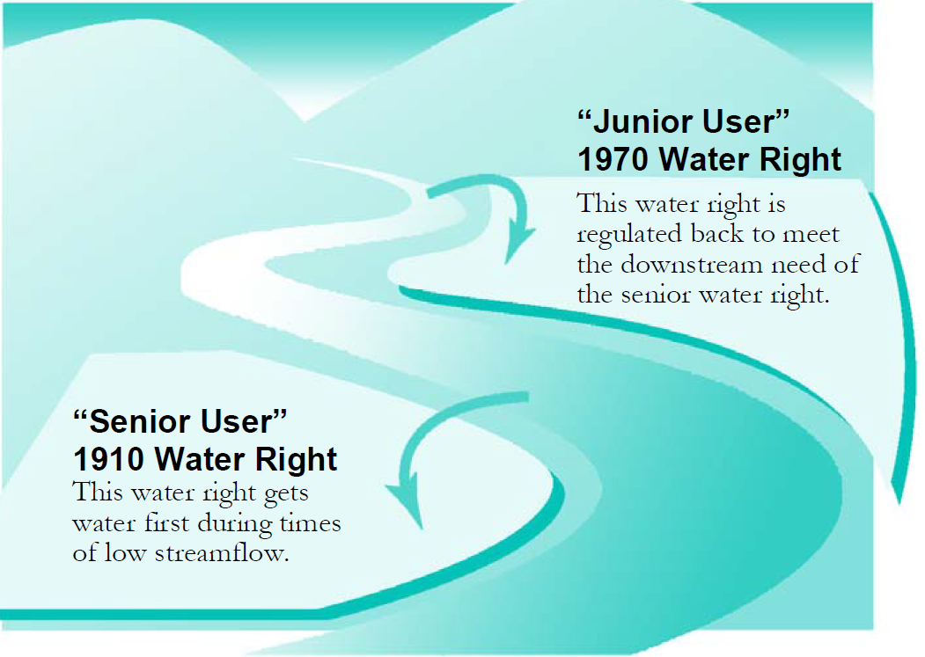
Oregon Water Law - Prior Appropriation Doctrine

Slide 3
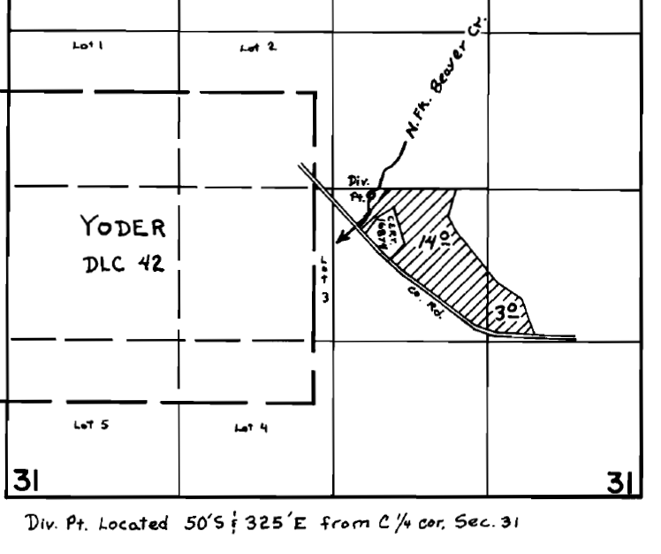
How do map water rights?
Paper Map
GIS
Willamette River
N. Fk. Beaver Cr > Mill Cr
POD
Mill Creek> Willamette

Slide 4
What is a Stream Code
Describes the relationship of that stream to all streams in it’s downstream path.
Example:
N. Fk. Beaver Cr > Mill Cr:
02-1140-890-0300
02 – Basin 2
  1140 – Willamette River
  0890 – Mill Creek
  0300 – N. Fk. Beaver Creek
02-1140 Willamette River
02-1140-890-0300
N. Fk. Beaver Cr > Mill Cr
02-1140-0890
Mill Creek > Willamette R
POD
Notes:
Find rights for a stream system:
Searching for rights with a stream code that start with 02-1140 would return all rights on the Willamette River and all of it’s tributaries.
Limitations
Can not limit it to a section of the Willamette River.
Can not tell if a right is upstream or downstream of other rights
This would be similar to just having the street name of a house without knowing the house number.

Slide 5
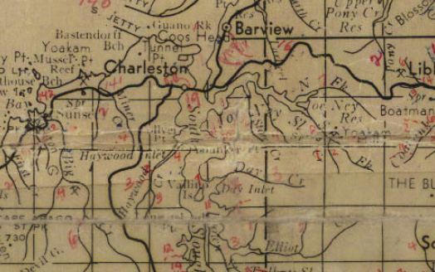
Stream Code/Mapping History
Early 1980s – Basin Maps
Manually written on a paper map!
Only streams with water rights were coded.

Slide 6
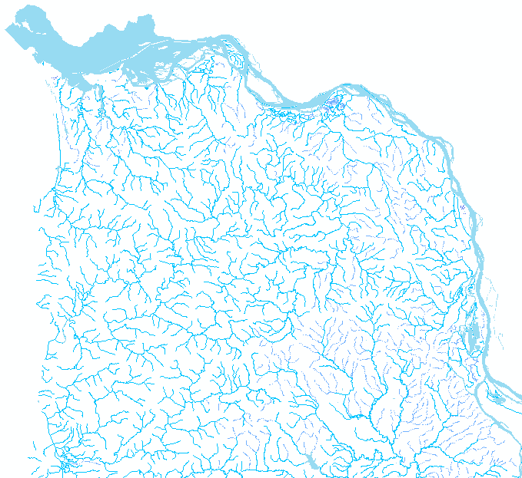
Stream Code/Mapping
Mid 1990’s – 100k Scale
Hydrography Map was 100k scale
Stream codes manually assigned from the paper maps
Stream cartography did not have flow directions or measures
Notes:
Not all 100K streams have stream codes.

Slide 7
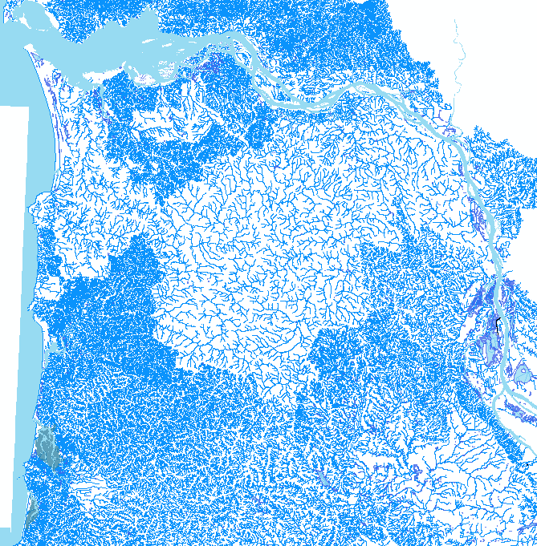
Stream Code/Mapping
Mid 2000 – 24k Scale
100k stream data was conflated to 1:24,000 scale stream data.
More accurate representation of the streams
More streams in 24k data
Stream cartography still did not have flow directions or measures

Slide 8
Stream Code/Mapping
2015 - National Hydrography Dataset
National standard
Based on 24k stream data
Includes flow direction lines
Includes measurements for the lines

Slide 9
Conflate NHD & WRD Streams
Annie Creek
(14009050100230270050)
NHD and WRD streams are overlaid
Fort Creek
(14009050100230270040)
Wood River
(14009050100230270 )

Slide 10
WRD Streams with Directionality, Indexing, and Confluences
19.80
Annie Creek
(14009050100230270050)
17.86
17.15
9.71
Fort Creek
(14009050100230270040)
3.63
Wood River
(14009050100230270 )
0.00

Slide 11
POD Indexes are Created for the Routed Stream Network
19.80
Annie Creek
(14009050100230270050)
17.86
17.15
9.71
Fort Creek
(14009050100230270040)
3.63
Wood River
(14009050100230270 )
0.00
Point of Diversion
Notes:
Indexes are created where the points of diversion would fall along the stream
We keep track of how far the point of diversion is located from the stream it is coded to.

Slide 12
It is now possible to select upstream PODs
19.80
17.30
Annie Creek
(14009050100230270050)
15.75
17.86
4.50
17.50
17.15
16.50
15.40
12.50
11.25
10.50
9.71
1.35
9.21
2.40
Fort Creek
(14009050100230270040)
4.80
7.30
3.00
2.50
3.63
Wood River
(14009050100230270 )
0.00
Point of Diversion
Notes:
Here is an example of the computed indexes that would be created in this example where PODs would fall along the stream.
Given this, we can now pick a point on a stream and identify all of the PODs that above or below that point.
Kirk Reef: The very day we got this working for our Klamath pilot, we were asked to identify rights above Kirk Reef on the Wood River. Prior to this technology, we would have spent several days trying to identify the area and select the rights that fall within that area. With the NHD, we were able to simply pick the point on the stream where Kirk Reef was system was able to return all the rights upstream from that point and we could respond to this request in a manner of minutes. Also, it made subsequent refinements of the data request much easier.

Slide 13
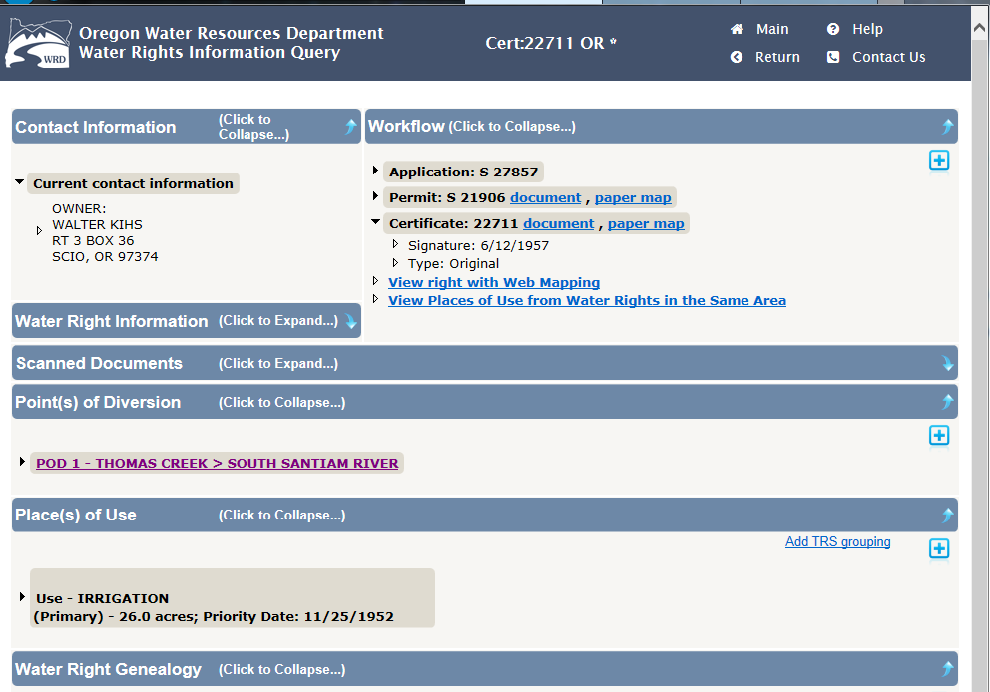
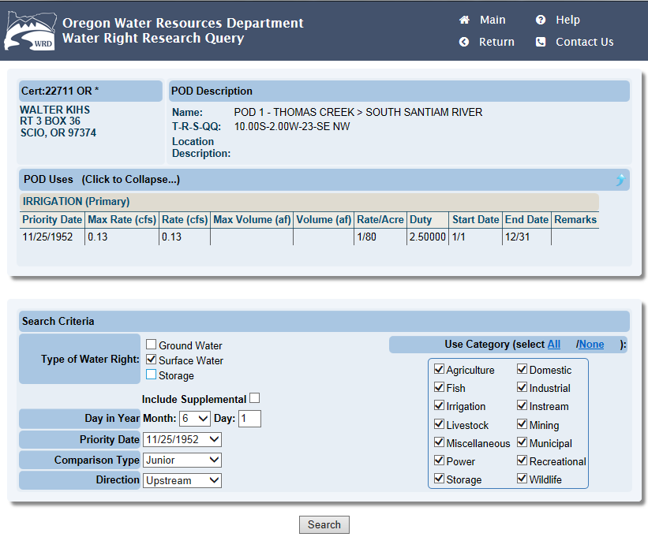
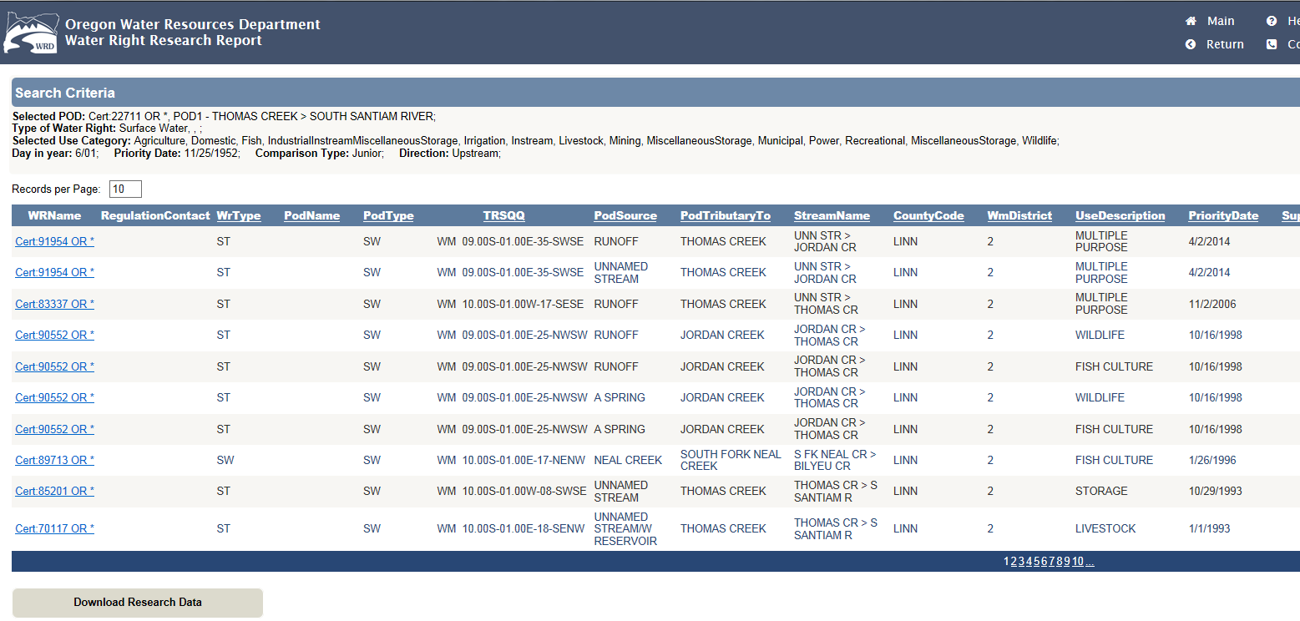
New Water Right Research Tools

Slide 14
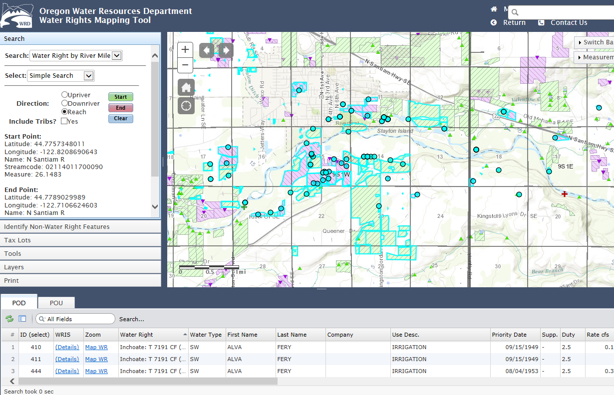
Interactive Mapper Search

Slide 15
Issue – Highlights Bad Data
Wrong stream code/mapped location
Fixed those more than 10 miles away
Working on PODs not in the stream coded watershed
19.80
Annie Creek
17.86
17.15
9.71
Fort Creek
3.63
Wood River
0.00

Slide 16
Summary
Stream Network Analysis
Easy to use tools for public and staff
  Graphical Interactive Mapper
  Intelligent Tabular Searching and Research
Highlighted errors in Water Right Data

Slide 17
Questions?
Kenneth Smith
  IT Manager
  Kenneth.L.Smith@wrd.state.or.us
  503-986-0867
Water Rights Query:
  http://apps.wrd.state.or.us/apps/wr/wrinfo/
Interactive Mapper:
  http://apps.wrd.state.or.us/apps/gis/wr/

