Slide 1
2018 Farm Bill
Astor Boozer
May 2020

Slide 2

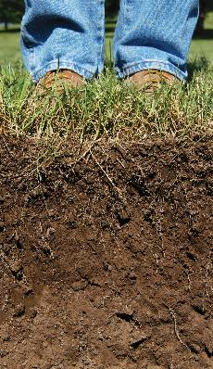
Highlights – Snapshot
Demonstrates strong support for private lands conservation
Enables NRCS to simplify and better target its programs
Removes impediments to quality customer service
Supports innovative solutions
Notes:
Demonstrates support through continued or elevated funding, provides for the opportunity to address the natural resource issues facing the nation’s farmers and ranchers on a voluntary basis, provides for continued engagement of partners to expand resources available to our stakeholders…

Slide 3
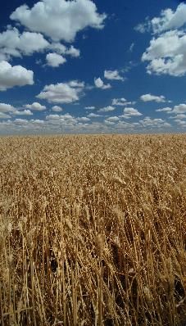
Highlights, more
Encourages focus on the benefits and outcomes of conservation, including benefits to profitability
Expands opportunities to improve soil health, water quantity and quality, and wildlife habitat

Slide 4
Conservation Planning and Technical Assistance Division
Easement Programs Division
Financial Assistance Programs Division

Slide 5

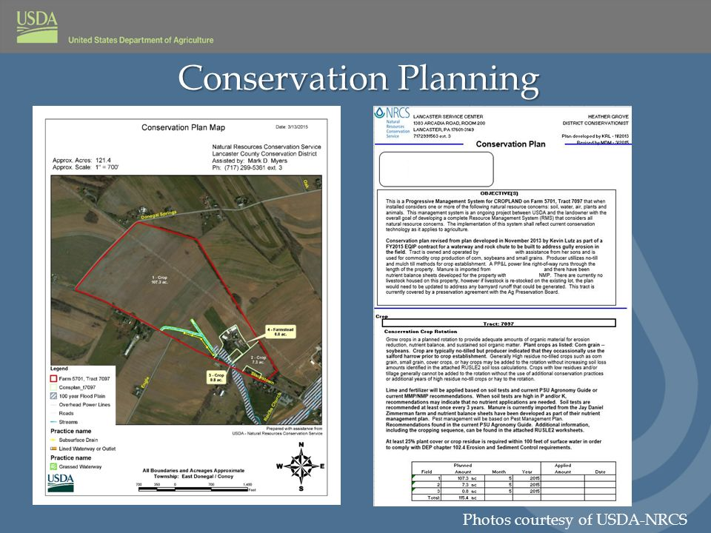
Conservation Planning and Technical Assistance Branch
Farm Bill =>
Streamline
16-times
NRCS must Streamline
Chief Priorities =>
Implement 2018 Farm Bill
Streamline our process and program delivery
Improve Customer Service
Secretary =>
Streamline Programs
Increase Efficiency
Improve Customer Service
Customers/Partners/Field Offices/NRCS of Future =>
Simplify - Streamline
Notes:
Priorities in the Farm Bill and Secretary
Streamline programs, increase efficiency and increase customer service – Sonny’s charge ahead of Farm Bill

Slide 6



National Conservation Planning Partnership

Slide 7
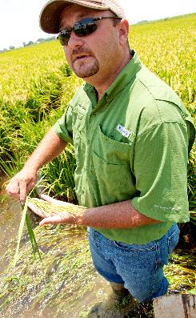
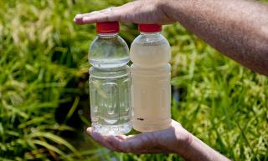
Areawide Planning Branch
Source Water Protection
Source water protection (quality and quantity) should be considered in all conservation planning/programs
Collaborate with community water systems and the State Technical Committees to identify priority areas for source water protection
Water quality and water quantity practices that protect source water may have increased payment rates (not to exceed 90%)
In each FY from 2019-2023, at least 10% of funding from each conservation title program except CRP must be devoted to support source water protection
Notes:
Source water protection (quality and quantity) should be considered in all conservation planning/programs, encouraging water quality and water quantity practices that protect source water while also benefitting ag producers
NRCS shall collaborate with community water systems and the State Technical Committees to identify priority areas for source water protection within each state
Water quality and water quantity practices that protect source water may have increased payment rates (not to exceed 90%)
In each FY from 2019-2023, at least 10% of funding from each conservation title program except CRP must be devoted to support source water protection

Slide 8
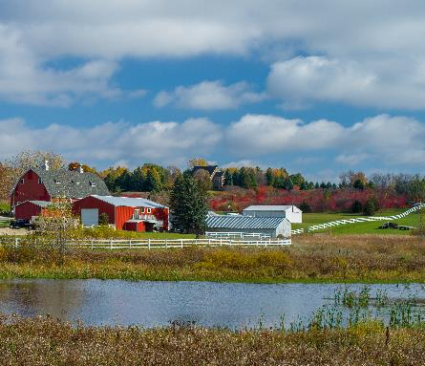
Areawide Planning Branch
Source Water Protection
Certain entities, such as states, irrigation districts and groundwater management districts, are now eligible for water conservation and system efficiency practices

Slide 9
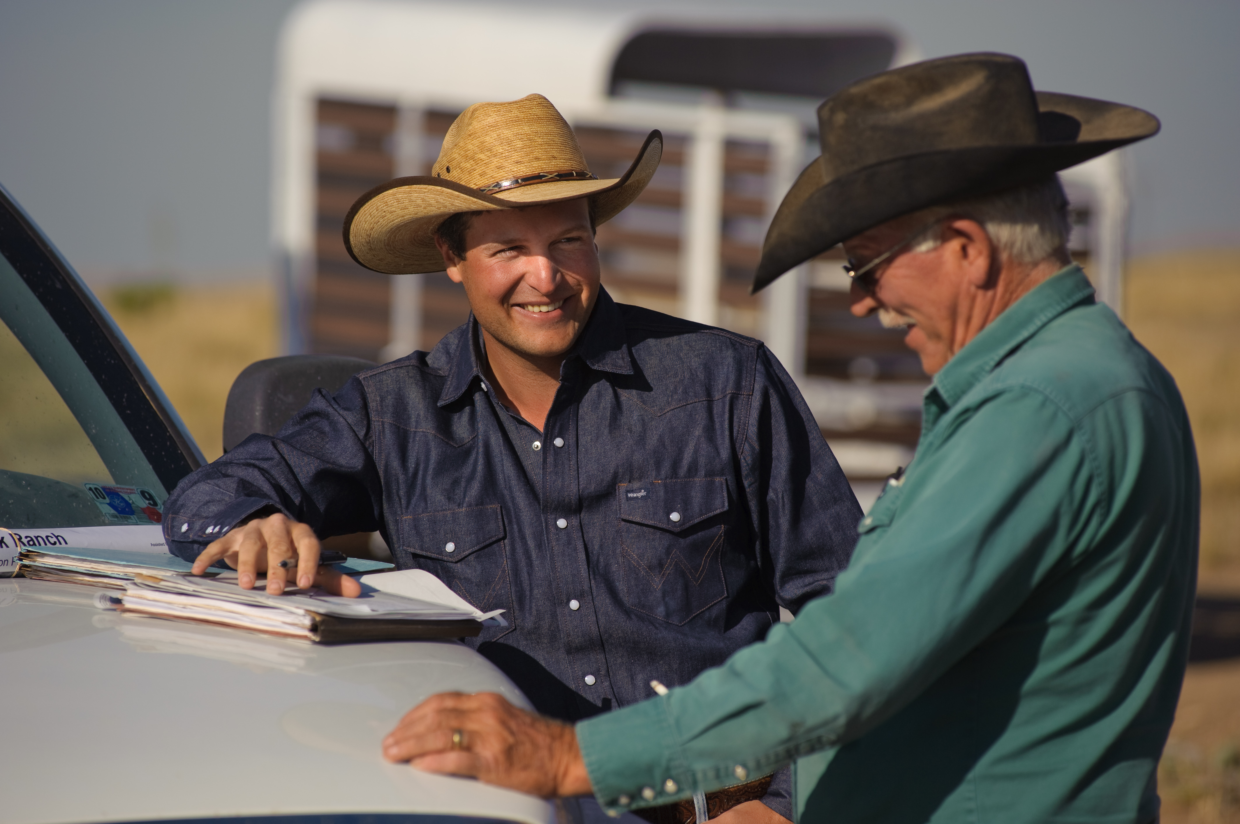
Technical Service Providers (TSPs)
New Conservation Activity Plans
Comprehensive Conservation Plan
Conservation Planning Assessment
Precision Agriculture
Resource Conserving Crop Rotation
Soil Health
Notes:
Customer Service/Data-Driven
Secretary Perdue has made it clear that his number one priority is improving customer service. He wants to make our Department the most efficient and effective in government.
You have heard about the reorganization that is happening at USDA. As part of that, the Secretary has established a new mission area called Farm Production and Conservation. FSA, RMA and NRCS are now part of that mission area – he refers to it as “bringing the family together.”
Our missions have not changed. What we do has not changed. The idea is when a farmer walks into a service center he may not know exactly what he’s looking for or who he needs to talk to. He’s just looking for help. The right people should be there, with the right expertise and information to provide him what he needs.
The Secretary has also stressed the need to be data-driven, which is something that has been at the core of our agency from the beginning. In order to do what we do, we need to be on top of the latest science and research. We will continue to look to the data to inform our work and provide sound advice to our customers.
We don’t do it alone. We tap into the expertise and research of our partners as well who are developing cutting-edge technologies and new, efficient ways of doing business.
Thanks to the 2014 Farm Bill, we can continue to support farmers, ranchers and foresters while funding innovation and bringing new partners and new resources to the table. In 2017, just looking at two of our core programs, Kansas farmers benefited from an obligation of more than $35 million through EQIP, and roughly $9 million through CSP.
We are providing support, but the farmers are the ones doing the work and their stewardship is what will continue to make the difference on the land. They are voluntarily stepping up to the plate to make these improvements. They want to be a part of the solution. They want to leave the land better than they found it, for their children and grandchildren.
They know what’s at stake. Not just the health of our soils and water – but the health of their operations. Being more resilient to the challenges ahead. Helping their operations means helping rural economies and making a real difference in people’s day-to-day lives. It means ensuring farmers can continue to produce the food, fuel and fiber our country, and the world, depends on.

Slide 10
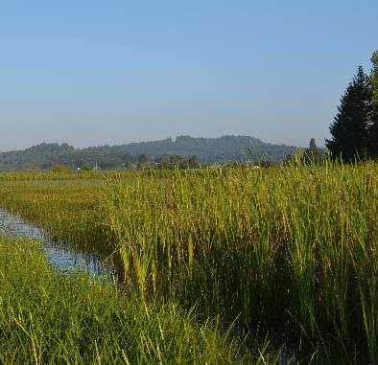
State Technical Committee
Many new references regarding input (e.g. Feral Swine, ACEP Alternative Plant Communities, CIG Priority Resource Concerns, etc.)
Up 10-practices for increased payment rates, capped at 90% (EQIP)
Add State Cooperative Extension Service and land-grant university to composition

Slide 11
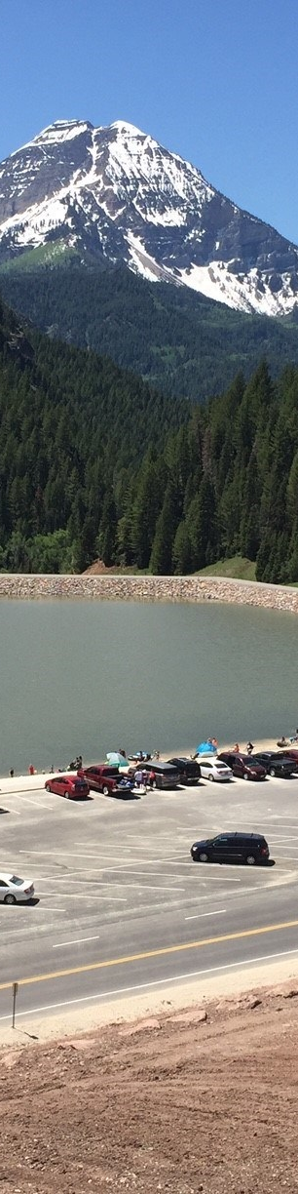
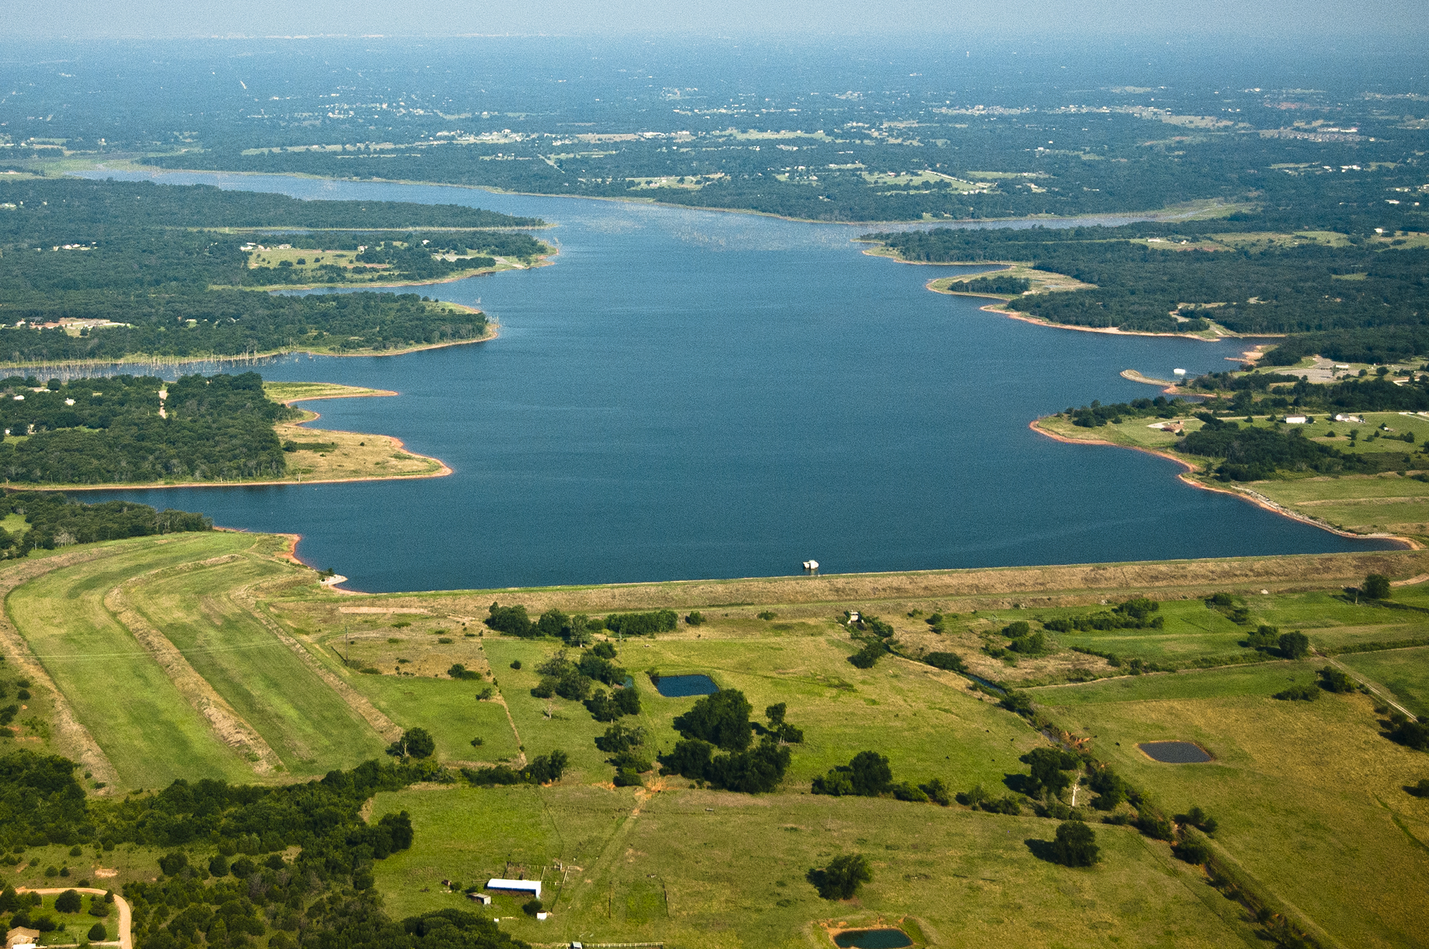
Watershed and Flood Prevention Operations
  Provisions to waiver watershed plan
  Stable funding authorized at $50 Million/Year
  RCPP limitation to CCA only is removed

Slide 12
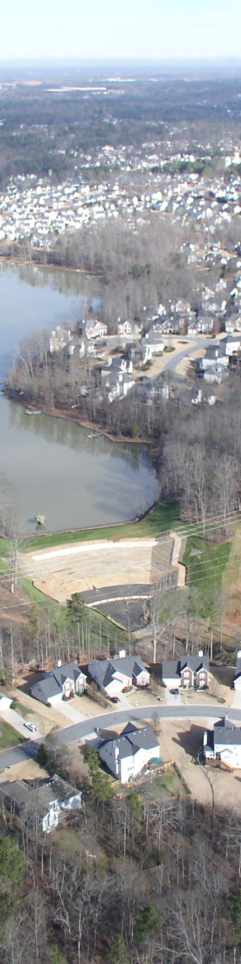
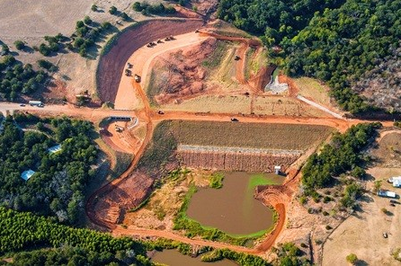
Watershed Rehabilitation Program
  Stable funding authorized at $85 Million/Year

Slide 13
Easement Programs Division
Policy Branch
Program Implementation Branch
Easement Acquisition Branch

Slide 14
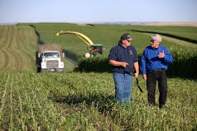
Easement Programs
Policy Branch
ALE - Buy, Protect, Sell
ALE – Certification of Eligible Entities
ALE – Charitable Donation
ALE – Clarity on agency’s monitoring role
ALE – Conservation Plans
ALE – Grasslands of Special Significance
WRE – State Tech Committee look at alternative vegetative communities
Data-driven
Slide 14

Slide 15
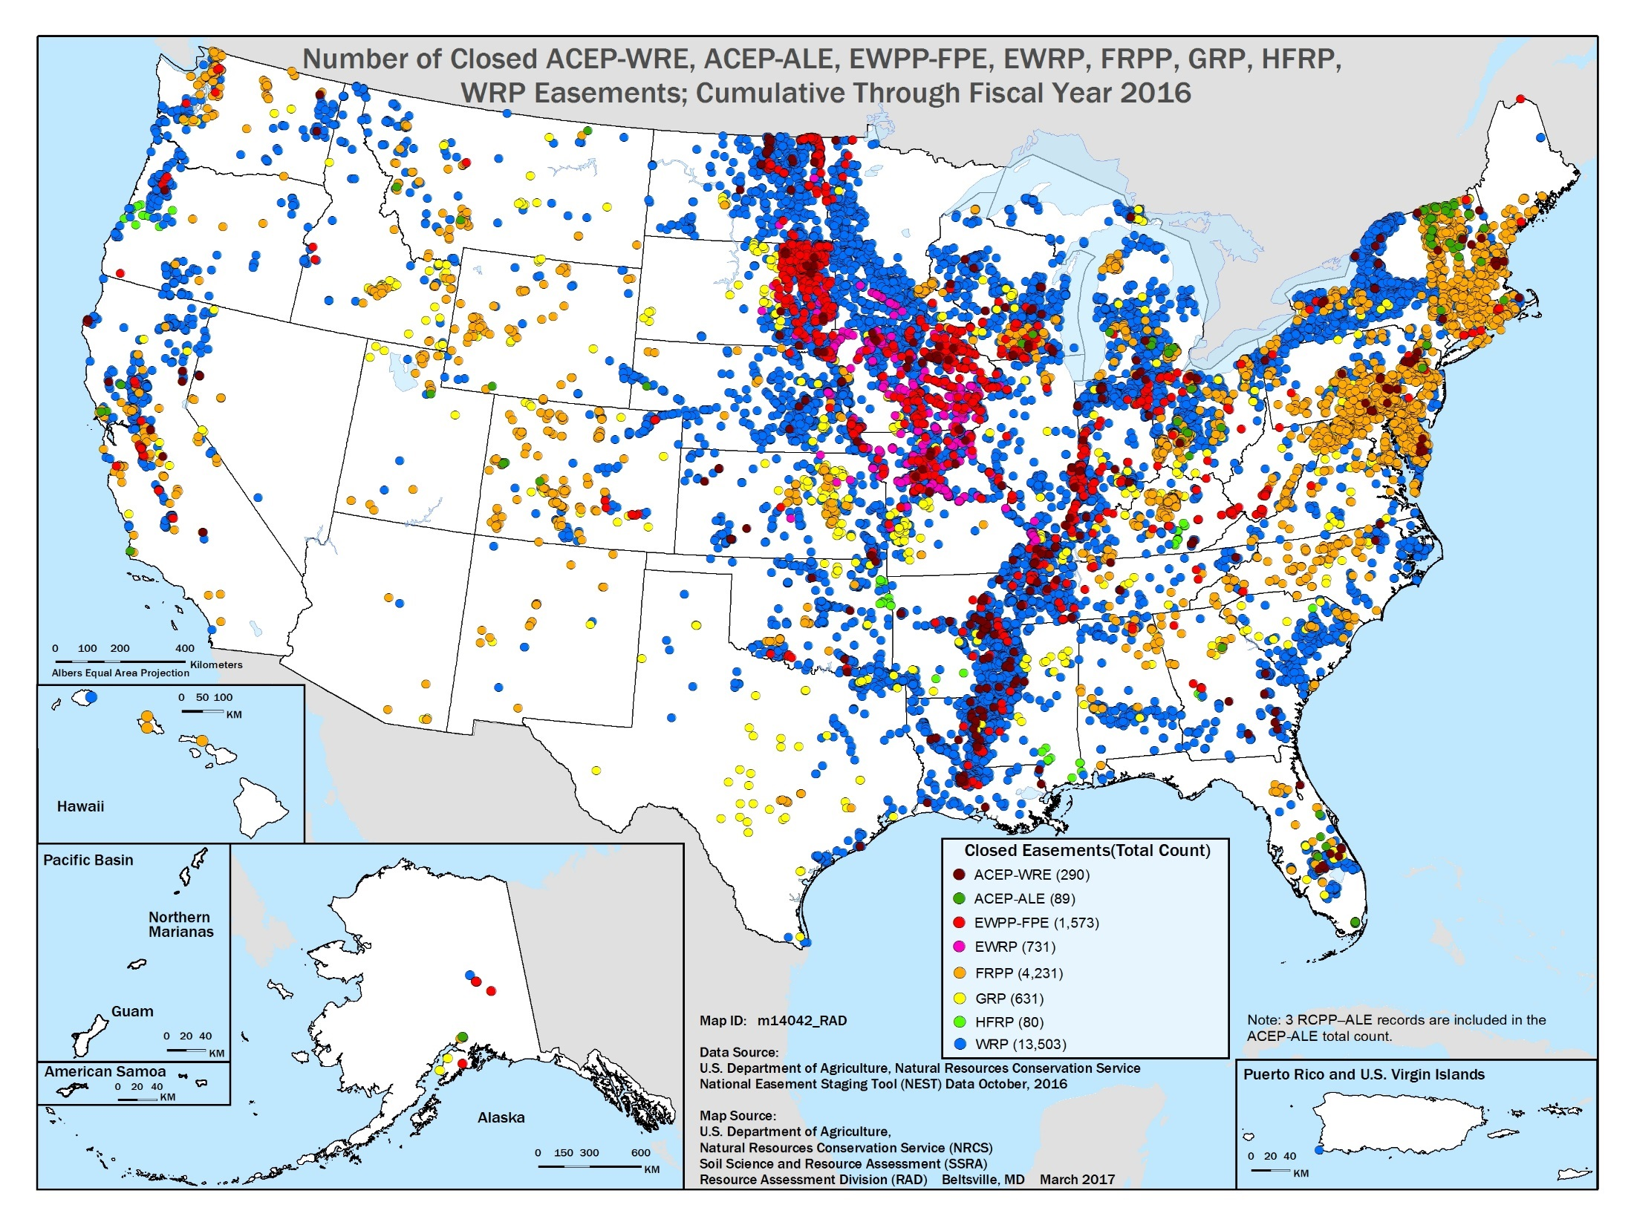

Slide 16
Financial Assistance Programs Division
Policy Branch
Program Implementation Branch
Projects Branch

Slide 17
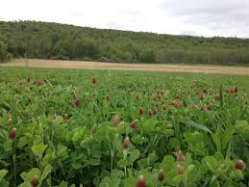
FAPD – Policy Branch
Environmental Quality Incentives Program (EQIP)
New or expected resource concerns
Payments for Soil Remediation
Payments for Soil Testing
CNMP – Progressive Planning
Livestock Threshold from 60% to 50%
Wildlife Threshold from 5% to 10%
Water Conservation and Contract with irrigation district…or similar entities
Organic contract limits increased to $140,000
Increases authorization to > $2 Billion by 2023
technology.
For

Slide 18
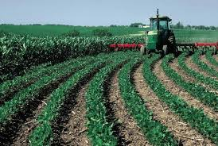
FAPD – Policy Branch
Policy Branch – EQIP Incentive Program
Define Incentive Practice
Remote Telemetry Data as a practice (EQIP-Classic also)
Data on Conservation Practices and Outcomes

Slide 19
FAPD – Policy Branch
Policy Branch – Conservation Stewardship Program
Acres to Dollars Program
Grows to $1 Billion by 2023
Streamline with EQIP
CSP-Grasslands
  Land grass/idle 2009-2017
  Addresses resource concerns related to grassland
  $18/acre for 5-years
  Withdraw with no penalty

Slide 20
Financial Assistance Programs Division
Policy Branch
Program Implementation Branch
Projects Branch

Slide 21

FAPD – Projects Branch
Conservation Innovation Grants (CIG)
Increased authorization to $37.5 Million
On-Farm Trials for $25 Million, including Soil Health Demonstration Trails (farmer-centric)
CIG-Classic for $12.5 Million
Requires establishment of a publicly available conservation practice database that provides a compilation and analysis of effective conservation practices for soil health, nutrient management, and source water protection.
Expedited Revision to Standards (S&T)
Notes:
Requires establishment of a publicly available conservation practice database that provides a compilation and analysis of effective conservation practices for soil health, nutrient management, and source water protection.

Slide 22

FAPD – Projects Branch
Regional Conservation Partnership Program (RCPP)
May use Availability of Program Funding without regulation
Removes “donor” program requirements
Increases funding to $300 Million
Defines Partnership Agreement (Streamline the Program)
Notes:
Requires establishment of a publicly available conservation practice database that provides a compilation and analysis of effective conservation practices for soil health, nutrient management, and source water protection.

Slide 23
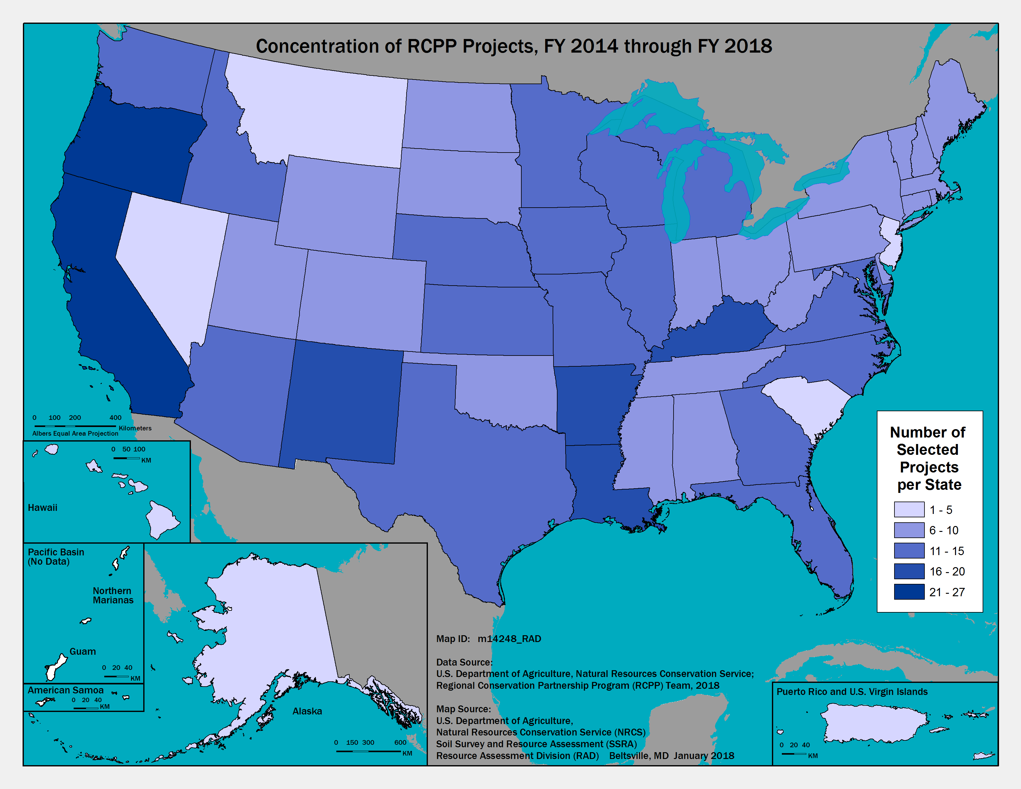
FAPD – Projects Branch
Regional Conservation Partnership Program
Removes National Funding Pool
Specifies 50% for State and CCA Funding Pools
Establishes renewal option
Allows greater than 5-years
Allows up to 15-Alternative Funding Arrangements
Adds CRP as a “covered program”
Notes:
Requires establishment of a publicly available conservation practice database that provides a compilation and analysis of effective conservation practices for soil health, nutrient management, and source water protection.

Slide 24
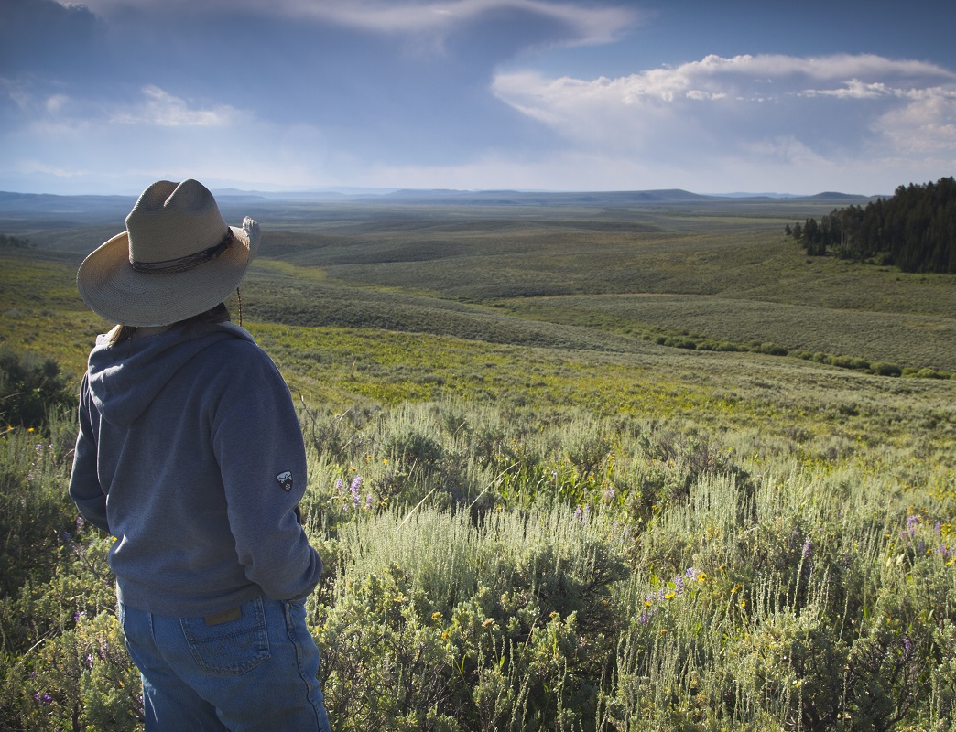

Voluntary Public Access-Habitat Incentive Program
Delivering Results for Agriculture and Conservation
Notes:
Kari Cohen
72nd Soil and Water Conservation Society conference (SWCS)
July 31, 2017, Madison, WI

Slide 25
VPA-HIP Purpose
To encourage owners and operators of privately-held farm, ranch and forest land to provide public access for wildlife-dependent recreation, and to encourage wildlife habitat improvement on those lands.

Slide 26
VPA-HIP Existing Projects
23 States and one Tribe received VPA-HIP awards under the 2014 Farm Bill
Most awards went to expand the reach of existing public access programs—Illinois, Iowa and Missouri established new programs with the NRCS funding
Largest award--$6 million to Pennsylvania
Smallest award--$374,584 to the Yakima Tribe

