Slide 1
WaterSMART Program
Amanda Erath, Josh German, Darion Mayhorn
Water Resources and Planning Office
September 17, 2020

Slide 2
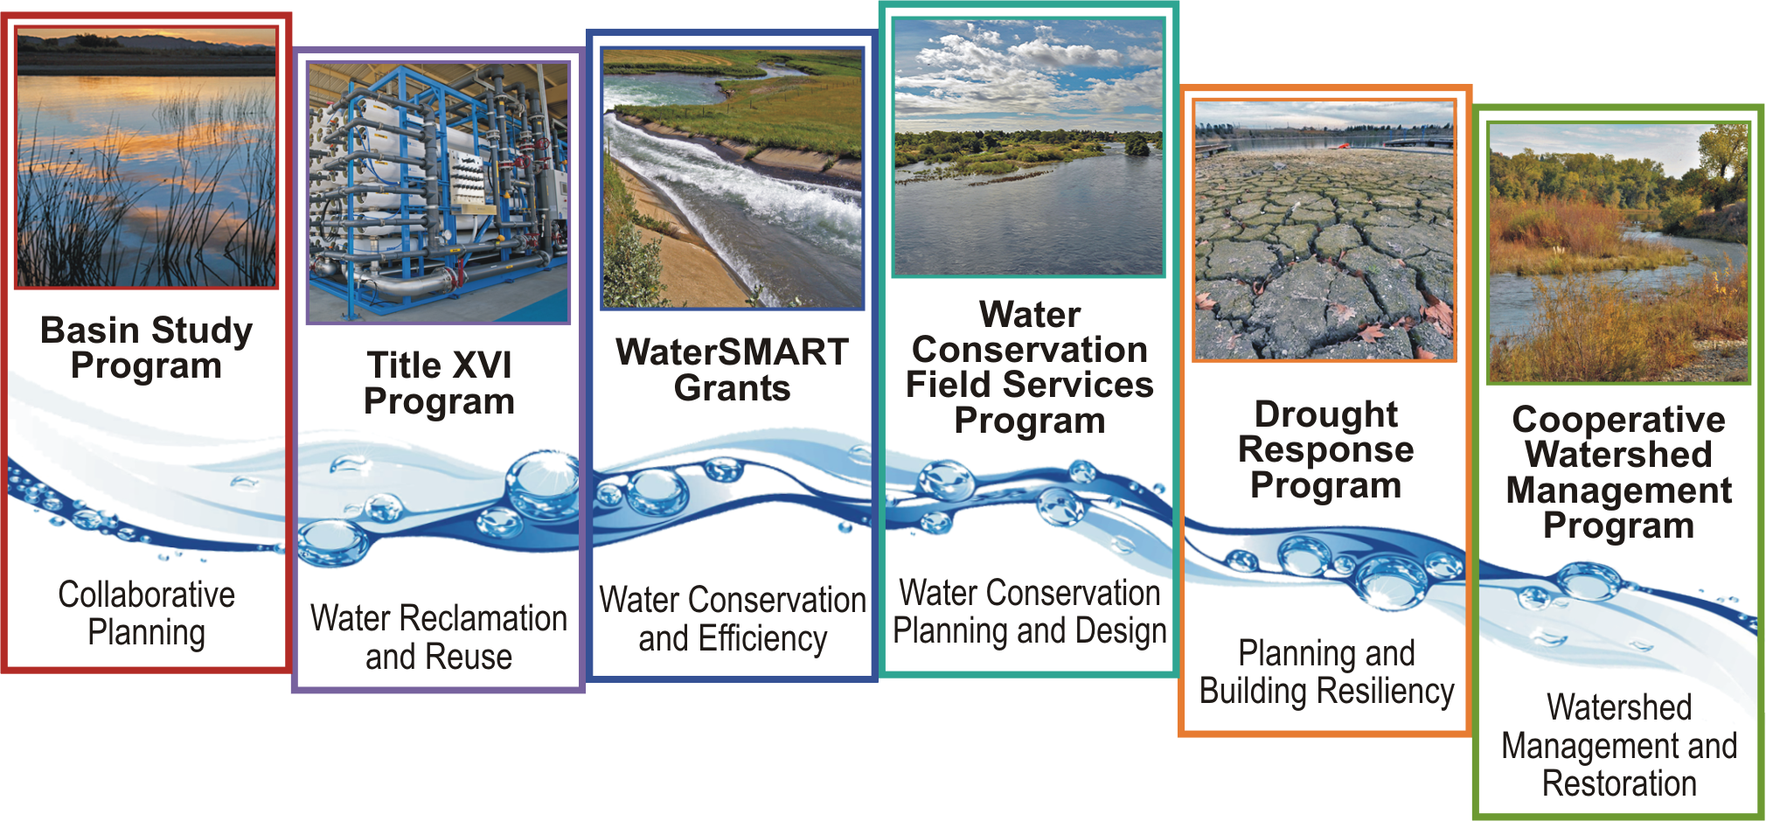
WaterSMART Program
Provides a framework for Interior to support water supply reliability for multiple water users.

Slide 3
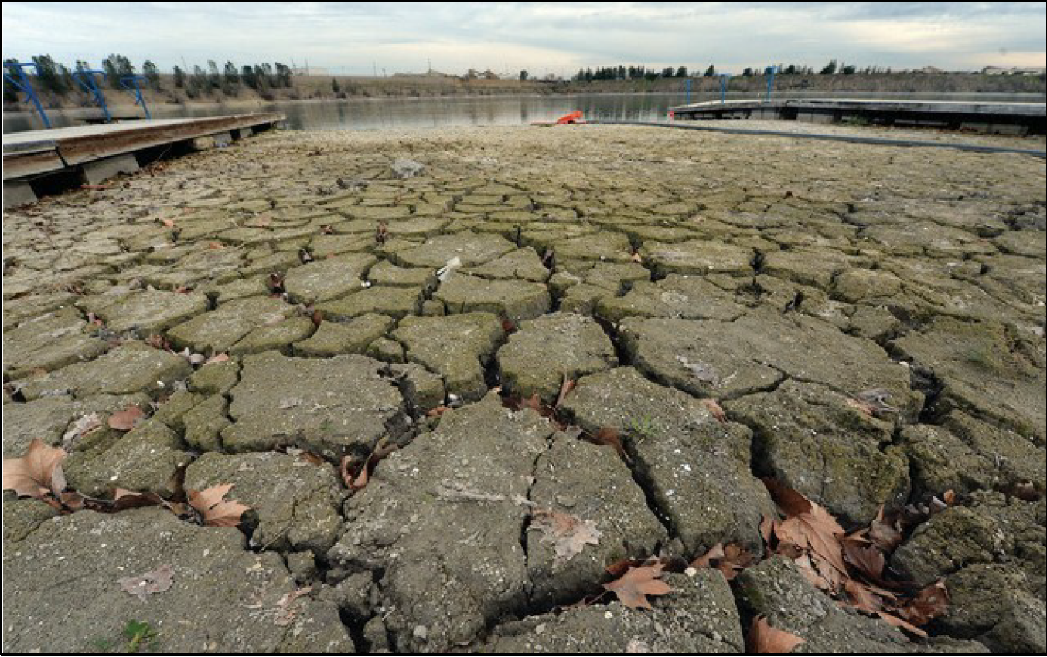
WaterSMART Program Overview
Growing Populations
Restoration Needs
Drought
Increases water supply reliability through investments and attention to local water conflicts
Supports water conservation and water management improvements to help meet competing demands for water
Leverages Federal and non-Federal funding
Relies on collaboration with stakeholders to develop local solutions to water supply issues

Slide 4
Build a Foundation Through WaterSMART
Drought Contingency Plans
CWMP Phase I
Water Marketing Strategy Grants
Applied Science Tools
Reservoir Operations Pilots
Water Management Options Pilots
Drought Resiliency Projects
Drought Resiliency Projects
Water and Energy Efficiency Grants
Small-Scale Water Efficiency Projects
CWMP Phase II
On-the-Ground Projects
Science and Tools
Planning

Slide 5
WaterSMART Program Basics
Most WaterSMART activities are grant programs
Generally a 50% non-Federal cost share is required for grants under WaterSMART
Applicants include entities such as states, tribes, cities, water districts, irrigation districts, watershed groups, non-profits, and flood control districts within the 17 Western United States (and in some cases AK and HI)
Funding is allocated through annual competitive processes

Slide 6
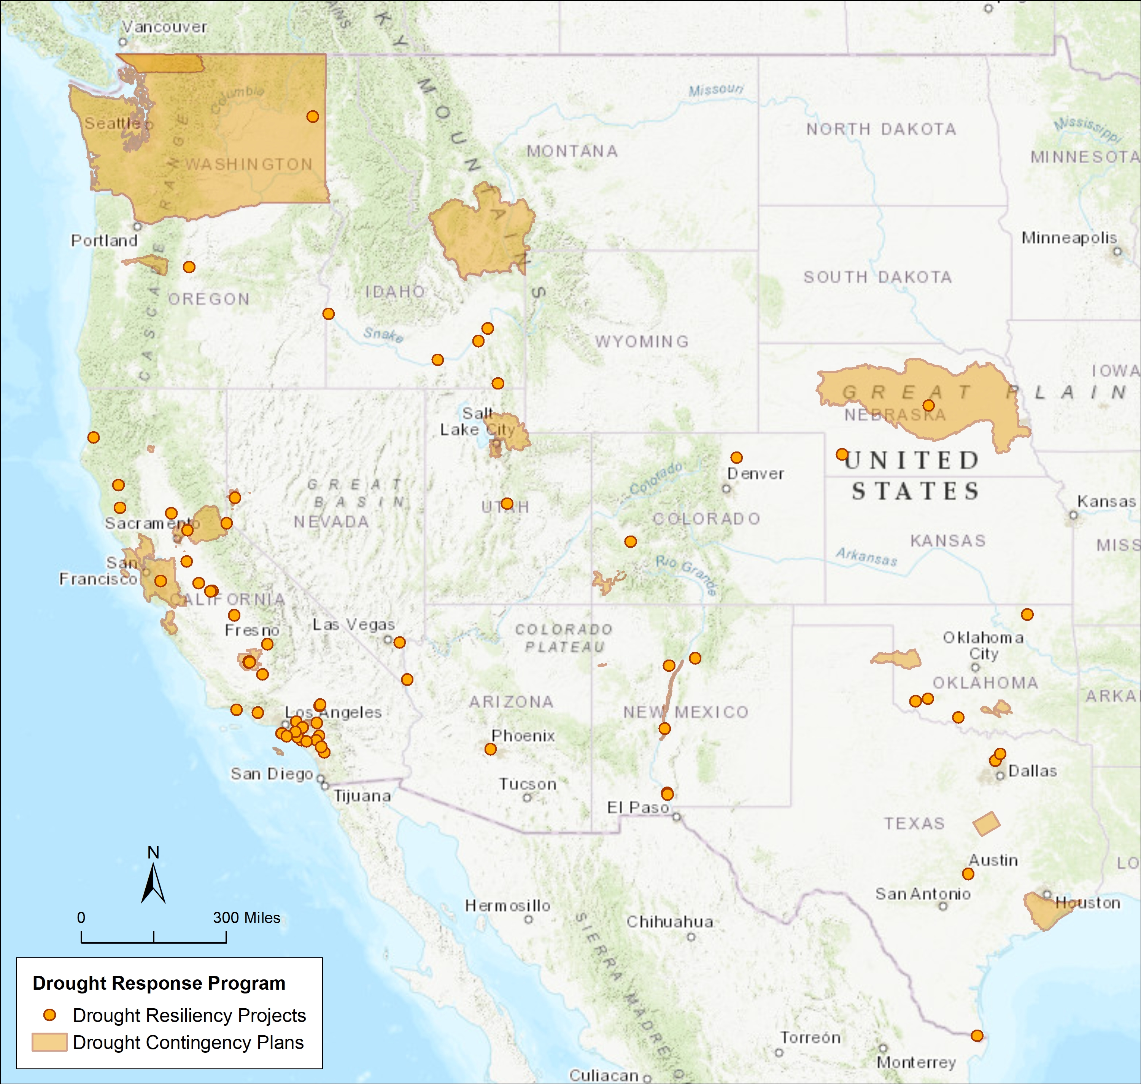
Drought Response Program
3 sub-activities
Drought Contingency Planning
Drought Resiliency Projects
Emergency Response Actions
Since 2015, the program has provided over $41 million in competitively-awarded funding for drought planning and drought resiliency.

Slide 7
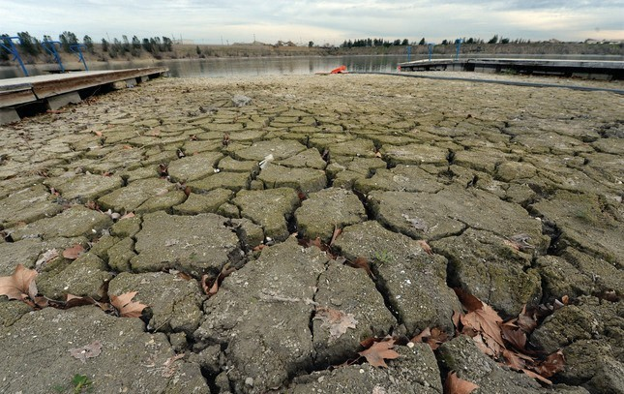
Drought Response Program
Drought Contingency Planning
Eligible Projects
  Funding for development, or update, of comprehensive drought plans.
Funding
  Non-Federal Cost Share: 50% or greater
    Cost share reduction/waiver available for applicants with financial hardship and a significant Federal interest
  Up to $200,000
  *Authorized by Title I of the Reclamation States Emergency Drought Relief Act of 1991

Slide 8
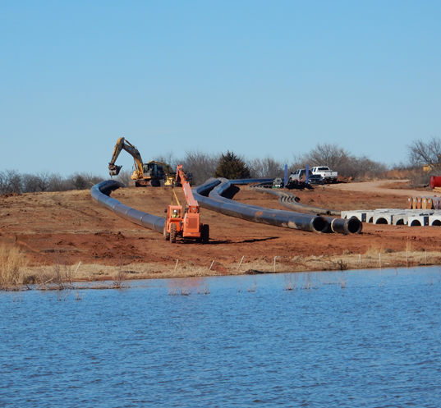
Drought Response Program
Drought Resiliency Projects
Eligible Project Types
  Infrastructure Improvements
  New conveyance system components
  Additional water storage
  Recharge facilities
  Capture and treat alternative supplies
  Decision Support Tools & Modeling
  Environmental Protection
Funding
  Non-Federal Cost Share: 50% or greater.
  Funding Level I: $500k 2 years
  Funding Level II: $1.5m 3 years
Criteria focuses on building long-term resilience to drought
*Authorized by Section 9504 of P.L. 111-11, SECURE Water Act
Notes:
Infrastructure Improvements
Modifying surface water intakes
New conveyance system components
Additional water storage
Recharge facilities
Capture and treat alternative supplies
Decision Support Tools & Modeling
Tools to support water marketing
Tools to convey water supply information
Measurement
Environmental Protection
Improve habitat
Install fish screens and ladders

Slide 9
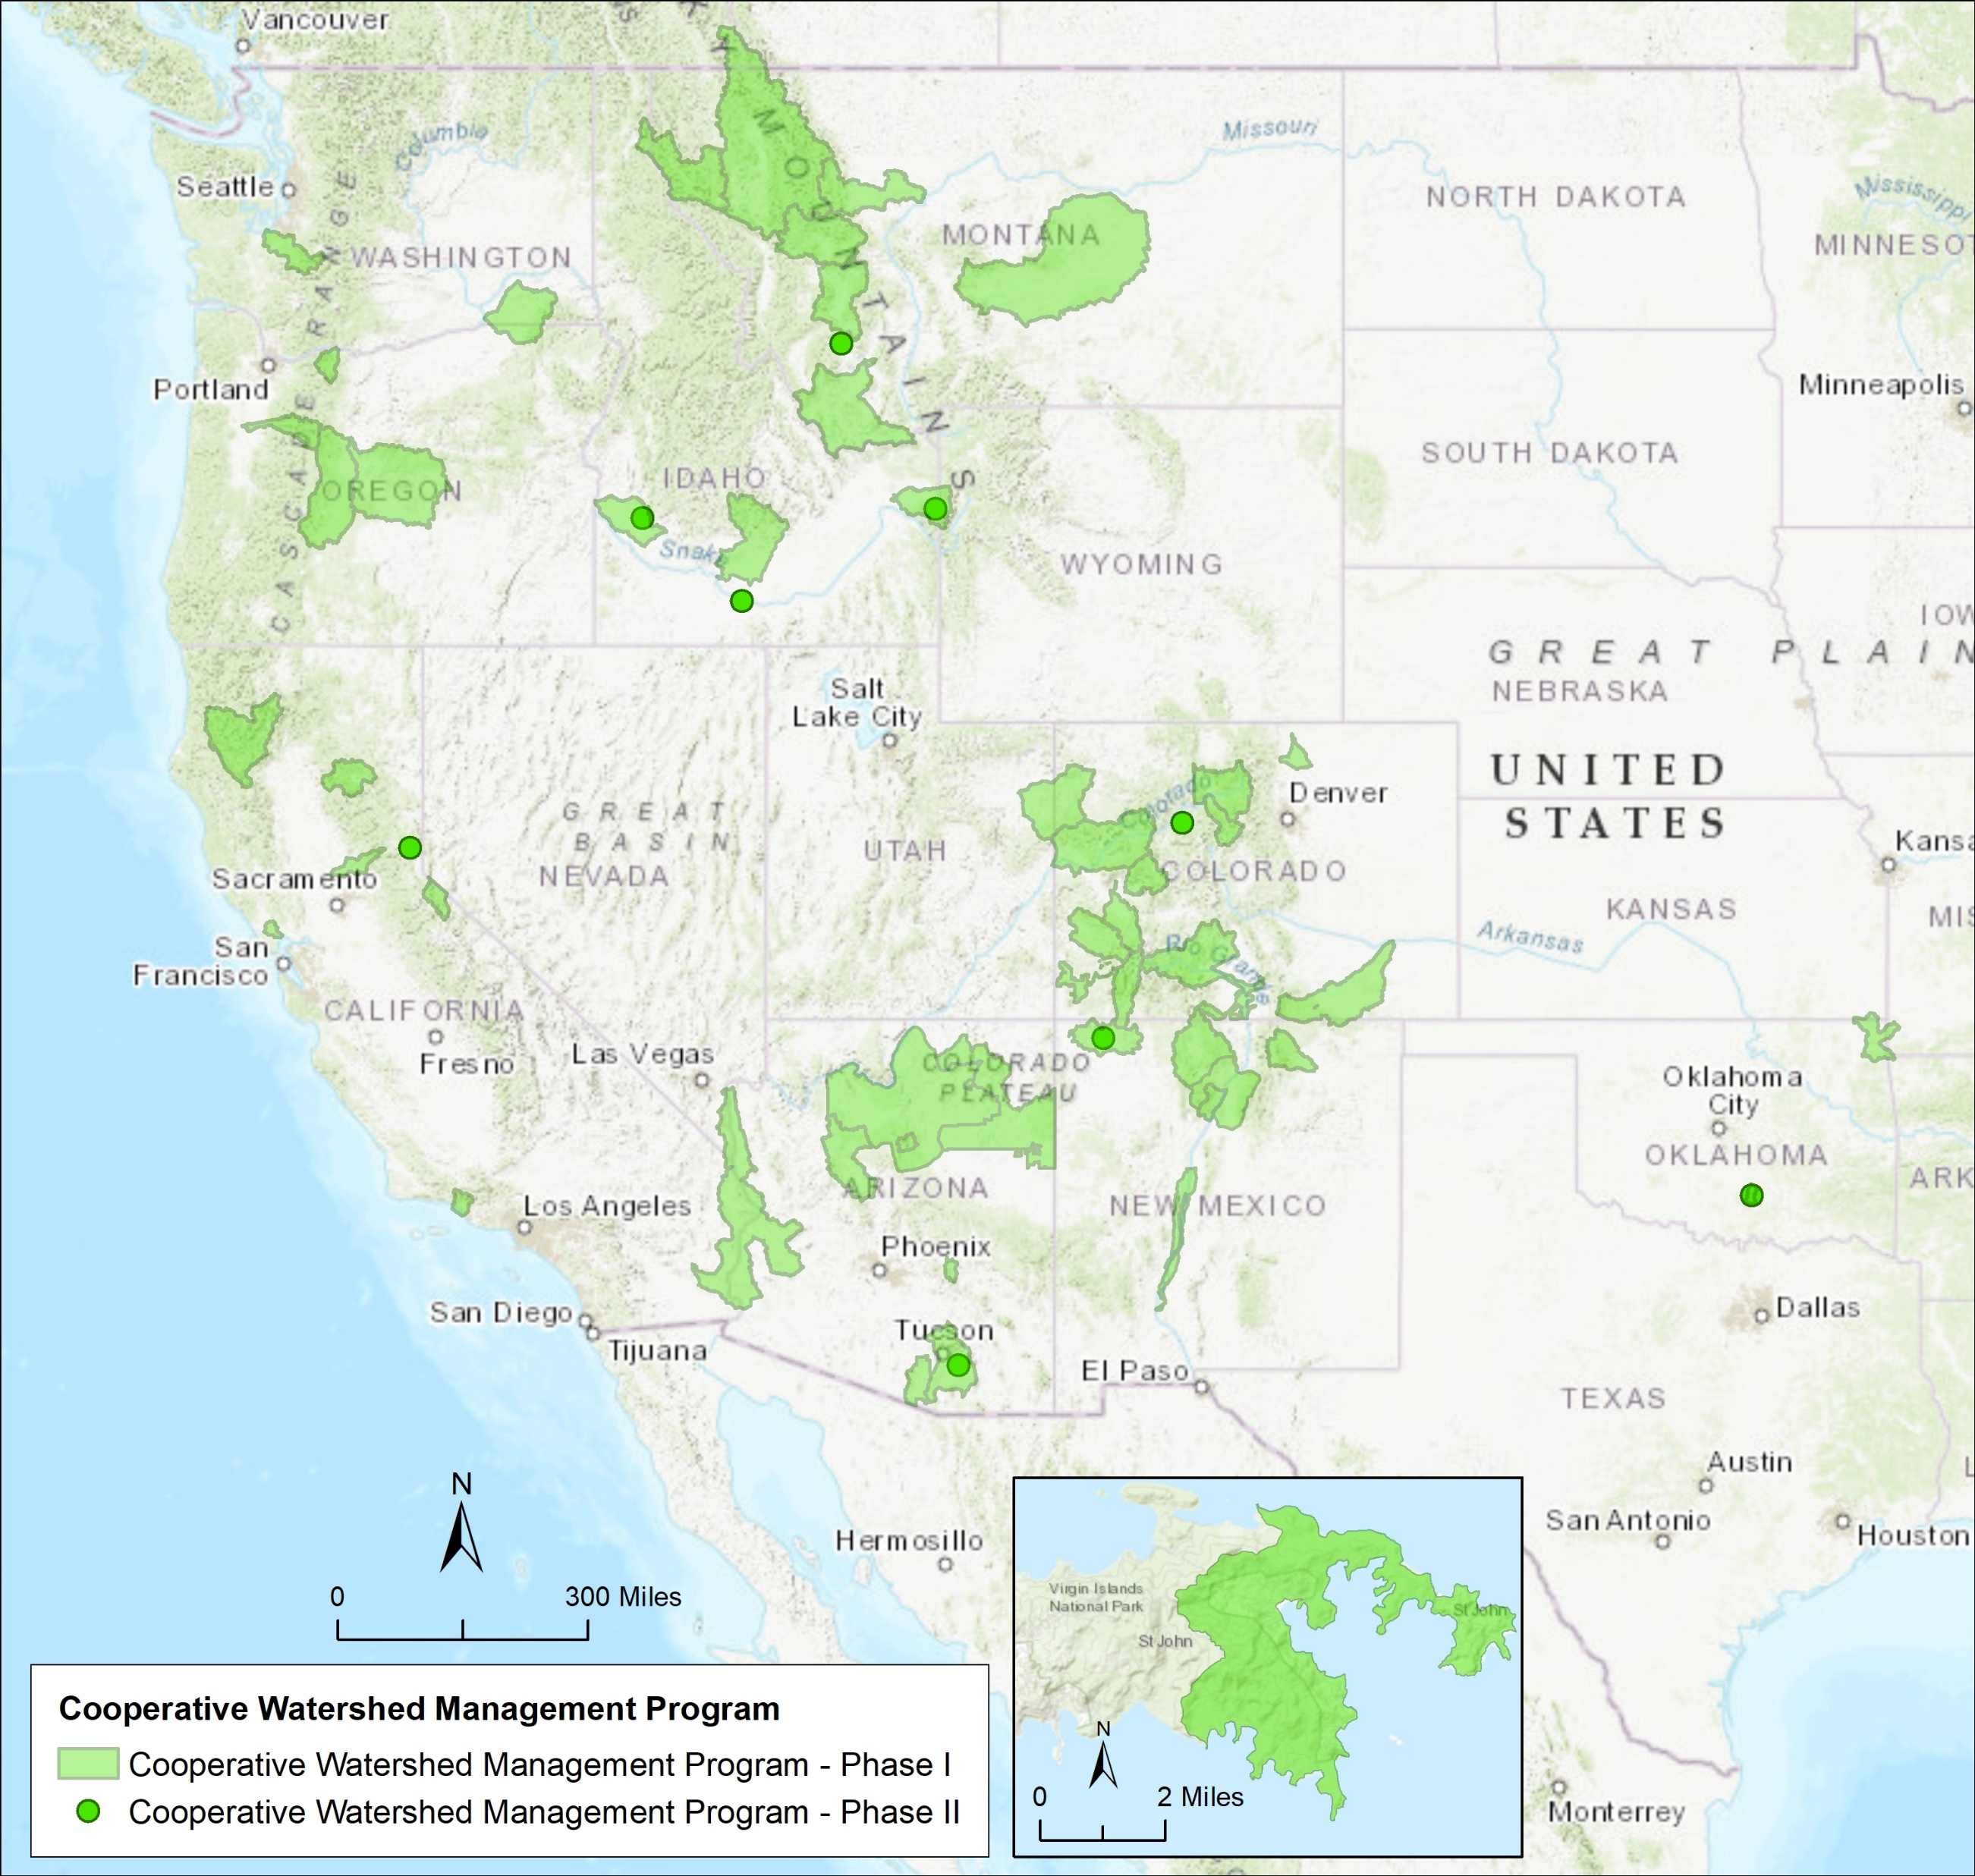
Cooperative Watershed Management Program
2 sub-activities
Phase I: Form a watershed group, develop a restoration plan and do project design
Phase II: Implement on-the-ground watershed management projects
*Authorized by Section 6002 of the Cooperative Watershed Management Act, Subtitle A of Title VI of the Omnibus Public Land Management Act of 2009, P.L. 111-11

Slide 10
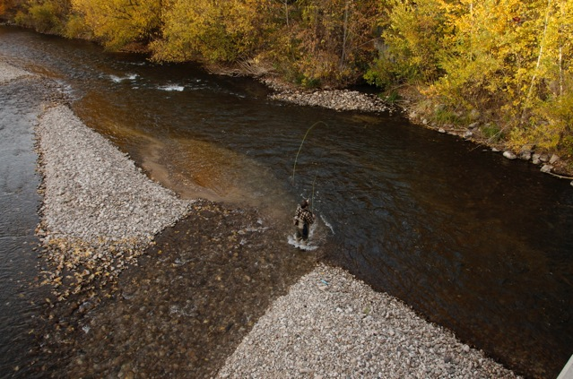

Cooperative Watershed Management Program
Phase I – Watershed Group Development and Restoration Planning
Eligible Project Activities
  Watershed group development
  Conducting outreach activities
  Gathering data about the watershed
  Watershed restoration plans
  Watershed management project design
Funding
  0% non-Federal cost share required
  Up to $100,000 in Reclamation funding over 2 years
  Sufficiency review required for second year funding
Evaluation Criteria
  Project benefits
Photo courtesy of the Boise River Enhancement Network

Slide 11
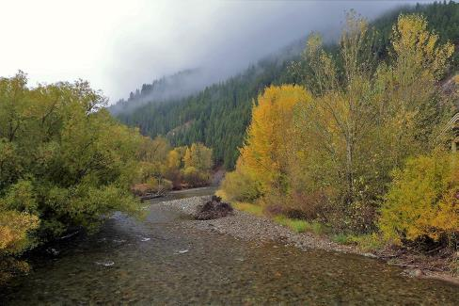
Cooperative Watershed Management Program
Phase II – Watershed Management Project Implementation
Eligible Project Activities
  Enhancing riparian vegetation
  Water delivery system improvements
  Increasing instream flows
  Invasive species control
  Fish passage
  Stream channel reconstruction and bank stabilization
Eligible Applicants
  *Must be established Watershed Group to apply*
Funding
  50% non-Federal cost share required
  Up to $300,000 in Reclamation funding over 2 years
  Sufficiency review required for second year funding
Evaluation Criteria
  Project benefits, watershed restoration planning
Photo courtesy of Trout Unlimited

Slide 12
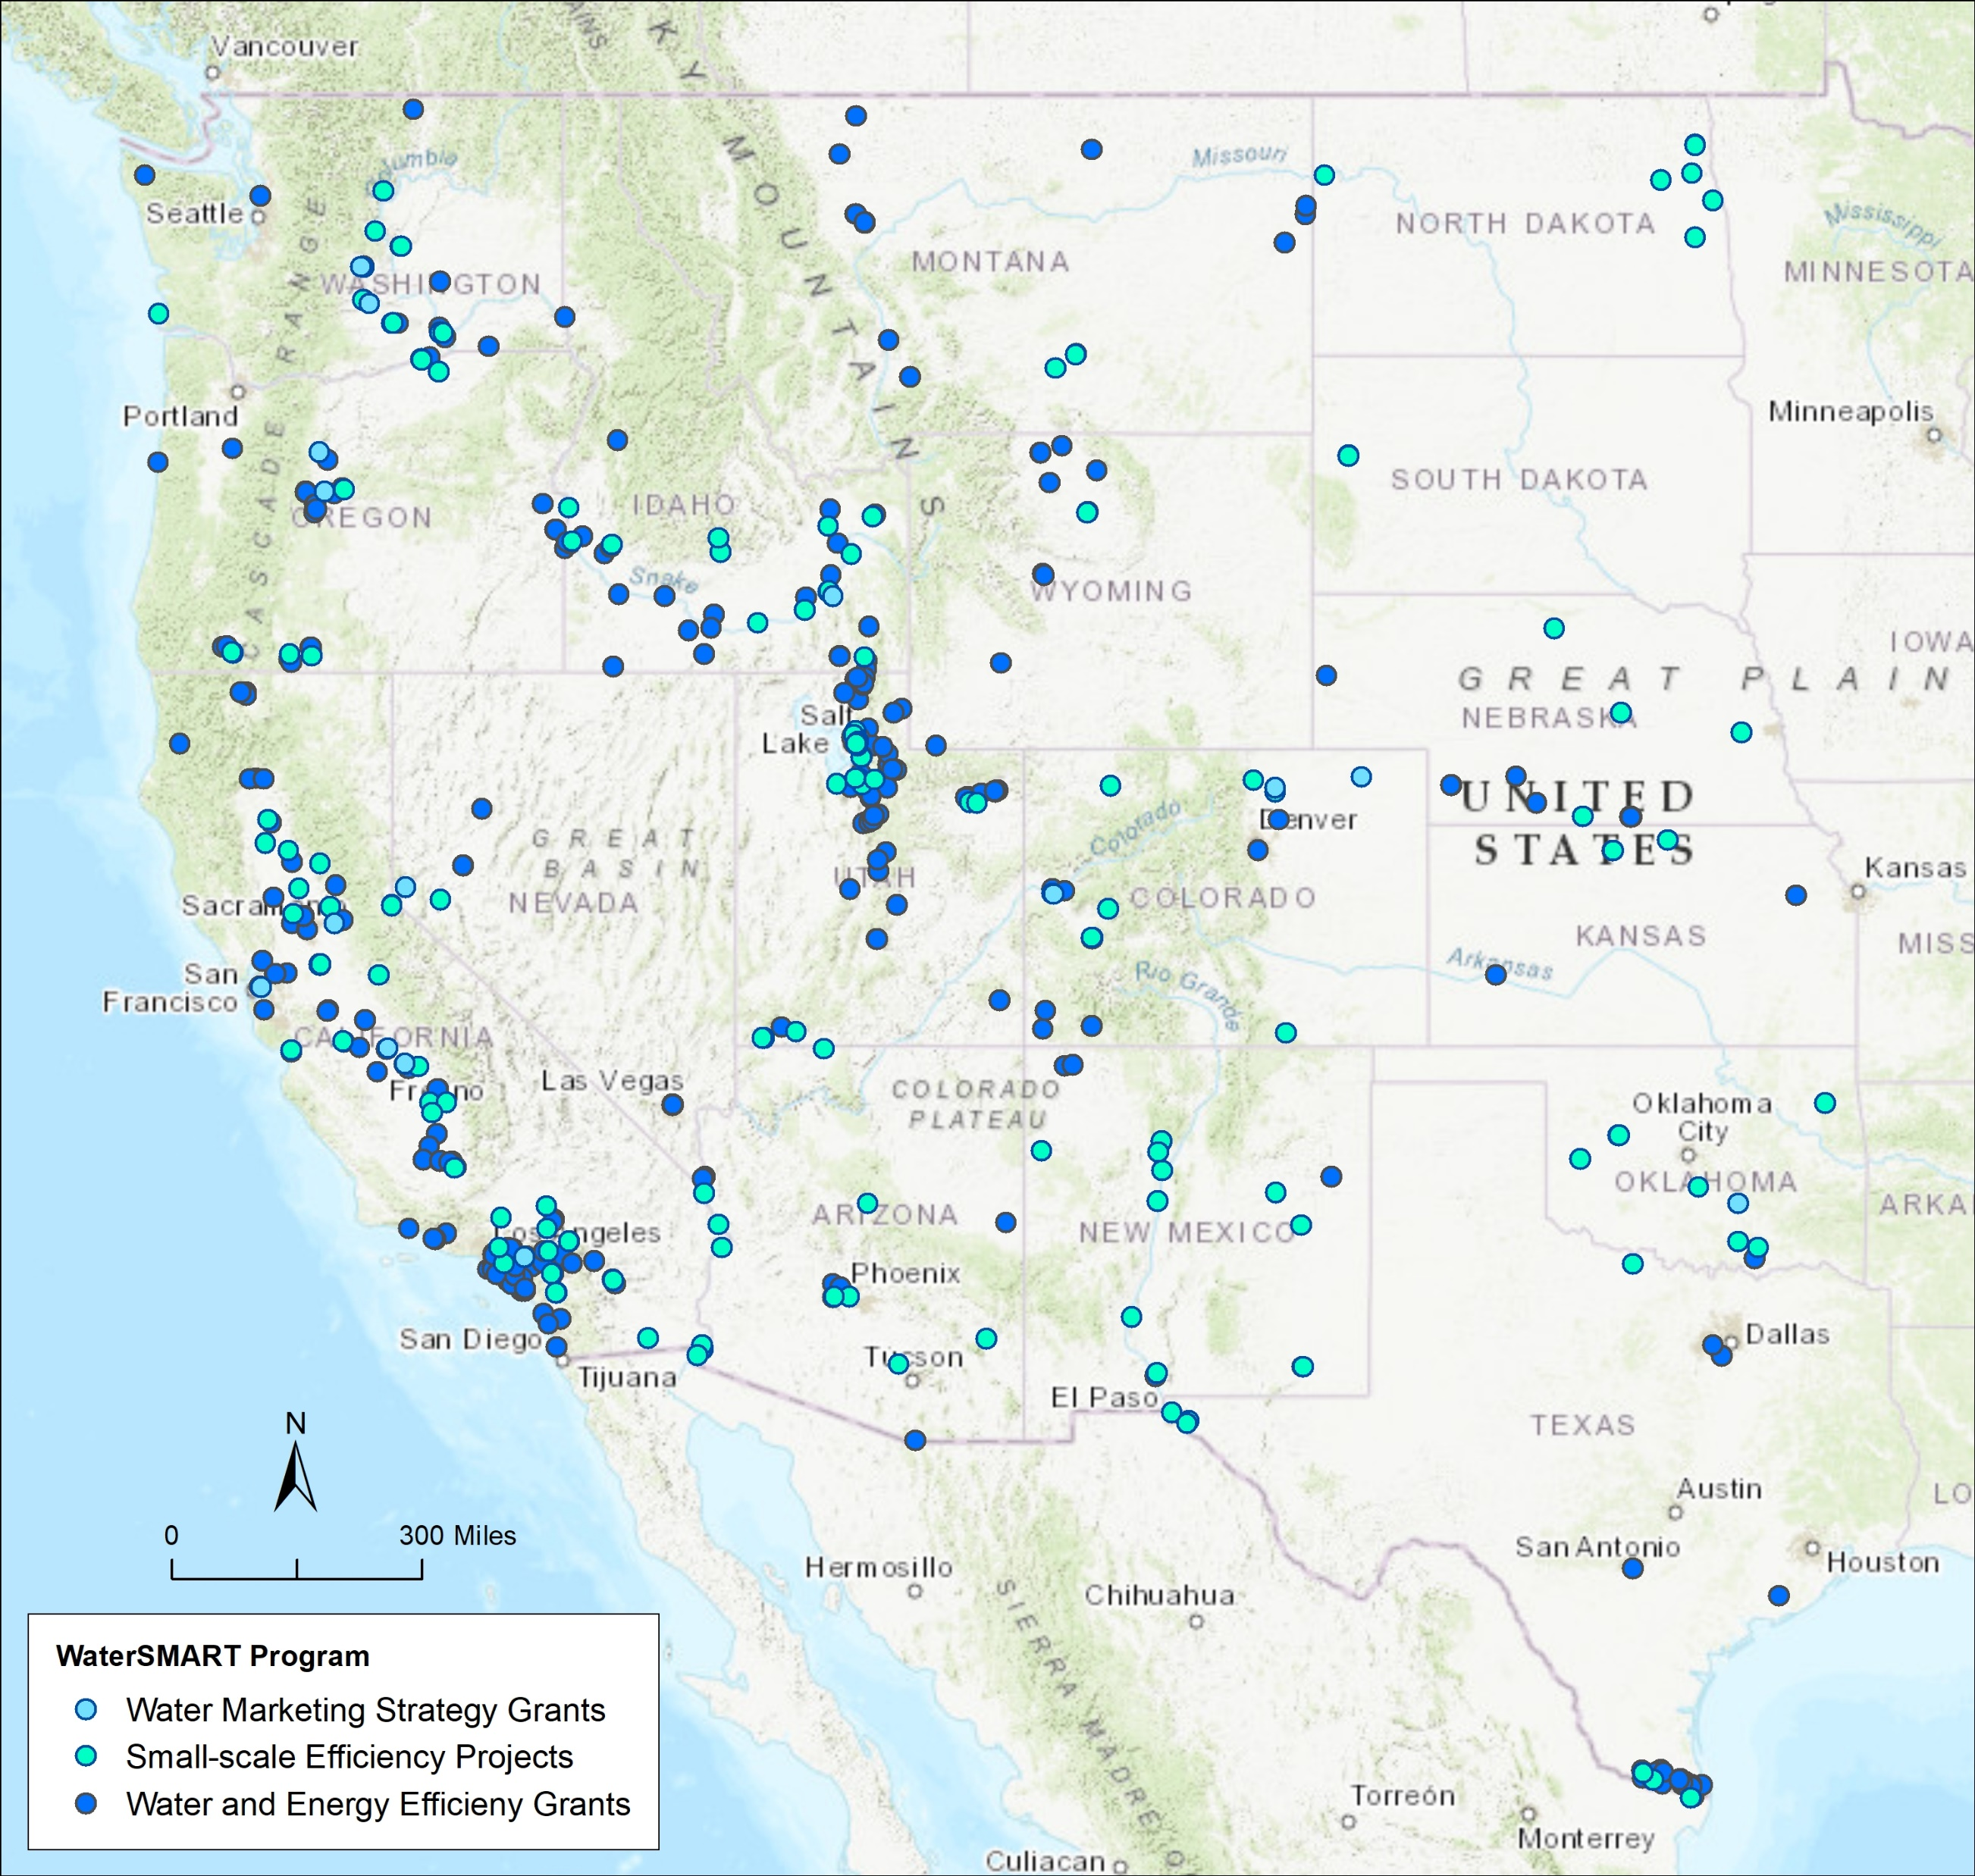
WaterSMART Grants
3 sub-activities
Water and Energy Efficiency Grants (WEEG)
Small-Scale Efficiency Projects (SWEP)
Water Marketing Strategy Grants (WMSG)
*Authorized by Section 9504 of P.L. 111-11, SECURE Water Act

Slide 13
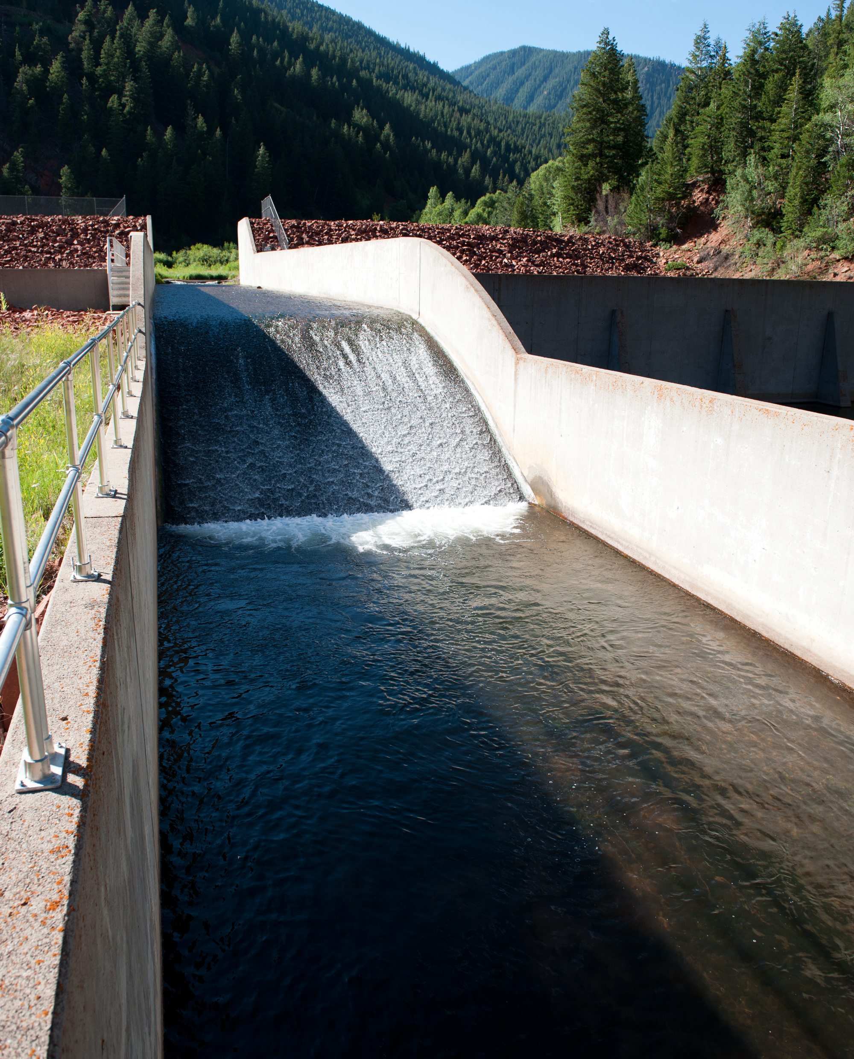
WaterSMART Grants
Water and Energy Efficiency Grants
Eligible Project Types
  Water and energy efficiency
  Canal lining/piping
  Municipal metering
  Irrigation flow measurement
  Landscape irrigation measures
  Hydropower
Funding
  Funding Group I: Up to $500k in 2 years
  Funding Group II: Up to $2 million in 3 years
Criteria focus on quantifying water savings
FY20 Project Selections:
  54 project selected
  $147 million in total improvements
  Expected water savings over 65,000 acre-feet

Slide 14
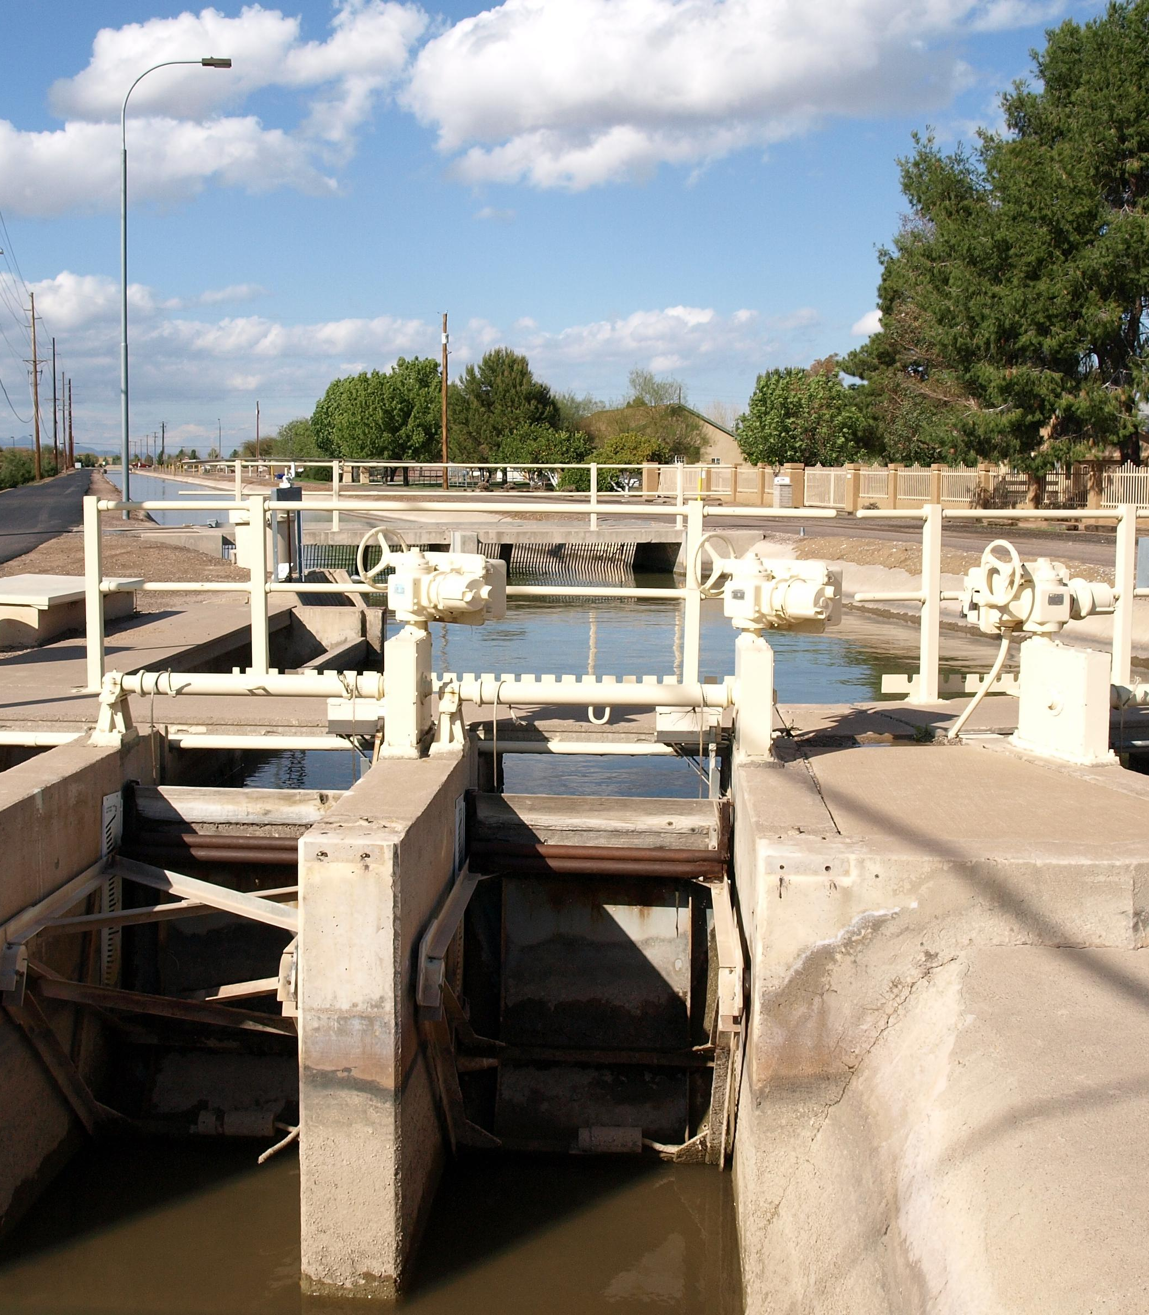
WaterSMART Grants
Small-Scale Water Efficiency Projects
Eligible Project Types
  Canal lining/piping
  Meter and flow measurement (Municipal or Ag)
  Landscape irrigation measures
  SCADA and Automation
Funding
  Up to $75k in Reclamation funds
  Maximum total project costs of $200k per project
Evaluation Criteria
  Simplified evaluation criteria
  Benefits to applicant
  Previous planning efforts supporting the project

Slide 15
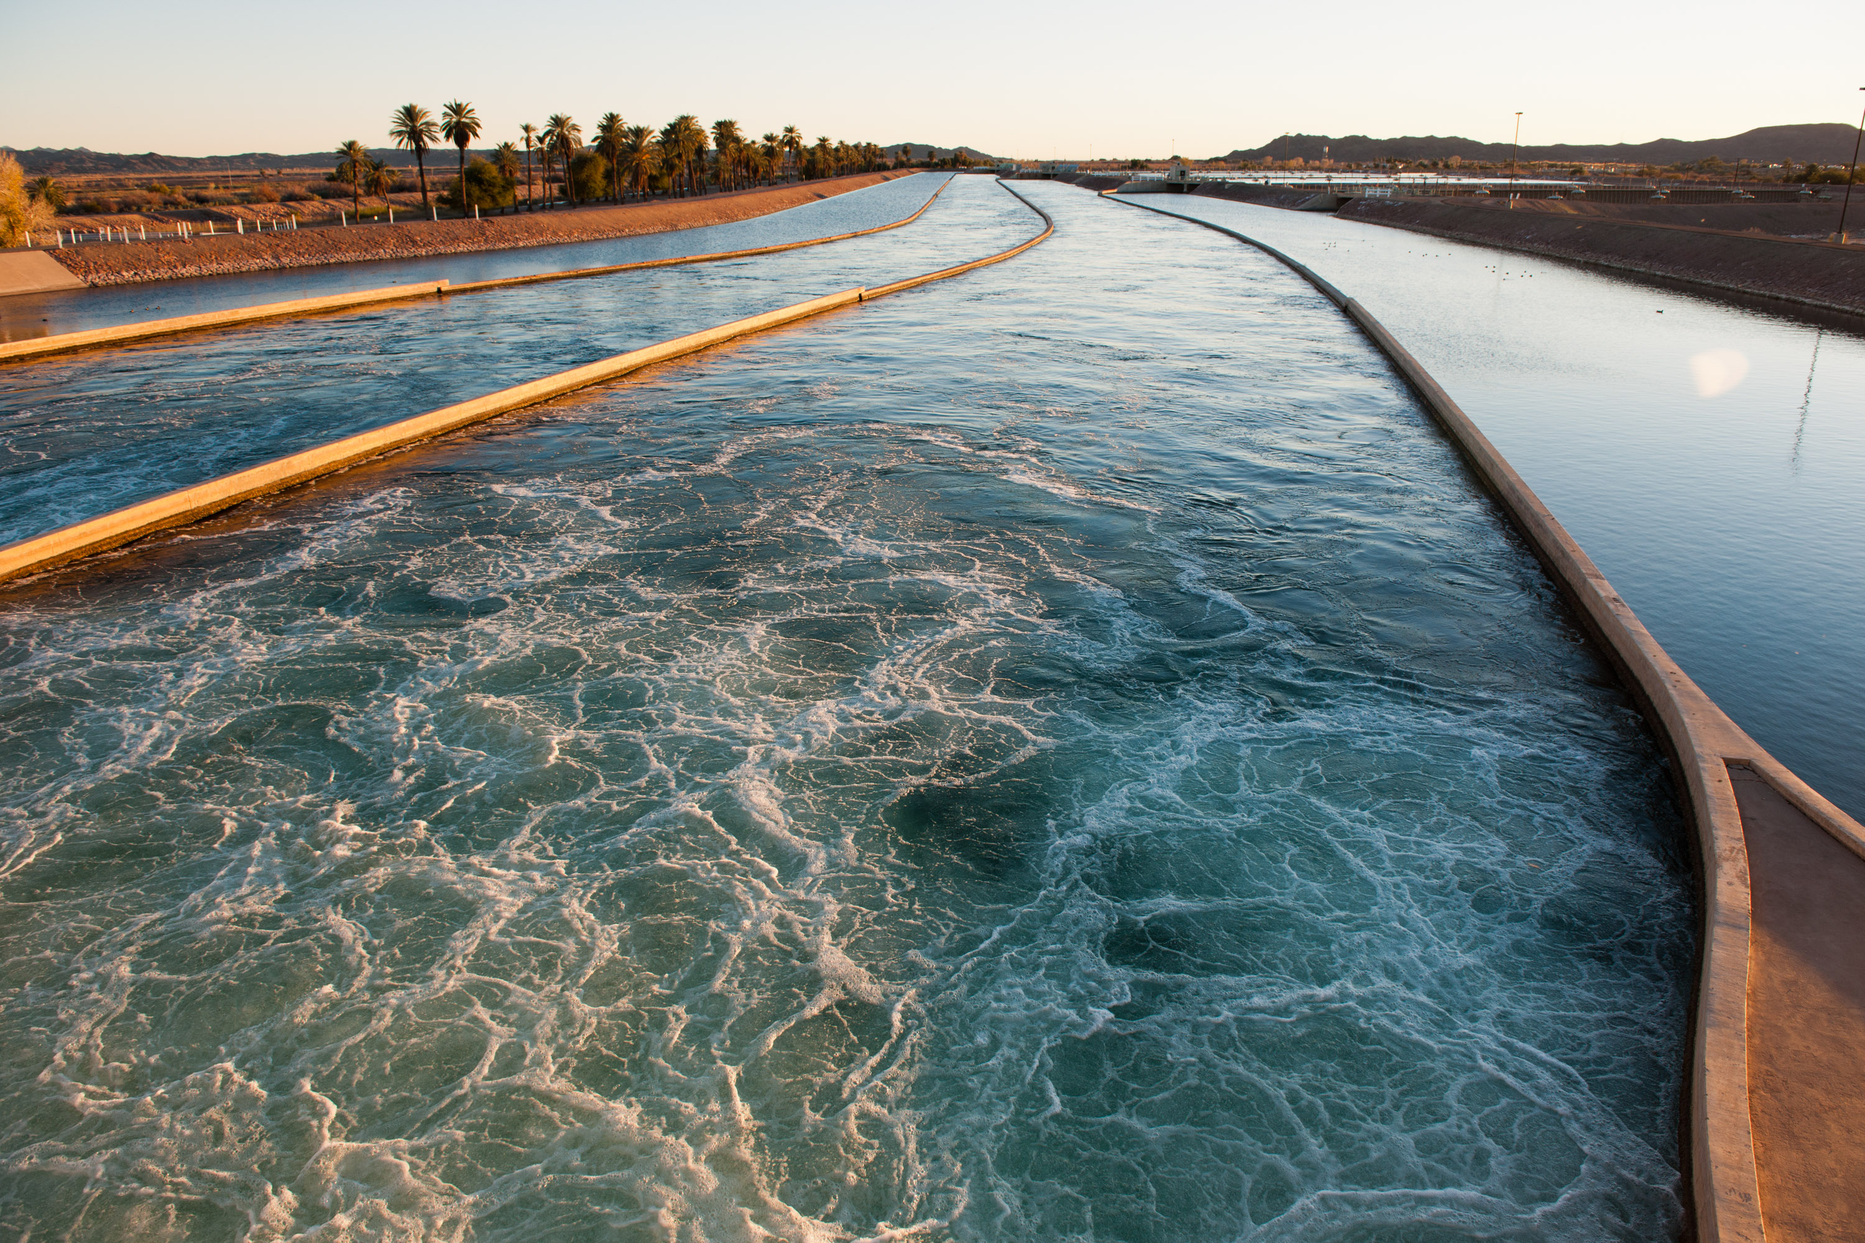
WaterSMART Grants
Water Marketing Strategy Grants
Program Objective: Water markets between willing buyers and sellers can help meet demands efficiently in times of shortages, preventing conflicts
Eligible activities:
  Outreach and partnership building
  Scoping and planning
  Development of a water marketing strategy document
  Pilot activities to further the development of a water marketing strategy
Funding levels:
  Up to $200k for a 2-year project
  Up to $400k for a 3-year project

Slide 16
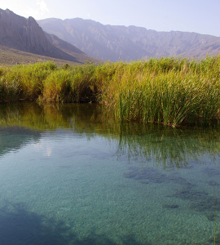
Basin Study Program
Basin Studies
Water Management Options Pilots
Applied Science Grants
Baseline Assessments
*Authorized by Section 9503 of P.L. 111-11, SECURE Water Act

Slide 17
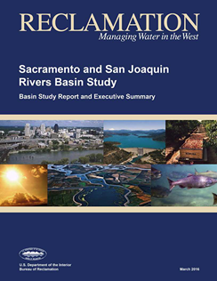
Basin Studies
Reclamation works with non-Federal partners to evaluate current and future water supply and demand and develop strategies to ensure reliable water supplies in river basins in the 17 western states
Eligible Applicants
  States, Tribes, water districts, cities, and other local or state government entities with water delivery or management authority
Funding
  50% non-Federal cost share required
  Basin Studies are not grants and Reclamation funding must be used for Reclamation staff time or contractors
Reclamation has initiated 27 Basin Studies in 15 western states since 2009, and 17 of these studies are now complete

Slide 18
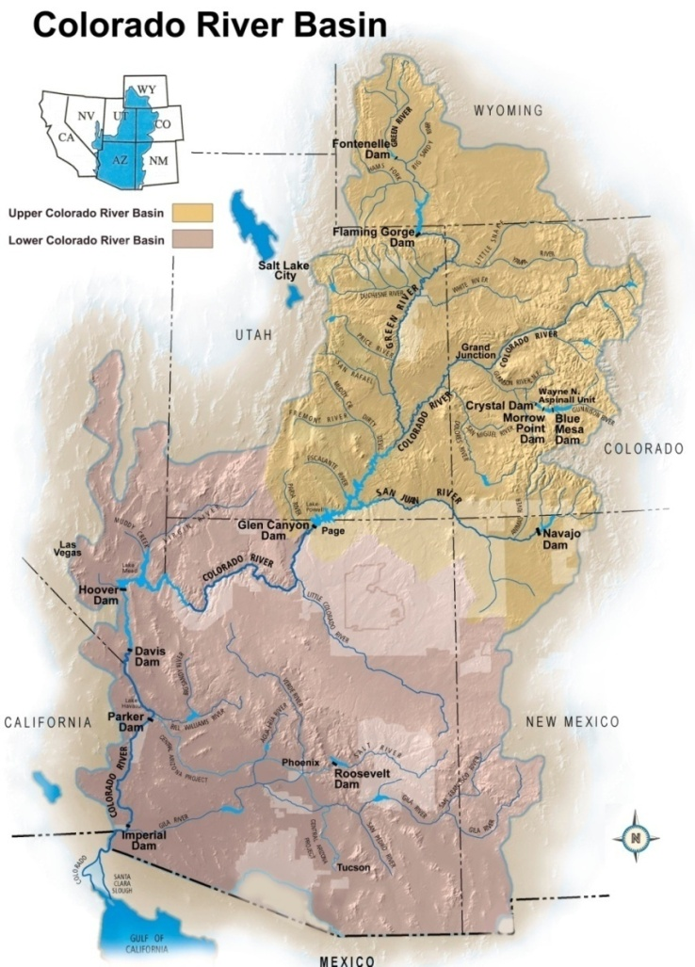
Water Management Options Pilots
Reclamation and stakeholders build on completed Basin Studies through efforts to advance strategies and apply tools and information to address water management challenges and supply and demand imbalances
Eligible Applicants
  Non-federal entities with water delivery or management authority that are located within a basin that has a completed Basin Study
Funding
  50% non-Federal cost share required
  These Pilots are not grants and Reclamation funding must be used for Reclamation staff time or contractors

Slide 19
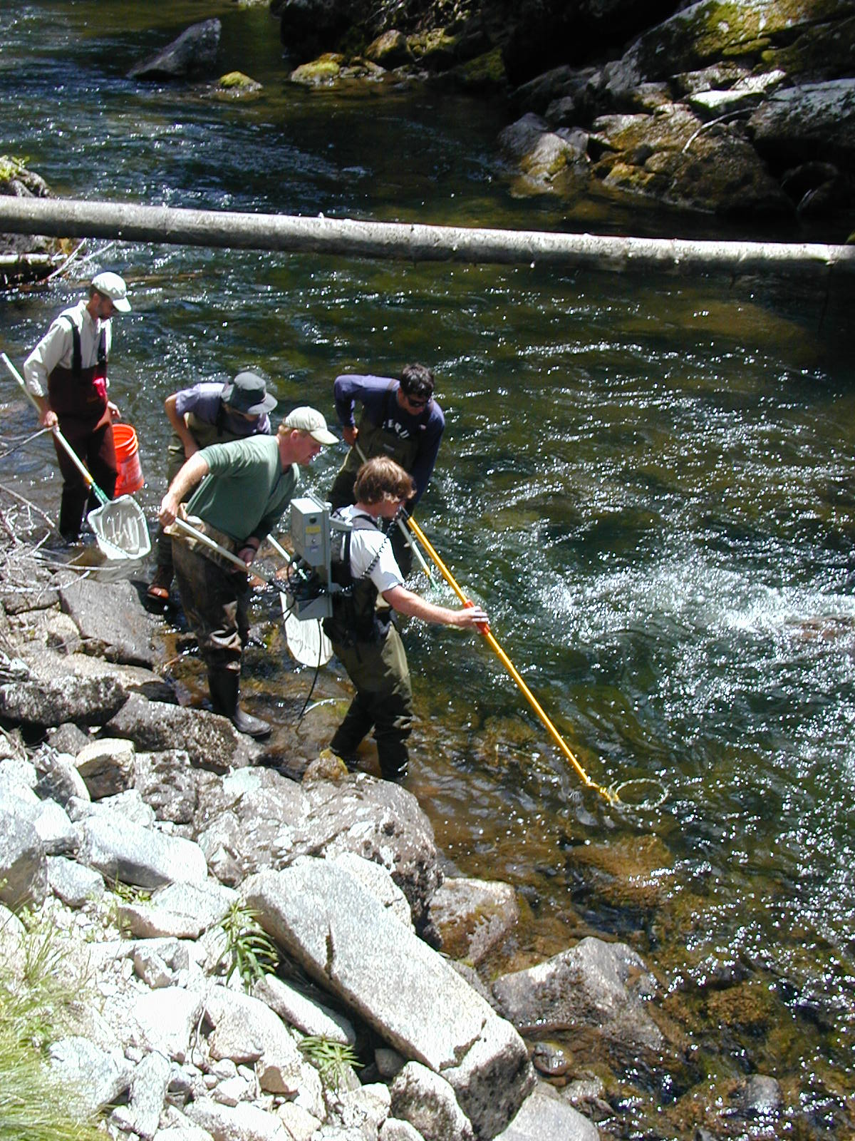
Applied Science Grants
Eligible Projects
  Improve or enhance modeling capabilities
  Improve or adapt forecasting tools and technologies
  Improve access to and use of water resources data
Eligible Applicants
  States, Tribes, irrigation districts, water districts, universities, nonprofit research institutions, organizations with water or power delivery authority, or nonprofit organizations
Funding:
  50% non-Federal cost share required
  Up to $150k for a 2-year project
  Up to $300k for a 3-year project

Slide 20
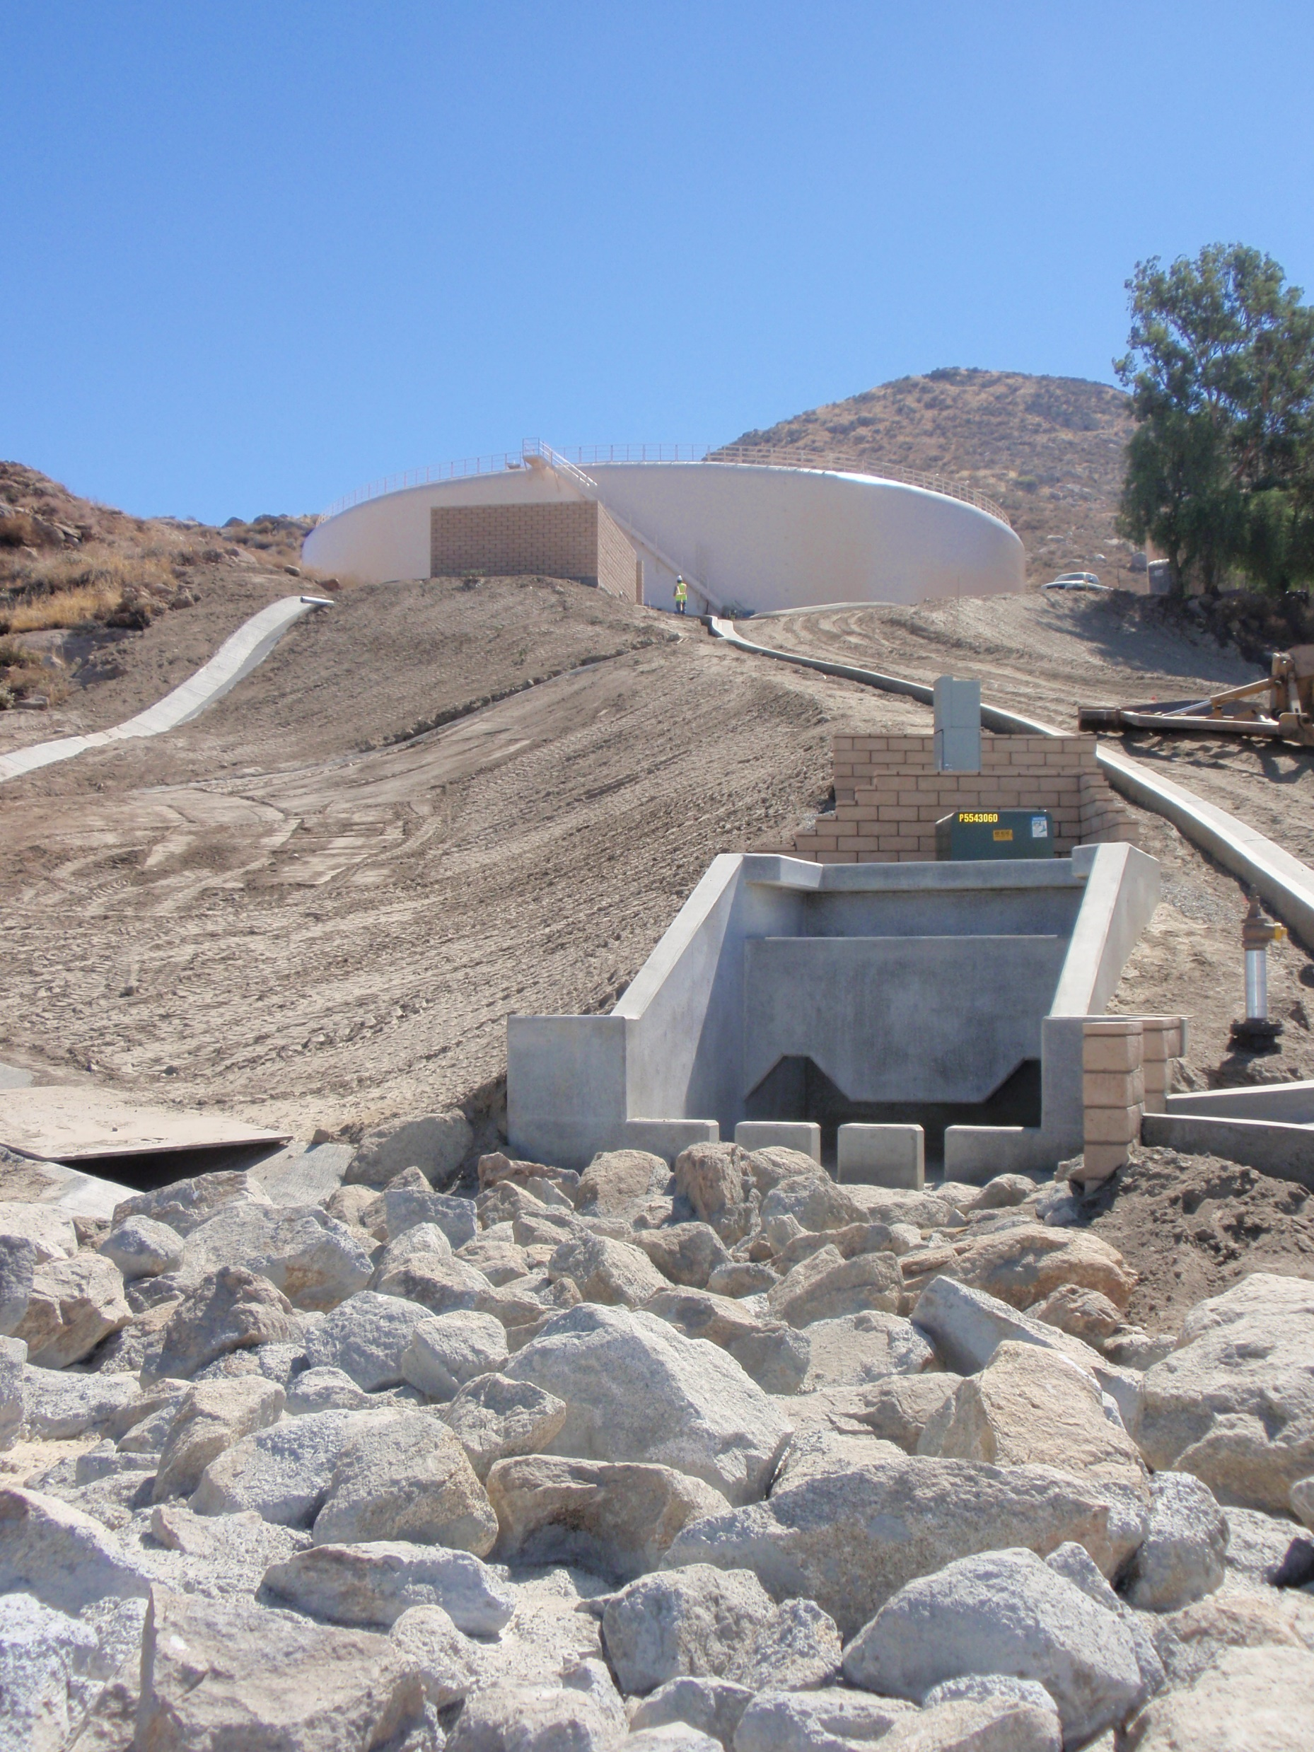
Title XVI
Water Reclamation and Reuse Projects
Eligible Project Types
  Projects that reclaim and reuse municipal, industrial, and agricultural wastewater; or impaired ground and surface waters
  Projects must either have a specific congressional authorization or be eligible under section 4007(c) of the Water Infrastructure Improvements for the Nation (WIIN) Act amendments
Funding
  75% non-Federal cost share required
  Up to $20 million in Federal funding per project, unless otherwise specified by Congress
In 2019, water reuse projects funded through the Title XVI Program delivered over 411,143 acre-feet of recycled water
*Authorized by Title XVI of P.L. 102-575, Wastewater and Groundwater Study and Facilities Act, as amended

Slide 21
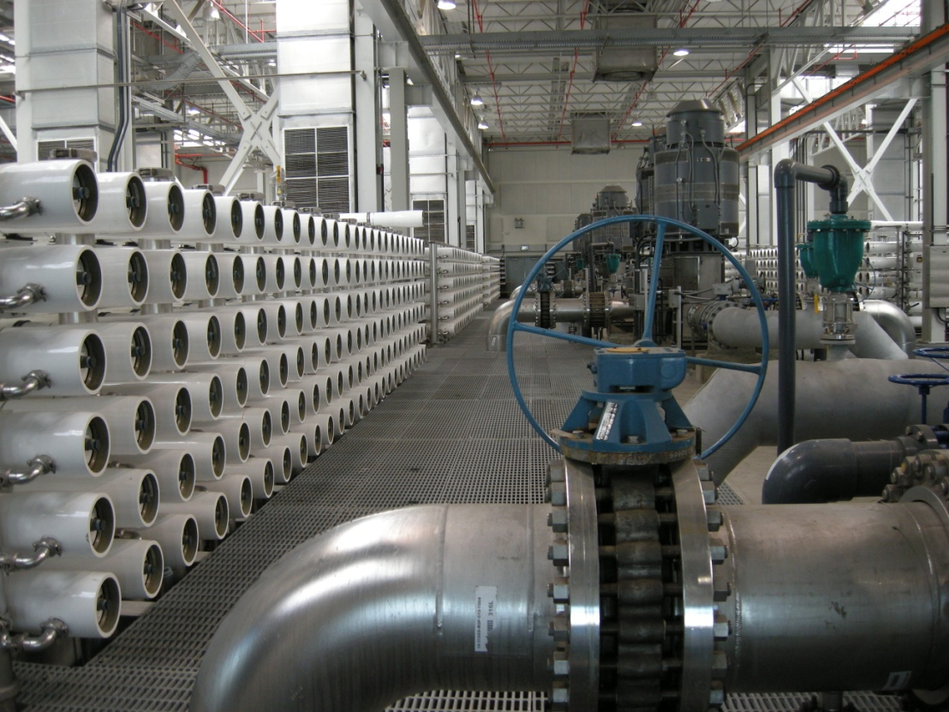
WIIN Act Desalination Projects
Eligible Project Types
  Ocean or brackish water desalination projects that meet the requirements of Section 4007(a) of the WIIN Act amendments to the Desalination Act
Funding
  75% non-Federal cost share required
  Up to $20 million in Federal funding per project
*Authorized by P.L. 104-298, Water Desalination Act of 1996, as amended

Slide 22
WaterSMART Funding
Program | FY 2019 Enacted | FY 2020 Enacted | FY 2021 President’s Budget
WaterSMART Grants | $34 million | $55 million | $7.9 million
Cooperative Watershed Management Program | $2.25 million | $2.25 million | $250,000
Basin Study Program | $5.2 million | $5.2 million | $2 million
Title XVI Program | $58.6 million | $63.6 million | $3 million
Drought Response Program | $9 million | $8 million | $2.9 million
WIIN Act Desalination Projects | $12 million | $12 million | $0
Water Conservation Field Services | $4.2 million | $4.2 million | $2.14 million
Total | $125.25 million | $150.25 million | $18.15 million

Slide 23
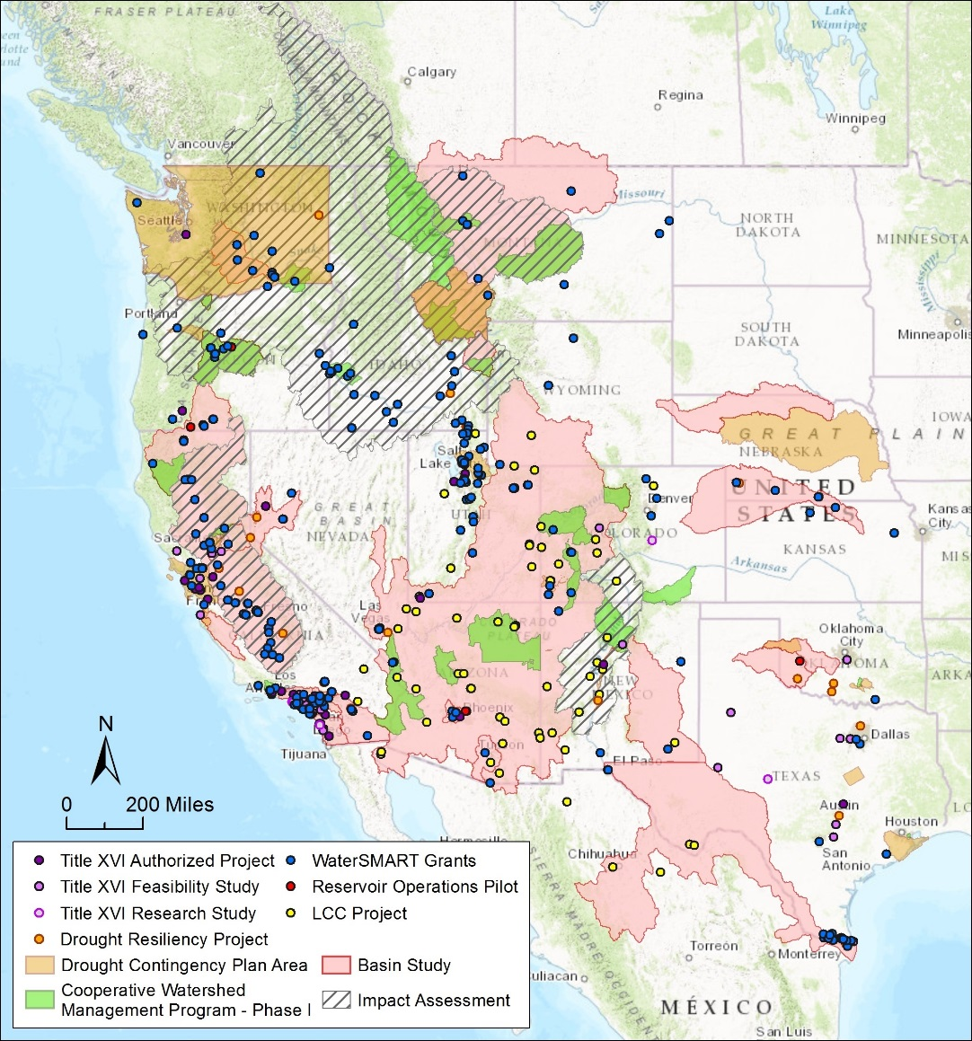
WaterSMART Data Visualization Tool
Data Visualization Tool is an interactive website with program information including:
    Interactive maps
    Featured project tours
    Program growth over time
    https://www.usbr.gov/watersmart/

Slide 24
Thank you! Questions?
Amanda Erath Darion Mayhorn
303-445-2766 303-445-3121
aerath@usbr.gov dmayhorn@usbr.gov
Josh German
303-445-2839
jgerman@usbr.gov

