Slide 1
Prize Competitions
WestFAST Topics Webinar
October 21, 2020

Slide 2
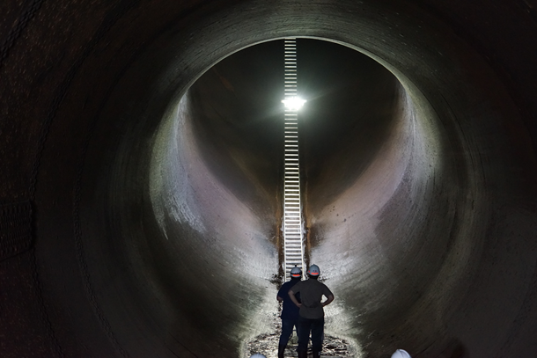
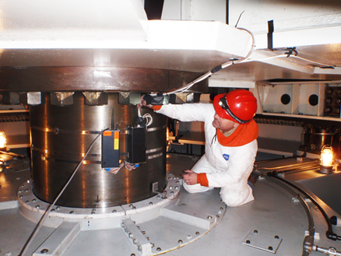
Research and Development Office
Programs
  Desalination & Water Purification
  Science & Technology
Address Technical Challenges in:
  Developing water supplies (both programs)
  Water infrastructure
  Power and energy
  Environmental issues in water management
  Water operations and planning
Customers
  Reclamation facility and resource
  managers, customers, stakeholders,
  private sector, public
https://www.usbr.gov/research/

Slide 3
Pathways for Advancing Research
Prize Competitions
Technology Transfer
S&T Research Reclamation Led
Science & Technology
  S&T Program:
    $11.0 – 22.0 million/year since FY 2016
  Prizes:
    $3.0 - 8.5 million/year
    ~ $24.7 million total
Technology Transfer
  Cooperative Research and Development Agreement
  Material Transfer Agreement
  Facility Use/Service Agreement

Slide 4
Prize Competitions
A tool for solving tough issues and advancing research
How it works:
  Issue a challenge to solve a problem
  Establish monetary and non-monetary incentive prizes
  Set a “Bar of Success”
Since 2014:
  24 Competitions launched
  745 Solutions submitted
  100 Winning solutions
  ~$1.5 million awarded
  10 Winning solutions in research and development
Known Solvers
Problem
Solvers in other domains

Slide 5
Process
Workflow
Can include on-site demonstration that include solvers and commercial interests or investors
Identify Topics
(ongoing)
Design
Launch
Judge
Award
Input from Reclamation, other Feds, and external stakeholders on research ideas
Reclamation, partners (Federal/non-Federal), contractors, etc.
Paid by Reclamation and Fed/Non-Fed Co-Sponsors
Promotional Materials & Competition Web-Page
Announce Winners
Reclamation Public Affairs and Contractor

Slide 6
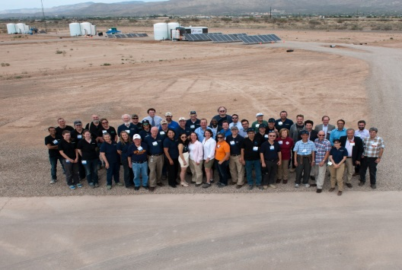
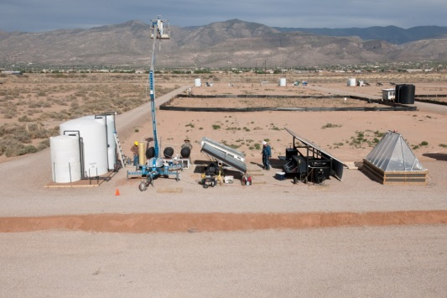
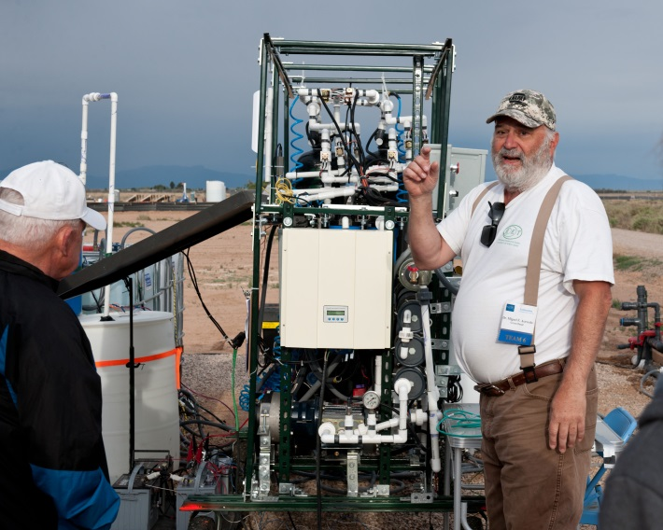
2015 Desal Prize (USAID Lead)
Challenge: Treat brackish groundwater for rural and underdeveloped areas
Success Criteria: Potable and irrigation water volumes, renewable energy-powered, demonstration event
Winners: Two sharing $200K, additional $400K in grants awarded
Maturing Solutions: Winner and Manufacturer partnering to commercialize
Bloomberg “Burning Man for Water Geeks”

Slide 7
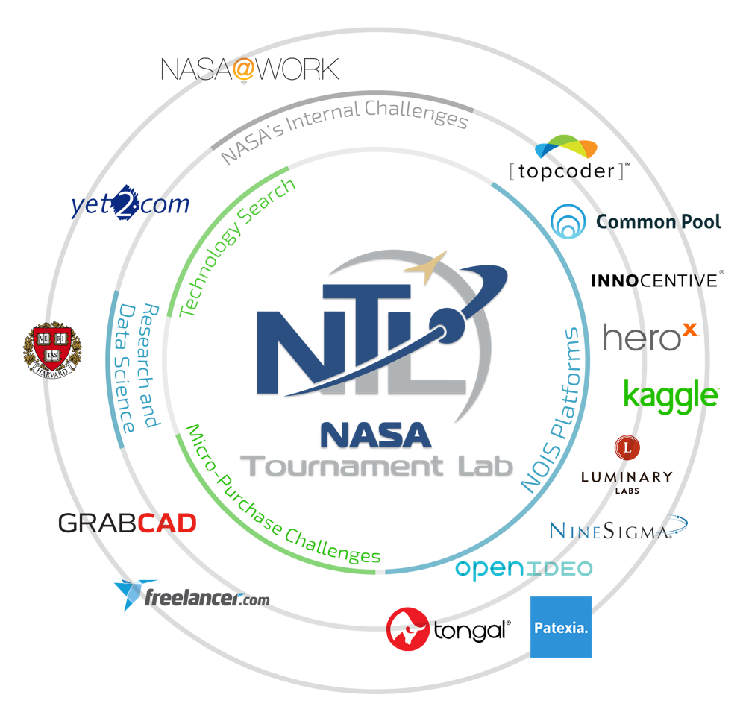
Program Evolution
2014 – 2019 - Theoretical and Ideation
2018 - Transition
  Multiple stages
  Reduction To Practice
  Procurement authority
  Partnership - NASA’s Center of
  Excellence for Collaborative Innovation
    Access to multiple prize competition vendors and solver communities
    Technology Searches

Slide 8
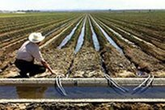
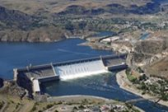
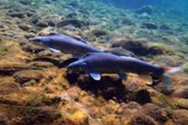
Program Organization
Water
Help water managers facing current and future water demands from agriculture, municipal, industrial, Native American, rural, recreation, power generation, and ecosystem needs
Infrastructure
Support safe, well-maintained, and reliable inventory of dams, pipelines, hydropower generation facilities, canals, and levees
Environment
Aids operations to ensure watersheds are healthy, continue producing water, and supports State and Federal law compliance

Slide 9

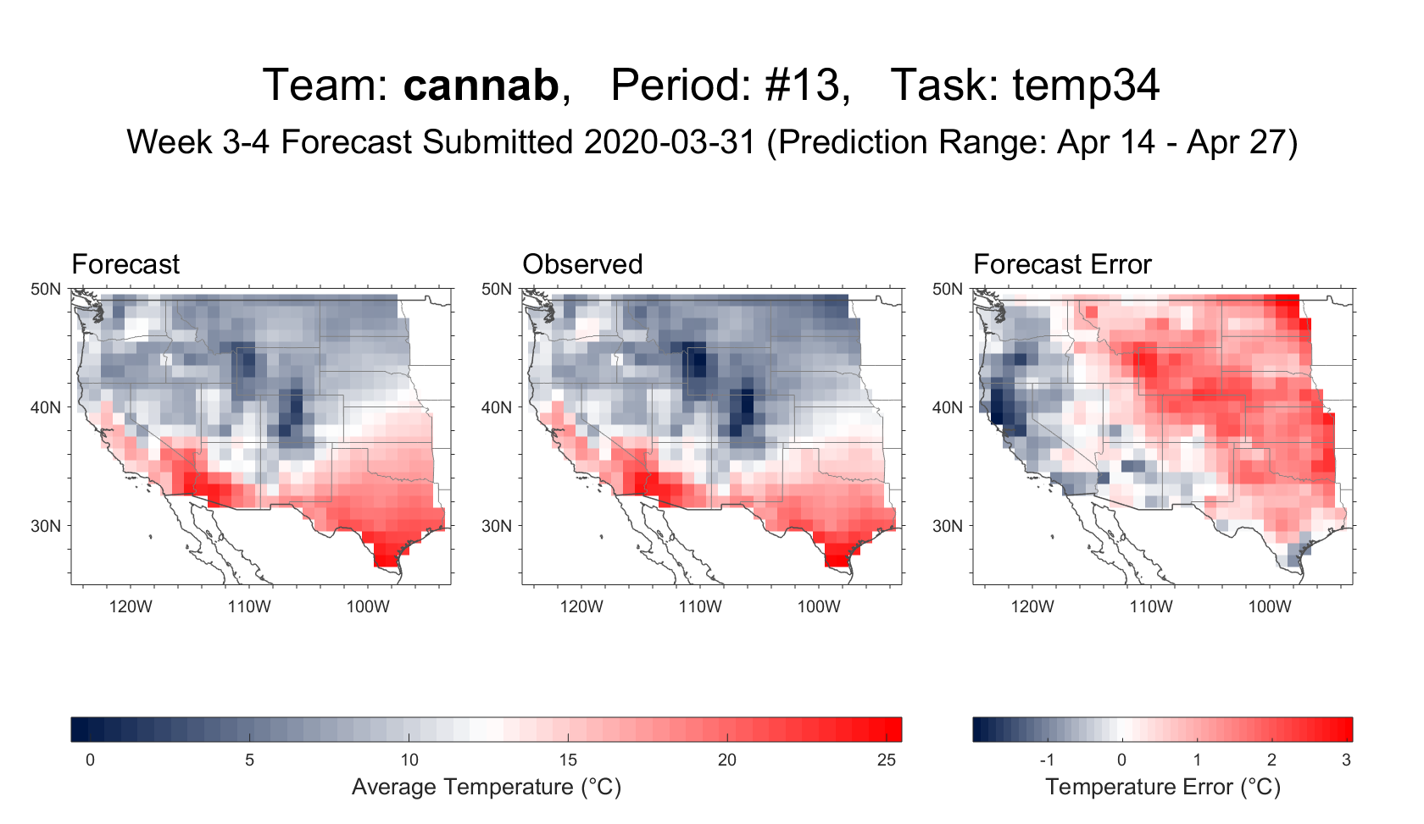
Water - Supplies
Current
  Streamflow Forecast Rodeo
Scoping
  Improving Snow-Water Equivalents Estimates
    Multiple partnerships
Success
  Sub-Seasonal Climate Forecast Rodeo II
      www.drought.gov/drought/forecast-rodeo-ii-leaderboard
  Lowering the Cost of Continuous Streamflow Monitoring

Slide 10

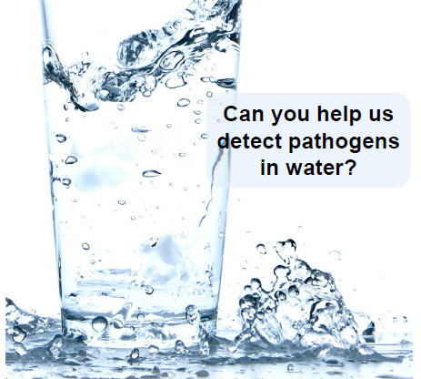
Water - Treatment
Launching Oct. 28!
  More Water Less Concentrate
Scoping
  Arsenic Sensor - Technology Search
    EPA Partnership
Success
  Pathogens Sensor
    Maturing winning technology through DWPR grant
www.MoreWaterLessConcentrate.org

Slide 11

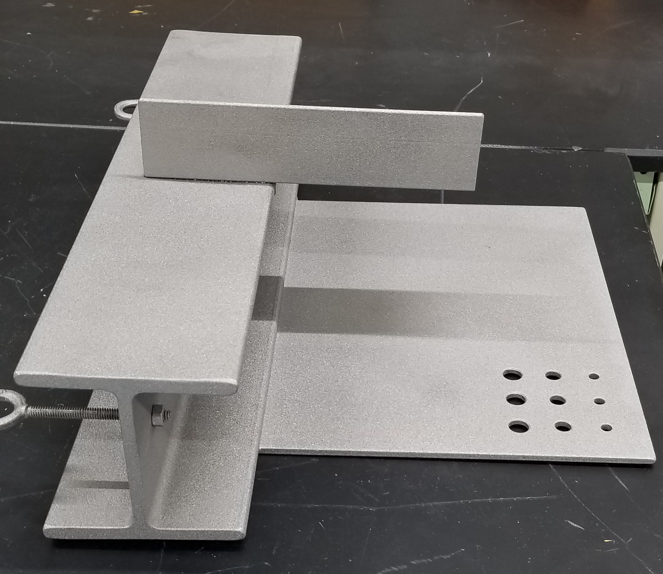
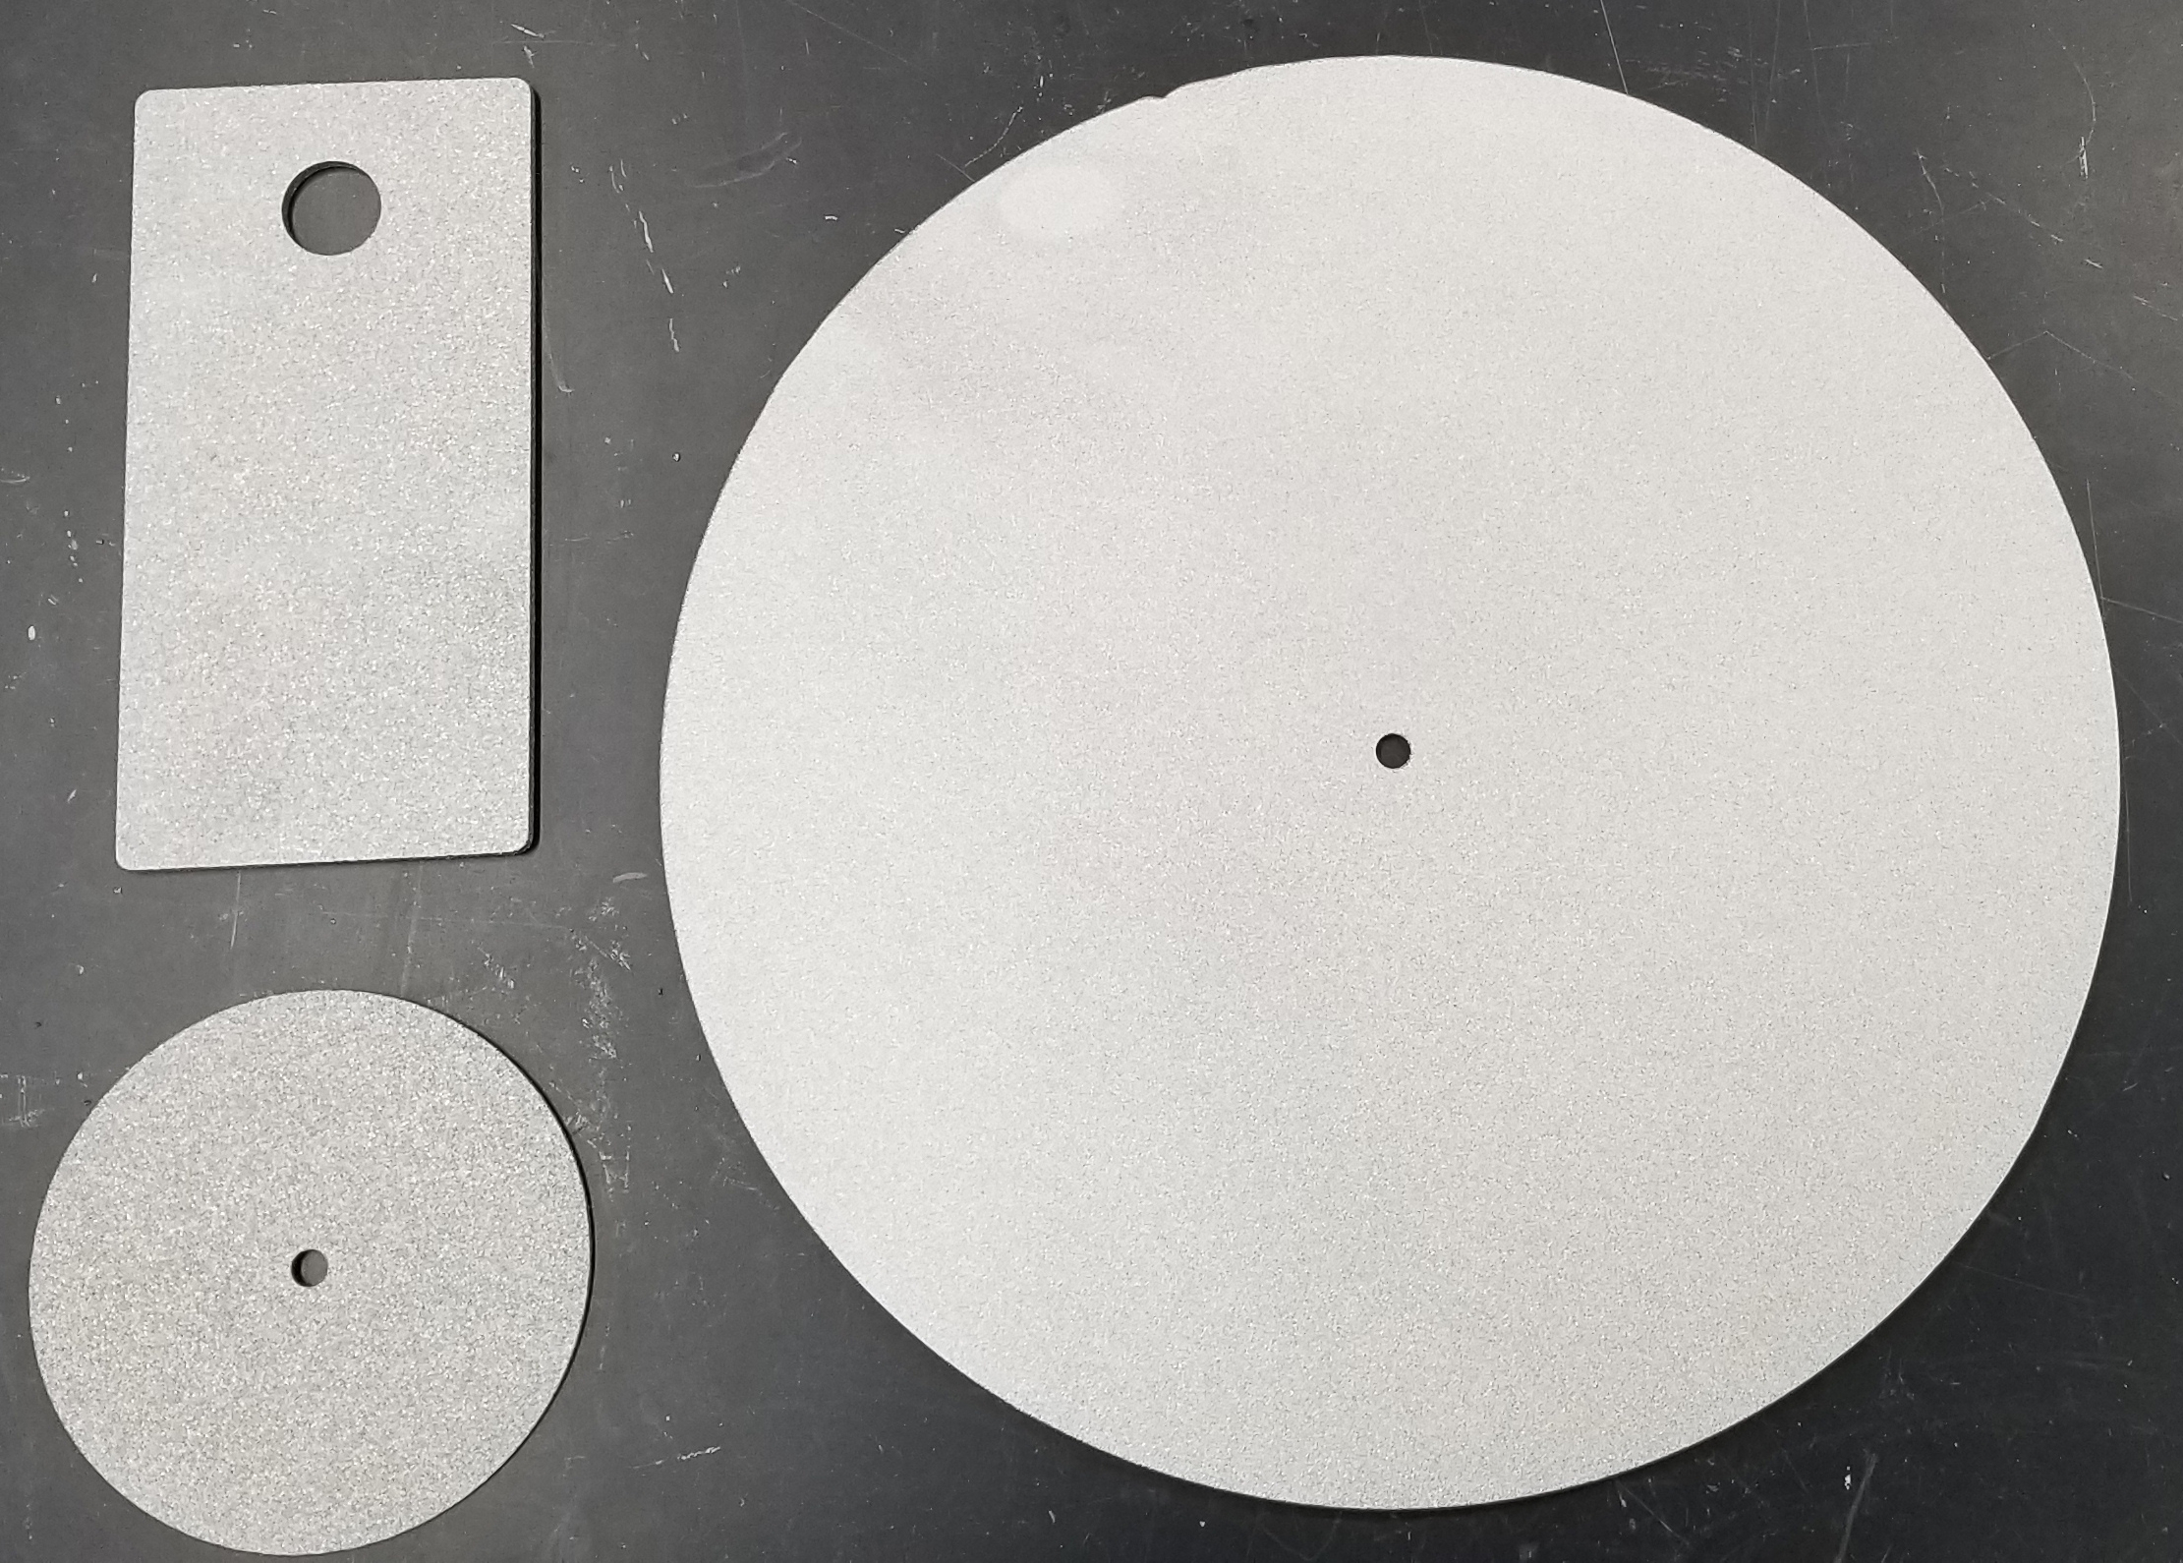
Infrastructure
Current
  Improving Canal Safety – Launching 10/22/20
  Rust Busters
Scoping
  Reducing Canal Seepage
  Non-Destructive Composites Condition Assessment
  No Outage Testing of Hydropower Protection Systems
Success
  Detecting Internal Erosion - Evaluating Distributed Acoustic Sensing
www.canalsafetychallenge.org

Slide 12
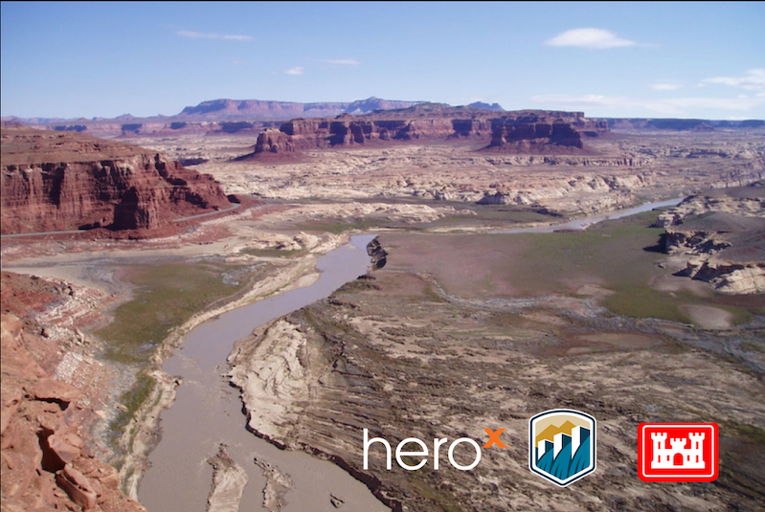

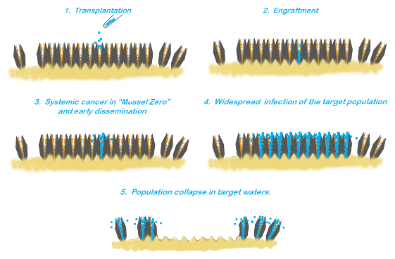
Environment
Current
  Guardians of the Reservoir
Scoping
  Management of Aquatic Vegetation in Canals
Success
  Fish Exclusion/Fish Protection Prizes
  Eradication of Invasive Mussels

Slide 13





















Collaboration is Vital
Additional Perspectives, Opportunities, and Resources
Partnership Opportunities
  Topic/Issue Identification
  Subject Matter Experts for Design/Judging
  Technical Support to Solvers
  Solution Testing and Evaluation
  Amplification of Competition
  Monetary or Non-Monetary Recognitions/Contributions
  Maturing Solutions

Slide 14
Jennifer Beardsley
Prize Competitions Program Administrator
jbeardsley@usbr.gov | 303.445.2127
https://www.usbr.gov/research/challenges
https://www.usbr.gov/research/docs/ks/ks-2019-04.pdf

