Slide 1
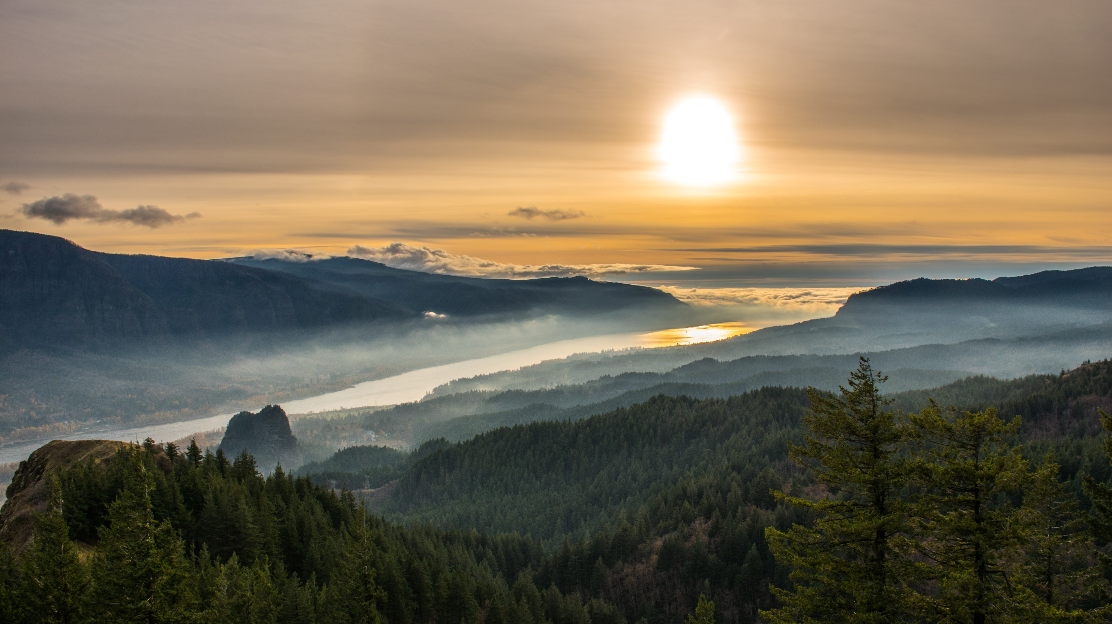

Internet of Water
Nicholas Institute for Environmental Policy Solutions, Duke University

Slide 2
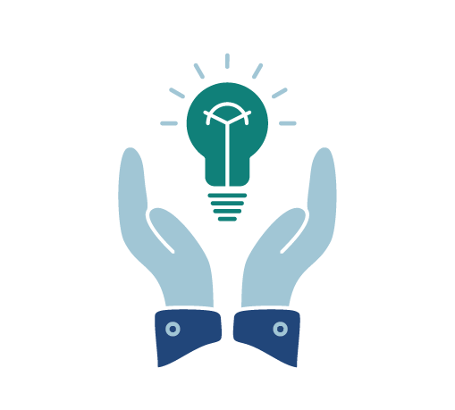


PHILOSOPHY
PHILANTHROPIC PROJECT
EMERGING
FEDERAL INITIATIVE
Notes:
The Internet of Water is a philosophy, a philanthropic project, and an emerging Federal initiative that has three major goals:

Slide 3
Collaborative water data projects
Nationwide community of practice
Essential new technologies
Notes:
to support critical water policy outcomes through collaborative water data projects;
to provide a community of practice for implementing the Internet of Water philosophy nationwide, supported by variety of online resources and tools;
and to build and sustain essential new technologies that will make an Internet of Water possible, both now and into the future. At the heart of these new technologies is Geoconnex, a prototype catalog and indexing system, that when connected to the USGS National Hydrography Infrastructure, will be capable of searching and retrieving all water metadata held in the United States, and ultimately North America.

Slide 4
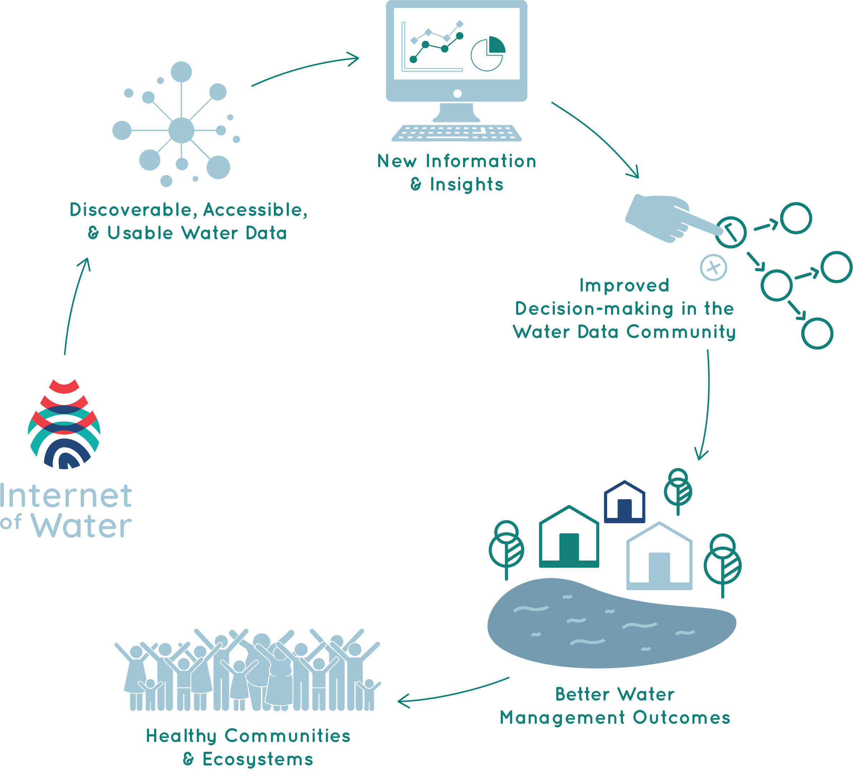


PHILOSOPHY
PHILANTHROPIC PROJECT
EMERGING
FEDERAL INITIATIVE
Notes:
The Internet of Water philosophy is rooted in the idea that greater water data discovery, sharing and integration is necessary to support major areas of water policy and water mission work, such as climate and drought resilience, water equity, clean water, conservation, and regional planning at the land-energy-water nexus. Because data are the food of models, such data sharing is also critical to the science, technology, and modeling activities necessary to achieve those policy outcomes. Greater water data sharing and integration requires water data become modern and FAIR: meaning findable, accessible, interoperable, and reusable.
The Internet of Water builds on decades of previous work to address the challenge of FAIR water data. These have included USGS and White House efforts around open water data, as well as many years of work in the water informatics community to develop and implement shared standards, especially the formation of CUAHSI in 2005, the formation of the Western States Water Council’s Water Data Exchange (WaDE) in 2011, and the Open Water Data Initiative that began under the Obama Administration.
Today, the USGS is actively advancing the philosophy of an Internet of Water in its programs.
While we have made important progress, water data today is still managed on hundreds of independent platforms across multiple agencies and jurisdictions, in thousands of different, often difficult-to-access formats. These data sets must be cleaned and reorganized for every new use, costing tens of thousands of dollars and months of work each time.
A dedicated effort is needed to overcome continue progress toward making water data more FAIR; the Internet of Water project is just such an effort.

Slide 5
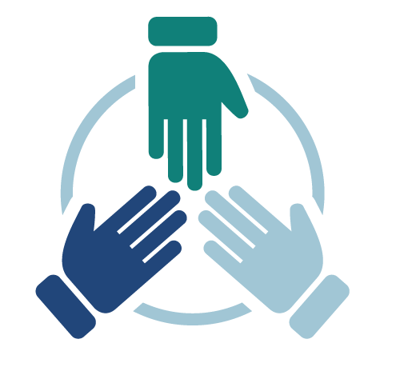
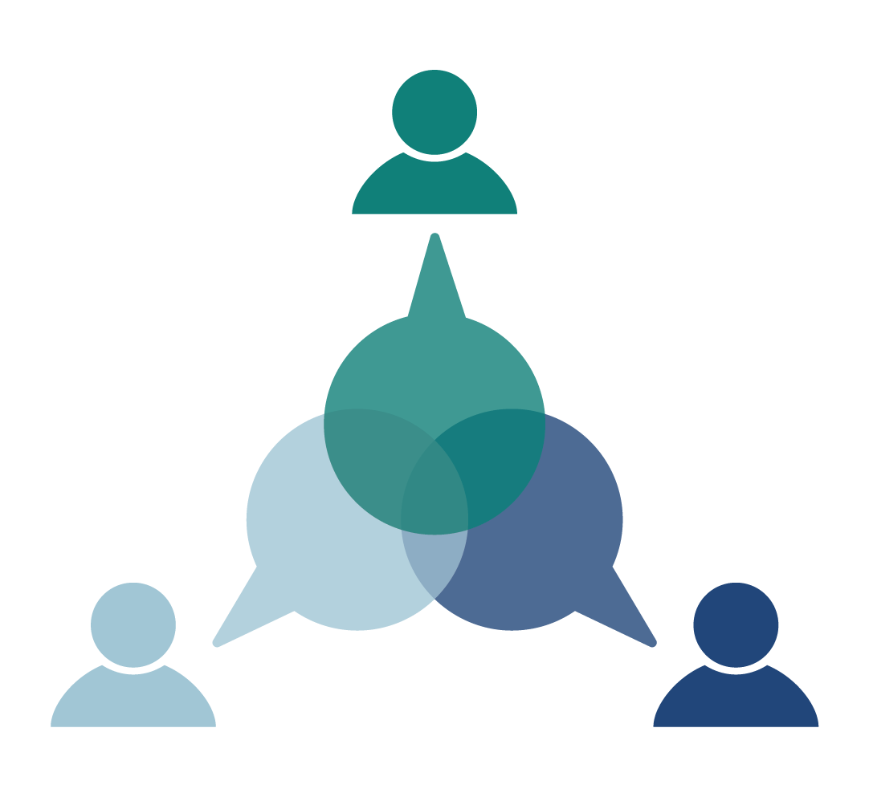
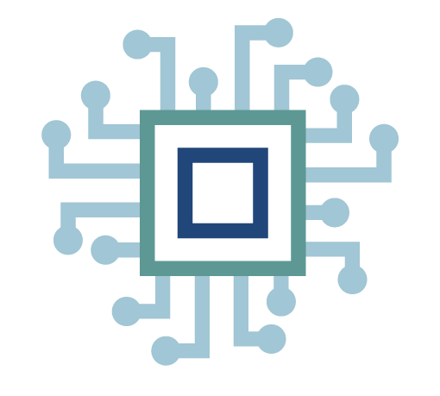

PHILOSOPHY
PHILANTHROPIC PROJECT
COLLABORATIVE PROJECTS
COMMUNITY OF PRACTICE
NEW TECHNOLOGY
EMERGING FEDERAL INITIATIVE
Notes:
The Internet of Water philanthropic project was founded at Duke University in 2018 with the support of six private foundations, following an Aspen Institute dialogue series and report that called for its creation. The Internet of Water Project is completing its 3-year start-up phase this year and has successfully raised funding for a 4-year growth phase through 2025. The Internet of Water Project, led by Duke, is being implemented in partnership with multiple state and federal agencies and non-profit organizations.
As I stated out the outset, the Internet of Water project has three goals: 1) to advance collaborative projects; 2) to build a community of practice; 3) and to create essential new technologies.

Slide 6
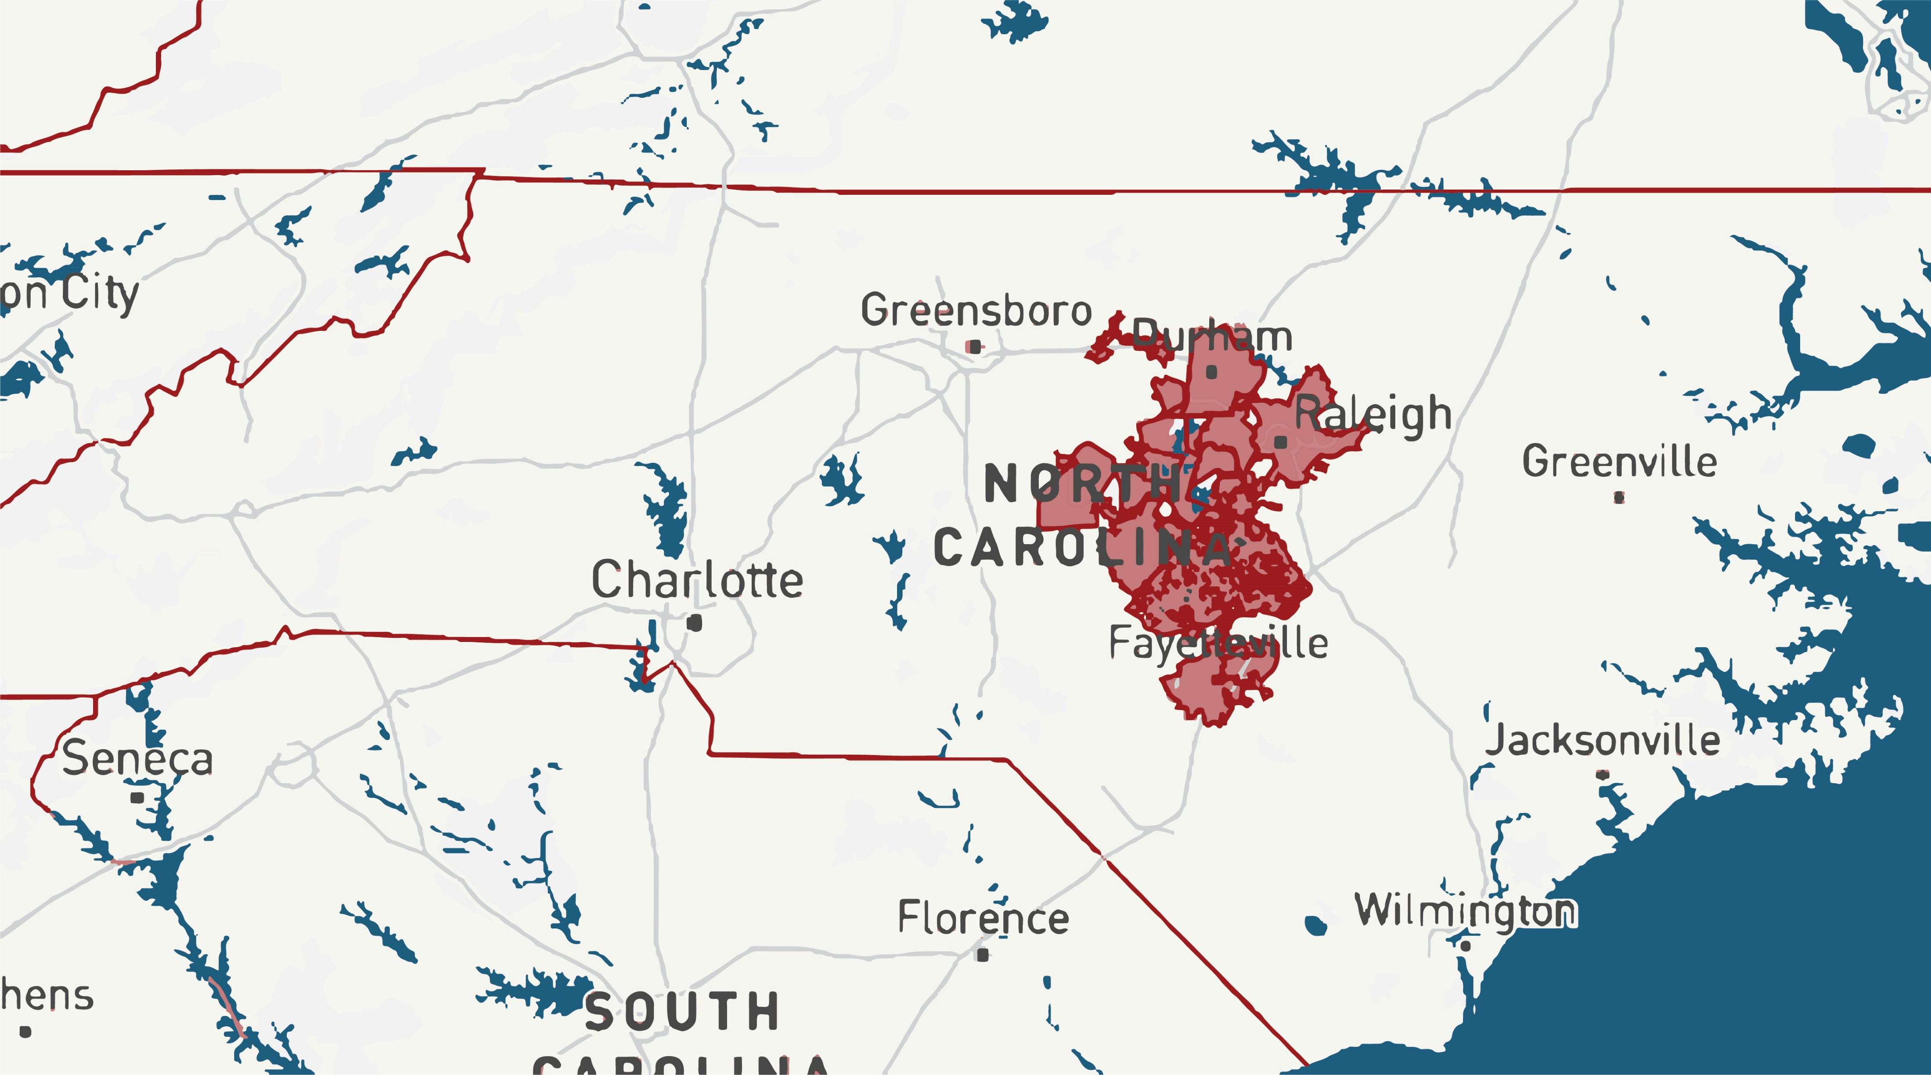
PHILOSOPHY
PHILANTHROPIC PROJECT
NC WATER SUPPLY DASHBOARD
Helping utilities share demand, conservation status, and other data relevant to water supply
EMERGING
FEDERAL INITIATIVE
Notes:
At the request of our stakeholders, our collaborative projects have focused mostly on water supply and drought resilience. For example (1) In North Carolina , we are helping utilities build a water conservation and supply dashboard;

Slide 7
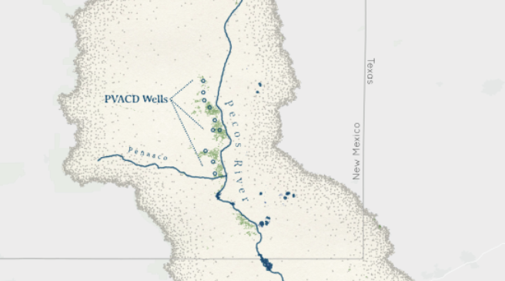
PHILOSOPHY
PHILANTHROPIC PROJECT
IMPROVED DATA MANAGEMENT AND DECISION SUPPORT IN THE LOWER PECOS VALLEY
Management of groundwater withdrawals for the Pecos Valley Artesian Conservation District
EMERGING
FEDERAL INITIATIVE
Notes:
In New Mexico, we are advancing careful monitoring of groundwater wells on the Pecos River

Slide 8
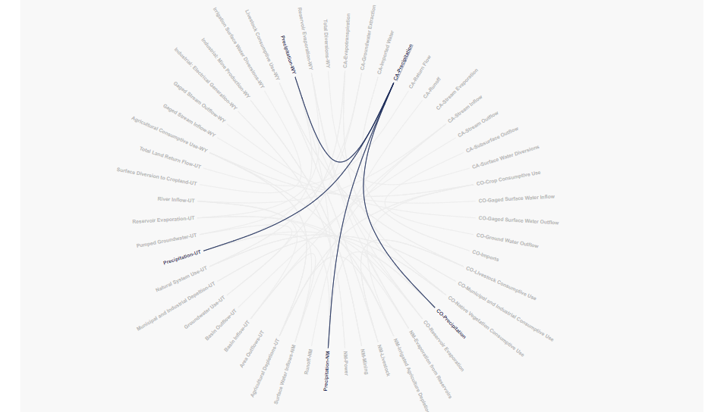
PHILOSOPHY
PHILANTHROPIC PROJECT
Water Budget Navigator
Compare budgeting formulas and use estimates across states
EMERGING FEDERAL INITIATIVE
Notes:
In the Colorado River Basin, we are providing a Water Budget Navigator Tool, -compare water budgeting formulas and use-estimations across states.

Slide 9
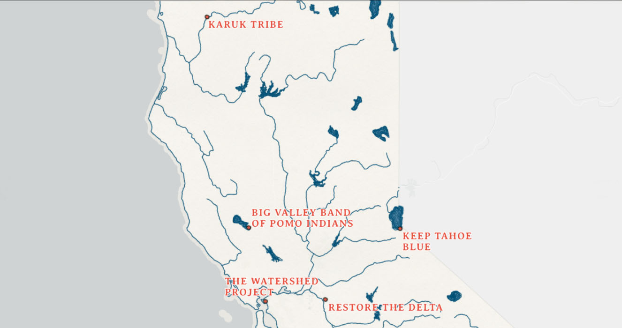
PHILOSOPHY
PHILANTHROPIC PROJECT
FRESHWATER HARMFUL ALGAL BLOOMS MONITORING AND NOTIFICATION SYSTEM
Integrating state monitoring data with data collected by tribal governments and community science organizations
EMERGING FEDERAL INITIATIVE
Notes:
In addition, our projects have supported other policy goals, such as in California, where we are working to integrate tribal and community data sets into California’s state harmful algal bloom monitoring system. Each of these efforts involves a robust participatory engagement process.

Slide 10
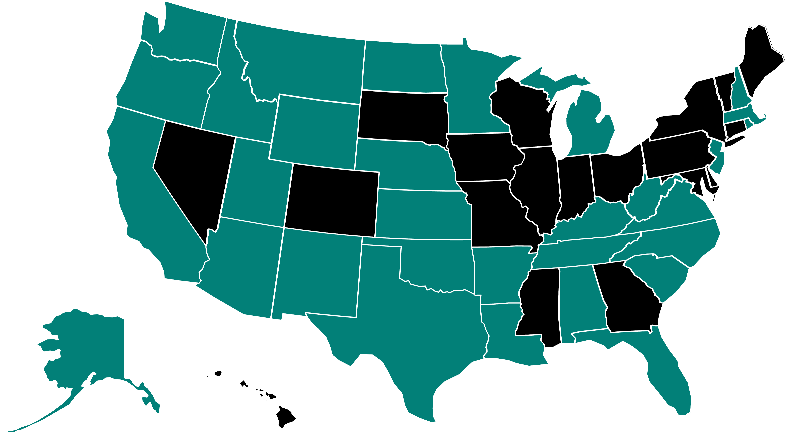
COMMUNITY OF PRACTICE
PHILOSOPHY
PHILANTHROPIC PROJECT
145 members
33 states
EMERGING FEDERAL INITIATIVE
Notes:
In addition to our collaborative projects, the IoW provides a growing community of practice of water data producers and users through our Peer 2 Peer Network which formally includes 145 members from 33 states; and has engaged more than 700 participants thougth the IoW webinar series. The Peer2Peer Network is supported by a rich array of online tools and resources available in the IoW Learning Center on our website. In particular, our Data 101 Guidebook provides critical guidance on water data and metadata standards to advance FAIR data principles.

Slide 11
PHILOSOPHY
PHILANTHROPIC PROJECT
NEW TECHNOLOGY
EMERGING FEDERAL INITIATIVE
Notes:
Finally, the IoW project is engaging in the development of essential new technologies that will make an internet of water possible

Slide 12
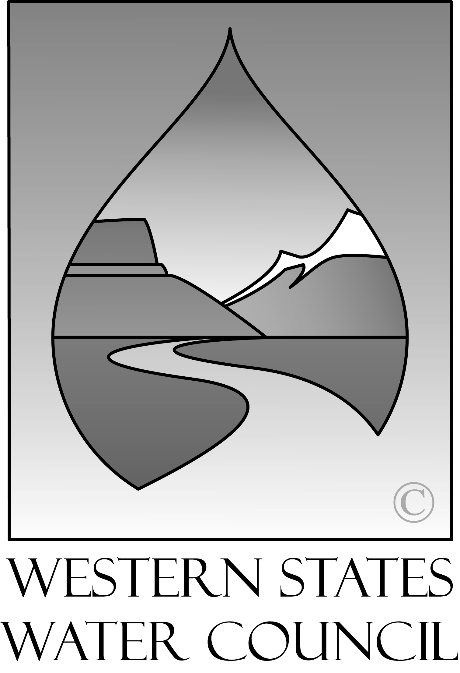
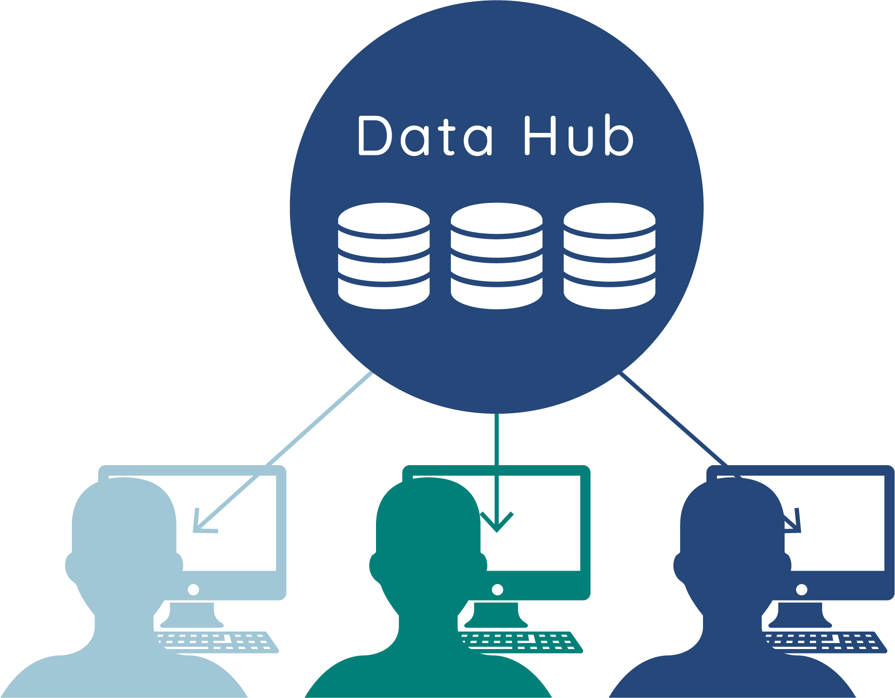
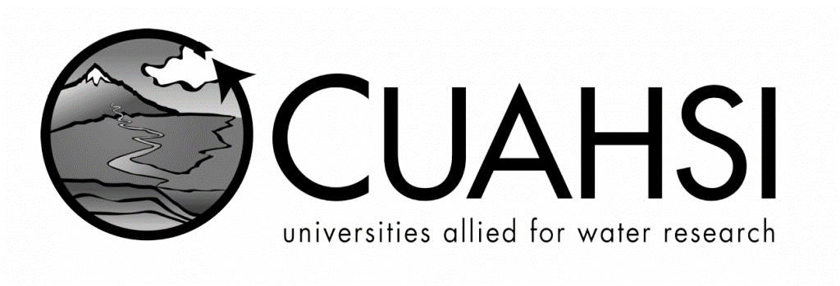
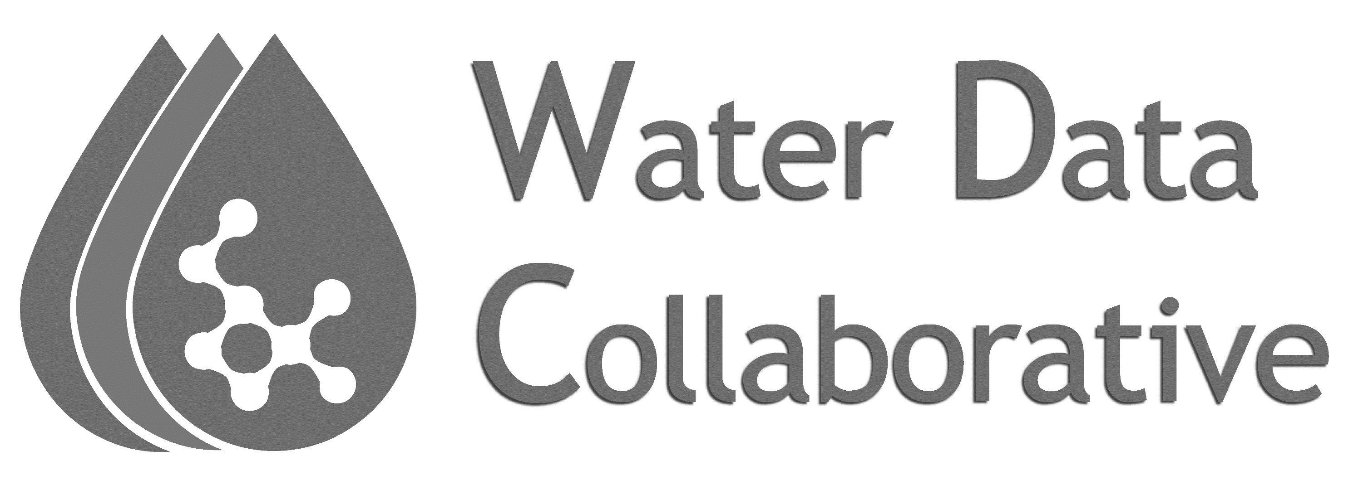
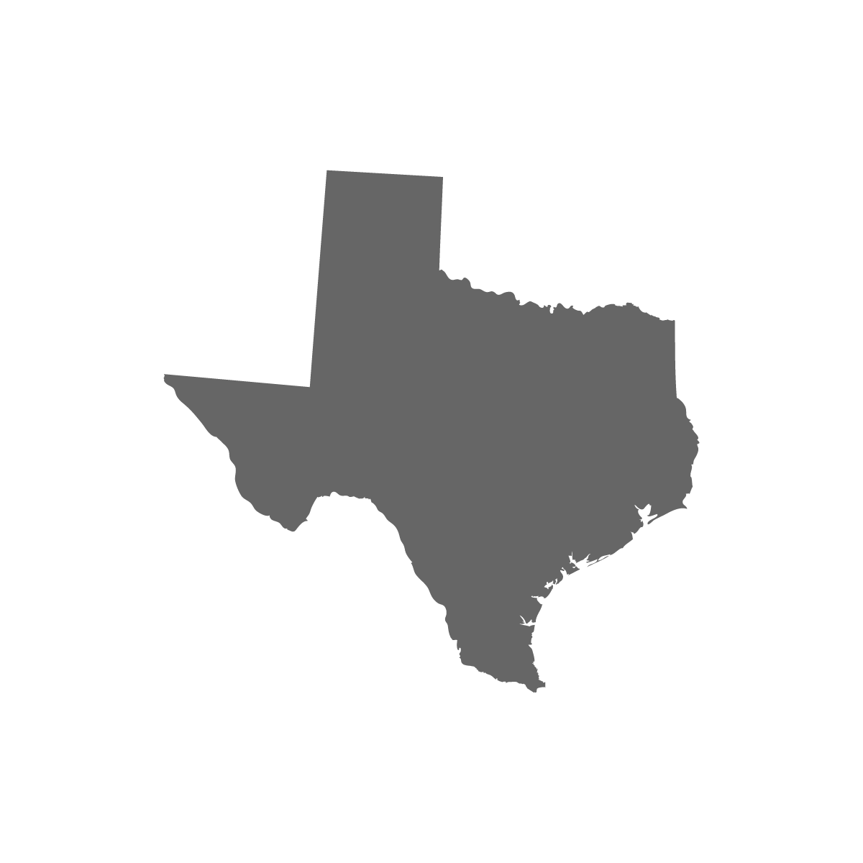

PHILOSOPHY
PHILANTHROPIC PROJECT
TX
NM
EMERGING FEDERAL INITIATIVE
Notes:
First is a system of thematic and geographic hubs, fostering the digital transformation of public water agencies and utilities. These include:
non-federal thematic hubs --for sensor data at CUAHSI, water rights and water use data at WaDE, and community science data at the Water Data Collaborative (WDC);
geographic hubs in the states of New Mexico and Texas;
a growing list of federal hubs that meet FAIR data standards, including the Water Quality Portal (WQP), the National Water Information System (NWIS), the U.S. Bureau of Reclamation Information Sharing Environment (RISE), the Oak Ridge National Labortory’s Hydrosource hub for hydropower data; and

Slide 13
Water Data Exchange (WaDE)
PHILOSOPHY
Western Cornerstone
of the
Internet of Water
PHILANTHROPIC PROJECT
EMERGING FEDERAL INITIATIVE

Slide 14
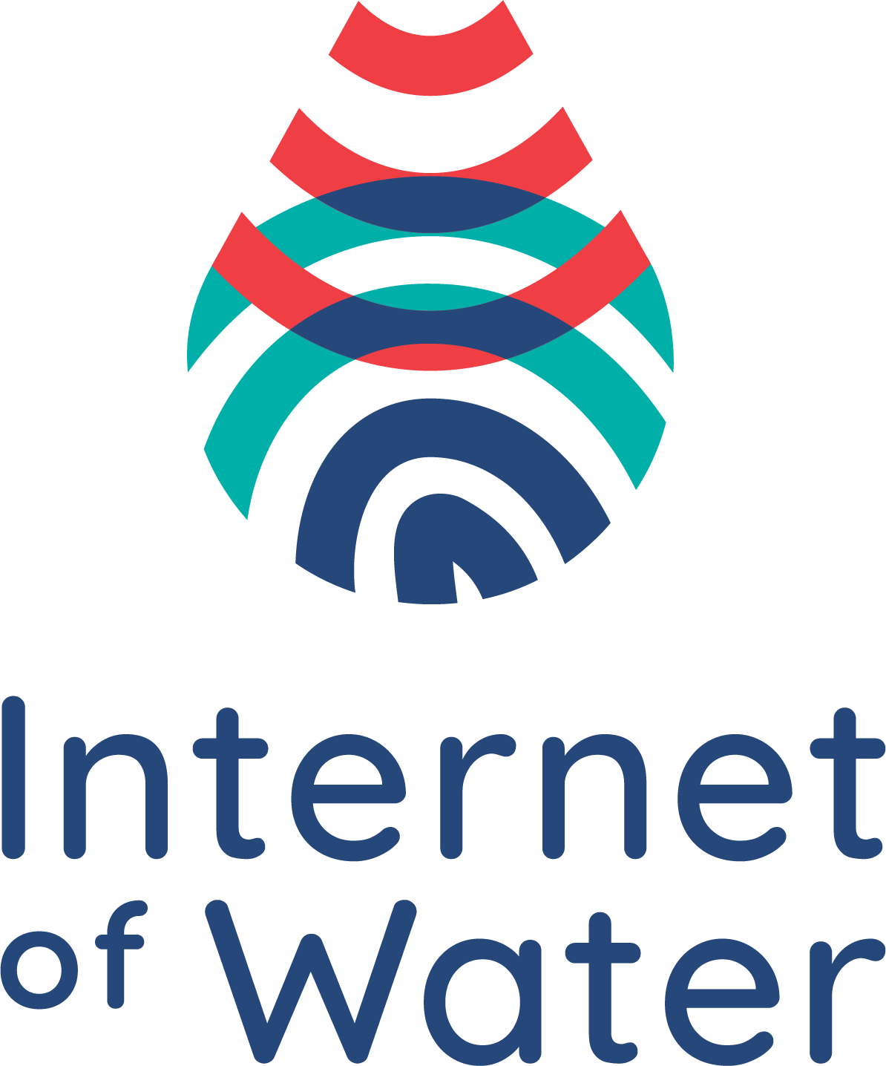

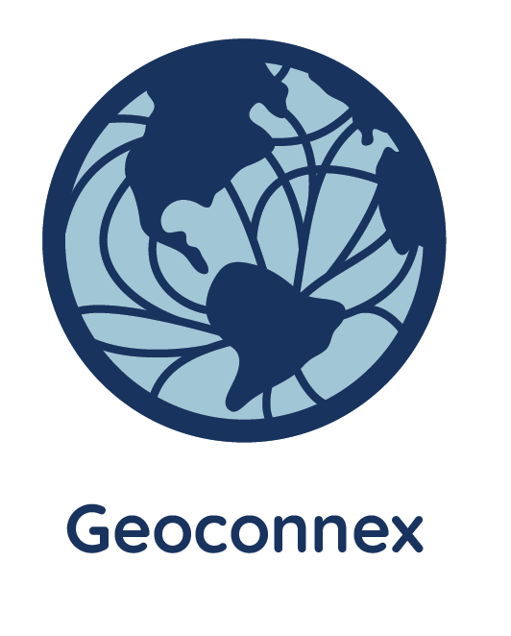
PHILOSOPHY
A search index for water data from all organizations, built in partnership with USGS
PHILANTHROPIC PROJECT
EMERGING FEDERAL INITIATIVE
Notes:
Finally, and most importantly, IoW is developing Geoconnex, in partnership with the USGS. The Geoconnex system lies at heart of the Internet of Water, as a linked data system for cataloging, indexing, and searching for water data, which connects water data via geographic location, from all hubs and other sources using the National Hydrography Infrastructure.

Slide 15
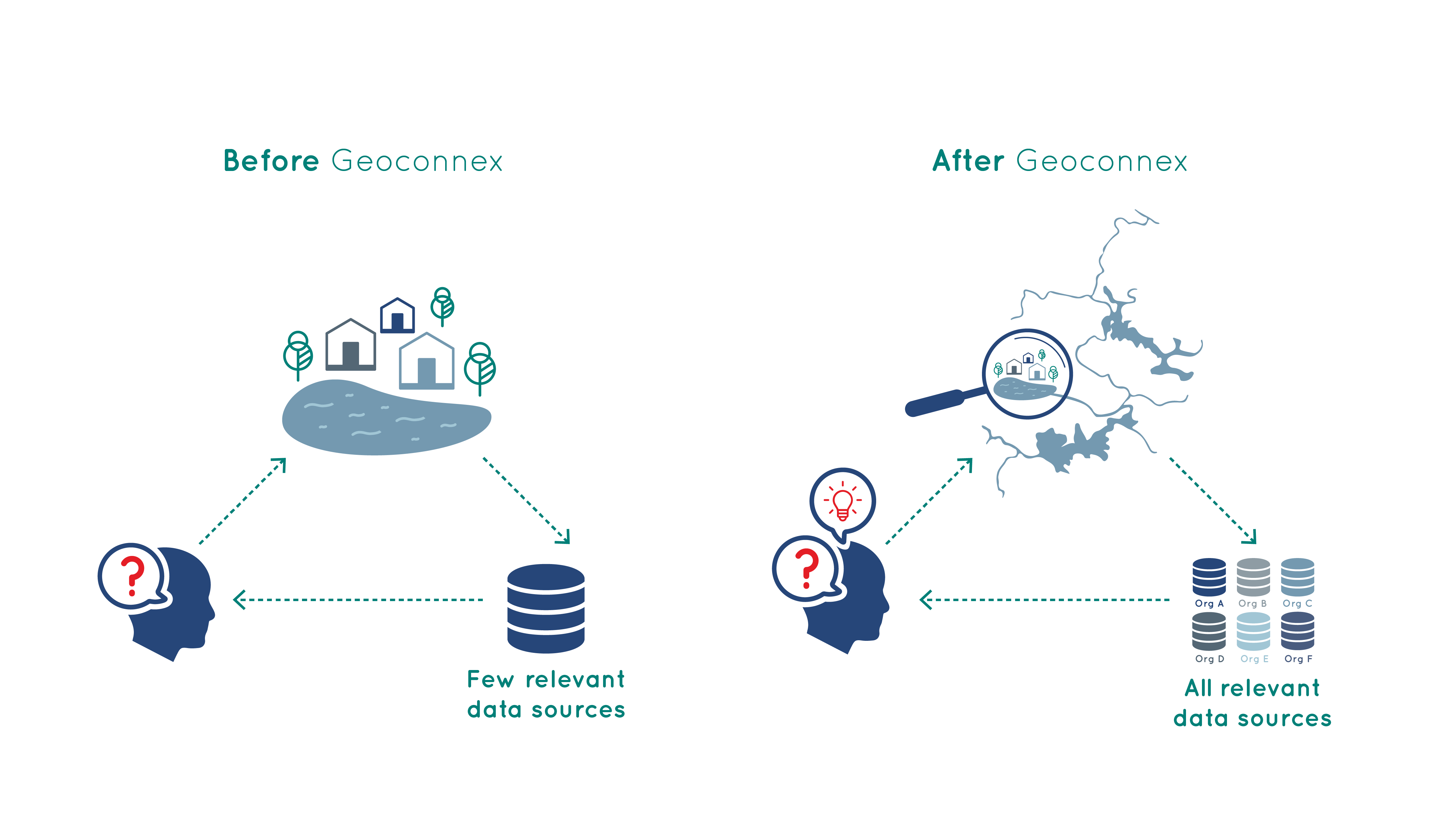
Before Geoconnex
After Geoconnex
PHILOSOPHY
PHILANTHROPIC PROJECT
EMERGING FEDERAL INITIATIVE
Notes:
Geoconnex: The Core Technology of the Internet of Water
As I said at the outset, this system will be capable of searching and retrieving all water metadata held in the United States, and ultimately North America.
Geoconnex relies on a distributed linked data system. Such systems are foundational elements of modern internet search technology, allowing for the search and retrieval of millions of records in an instant. Such a linked data system does not yet exist for water data but has been an aspiration of the water data informatics community for some years, and the subject of significant research to date.
Geoconnex will improve the discoverability of core water resources information currently not readily available to federal agencies from states, tribes, territories, and local governments. Geoconnex outreach efforts with these local agencies will yield data contributions, insights, and essential community engagement for the broad uptake of this new, lightweight technology.
Geoconnex will cover metadata for all water resources data, including all sensor and sample data on natural systems such as watersheds, rivers, and aquifers, but also anthropogenic data, such drinking and wastewater treatment plant locations, discharge and NPDES permit data, water rights, use, and diversions data, as well as related water infrastructure such as bridges, aqueducts, dams, and thermo-electric powerplants.
Geoconnex provides a neutral, third-party mechanism, privileges no particular agency or data set, gives features as small as an individual irrigation ditch an address on the internet.
When fully developed as part of the USGS National Hydrography Infrastructure, Geoconnex will become the core technical foundation for "an Internet of Water" to appear, thus closing a critical gap in the nation’s water data infrastructure.

Slide 16
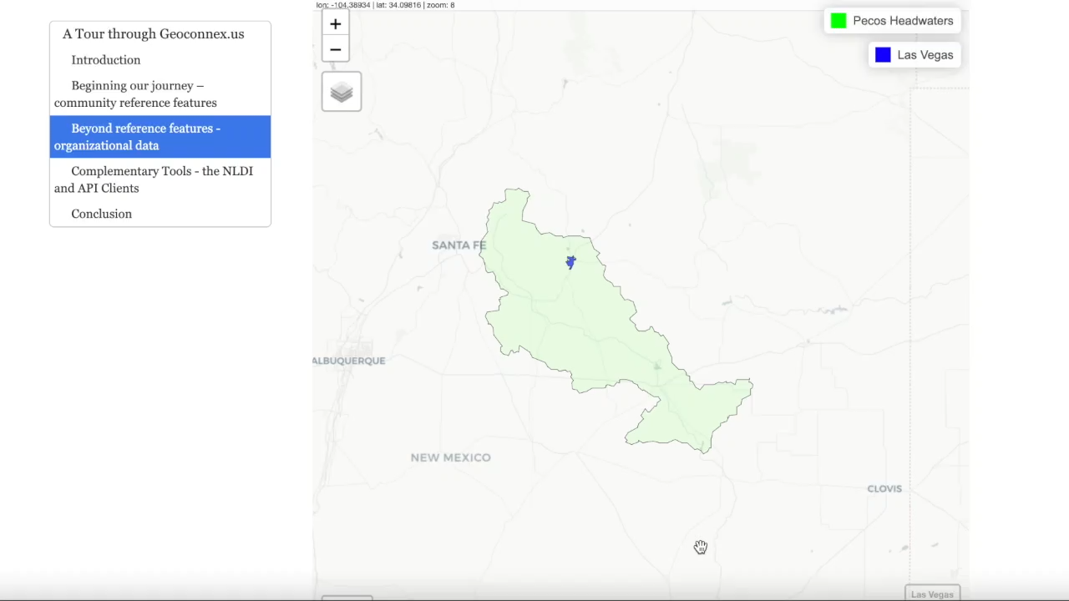
Notes:
If I wanted to find data from the Pecos Region, Geoconnex will allow me to select this region of interest, and what you see here is a representation of the data available in this selected region.
While I’m here, I can then select a datapoint, then the Geoconnex link, which will take me directly to this datapoints Geoconnex page.
Here I find descriptive information about the data, including a link to the data provider, in this case the USGS.
By selecting the link in the Geoconnex page, I am redirected to the original source. Because Geoconnex is also a persistent identifier service, these links are always up to date, even when the source changes the url.
As another example, if I were to select a different type of data source, in this case a Census polygon, I would be again directed to the Geoconnex page, then directly to the data source page, where I can find detailed information about this particular polygon.
The point of this is that Geoconnex is machine-readable, so the process that I’ve demonstrated here can be automated and reproducible for any number of analytical workflows, for example if I needed to aggregate all precipitation, streamflow, and groundwater measurement data for a stream segment during a surface-water, groundwater study – I could easily do that with Geoconnex.
Geoconnex currently holds a variety of collections, representing over 1 million locations across the U.S.
In the coming year, we will build a front-facing feature to complete the first edition of this valuable technology.

Slide 17


The Internet of Water
IoW is a neutral third-party with a clear mission
Develops free open-source software solutions
Provides and opportunity to build on prior research and leverage millions in philanthropic contributions
PHILOSOPHY
PHILANTHROPIC PROJECT
EMERGING FEDERAL INITIATIVE
Notes:
Why haven’t we built an Internet of Water before now?
Despite the enormous public benefit such a system might bring, the public sector has not created it because of a lack of data engineering capacity at state, local, and tribal agencies, the high cost of doing so to date, and the absence of a neutral third-party entity with a clear mission to do so across multiple jurisdictions. The Internet of Water provides that missing capacity for this essential public good.
The private sector has not created an Internet of Water because there is no market demand signal or immediate return on investment for exposing raw water metadata from public agencies. Emerging low-cost or free open-source software solutions now make such a system possible with relatively modest investment in its initial development and very low costs for long-term operations and maintenance.
An emerging new federal initiative for the Internet of Water could build on prior research and leverage millions in philanthropic sector contributions to date. Such a federal initiative would focus on core effort to develop and sustain Geoconnex and the IoW hubs, and could also extend and continue collaborative projects that solve real water problems in communities across the country.

Slide 18
Notes:
Thank you for listening, and I’m happy to take your questions.

