Slide 1
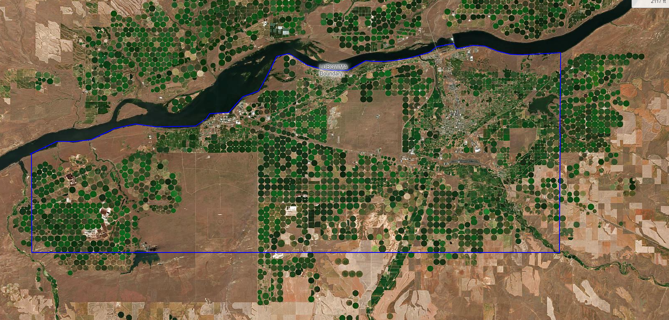
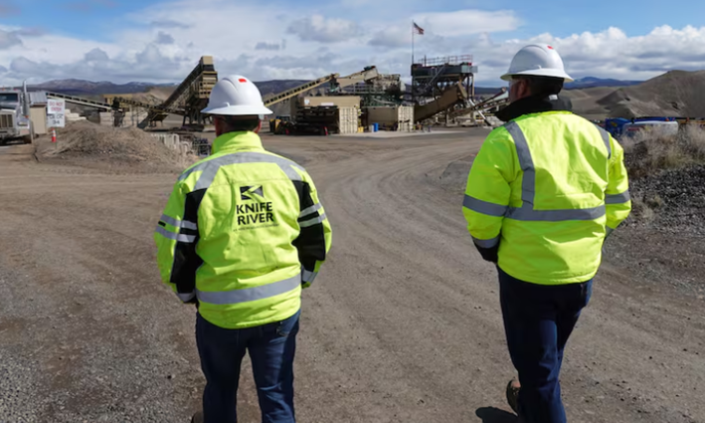
Groundwater Quality Protection in Oregon—Two Case Studies
Oregon Department of Environmental Quality
Notes:
What is/was the water quality issue?
Nitrate groundwater contamination. Longstanding issue, historical lack of resources to address it.
One of many places in OR with groundwater issues.
Groundwater regulatory authorities mostly under state law, not covered by CWA. No regulation of private domestic wells.
Petition one of many things that converged around same time: pending CAFO permit, large DEQ enforcement actions, local public health emergency, activated local community (not part of petition – petitioners were mostly state/national groups, not local), EJ community, Governor and legislative interest.

Slide 2
Outline
Overview of Oregon Statute and division of oversight with partners
LUBGWMA Case Study – Formally-designated GWMA with nitrate issue from various sources
Crook County Case Study – Manganese in private well from unknown source leading to special consideration area
Conclusions highlighted from both

Slide 3
Groundwater Protection Act of 1989
Goal: “To prevent contamination of Oregon’s ground water resource while striving to conserve and restore this resource and to maintain the high quality of Oregon’s ground water resource for present and future uses (ORS 468B.155)”
  Establish public education, research and demonstration projects and award grants
  Maintain consistency with all state agencies’ rules and programs to achieve above goal
  Conduct statewide programs to identify and characterize groundwater quality
  Maintain a data repository of groundwater conditions
  Encourage best management practices to prevent degradation of groundwater quality
  Develop contaminant concentration triggers for government actions to restore groundwater quality
  Protect groundwater of state for all existing and future beneficial uses that the natural water quality allows
Notes:
Have statute, but not fully resourced and has some ambiguity regarding roles, responsibilities for agencies, local efforts

Slide 4
Agency Partners in Groundwater Protection
DEQ
ODA
AgWQ Management – SW and GW, CAFO permit responsibilities. Pesticide regs, enforcement WQ protections.
OHA
Drinking water protection health impact evaluations. Public water supplies, limited domestic well support
OWRD
Groundwater investigations, water levels, flow direction, flow paths, recharge areas, ASR/AR/MAR
DLCD
Area-wide land use decisions (e.g., on-site)
OSU Extension/Experiment Station – public ed, BMP development and dissemination, local contact/technical assistance
DOGAMI
Mining requirement for WQ – SW, GW

Slide 5
Lower Umatilla Basin Case Study
Nitrates from Various Sources

Slide 6
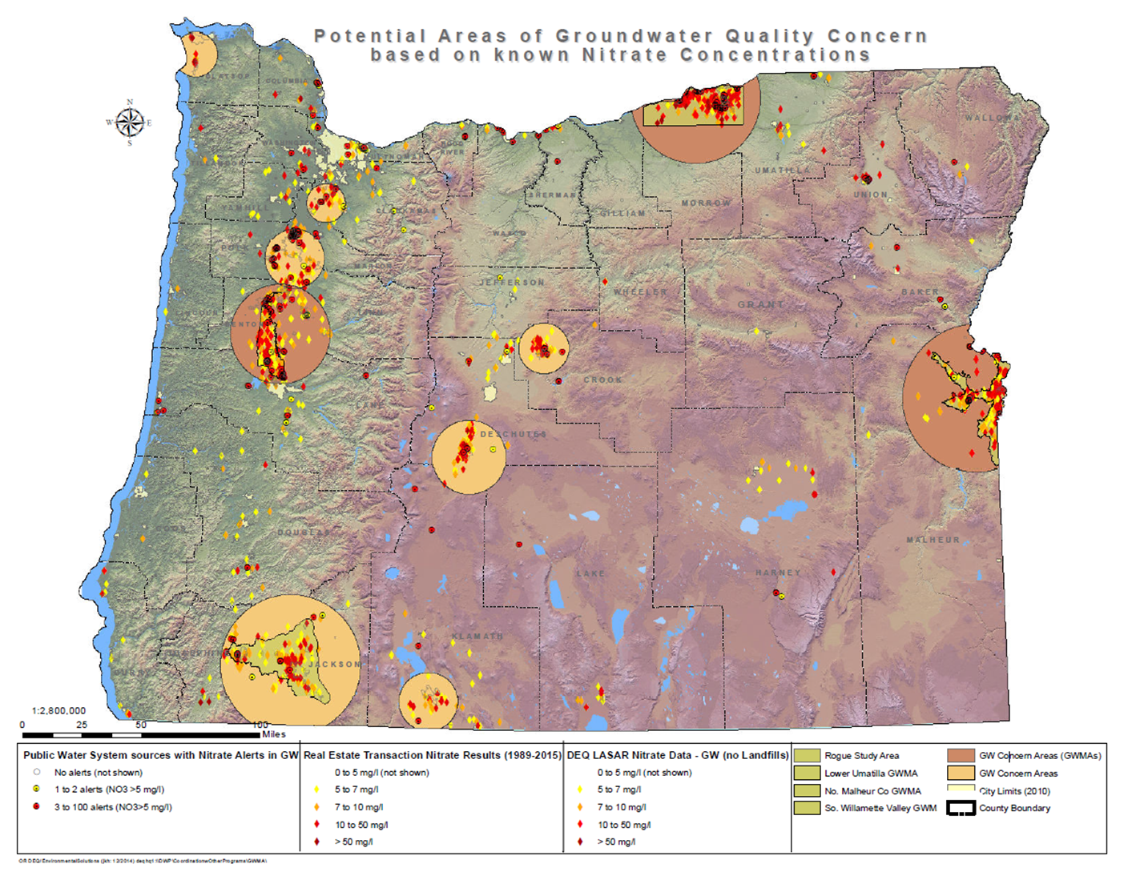
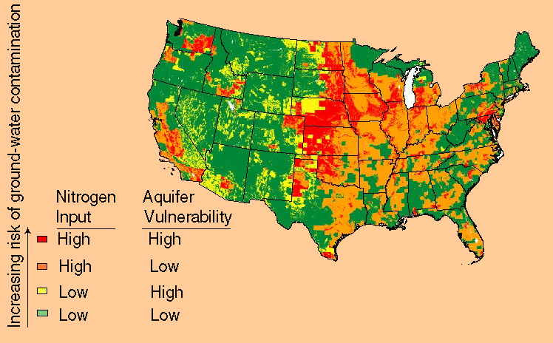
Nitrate in Groundwater – National Issue
National look at nitrate contamination of Ground Water (usgs.gov)
Notes:
What did you learn through the process and what advice might you offer for other states that are or might deal with similar petitions?
Try to get EPA technical staff involved early, rather than just enforcement staff.
Make resource requests of EPA to support the work.

Slide 7
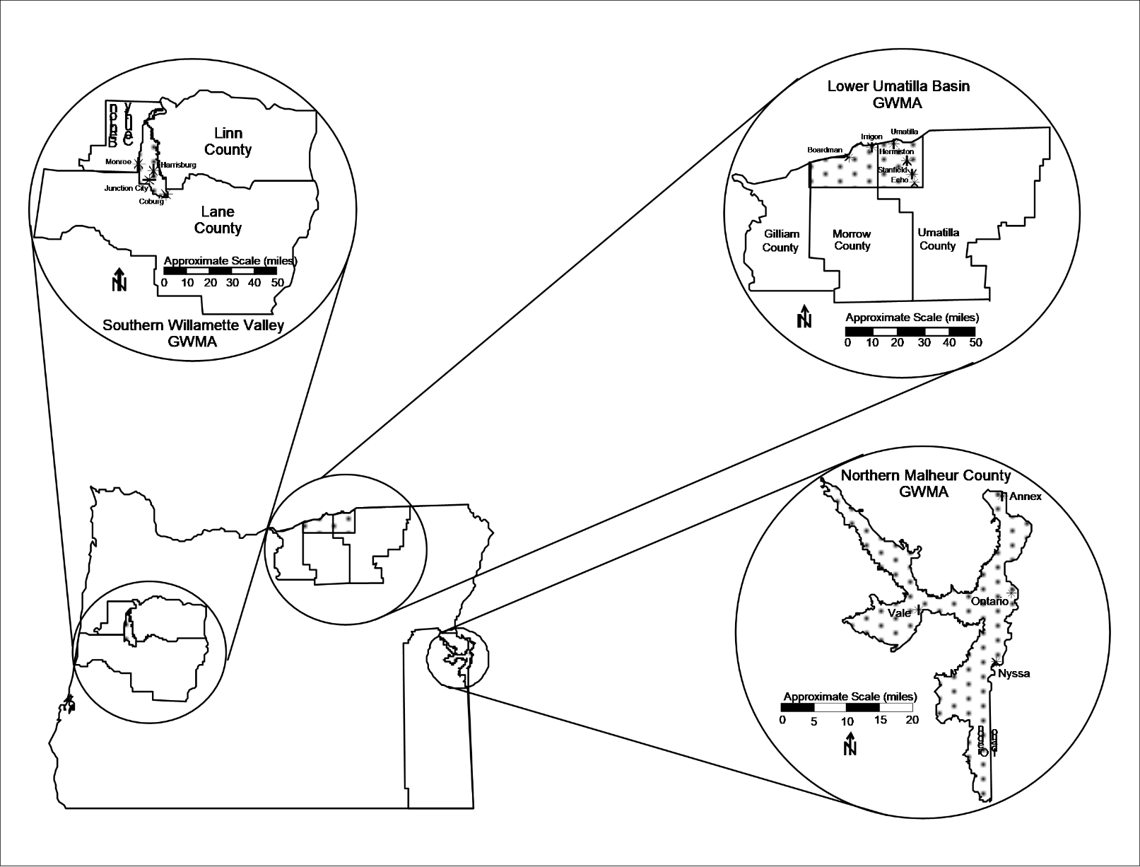
Oregon’s Three Groundwater Management Areas
Northern Malheur County (1989)
Lower Umatilla Basin (1990)
Southern Willamette Valley (2004)
Notes:
What did the petition ask for and when did they ask for it?
Petition filed Jan. 2020, just as state was prepping to issue a large CAFO permit.
Asked for safe drinking water for resident AND moratorium on CAFO permits in the area.

Slide 8
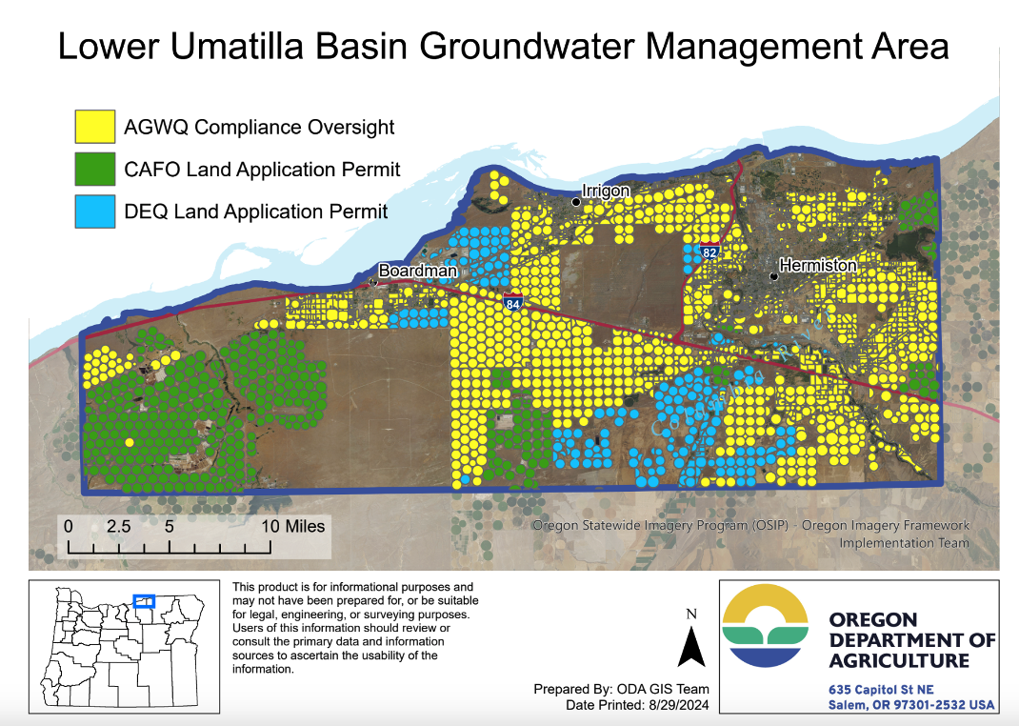
Notes:
What was EPA's response (regional and HQ)?
Irrigated ag, CAFOs, food production industry/reuse of nitrate rich wastewater.
Driven by regional enforcement staff. Demands for domestic well outreach, testing, safe drinking water delivery.
Lots of questions about permit actions, other state authorizes for addressing groundwater nitrate.

Slide 9


Oregon Nitrate Reduction Plan
Nitrate Reduction Plan
Background
Collaborative Governance Among State Agencies
Nitrate Reduction Strategies by Source
Monitoring, Data, and Analysis
Safe Drinking Water Strategies
https://ordeq.org/LUBGWMA
Notes:
What actions were needed (or not needed) that occurred to address the petition?
Quarterly meetings/report-outs to EPA
Unprecedented public health program for water testing, treatment, delivery in unregulated domestic wells.
Nitrate Reduction Plan – detailing state’s strategies and timelines for public health and groundwater nitrate reduction.
Has the petition been resolved (informally or formally)?
No. EPA has been unclear on what could resolve petition.

Slide 10
Crook County Case Study
Manganese from Unknown Source

Slide 11
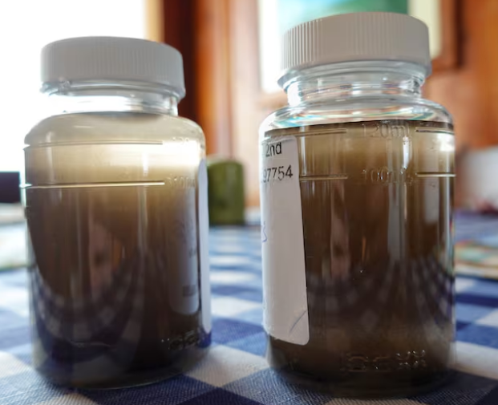
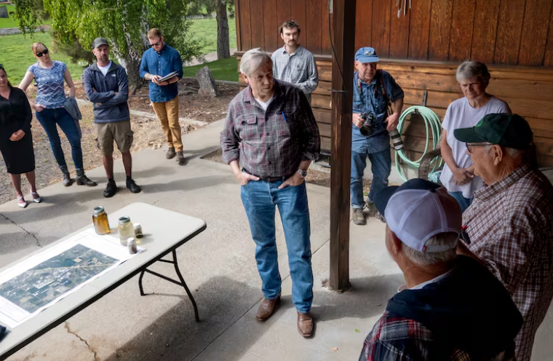
Crook County Groundwater
Issued identified by residents
Manganese levels elevated in private well samples
Nearby sand/gravel mine a possible point source and basin-wide issues likely
Notes:
Basin wide issues include – naturally occurring minerals throughout basin, decreasing water levels due to overallocation and climate change potentially causing increased oxidation and precipitation of the minerals.

Slide 12

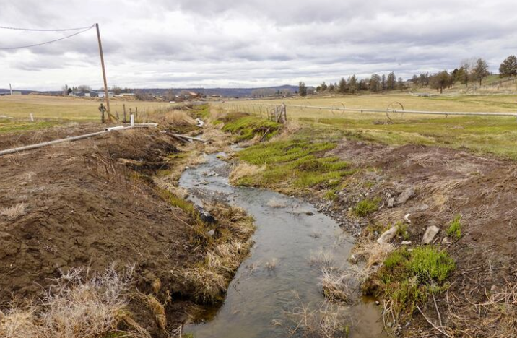
Crook County Groundwater
DOGAMI primary mining oversight
  – year long investigation beginning
  DEQ supporting
DEQ and OHA analyzing water quality at domestic wells
  2 rounds of private well testing in progress
  Heath assessment to follow
Manganese remains primary issue

Slide 13
Conclusions
Groundwater issues increasing due to decreasing water levels and increased needs
No regulation on private wells so susceptible to issues without a direct solution
Rural communities spread out so municipal systems frequently not feasible
Complex economic interconnections to potential sources
Extremely limited agency resources to identify and support resolution with communities

